Slide 1
Teaching Nonfiction and the Secondary ESL Classroom
Created by Nicole Tabolt Da Silva
For MATSOL Conference
May 5, 2016

Slide 2
Please answer the 3 questions on the intake paper.
Notes:
From 1-10, how comfortable do you feel using nonfiction materials in your classroom?
What type of nonfiction do you currently use?
What strategies do you currently use to teach nonfiction in your ESL classroom?
Photo Credit: Mahler. "February 25th, 2015 Do Now and Close Reading." ELA with Ms Mahler. N.p., 25 Feb. 2015. Web. 19 July 2015.

Slide 3
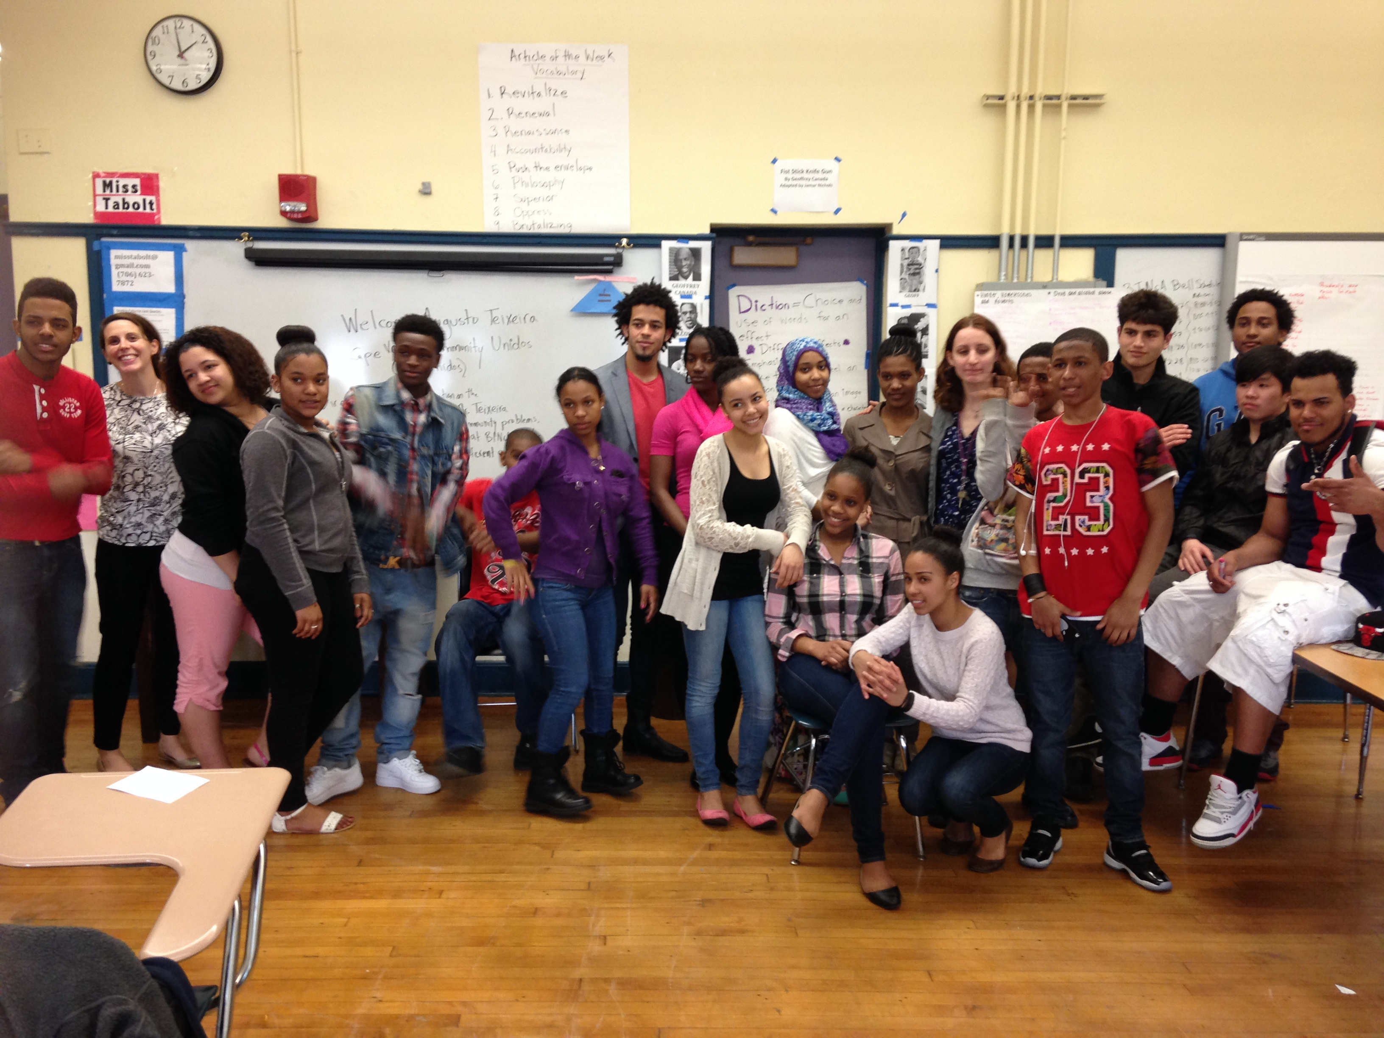
Introduction
ESL and ELA teacher
Worked with OELL and DOE on Common Core and ESL curriculum planning
Support for ELA teachers with SEI/ESL dual certificates

Slide 4
Objective for the Workshop
Content: Teachers will be able to identify and apply 2 appropriate teaching strategies for including and supporting the necessary skills for nonfiction reading.

Slide 5
AGENDA
Review of Reading Requirements and Common Core
Student’s Perspective and Common Core Informational Reading Standards
ESL Classroom Special Considerations
Teaching Strategy #1: Article of the Week
Teaching Strategy #2: Multimedia and Synthesis Writing
Share out of Future Plans/Strategies

Slide 6
Ground Rules
Respect each other, the work and our time.
Use your cell phone outside of the room.
No laptops

Slide 7
Common Core and Nonfiction
Notes:
Photo Credit: Great River Regional Library. (n.d.). Try New Nonfiction! Retrieved July 18, 2015.

Slide 8
Common Core’s 2 Types of Texts
Informational = Literary Nonfiction (Personal Essays, Memoirs, Speeches) and Historical, Scientific and Technical Texts
Literature = Stories, Myths, Dramas, Poetry, Graphic Novels, Dramas, and Poetry
Notes:
NGA Center and CCSSO. “Standard 10: Range of Text Types for 6-12.” English Language Arts Standards. Np, June 2010. Web 20 July 2015.

Slide 9
The Truth about “Only Teaching Nonfiction”
At the secondary level, Common Core Appendix A explains that secondary students should be reading:
70 % Informational
Texts
30 % Literature
THROUGOUT THE
ENTIRE DAY!
Notes:
Photo Credit: Dillon, A. (2014, August 15). Common Core and the Struggle For Stupidity. Retrieved July 10, 2015.

Slide 10
Nonfiction and the ESL Teacher’s Responsibilities
Double-blocks
1 main “ELA” class and 1-2 support classes
Humanities
Push-In
Pull-Out
HILT
Notes:
Photo Credit: Zazzle Inc. (n.d.). ESL Hats. Retrieved July 12, 2015.

Slide 11
Challenges for the Common Core ESL Classroom
Multiple levels of English in one classroom
Teaching grade-level content at lower ELD levels
Many secondary ESL students who have interrupted learning in native language and/or low literacy levels in native language
Notes:
Photo Credit: BuzzQuotes. (2015). CHOCOLATE QUOTES FOR TEACHERS. Retrieved July 10, 2015.

Slide 12
Special ESL Scaffolds
Review grammatical structures used in specific nonfiction text or series of texts (passive voice, past, quotations, etc.)
Explicitly discuss text features and structures of nonfiction (headlines, reading a map or graph, subheadings, captions)
Notes:
Photo Credit: Langone, N. Pinterest. (2014). Scaffolding. Retrieved July 10, 2015.

Slide 13
Special ESL Scaffolds
More scaffolds for vocabulary and background information (especially on American-specific topics)
Notes:
Photo Credit: Wahlstrom, D. (2012, February 4). Examples of Lessons for Teaching Vocabulary: ELA K-12. Retrieved July 15, 2015.

Slide 14
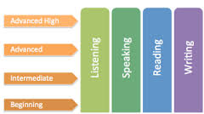
Special ESL Scaffolds
Need to support the understanding of nonfiction text in all 4 language domains
Notes:
Photo Credit: Region 10 Education Service Center. (n.d.). English Language Proficiency Standards (ELPS) Domains. Retrieved July 30, 2015.

Slide 15
Nonfiction Teaching Strategy #1: Article of the Week
Article of the Week =
A Strategy created by Kelly Gallagher where students read, respond to and discuss an article of the week
2 Purposes:
-Increase exposure and mastery of nonfiction
-Increase knowledge of current news and topics
Notes:
Photo Credit: Hulbert, M. (2013). Be Prepared for FCAT Writing. Retrieved July 16, 2015.

Slide 16
Kelly Gallagher Video
http://www.stenhouse.com/html/article-of-the-week.htm

Slide 17
Reading and Annotation
Directions:
Read the article on Syrian refugees
As you read, annotate for
1) Ideas that You Agree or Disagree with
2) Ways You Could Use His Ideas in Your Classroom

Slide 18
Great Idea---But How does it work in ESL Classroom?
Leveled Articles of the Week (Lite, Medium and A+ Challenge) Pages 21-36
Leveled Examples of Analysis/Responses
Notes:
Photo Credit: Stuart, D. (2014, September 24). Getting Started with Gallagher's Article of the Week. Retrieved July 15, 2015.

Slide 19
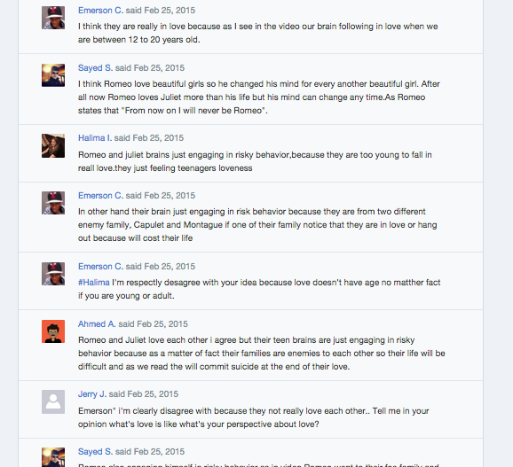
Great Idea---But How does it work in ESL Classroom?
Supporting Speaking/Listening Domains:
Socratic Seminars
Table Debates
Online Discussions: Google/Edmodo Small Groups allow for multiple small group discussions for leveled articles

Slide 20
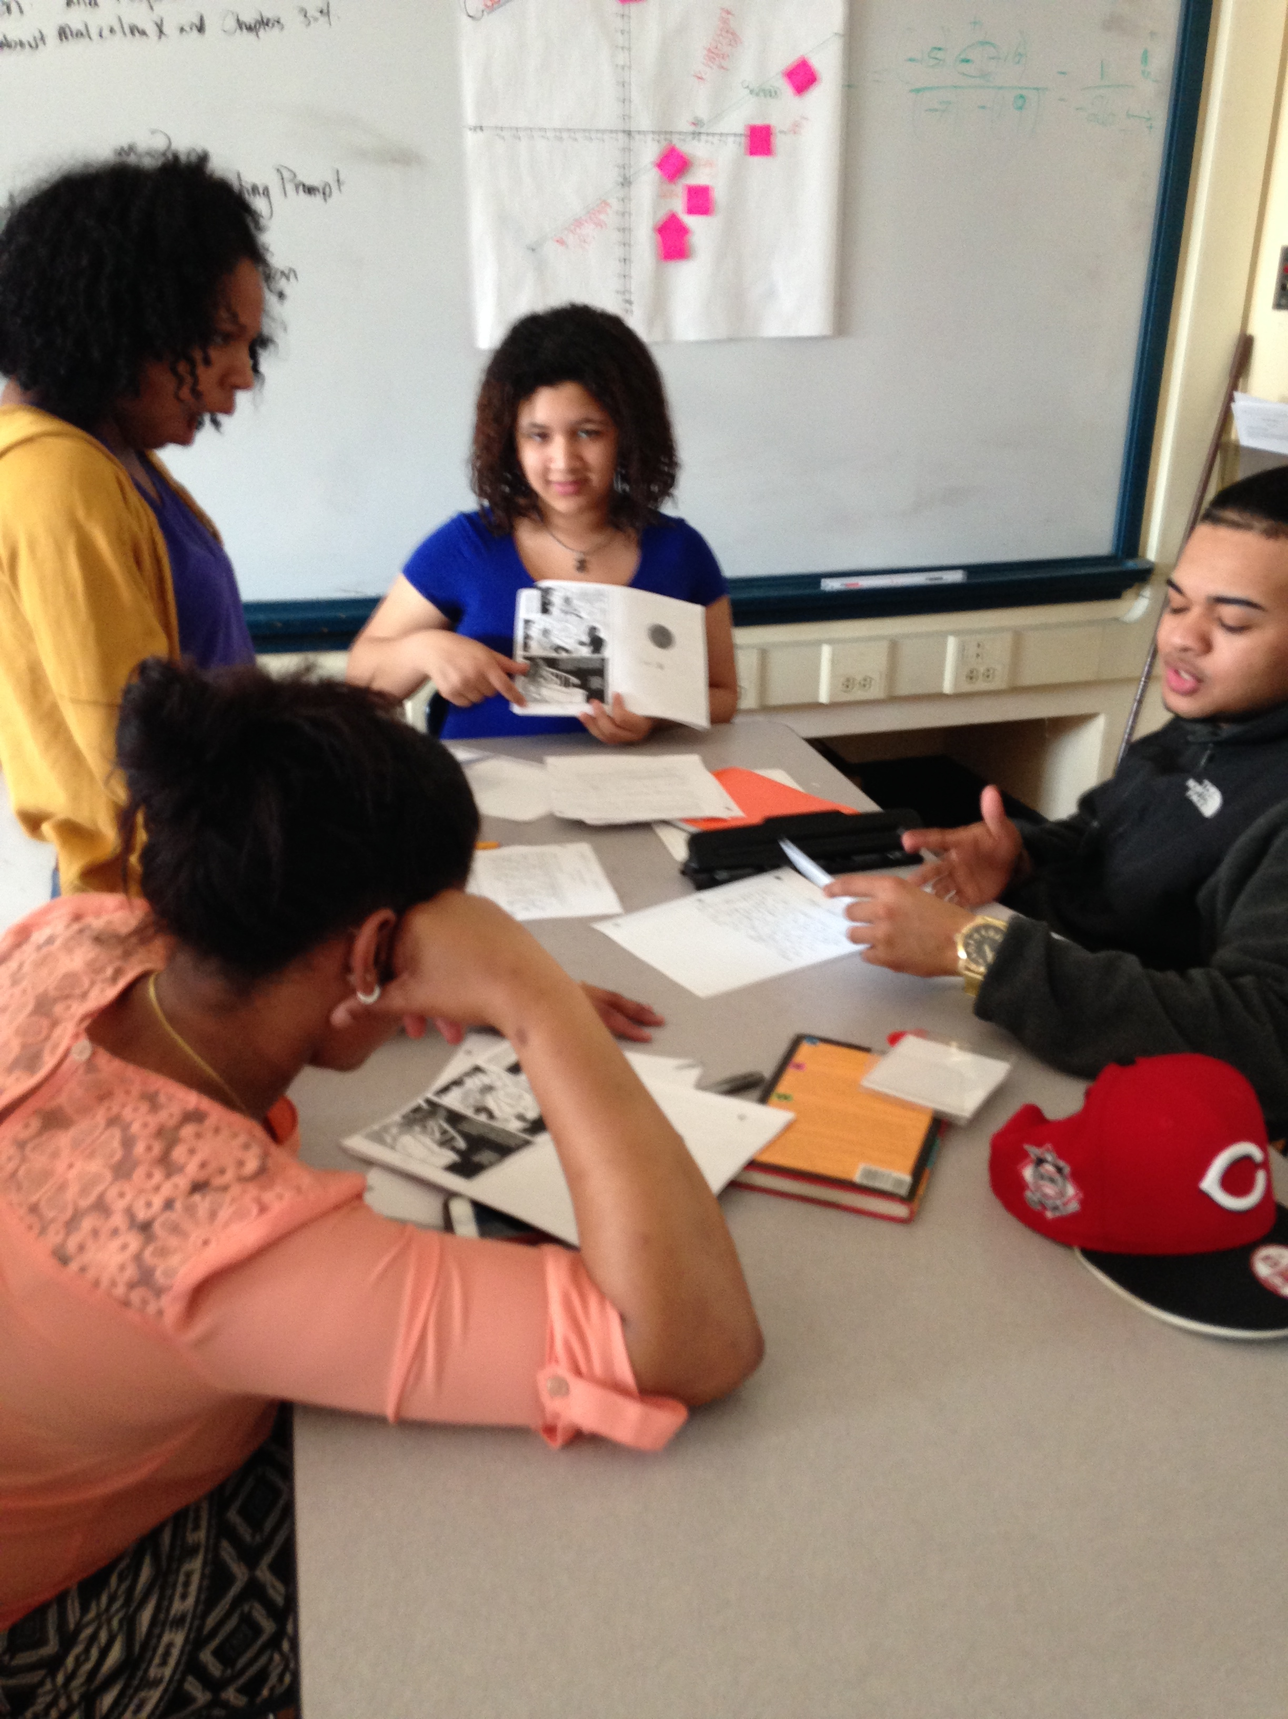
Great Idea---But How does it work in ESL Classroom?
Vocabulary Strategies
Pre-teaching vocabulary with visuals
Vocabulary word-splash graphic organizer
Requiring students to use vocabulary words in responses and discussions

Slide 21
Nonfiction Reading Strategy #2: Using Informational Multimedia to Augment your Literary Choices
Notes:
Photo Credit: Multimedia Archives. (2011, February 2). Retrieved July 16, 2015.

Slide 22
Why should you use multimedia?
Common Core Connection: “The need to conduct research and to produce and consume media is embedded into every aspect of today’s curriculum. In like fashion, research and media skills and understandings are embedded throughout the Standards rather than treated in a separate section.”
Notes:
CCSSO. (2010). English Language Arts Standards » Introduction » Key Design Consideration. Retrieved July 16, 2015.

Slide 23
What type of multimedia can you use?
Informational | Argumentative
Documentaries Newscasts Radio Clips | Commercials Video Editorials Blogs and Websites Radio/Video Interviews Lectures/TedTalks

Slide 24
Way to Scaffold Nonfiction Reading and Synthesis Skills
CCSS.ELA-LITERACY.CCRA.R.9 Analyze how two or more texts address similar themes or topics in order to build knowledge or to compare the approaches the authors take.
Notes:
Photo Credit: Bibo, K. (2015). A Day in the Life of a Multimedia Teacher. Retrieved July 16, 2015.

Slide 25
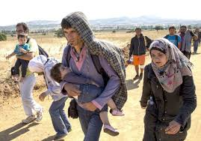
Syrian Refugee Crisis
Notes:
Photo Credit: Lacta Chocolate. (2014, February 13). Lacta Documentary - Does Love Exist? Retrieved July 30, 2015.

Slide 26
Video: The Guardian Documentary “We Walk Together: a Syrian Refugee Family’s Journey to the Heart of Europe”https://www.youtube.com/watch?v=ubGhzVdnhQw

Slide 27
Practice Synthesis Work
Directions:
Step 1: Complete the Venn Diagram on page 39.
Step 2: Read the example synthesis paragraph.
Step 3: Write 2-3 ways that you could use informational multimedia in your classroom.
Notes:
Photo Credit: Brandowski, D. (2013). Making the Most Of Your Practice Time - Deering® Banjo Company. Retrieved July 17, 2015.

Slide 28
Sharing Your Plan/Strategy
Teachers will share their plan or strategy.
One strategy I want to use is ________, and my plan includes ____.
Notes:
Photo Credit: Guinan, S. (2013, March 31). Getting Students to Read Online. Retrieved July 15, 2015.

