Slide 1
Summoning Primo: The Migration Experience of the University of Denver
Christopher C. Brown
Reference Technology Integration Librarian
University of Denver, Main Library
ELUNA Conference, Oklahoma City, OK May 5, 2016

Slide 2
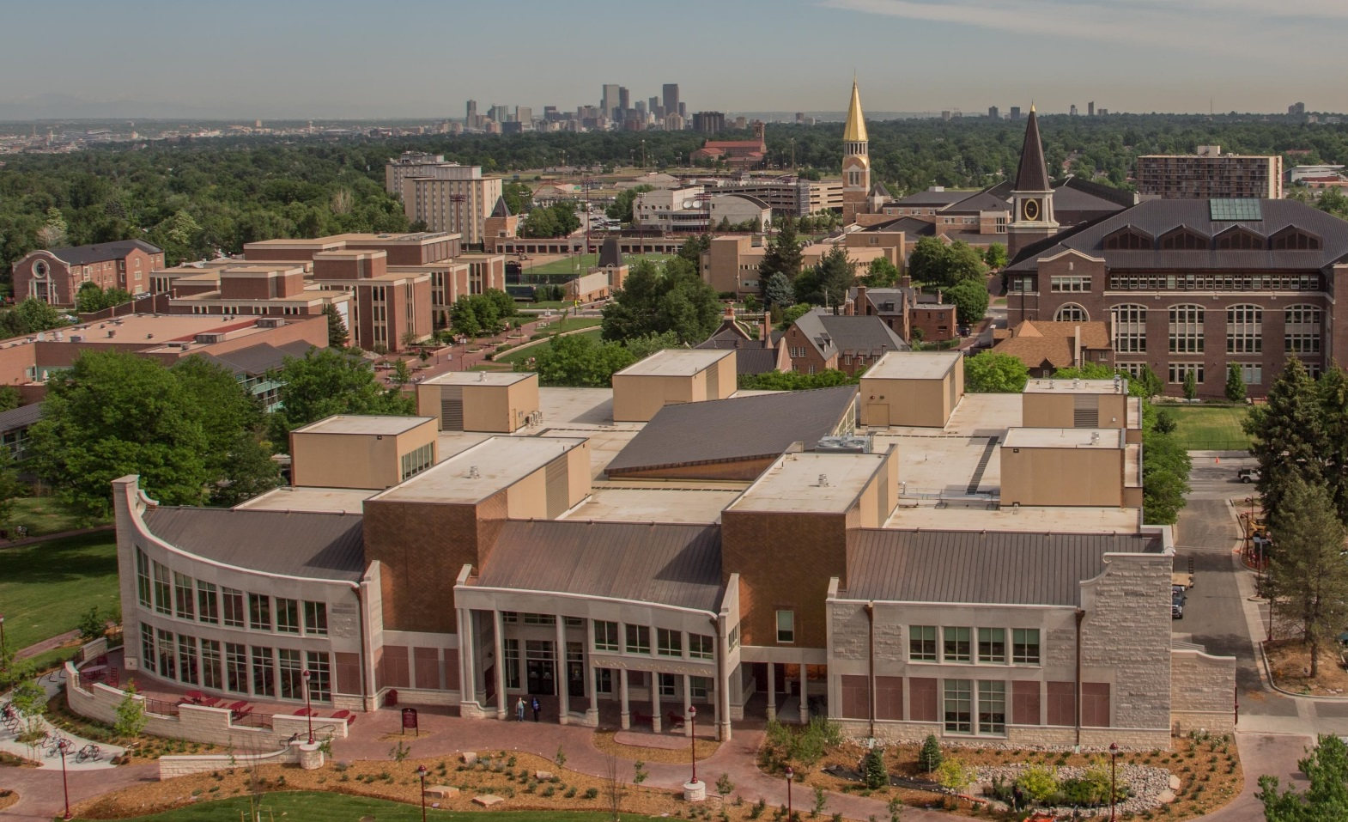
University of Denver
Private university in an urban residential environment
About 11,000 students, roughly 50/50 undergrad/grad mix

Slide 3
Back View: DU Library Discovery Landscape
Catalog – Innovative Interfaces, Inc.
Broadcast Search– ProQuest
Classic catalog
(1997-June 2016)
Webpac, Millennium, Sierra
360 Search
(2008-2010)
Discovery – ProQuest
Catalog records loaded into Summon, at first nightly, then weekly
Summon
(2011-June 2016)
Encore Next-gen catalog
(2008-June 2016)

Slide 4
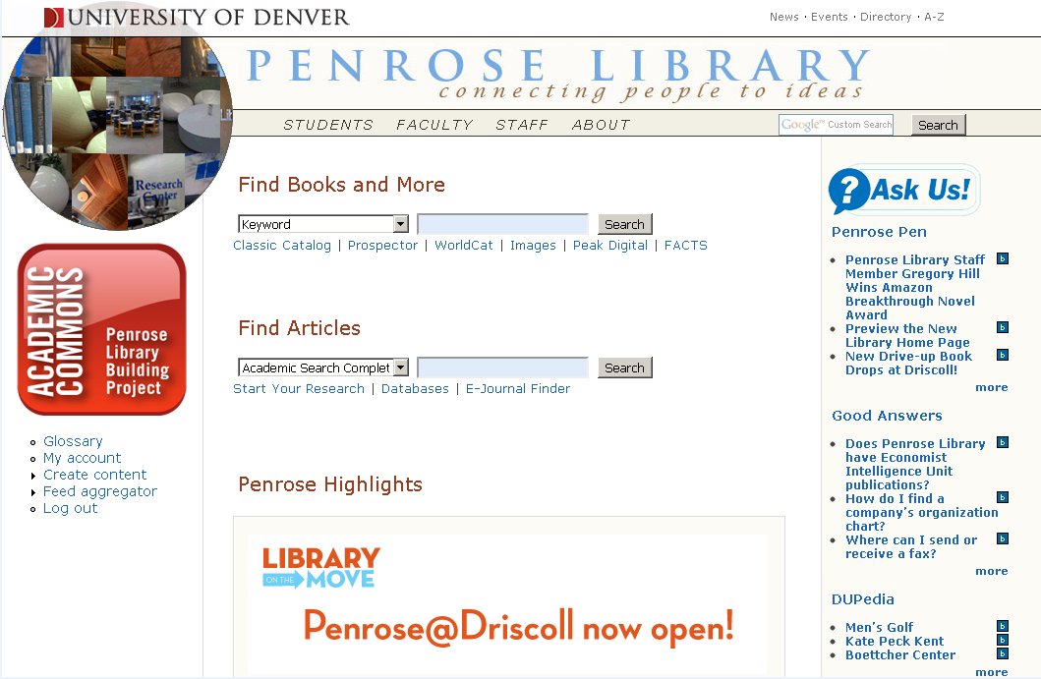
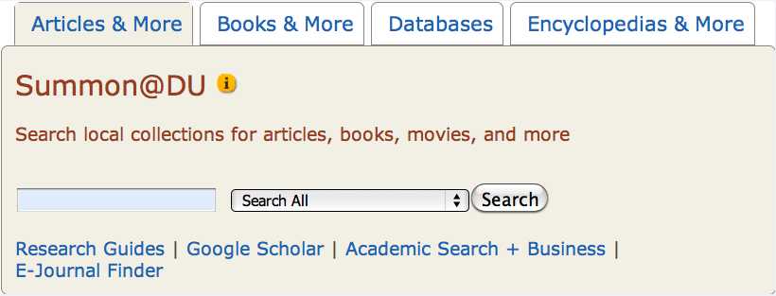
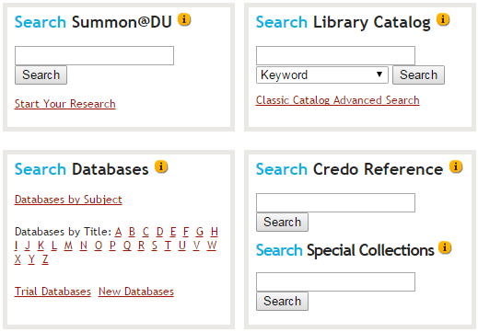
University of Denver Library Discovery Layers
Period | Time Span | Description
Period 1 | January 2011 – March 2011 | Encore as default search, Millennium secondary
Period 2 | April 2011 – August 2011 | Same as above, but Summon active but buried
Period 3 | September 2011 – August, 2011 | Summon as default search tab; Encore and Millennium in secondary tab
Period 4 | September 2014 – June 2016 | Summon as first search box, Encore as second with Millennium pull-down options.
Period 5 | July 2016 – | Primo as discovery system
Next slide

Slide 5
Front View: Alternatives and Confusion
Encore has a nice next-gen interface, and is easier to locate library materials than Summon
Summon contains catalog records, but not easy to identify them within Summon
Classic view of catalog provides additional features and is preferred by some users

Slide 6
Our confusing boxes

Slide 7
Things to Love about Summon
Feature | Notes
1. Null Search yields results | Helpful in evaluating Summon content
2. Known item searching | Biasing of title searches serves us well
3. Sidebar (link resolver)
4. Full text depth | Sometimes works for articles and often works for books (not just ebooks)
5. Scrolling results | “Infinite scroll” = 200 results, but no paging
6. Database recommender
7. Discipline facet | Broader that subject. Very useful.
8. Ulrich’s integration | Means that “peer reviewed” results based on an accepted authority

Slide 8
Null Search Yields Results We use this for tracking Summon growth
Records
Full Text
1.

Slide 9
Tracking Summon
1.

Slide 10
Tracking Summon
1.

Slide 11
Known Item Searching
Biasing of title and biasing of book format assist user in locating materials quickly
2.

Slide 12
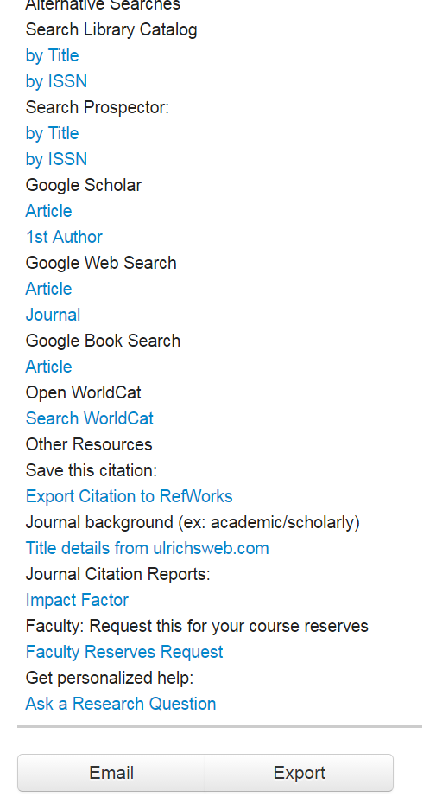
Summon Sidebar Sidebar with OneClick works well for us
3.

Slide 13
Full Text Exposure
Information Access Anomaly
Breadth vs. Depth
Putting discovery tools to the test: Library of Congress
4.

Slide 14
The Information Access Anomaly
 | Book (average) | Journal Article (average) | Google (Scholar/Books)
Typical Length - full text (FT) | 200 pages x 400 = 80,000 words | 15 pages x 400 = 6,000 words
Surrogate Record (SR) | 50-100 words (75 ave.) | 300-500 words (400 ave. ¹)
SR to FT ratio | 1 to 10,666 | 1 to 15 | 1 to 1
¹ http://www.writersservices.com/wps/p_word_count.htm
Q for thought: How do the differences in ratios affect search strategies?
4.

Slide 15
Relevance vs. Discovery
Metadata
Higher Relevance
Higher Discovery
Full Text
4.

Slide 16
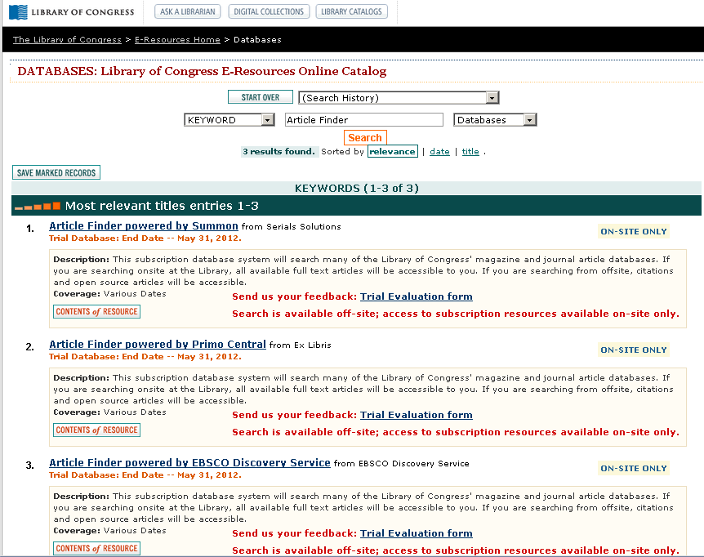
Unique Library of Congress Trials Unique testing experience in 2012
4.

Slide 17
Library of Congress Trials (2012): My Conclusions
Summon allows users to see all available content, but EDS and Primo Central do not. Thus, we need to do a search that pulls up something. For this comparison I searched on the word “states.”
Search: states | Total Results | FT Results
Summon | 79,928,385 | 77,526,648
EDS | 181,905,166 | 45,928,232
Primo | 36,788,443 | 29,748,221
4.
EDS has more A&I sources
Summon has more FT

Slide 18
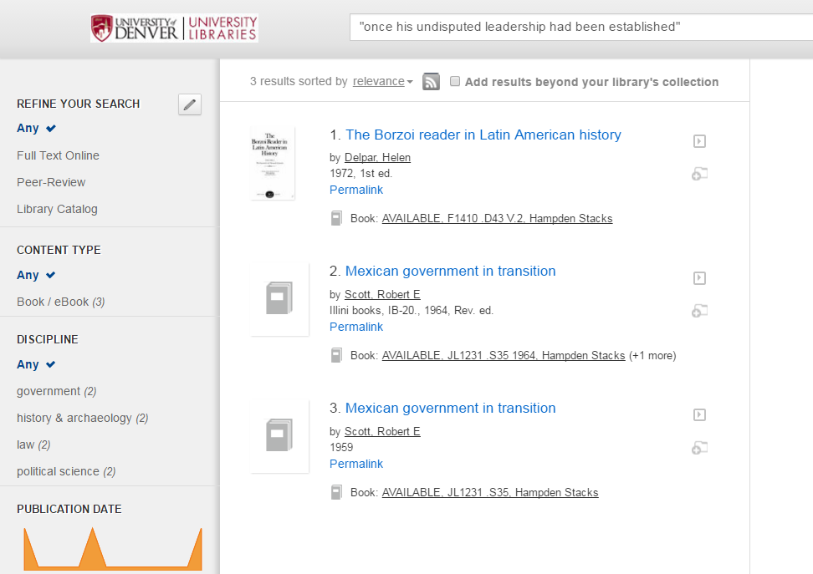
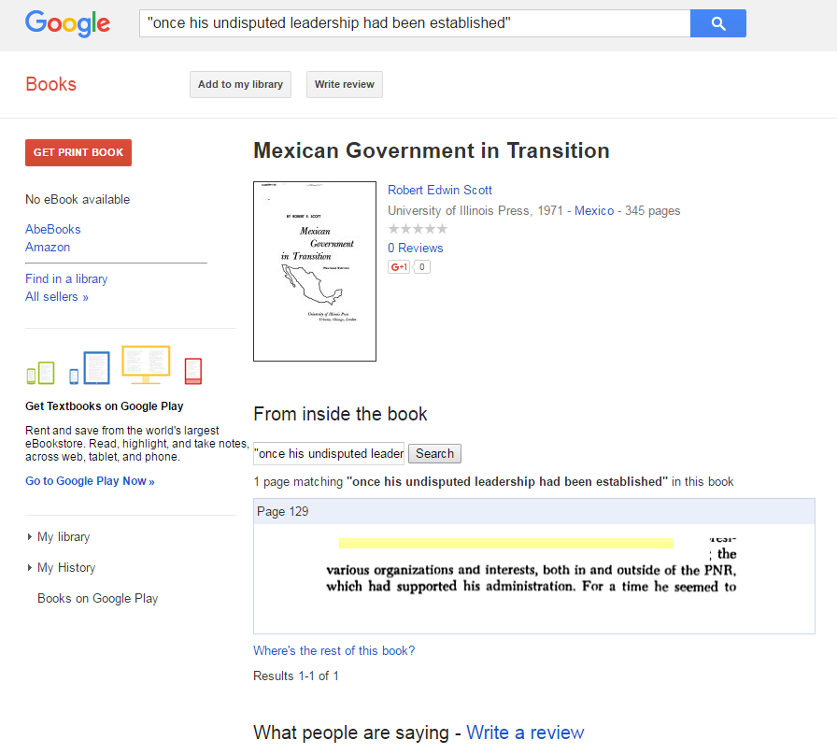
Full Text Depth: HathiTrust Behind the Scenes
Summon can (optionally) search HathiTrust (not just public domain), but does not show keywords in context.
Users are perplexed as to why results appear.
Yet, this is the right direction for a discovery tool.
Google Books can be sometimes be used to discover exact page references.
4.

Slide 19
Scrolling Results (200) – Rather than Pages
5.

Slide 20
Database Recommender
6.

Slide 21
Discipline Facet – better than Subject
7.

Slide 22
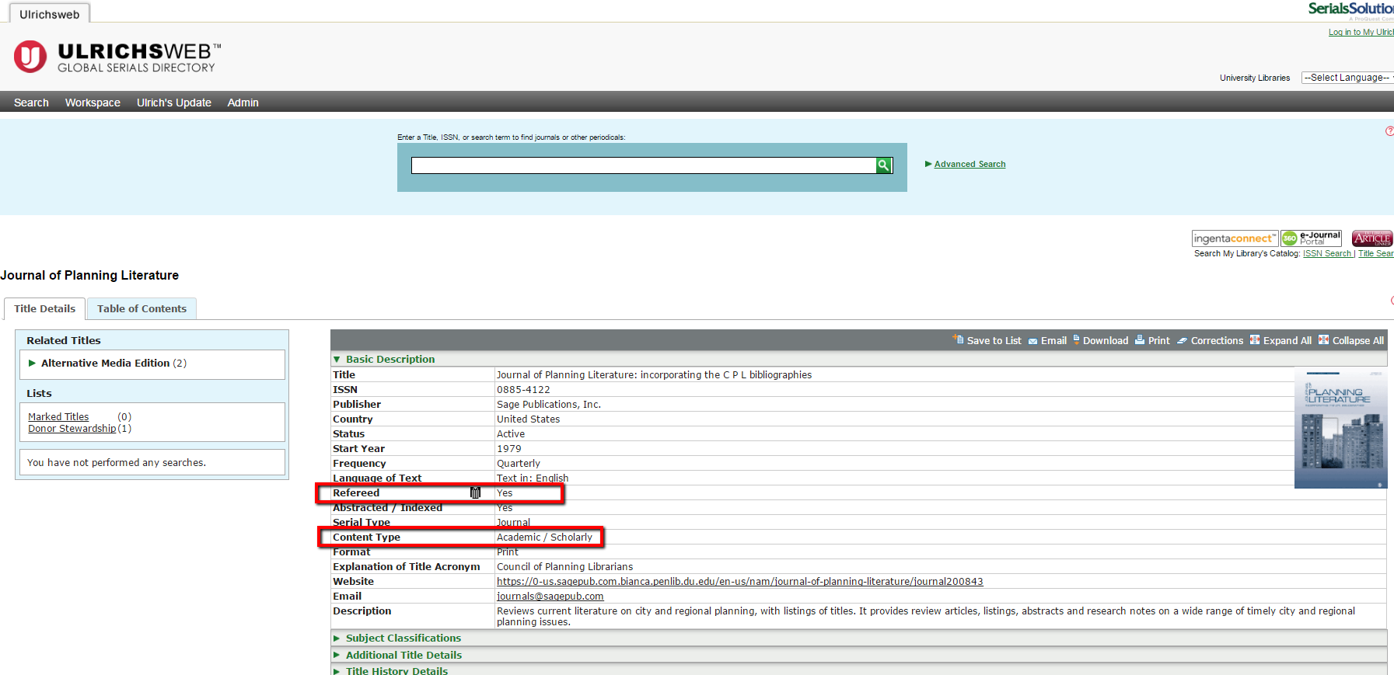
Ulrichsweb improves peer reviewed journal identification
8.

Slide 23
Primo – Out of the Box

Slide 24
Primo Mock-up – for July 2016 rollout

Slide 25
Testing the Differences of FT Exposure
Search 1
Library | Search | All Citations | FT Only | Ratio
U. Michigan | States | 300,520,280 | 297,078,097 | 98.9%
Cornell | States | 281,018,522 | 277,373,055 | 98.7%
Columbia | States | 285,268,494 | 277,971,499 | 97.4%
Summon
Library | Search | All Citations | FT Only | Ratio
Notre Dame | States | 36,521,626 | 29,981,319 | 82.0%
U. Washington | States | 35,000,707 | 18,708,603 | 53.5%
Boston U. | States | 11,318,185 | 11,142,870 | 98.5%
Primo
Search 2
Library | Search | All Citations | FT Only | Ratio
U. Michigan | Elephants | 2,014,569 | 2,003,792 | 99.5%
Cornell | Elephants | 1,865,545 | 1,854,925 | 99.4%
Columbia | Elephants | 1,904,068 | 1,881,271 | 98.9%
Summon
Library | Search | All Citations | FT Only | Ratio
Notre Dame | Elephants | 26,964 | 18,991 | 70.4%
U. Washington | Elephants | 32,380 | 18,078 | 55.8%
Boston U. | Elephants | 12,765 | 12,444 | 97.5%
Primo

Slide 26
Primo Concerns
Result sets are not as robust. Reasons may include breadth of indexing (number of database exposed), ratio of A&I to FT results, and depth of FT indexing.
Full text of content is not exposed enough. Need greater exposure of open source, licensed, and ebook content. Working with Summon people to integrate their successes into Primo would be a step in the right direction.
Not having the link resolver sidebar will be a setback. I got addicted to it and want it back ASAP.
Known item searching seems irregular. Need to bias the title and bias the book format.

Slide 27
Questions?
Chris Brown – Reference Technology Integration Librarian
christopher.brown@du.edu
(303) 871-3404

