Slide 1
Strategies for Fostering Authentic Metacognitive Narratives in ESL Writing Portfolios
MATSOL 2016
Friday, May 6: 10:30am–11:15am, 7 Middlesex W
Christina Michaud
Boston University

Slide 2
Metacognition in the L2 Writing Classroom
Strategies for Fostering Authentic Metacognitive Narratives in ESL Writing Portfolios
Often seen as a key component of writing instruction
Implemented as part of a process-based approach
Believed to help learners become more independent writers and revisers
Also useful in EAP/ESP and genre-based approaches
Important for teachers as well as for learners
Particularly essential for portfolio-based assessment

Slide 3
Practical Problems with Metacognitive Narratives
Strategies for Fostering Authentic Metacognitive Narratives in ESL Writing Portfolios
Boring
Predictable
Canned
Written to please teachers
Superficial
Not individualized
Unrelated to learners’ true strengths and needs
False (at times) arcs of triumph over adversity
Ultimately unhelpful to both learners and teachers
Notes:
without explicit intervention and models of how to achieve true metacognition, learners (particularly in portfolio-based classes) often produce canned narratives of triumph--describing their initial attempts at writing as abysmal, but crediting the miraculous teacher with their victory over challenges. As teachers, we would much prefer that learners' self-reflections are specific and accurate--that is, reflected in the reality of learners' own writing. Drawing on experimental techniques piloted in several sections of L2 first-year college composition classes, and briefly contextualizing these techniques within theory on reader-based prose, portfolios, and process writing, this presentation walks participants through the steps of refining the metacognitive component in existing academic writing classes. Participants will view and analyze frequent examples of learner prose (in-class writing/free-writing; self-assessment and goal-focused short-answer responses; and portfolio introductions, cover letters, and annotations) and will learn to move beyond a lip-service approach to metacognition. Instead of tossing vague prompts at learners and hoping for the best ("How has your writing improved during this semester?"), participants will leave with practical, take-home handouts including:
Beginning-of-semester "ice breaker" activities that foreground an emphasis on metacognition in the classroom
Mid-semester goal-setting worksheets that help learners operationalize their own goals and concretely see the purpose of all the self-reflection we ask them to do
Graphical-style templates that help learners better articulate their own purpose for improving and analyze different cultural approaches (drawing in part on research and theory in Li, Cultural Foundations of Learning: East and West, 2012)
Collections of reflective writing prompts that can be used in class or at home to scaffold learner metacognition and prompt learners to move toward accurate assessments of their individual strengths and needs
Checklists and suggested rubrics for assessing portfolio introductions and/or cover letters

Slide 4
Key Strategies: Making Metacognition Work
Strategies for Fostering Authentic Metacognitive Narratives in ESL Writing Portfolios
Make metacognition a full and integral component of the course, from beginning until end.
Teach, and scaffold, the process of metacognition effectively.
Offer creative ways for learners to reflect on their own learning and writing.
Clarify for learners and teachers the goals of metacognitive self-assessments and the basis (if any) for further assessment by teachers.
Use models carefully.

Slide 5
Make metacognition a full and integral component of the course, from beginning until end.
Strategies for Fostering Authentic Metacognitive Narratives in ESL Writing Portfolios
Beginning-of-semester (“icebreaker”) metacognitive activities
Mid-semester scaffolded reflections and self-assessments
End-of-semester (“pay-off”) metacognitive narratives and reflections

Slide 6
Ice-Breaker/Initial Writing
Strategies for Fostering Authentic Metacognitive Narratives in ESL Writing Portfolios
What do you think about writing? There aren’t any right answers here—just mark True or False for your opinions about writing for each item.
1. I don’t write anything outside of schoolwork. 2. The most important parts of writing are spelling and grammar.
3. I think I’m a good writer in English.
4. I always try to revise my writing before turning it in.
5. I try to keep a diary or a journal at home.
6. I think I’m a good writer in my native language.
7. I like to write.
Beginning-of-course metacognitive strategies

Slide 7
Ice-Breaker/Initial Writing (cont’d.)
Strategies for Fostering Authentic Metacognitive Narratives in ESL Writing Portfolios
8. When I write an essay for school, I just write one draft and stop.
9. I write poems, stories, or essays at home.
10. I write letters or emails often.
11. I once wrote something that I was really proud of.
12. Writing in general is okay, but writing essays for teachers is hard.
13. Writing in my native language is easy and fun.
14. I’m getting better at writing in English.
15. I’ve shared some of my writing with my family, and they like it.16. Writing English is very different than writing my native language.
Beginning-of-course metacognitive strategies

Slide 8
Ice-Breaker/Initial Writing (cont’d.)
Strategies for Fostering Authentic Metacognitive Narratives in ESL Writing Portfolios
Pair discussion: Work with a partner. Introduce yourself and then share your responses to the items above. Discuss some of your past experiences with writing. What attitudes to you share, and where do you differ?
Take-home assignment: Choose any two of the above items you feel very strongly about. For each of these items, write one page, double-spaced, explaining your feelings more specifically. Why do you feel this way? What experience are you thinking of? Bring your responses to class tomorrow.
Beginning-of-course metacognitive strategies

Slide 9
Initial Letter to Teacher
Strategies for Fostering Authentic Metacognitive Narratives in ESL Writing Portfolios
For our next class, please write me a 1-3 page (double-spaced) letter introducing yourself as a writer. What kind of writing do you like to do? Why? What has been challenging for you about writing, and why? What have you done to try to overcome these challenges? How do you see yourself as a writer in the past, present, and future? You do not need to answer all of these questions (or indeed, any): they are just here to get you started thinking.
Beginning-of-course metacognitive strategies

Slide 10
Initial Self-Assessment
Strategies for Fostering Authentic Metacognitive Narratives in ESL Writing Portfolios
List five key words/themes/terms from your previous writing class. These might be content-related, writing-related, or both: choose the five most important words, in your opinion, which are salient in your memory and help represent the class to you.
List two ways that your previous writing class met your expectations of a college writing class and two ways it diverged from your expectations.
Describe one challenging experience writing beyond your WR class so far at college. This could be a lab report, research paper, email to a professor, or anything else. What was challenging about it and why?
Beginning-of-course metacognitive strategies

Slide 11
Teach, and scaffold, the process of metacognition effectively.
Strategies for Fostering Authentic Metacognitive Narratives in ESL Writing Portfolios
Theory of gradual release:
move from greater instructor control to less
from less learner agency to more.
Middle-of-course metacognitive strategies

Slide 12
Early Self-Assessments (Controlled)
Strategies for Fostering Authentic Metacognitive Narratives in ESL Writing Portfolios
MACRO ISSUES
What do you think worked well in your essay on the paragraph or text level? What are you proud of, and why?
What do you think needs improvement in your essay on the paragraph or text level? What would you work on if you had more time, and what would you do?
MICRO ISSUES
What grammar or punctuation points did you work hard on? What strategies did you use to try to find and correct your errors?
What grammar or punctuation point was most difficult for you? What strategies did you use to try to find and correct your errors? What’s still causing problems for you here?
Middle-of-course metacognitive strategies

Slide 13
Mid-Semester Self-Assessments
Strategies for Fostering Authentic Metacognitive Narratives in ESL Writing Portfolios
What’s my thesis? Where is it? Is it arguable? Do I keep it in mind throughout my essay?
How effective is my support? Do I explicate my quotes fully?
How effective is my organization? Can a reader follow all my twists and turns?
What’s something I did well in this draft?
What’s something I need to work on more?
How well did I craft my sentences? Did I work on the grammar/punctuation points we talked about in previous meetings and in class? What’s one sentence- level concern I still have?
Middle-of-course metacognitive strategies

Slide 14
Metacognitive “Pop Quiz”
Strategies for Fostering Authentic Metacognitive Narratives in ESL Writing Portfolios
What is your topic?
What is your claim?
To what extent are you making a claim about the text, or about the world? Explain.
Why do you want to write about this topic, and make this specific claim?
Why does your claim matter to a reader of your essay?
Middle-of-course metacognitive strategies

Slide 15
Offer creative ways for learners to reflect on their own learning and writing.
Strategies for Fostering Authentic Metacognitive Narratives in ESL Writing Portfolios
Third-person “blurbs”/interviews
Drawing
Creative writing
Middle-of-course metacognitive strategies

Slide 16
Interviews/Third-Person “Blurbs”
Strategies for Fostering Authentic Metacognitive Narratives in ESL Writing Portfolios
Interview your partner with the following questions (plus any follow-up questions that come to mind). It is your job to take good enough notes on the interview so that you can write up a 150-300 word “blurb” about your partner.
Describe yourself as an academic writer. What adjectives come to mind, and why?
Talk about which pieces you’ve written this semester you are proudest of, and why. Which pieces of writing have been most helpful to you as you continue to write and learn and read and revise, and why?
A good academic writer is a strategic one. What does that mean, to you? How does this portfolio show the strategies you use/used/will continue to use while drafting, revising, and editing?
Middle-of-course metacognitive strategies

Slide 17
Example:
Strategies for Fostering Authentic Metacognitive Narratives in ESL Writing Portfolios
Rose thought that she is an average academic writer. She works really hard and spends a lot of time on improving writing. Due to these hard works, she improved a lot (from WR98 to WR100). For instance, her words choices and transitions of writing improved a lot. From my perspective, I think Rose is a perceptive academic writer. She is good at representing her ideas. In addition, when we discuss problems in class, her point of view is always very special and interesting. Moreover, Rose is a writer who can learn a lot from the class or other people. For instance, when she went to writing center to revise her essay and the adviser suggested her to imagine her readers’ responses to her essay; she soon learned this method and utilized this method when writing other essays.
Middle-of-course metacognitive strategies

Slide 18
Example:
Strategies for Fostering Authentic Metacognitive Narratives in ESL Writing Portfolios
Ronnie doesn’t like academic writing and would not want to be an academic writer, therefore he isn’t proud of any writings he posted on [our class site]. However, as a writer in general, his objectives are to work on the word choices and better sentence structuring. The second paper seems to contribute the most to Ronnie’s progress in his writing; it gives him the opportunity to expand and develop his argument while writing a topic of his own choice. The word limits on the second paper forced him to revise and cut down most part of his draft; this helps him to understand his central idea better and increase the overall coherency of the body paragraphs.
Middle-of-course metacognitive strategies

Slide 19
Drawing
Using crayon, pen, or pencil, draw a picture that illustrates your writing process, either on this final paper or in general. Draw on a visual “vocabulary” that feels comfortable to you:
A Venn diagram or geometric diagram
A flow chart with shapes and arrows
A map
A cartoon with thought bubbles
A scientific illustration/cross section
You decide!
With thanks to Melanie Smith, Boston University, who has helped develop these drawing activities and uses them extensively in her own classes.
Middle-of-course metacognitive strategies

Slide 20
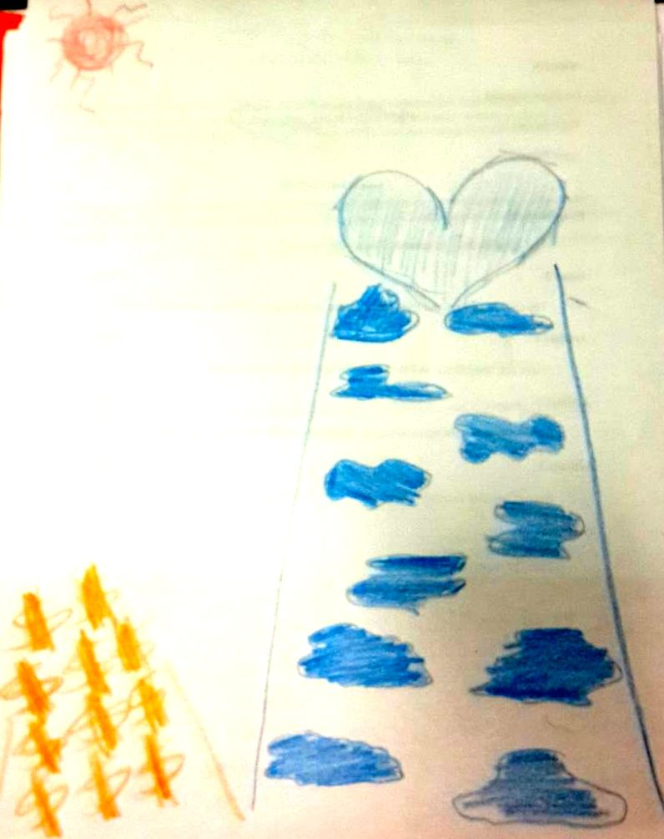
Love or Money
Strategies for Fostering Authentic Metacognitive Narratives in ESL Writing Portfolios

Slide 21
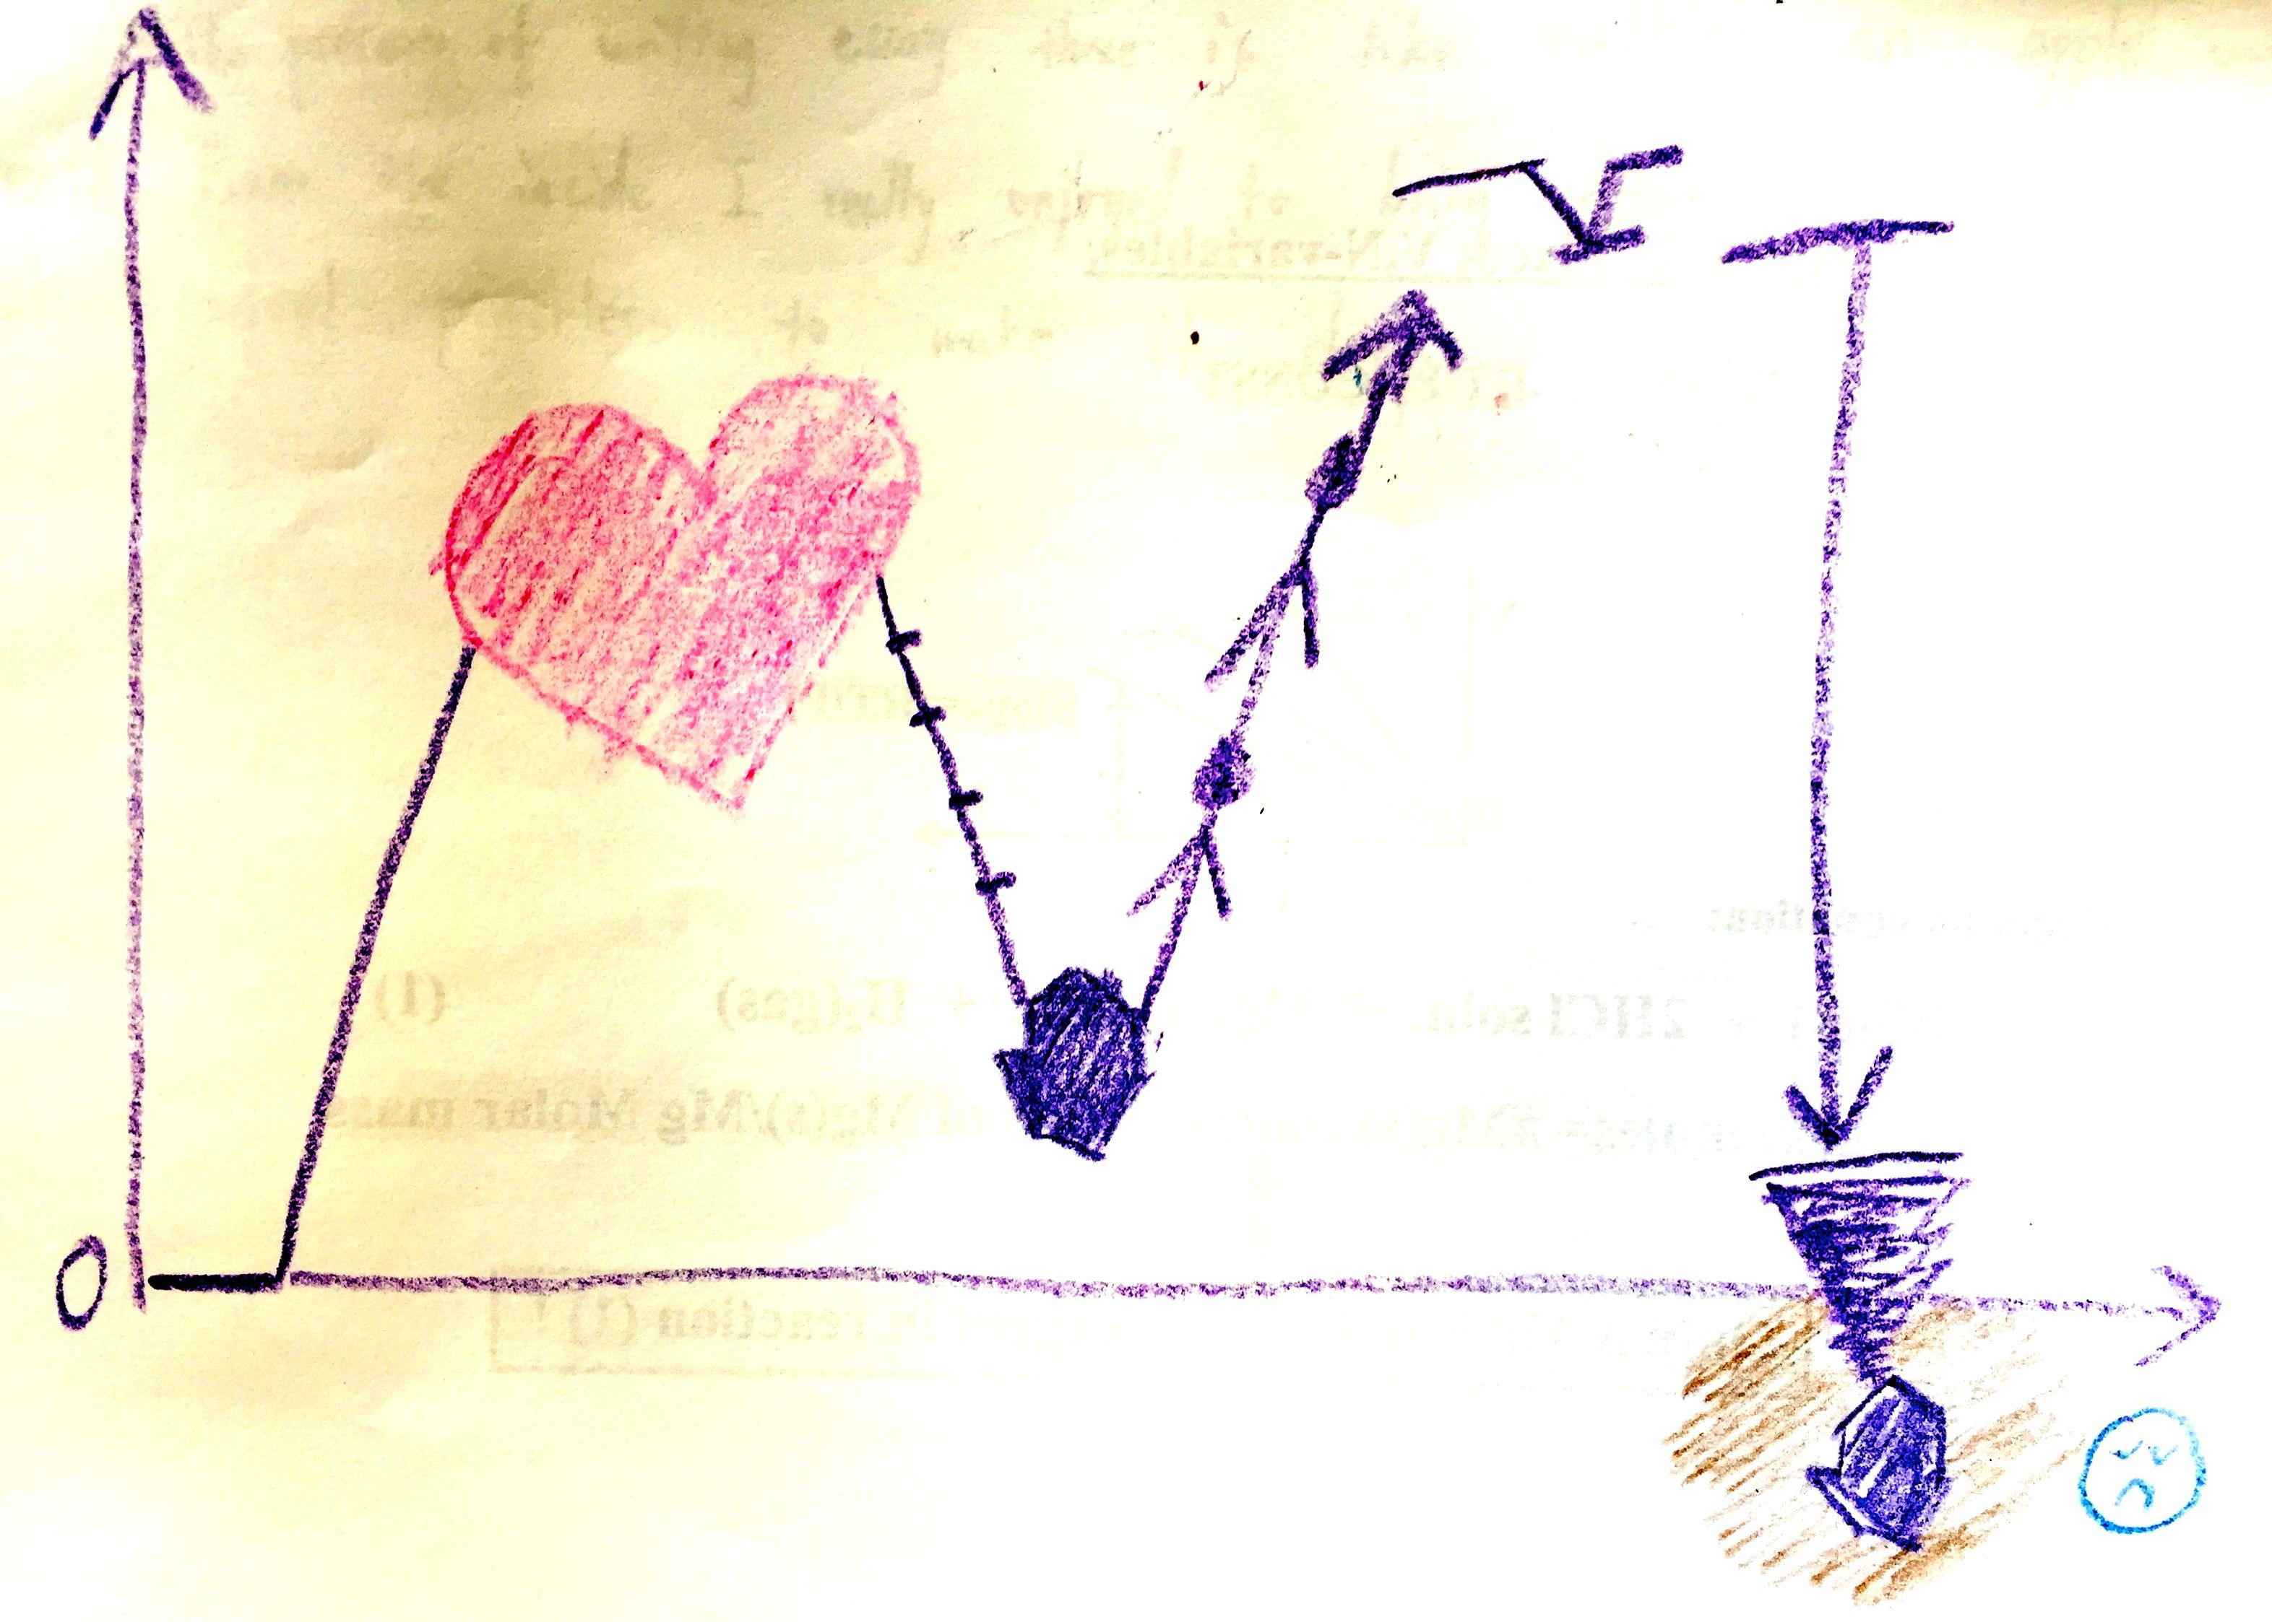
“Depth”
Strategies for Fostering Authentic Metacognitive Narratives in ESL Writing Portfolios

Slide 22
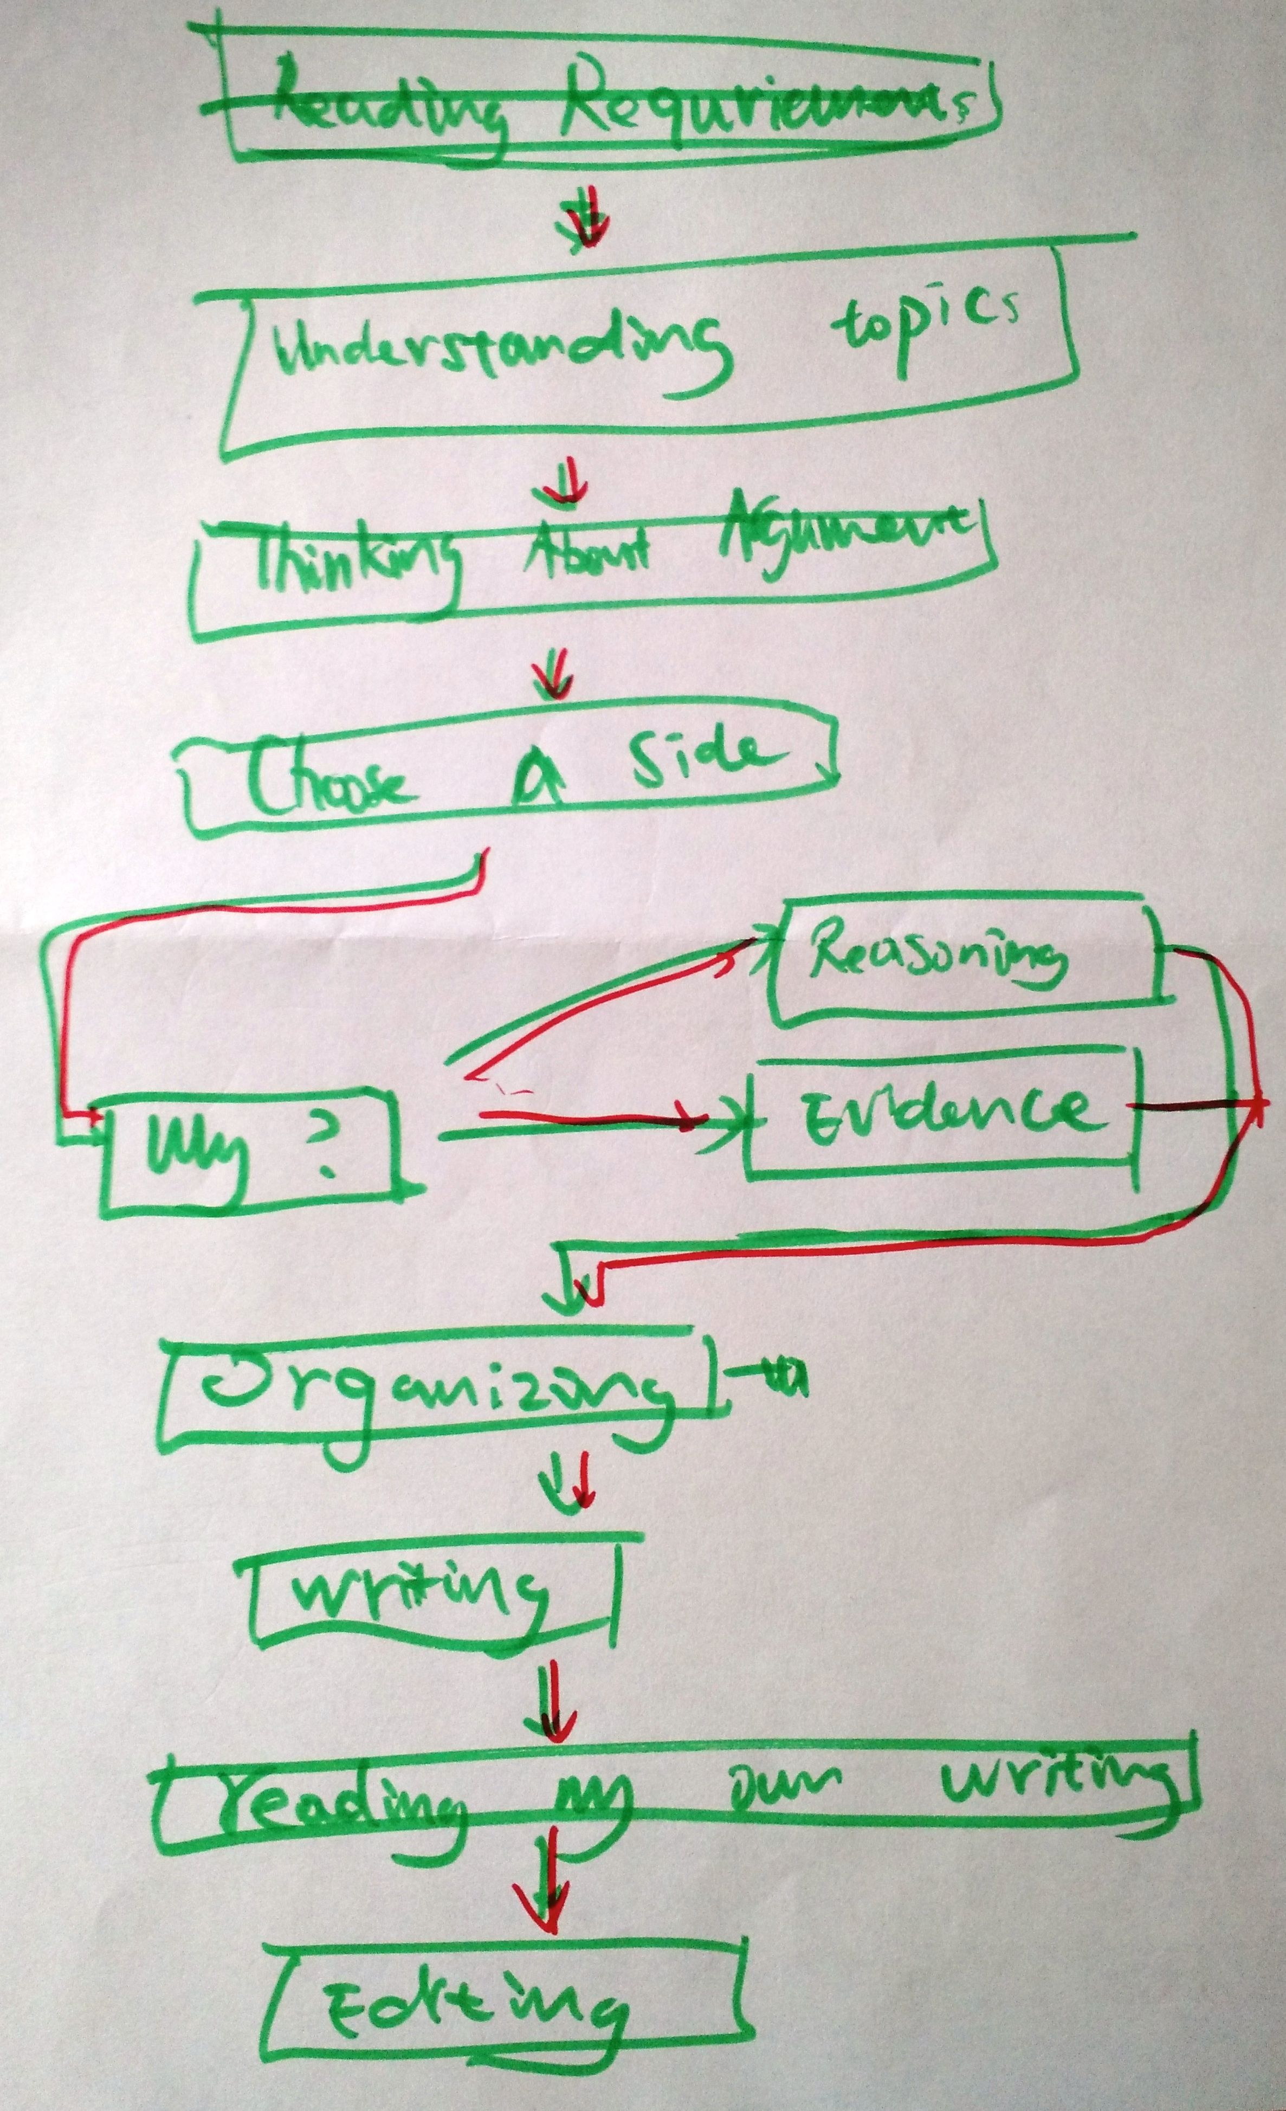
Flowchart
Strategies for Fostering Authentic Metacognitive Narratives in ESL Writing Portfolios

Slide 23
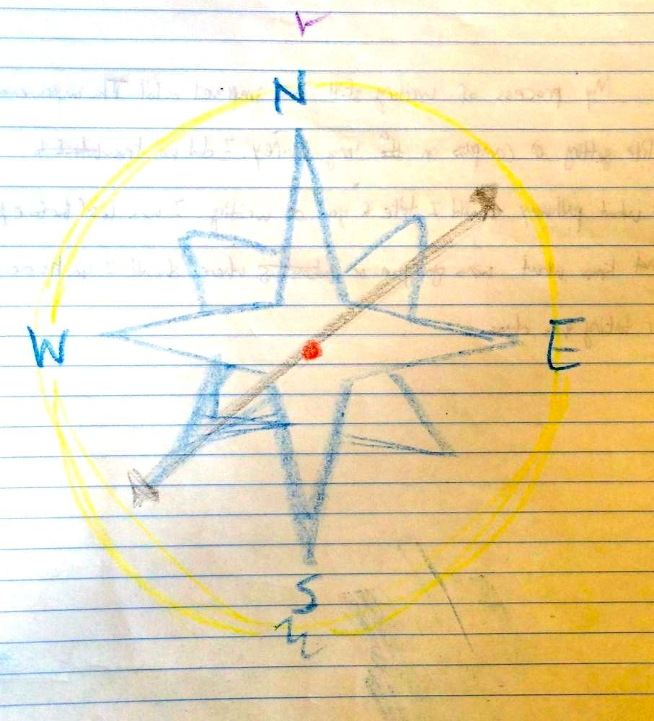
True North
Strategies for Fostering Authentic Metacognitive Narratives in ESL Writing Portfolios

Slide 24
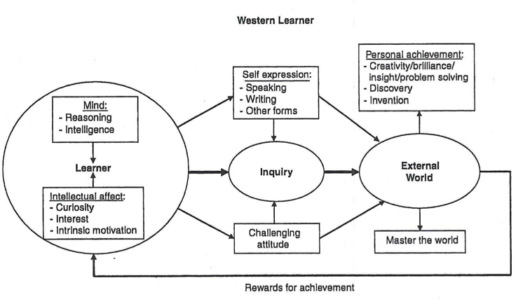
Strategies for Fostering Authentic Metacognitive Narratives in ESL Writing Portfolios
Li, Jin. Cultural Foundations of Learning: East and West. New York: Cambridge UP, 2012, p. 36.

Slide 25
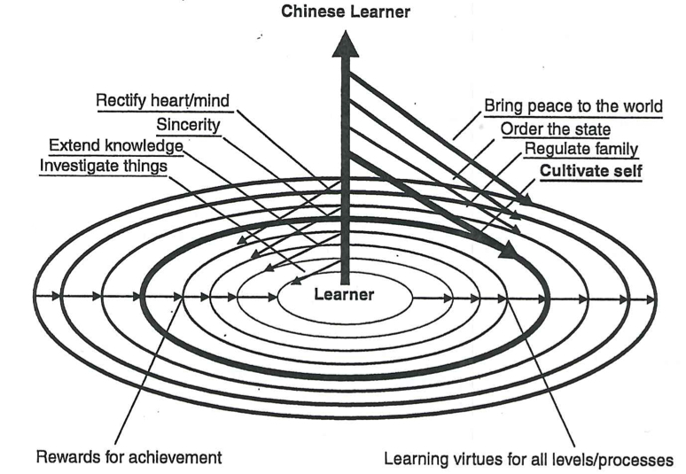
Strategies for Fostering Authentic Metacognitive Narratives in ESL Writing Portfolios
Li, Jin. Cultural Foundations of Learning: East and West. New York: Cambridge UP, 2012, p. 56.

Slide 26
Creative Writing
Strategies for Fostering Authentic Metacognitive Narratives in ESL Writing Portfolios
The process of writing this final essay writing throughout this semester putting together this portfolio has been like…
baking a wedding cake
putting together a menu at a four-star restaurant
clearing a field of landmines
doing a jigsaw puzzle
competing in a championship golf tournament
End-of-course metacognitive strategies
Notes:
Extended similes

Slide 27
End-of-Semester (“Pay-Off”) Reflections
Strategies for Fostering Authentic Metacognitive Narratives in ESL Writing Portfolios
The Best Writing
Part 1: Look over the readings you’ve done for this class this semester. We read a lot of articles and some poems. What is your favorite line, sentence, or paragraph out of all the reading for this class? Choose the line, sentence or paragraph that you liked the most and copy it here.
Part 2: Look over the writing you’ve done for this class this semester. We wrote a lot of essays and journal entries. What is your favorite sentence or paragraph—the sentence or paragraph you are proudest of, and that you think is your best writing this semester? Recopy it below.
End-of-course metacognitive strategies

Slide 28
Clarify for learners and teachers the goals of metacognitive self-assessments and the basis (if any) for further assessment by teachers.
Strategies for Fostering Authentic Metacognitive Narratives in ESL Writing Portfolios
What’s the point?
Goals →
develop the tools to critique academic texts, including the ability to identify and critique thematic and rhetorical structures;
plan, write, and revise academic papers with structural accuracy, clarity, coherence, and attention to stylistic features of written English;
develop and use effective strategies for finding and correcting errors in your own work.
End-of-course metacognitive strategies

Slide 29
Final Portfolio Introduction
Strategies for Fostering Authentic Metacognitive Narratives in ESL Writing Portfolios
A portfolio is an organized collection of artifacts representing your work, framed by an introductory essay that assesses your progress toward the course goals and the goals you established for yourself at the beginning of the semester.
The process of creating the portfolio is itself a learning experience. In documenting and reflecting upon your accomplishments and development as a reader and writer, you come to a better understanding of what you have learned in the course and thus increase the likelihood that you will be able to transfer what you have learned to other contexts.
Compose an introduction (roughly 1000 words) for your entire portfolio. You should approach this as an argument about your writing and your development as a reader and writer, supported by the evidence of the portfolio itself.
End-of-course metacognitive strategies

Slide 30
Rubric for Portfolio Introductions
Strategies for Fostering Authentic Metacognitive Narratives in ESL Writing Portfolios
Portfolio introduction is
coherent
specific
accurate
grammatically correct
End-of-course metacognitive strategies
Notes:
specific (not vague generalities about “In the beginning I was a terrible writer but now with your help, professor, my writing has improved!”), 2) accurate (that is, the assertions the student makes—e.g., “I’ve gotten better at finding and fixing sentence-boundary errors”—are true and not contradicted by evidence within the portfolio itself), and 3) thoughtful (written with care, and edited well)

Slide 31
Use models carefully.
Strategies for Fostering Authentic Metacognitive Narratives in ESL Writing Portfolios
My personal approach:
model what I don’t want;
leave the doors wide open for everything I could imagine wanting, and more.
End-of-course metacognitive strategies
Notes:
--use models judiciously: model what you don’t want; leave the doors wide open for what you invite in

Slide 32
Final Portfolio Introduction Examples
Strategies for Fostering Authentic Metacognitive Narratives in ESL Writing Portfolios
Homer
It has been a while that I have been the small part of such a lovely writing class 98 in spring semester, 2015. Although this class is soon to be complete, my writing journey has never foreseeably ended; it is still continual for the rest of my life. Taking WR 98 is like just one step of the stairs that I have to move, and, most importantly, it makes me realize that not only my interests that are important, there are several skills I have to learn to fulfil myself as a well-round person.
I am ambitious and furious; I will do everything to accomplish my goal, and killing all A grades is recently my goal as long as I am a college student.
End-of-course metacognitive strategies

Slide 33
Homer (cont’d.)
Strategies for Fostering Authentic Metacognitive Narratives in ESL Writing Portfolios
Surprisingly, I was struggled by reading assignment of writing class despite the fact that I have overcome SAT reading before. However, it is not only reading, but also writing that I was struggled. I did not try to find the answer that why my English went down. Anyway, studying by myself that I had always done was apparently not that wise strategy. Fortunately, I met May who later became my close friend. Probably because we are Thai, I feel very comfortable talking with her. Moreover, her English is very opposite to mine like chalk and cheese. Not only helped me with the reading that I did not understand, she encouragingly suggested me to go to writing center in order to improve my first minor paper. She emphasized that the more I talk with a tutor, the more I get the idea. Even though I was stubborn at first, after the first time I went to meet my tutor, I immediately turned my mind.
End-of-course metacognitive strategies

Slide 34
Homer (cont’d.)
Strategies for Fostering Authentic Metacognitive Narratives in ESL Writing Portfolios
[My tutor] is very kind person, and does not mind listening to me speaking broken English. Instead, she encouraged me to be confident and speak as much as possible. “My tutor is a brilliant,” I said this to myself after listened to her advice. Sometimes I have no idea what to start; she helped me by drawing a big picture in my head and pointed what I should focus on. She actually taught me more than just English. She suggested me to use my heart writing the essay, thinking about what it is really about beyond the question. I became more open to English. Moreover, an ego has gone away from me; I asked more, listened more, and put more an effort on any kind of work.
End-of-course metacognitive strategies

Slide 35
Final Portfolio Introduction Examples
Strategies for Fostering Authentic Metacognitive Narratives in ESL Writing Portfolios
Hal
After the very first day of the class, we were asked to write an essay about ourselves—more specifically speaking, about ourselves as writers. To be honest, I had never thought about this question before even though I had had many experiences in writing in both Chinese and English. Indeed, I loved writing when I was a little boy (as I wrote in that essay) but something about writing had been changing all the time though out my early process of learning writing. I was told all kinds of skills (actually so many skills about a certain exam that I could always get a satisfactory grade on that easily) during this process and that almost convinced me writing is just a trick for which all you need to do is just use tricks and skills so I thought thoroughly about myself as a writer and

Slide 36
Hal (cont’d.)
Strategies for Fostering Authentic Metacognitive Narratives in ESL Writing Portfolios
what I should do to get rid of that thought about writing and to learn how to get my English academic writing really advanced.
[A beginning] is always important but still, probably no one including myself could be able to imagine how influential the first writing assignment could be. I knew since that time that I needed to find and learn how to write well in English. Then I went to the class, listened to what professor and others said during class time, talked with them and shared our own experiences, ideas and essays. After some number of classes, I just found an interesting fact very easily and that is: we all talked too much during classes, sometimes much more than professor did. Was it a good thing? I started to wonder but as time went by I knew for sure that it is very useful in some ways because I found that the my speed of writing (not of typing) was getting better and better in that what I

Slide 37
Hal (cont’d.)
Strategies for Fostering Authentic Metacognitive Narratives in ESL Writing Portfolios
was writing, was what we talked about many times during class; most of the times it really helped since our classmates could always come up with something that were very different from what you might be thinking, and follow up questions just came out naturally and then I could easily write something with my pencil. […] When your classmates were talking, they were sharing what they had been thinking and thus this could help with no doubt. […]
[About freewriting] At first I saw nothing useful on my piece of paper; however, one day when I was writing a film review [for another class], I was stuck and did not have any clue on what I shall do next. I suddenly recalled this method so I stopped, for about five minutes and then grabbed a piece of scratch paper for my computer science homework, and started to write. In about three to four minutes, I stopped and an idea just seemed to jumped out of nowhere.
Notes:
Some people might ask if there is a conflict or paradox between these two critical points for improving writing skills that on the one hand we have to think thoroughly before we start writing anything and on the other hand we sometimes need to write with nothing in mind. I am using the word sometimes here since about the second method, the most important thing to do is not this five-minute free writing, but write something real a lot (maybe a basic or an analytical summary, or a journal, or a five-page essay on whatever of topic you choose in all kinds of styles). Basically we were asked to write an essay, either short or long after every class meeting, and this is the most important part of mastering academic writing. There is no shortcut for anything after all.
I will not say that I am good at academic writing in English anyway, the point here I want to make is WR098 has indeed taught me the essence (for me) of writing, I can now write more types of essays and more easily than I did before. I have faith in my writing now once again; and the last but not the least, I am thinking about minoring film study now which I did not want to try because it requires lots of writing that I did not think I could manage before, even though learning films systematically in college had always been one of my dreams.

Slide 38
Hal (cont’d.)
Strategies for Fostering Authentic Metacognitive Narratives in ESL Writing Portfolios
Some people might ask if there is a conflict or paradox between these two critical points for improving writing skills that on the one hand we have to think thoroughly before we start writing anything and on the other hand we sometimes need to write with nothing in mind. I am using the word sometimes here […]
I will not say that I am good at academic writing in English anyway, the point here I want to make is WR098 has indeed taught me the essence (for me) of writing, I can now write more types of essays and more easily than I did before. I have faith in my writing now once again; and the last but not the least, I am thinking about minoring film study now which I did not want to try because it requires lots of writing that I did not think I could manage before, even though learning films systematically in college had always been one of my dreams.
End-of-course metacognitive strategies

Slide 39
Final Portfolio Introduction Examples
Strategies for Fostering Authentic Metacognitive Narratives in ESL Writing Portfolios
Zilly
I think I have a lot of words to say. In some ways, I’m quite good at writing in my Chinese class. I read different kinds of books and through reading I find that it helps me to increase my ability of writing. In fact, every time when an assignment is arranged, I read those beautiful sentences and remarkable thinking. I think I may do some assimilation through this process and it does help. The more words I take in, the more content I can spread out. And I think it’s the same for writing in English. I’m not reading enough English books currently. When I first read “How Does Our Language Shape the Way We Think?’ in Globalization, I think it is quite long yet easy. At that beginning, I’m reading as a Chinese student as I do English exam in China.

Slide 40
Zilly (cont’d.)
Strategies for Fostering Authentic Metacognitive Narratives in ESL Writing Portfolios
I cannot understand the article from an angle of the native speaker. It seems that I’m not reading the content of the article but the English words, just words. The words stand one by one and I translate it on by one. I think it’s a big advance when I almost know what every word means and I could understand what the word is doing. But I not really understand. I judge the article not by its structure, rhetorical technology and the deep meaning and wide world behind the word but by if I can know what every word means. I remember that you have mentioned that many Chinese students write down a meaning of English word in Chinese. Such way of reading proves to be useless. When I’m reading, I tend to skip the difficult sentence first. Actually, the more articles I read the easier for me to deal with those sentences.
End-of-course metacognitive strategies

Slide 41
Zilly (cont’d.)
Strategies for Fostering Authentic Metacognitive Narratives in ESL Writing Portfolios
[Describing class discussions] Students mention the structure and content of the article and try to trigger topic for us to discuss. At the end of presentation, you will point out some interesting part of the article, which is overlooked by the class. When I first read “The Shattered Mirror,” I think it quite challenging so that I read over it first and have to return back and clarify every weird or difficult part of it. These parts are not only about the meaning of the difficult word but also about some [nouns] that I’m not used to notice or meet when I’m reading like “Haji Abdu El-Yezdi,” “Mecca,” and “Persian Sufi.” If I can not figure out those words which I don’t even need to know its word meaning, I can not continue my reading. So at this time, I’m not doing the work of translating word meaning but doing translation of culture and religion. It’s not enough for me to just focus on the word. When I’m gathering the words, the world I face with is enlarging.

Slide 42
Zilly (cont’d.)
Strategies for Fostering Authentic Metacognitive Narratives in ESL Writing Portfolios
At that time I begin to notice some more things within the article, you asks us the meaning of “Beyond the Mirror” this title. I have never thought about that before and it’s only when I’m writing my essay that I realize the true answer of it. It’s true that this is a monoculture world with all faces of shattered mirror. However, sometimes in dealing with some moral problems when people cannot shrink and accept others because it must make a determination, people can no longer say that there’s no truth and false.
From then on, I seem to have the ability to grasp many interesting points within the article. I notice that and I underline it. I’m not fear of meeting those abbreviation and person or place names. So I begin to see the article as a toy model waiting to be separated. I’m excited to meet those interesting [nouns] and I’m excited to find the appealing sentences.

Slide 43
Thank you! Christina Michaud Boston University cmichaud@bu.edu

