Slide 1
Academic Conversations
Christi Cartwright Lacerda, Nicoleta Filimon, Athalia Gonzalez, Douglas Haubert
MATSOL 2016

Slide 2
Do Now
Watch the two presenters participate in a debate.
Analyze their performance on the debate using the rubric provided.

Slide 3
Debrief
How did the two participants differ in their discourse?
What elements were present/absent when you compared the presenters’ discourse to the features included on the rubric?

Slide 4
Values Fostered by Academic Conversations
Argumentation Skills
Persuade and respectfully challenge ideas
Support claims with details
Group Discussion Skills
Foster student-to-student interaction
Break the cycle of IRE (teacher initiation – student response – teacher evaluation)
Listening
Sharpen listening skills in order to respond adequately to a position
Interpret intonations, facial expressions, silences, and other nonverbal clues
(Zwiers and Crawford, 2011, p. 14)
Notes:
“Agree to disagree”

Slide 5
Values Fostered by Academic Conversations Cont.
Critical Thinking Skills
Build, shape, challenge new and valued ideas
Conversation is more complex than we realize
Promotes Different Perspectives and Empathy
Conflicts become smaller and fewer
Counterbalance the “me first” mentality
Connect to others and value diverse ideas and opinions
Foster Creativity and Engagement
Conversation is part of the “brainstorming stage” of the creative processes
Conversations build Content Understanding
Opportunity to use academic language and content vocabulary
Exposure to a range of proficiency levels
(Zwiers and Crawford, 2011, pp. 15-16)

Slide 6
Academic Conversations Supported by Shifts in Common Core
Shift 3: Focus from content to focus on language literacy content
Teachers need to know the language that is running the language show in each lesson. The more proficient we are at developing complex language and literacy skills, the better our students learn the content in enduring ways.
Shift 4: Focus from individual to collaborative
The more that students communicate to accomplish engaging and realistic tasks, the better their learning of content sticks in their minds.
(Ziewers, O’Hara, and Pritchard, 2014, p. 12)

Slide 7
Challenges
Scarcity of data regarding the effectiveness of academic conversation at low proficiency levels
Lack of research on academic conversation involving SLIFE
Inadequacy of existing resources that would address the needs of SLIFEs at the secondary level
Curriculum pacing constraints
General hesitation to implement opportunities for rigorous academic conversation into daily instruction

Slide 8
1. Slide & Glide
Why is Slide and Glide effective?
As a variation of “Turn and Talk”, “Slide and Glide” allows students multiple authentic peer conversation opportunities
Repetition builds confidence
Repetition allows students to remember new vocabulary
Can be used to build background on a new topic as an introductory activity
Movement increases student engagement

Slide 9
Lesson Context
Students have been explicitly taught future tense in order to form predictions.
Students asked partners questions about what will happen in the future using Slide and Glide and interview grids.
Question | Partner’s Response
What do you predict will happen in 1 year? | In 1 year, I will…
What do you predict will happen in 5 years?
What do you predict will happen in 10 years?
What do you predict will happen to society in 50 years?

Slide 10
Now it’s your turn…
Create 5 questions that you would like to ask someone on your first date (use the interview grid provided). Use vocabulary from the list below.
1. partner expectations
2. employment gaps
3. bad habits
4. pet peeves
5. interesting preferences

Slide 11
2. Debate
What makes debate rigorous?
Research and development of arguments
Use of textual evidence and citations to support claims
Collaboration in groups
Higher order thinking skills such as justifying, analyzing, and evaluating
Use of academic language stems

Slide 12
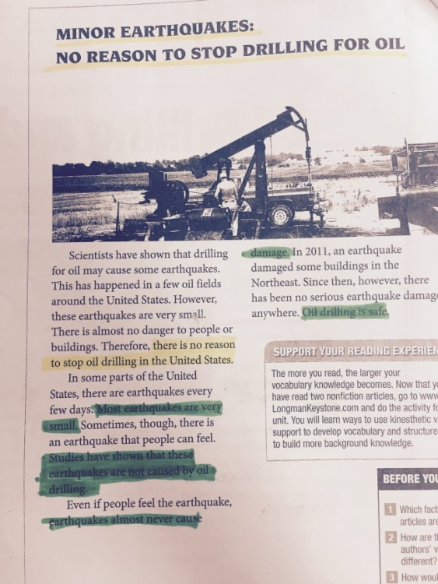
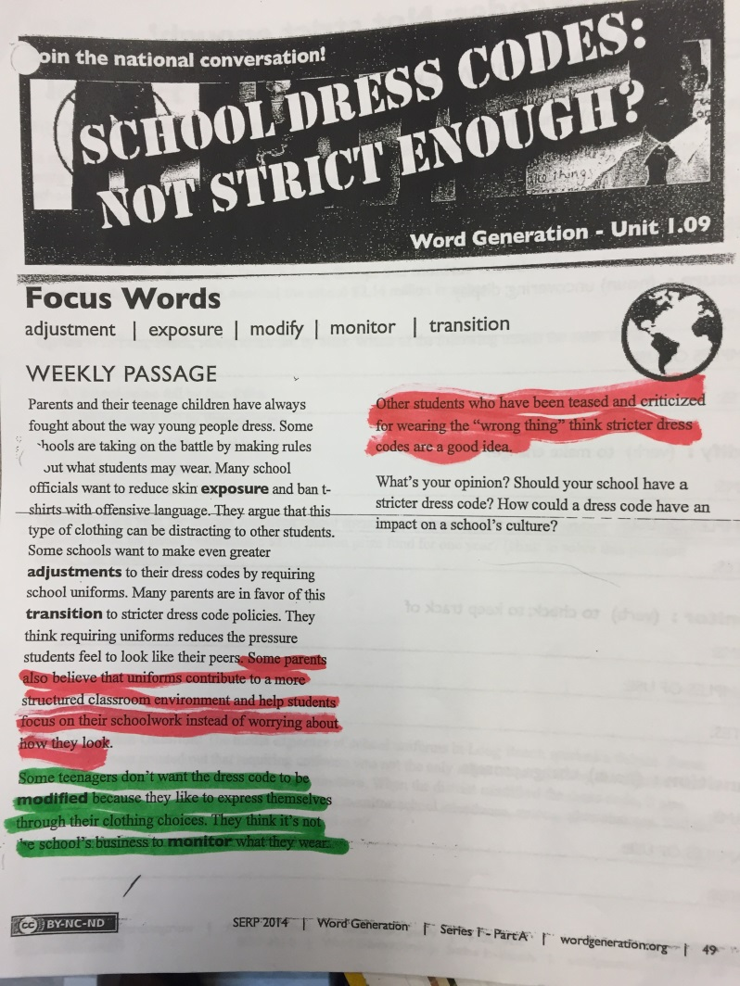
Steps and Scaffolds for ELLs in Classroom Debate
Pre-teach vocabulary for topic related to your curriculum
Choose an accessible text
Find main ideas and details in a text

Slide 13
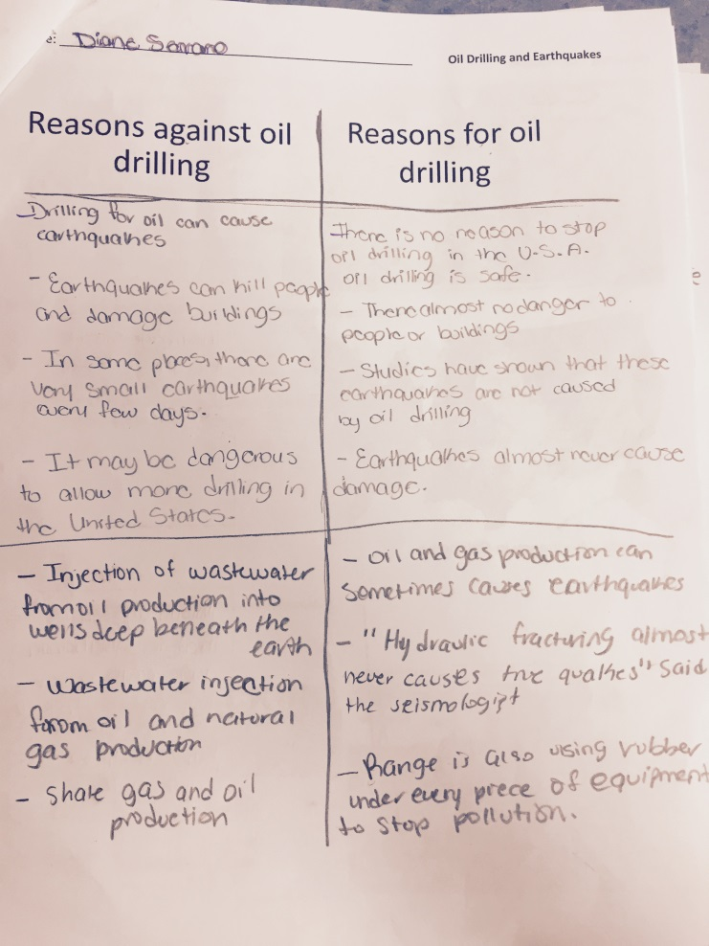
Steps and Scaffolds for ELLs in Classroom Debate
Create a T chart of pros and cons in pairs
Share out to generate a full list of pros and cons

Slide 14
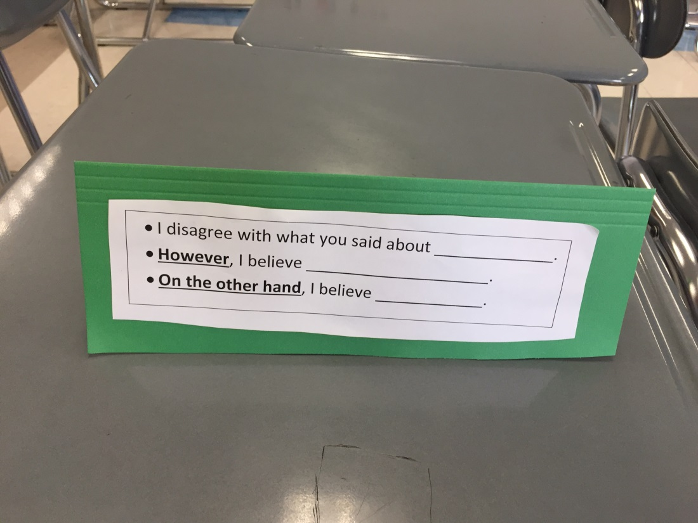
Steps and Scaffolds for ELLs in Classroom Debate
Create opening statements in small groups
Practice opening statements to develop clear pronunciation and build confidence
Practice sentence stems for rebuttal

Slide 15
3. Two-Way Conversation Protocol
Think about the academic “talk” that you hear in your own classrooms as students share their results during activities such as Turn and Talk or Think-Pair-Share.
-What do students say?
-What kind of vocabulary do they use?
-How “rich” are these conversations?
-Is each student participating?

Slide 16
Rationale
Not every student is able to complete an academic task
However, every student is able to talk and listen
With sufficient practice, every student can have an academic conversation in content classes

Slide 17
Example (Math)
A | B
What does the problem tell us? | The problem tells us that (reads the problem)….
What does the problem ask us to solve? What are we looking for? | The problem asks us to (reads the question)…
Which information in the problem is relevant? | The relevant information in the problem is….
How did you solve the problem? What did you do first? | First, I….
What did you do second? | Second, I ….
That’s interesting, please keep going. | …..
Okay, so you are saying that first, you….and then you…..(paraphrase the answer). | Right. Does this make sense to you?

Slide 18
Now it’s your turn…
With your partner, create a two-way conversation protocol to engage ELLs in content-area lessons.
Social studies
Science
Math
English Language Arts
Health

Slide 19
References
Wright, W.E. (2015). Foundations for Teaching English Language Learners: Research, Theory, Policy, and Practice (2nd edition). Philadelphia, PA: Caslon Publishing.
Zwiers, J. & Crawford, M. (2011). Academic Conversations: Classroom Talk That Fosters Critical Thinking and Coherent Understandings. Portland, ME: Stenhouse
Zwiers, J. O’Hara, S. & Pritchard, R. (2014). Common Core Standards in Diverse Classrooms: Essential Practices for Developing Academic Language and Discipline Literacy. Portland, ME: Stenhouse

Slide 20
Questions
christi.cartwrightlacerda@lawrence.k12.ma.us
nicoleta.filimon@lawrence.k12.ma.us
athalia.gonzalez@lawrence.k12.ma.us
douglas.haubert@lawrence.k12.ma.us

