Slide 1
The Reading-Writing Connection: Inquiry Learning and ELL Literacy Development Part Two
Writing Reports: Data Charts in the Inquiry Cycle
Pamela Reed Shufro, Ed.D.

Slide 2
Primary Grades
Journal (see A Writer’s Notebook
--Ralph Fletcher)
Unforgettable stories
Wonderings
Seed ideas
Mind pictures
Memories
Quick writes
Sketches

Slide 3
Writer’s Notebook Intermediate
Memory bank
Authority list
Things I like/dislike
I wonder…
Notable quotes
Essentials of life list
Timeline of my life
Feelings about…

Slide 4
Writing instruction
Teacher’s role
Student’s role
Before writing
Provides time for student reading of good models
Assigns a topic, suggests possible topics, or asks students to select a topic
Provides time, structure, and materials
Models aspects of writing
Provides a rubric
Before writing
Immerses self in reading good models
Selects a topic
Reads about, talks about, or free-writes about the topic
Plans writing
Examines a rubric

Slide 5
INQUIRY CYCLE

Slide 6
INQUIRY: ELLs
READ
WONDER
ASK

Slide 7
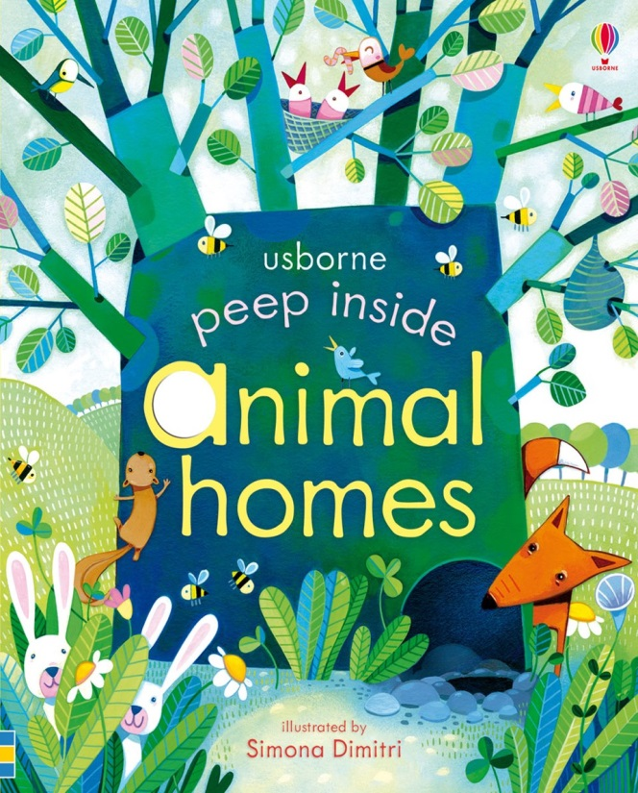
Picture book
Discuss
Question

Slide 8
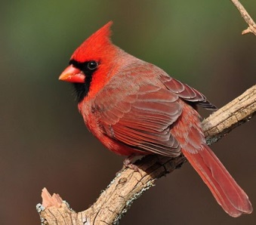
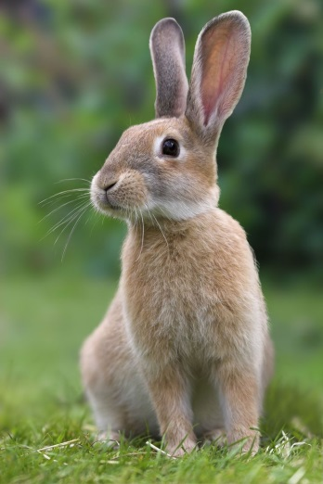
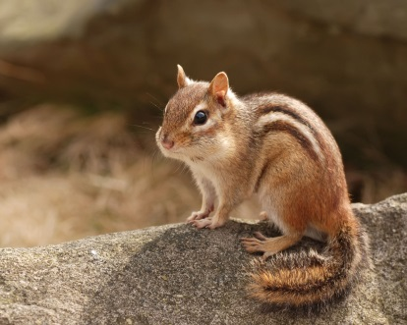
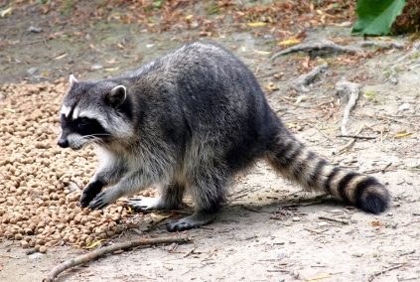
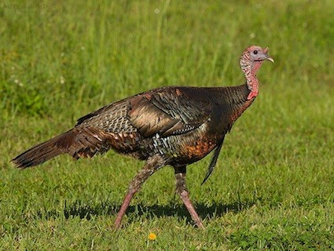
Backyard Animals
Robins
Cardinals
Squirrels
Chipmunks
Rabbits
Raccoons
Skunks
Turkeys

Slide 9
Robins
What kinds of nests do they have?
Who builds it?
What do they eat?
What do their eggs look like?
How many babies do they have?
Where do they go at night?
Where do they go in winter?

Slide 10
Read and Record
Robins | Animal Homes | www.learner.org | Audubon Society
What kinds of nests do they make?
Where do they put them?
Who makes them, male or female?
How many eggs do they lay?
What do robins eat?

Slide 11
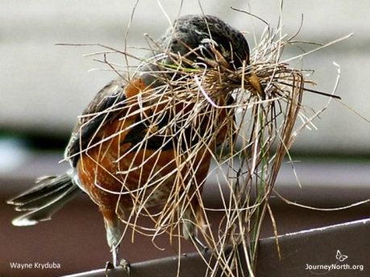
https://www.learner.org/jnorth/tm/robin/facts_nests.html
Robin Nests Contributed by Ornithologist Laura Erickson Back
Wayne Kryduba | nest size, weight, materials nest site selection nest-building process roles of males and females unusual nesting behavior
Q. How big is a robin's nest? A. A robin's nest is about 8-20 centimeters (3-8 inches) in diameter.Q. How much does a robin's nest weigh? A. About 200 grams (7 ounces). Q. How long does it take to build a nest? A. It usually takes 2-6 days for a robin to build a nest. Q. What is the nest made of? A. Mud, grass, and small twigs. Q. How is the nest made? A. A robin collects about 350 dried fibers of grass and small twigs that are about 6 inches long. After a soaking rain, the robin collects mud and travels to and from the nest several hundred times with beakfuls of mud. Next, the robin weaves the grasses together, cementing them to each other and to the supporting branch or windowsill. Finally, the robin lines the inside with the soft grasses and fibers to keep the eggs warm and protect them from sharp twigs or grasses. Q. Who builds the nest, the male or the female? A. Both the male and the female gather nest materials, but usually only the female does the building. Q. What signs tell me that robins are buiding a nest? A. Watch for the male or female flying with nest materials, or the female with mud on her breast. Q. Where do robins build their nests? A. The site should be protected from sun, wind and rain. It can be anywhere from ground to treetop in height; the site must be on something sturdy enough to anchor the nest securely in place. You don't want your nest to fall off! Your nest should also be very close to a good feeding spot so you can easily find worms while keeping an eye on it, and it shouldn't be too far from water. Choose a spot that is hard for predators to see.

Slide 12
American Robin Turdus migratorius
A very familiar bird over most of North America, running and hopping on lawns with upright stance, often nesting on porches and windowsills. The Robin's rich caroling is among the earliest bird songs heard at dawn in spring and summer, often beginning just before first light. In fall and winter, robins may gather by the hundreds in roaming flocks, concentrating at sources of food.
http://www.audubon.org/field-guide/bird/american-robin

Slide 13
Read and Record
Robins | Robins in Your Back Yard by N. Willis | www.learner.org | Audubon Society
What kinds of nests do they make? | Twigs, dew, straw, string, forms a cup | Mud, grass, small twigs | Lined with grasses
Where do they put them? | Fork of an evergreen branch | Protected spot Ground to treetop | Often on porches and windowsills
Who makes them, male or female? | Both | Both gather material but female builds nest | Mostly female
How many eggs do they lay? | Three | One a day Usually stop at 4 | Two broods per season, sometimes 3
What do robin eggs look like? | Shiny blue eggs | Bluish green | Pale blue or “robin’s egg blue”

Slide 14
First draft
Robins nests look like a bowl or cup. They are in trees and bushes. And porches and windowsills. Mother robin makes the nest. One egg a day. The egg is small and blue.
Conference needed

Slide 15
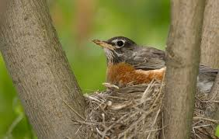
Robins in My Yard
I see a lot of robins in my yard, but I never saw a robin’s nest. I was wondering what they looked like, so I decided to find out. I looked at a book we had in school and I also looked on the internet. Here is what I found.

Slide 16
Robins’ Nests
Robins’ nests look like a bowl or a cup. They are made of mud, grass, and twigs. The inside is lined with grass. The reason I don’t see them is that they are hidden in bushes and trees. Usually the mother robin builds the nest, but sometimes the father helps. The mother robin lays four eggs and then stops, but she will lay more eggs later in the season. If you see a nest, look for small, blue eggs. Then you will know you have seen a robin’s nest.

Slide 17
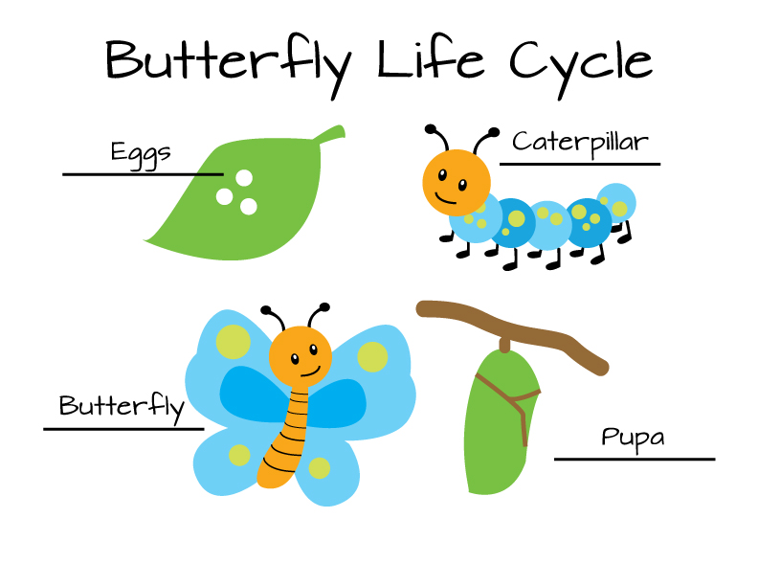
Primary Writing Genres
Drawings
Drawings with captions
Minibooks (B-M-End)
Q/A books
Reports

Slide 18
Intermediate Non-fiction Genres
Multi-event narratives
Family stories
News items
Book reviews
How-to writing
Business letter
Photo essay
Report
Notes:
Report just a little more difficult than photos with captions

Slide 19
Report Writing
Set the purpose
Decide the research question
Develop sources (readable, accurate, unbiased)
Review the “literature”
Interview guide
Surveys
Observations
Take notes (TEACH and MODEL)
Read and remember
Read and record--
Data chart or gathering grid

Slide 20
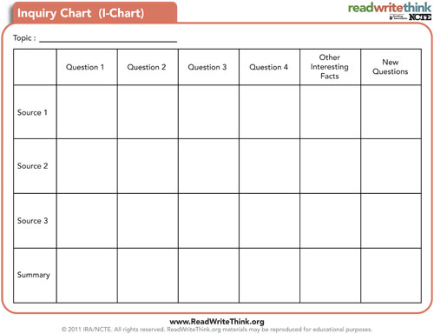

Slide 21
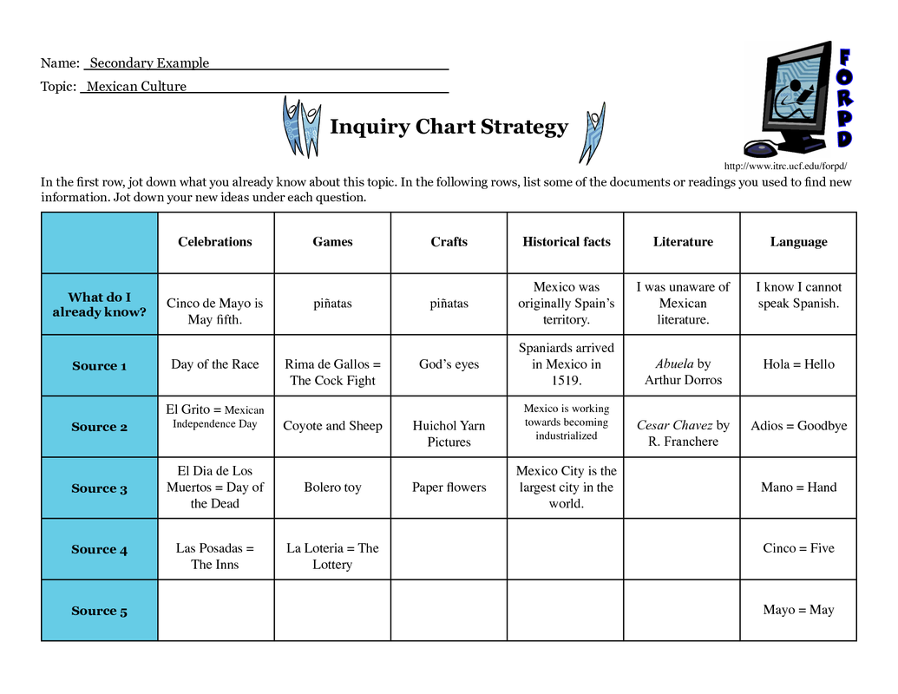

Slide 22
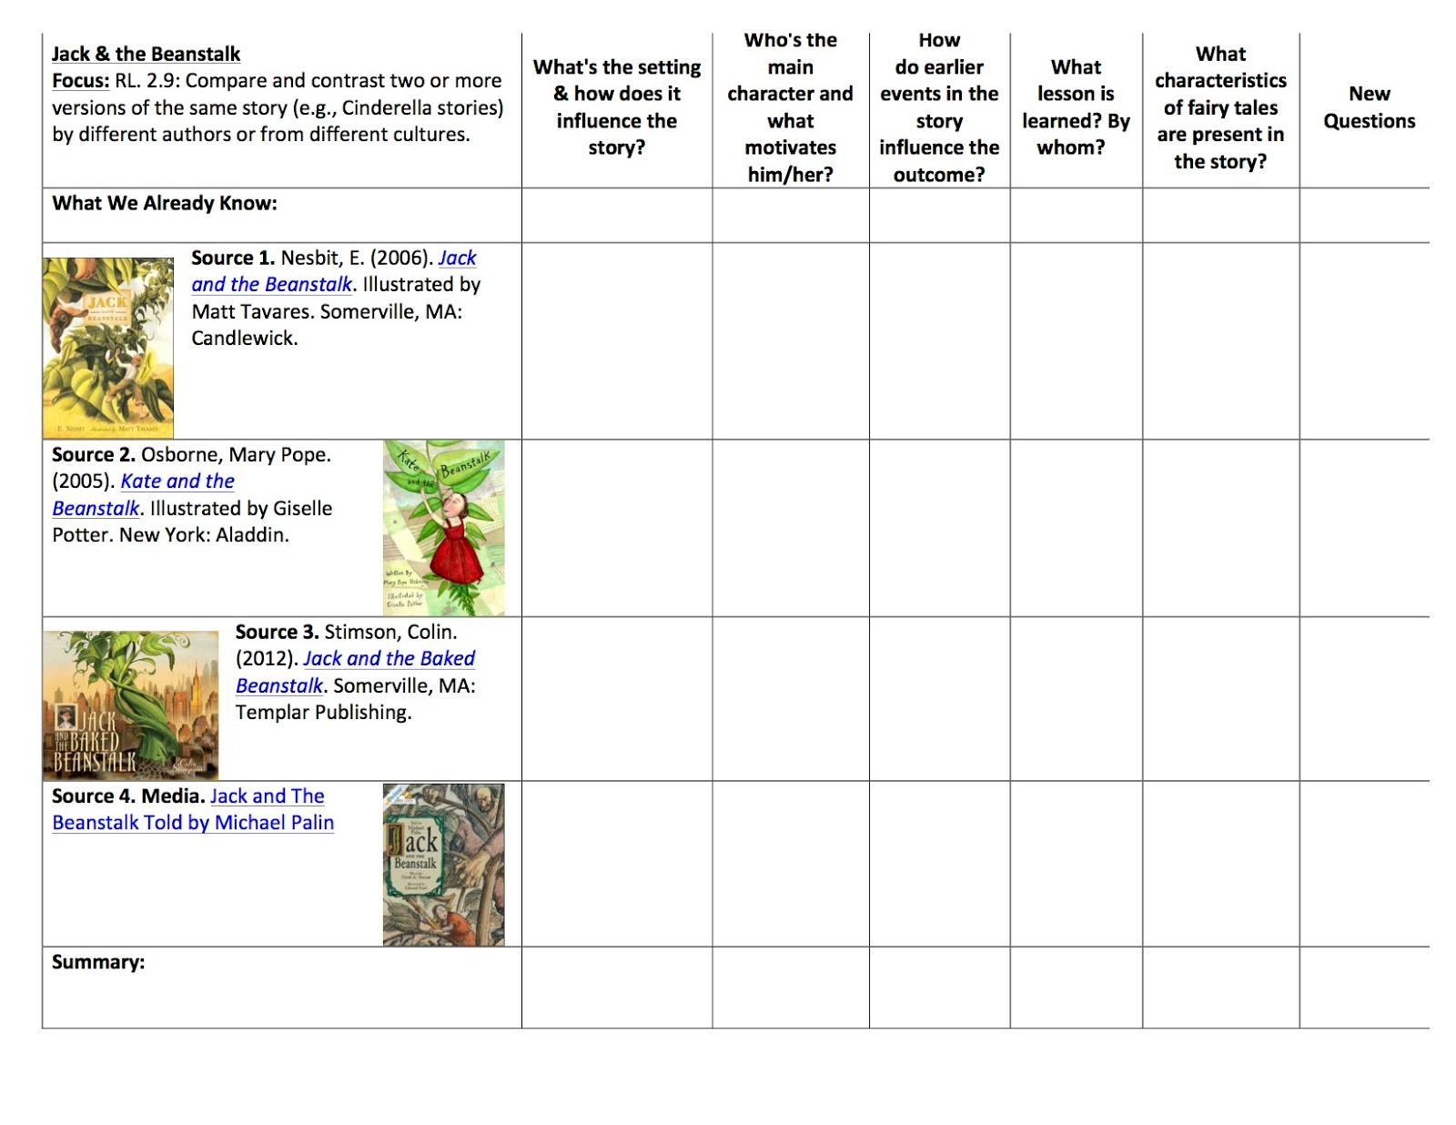
http://maryannreilly.blogspot.com/2015/01/creating-anchor-comprehension-charts-in.html

Slide 23
Primary Grades
1. Choose a subject.
2. Immerse yourself in the literature.
3. Start with a question or series of questions.
4. Make a data chart: collect information
5. Tell your INQUIRY STORY.

Slide 24
Middle Grades
1. Choose a subject.
2. Immerse yourself in the literature.
Start with a question or series of questions. What?
When? How?
Decide on a big question: Why are peregrine falcons an
endangered species?
5. Make a data chart: collect information
6. Weigh the facts.
7. Make a judgment (YOUR THESIS STATEMENT).

Slide 25
Why are peregrine falcons endangered?
Peregrine falcons | Source One | Source Two
What are the effects of pesticides? | Falcons can’t reproduce. Eggs have weak shells. | Pesticides can kill full-grown falcons. Falcons eat other birds infected with pesticides.
How has changing habitat affected them? | Sonic booms hurt falcon populations. | Wilderness is encroached by farms.
Adapted from P. Sebranek et al. Write Source 2000. Houghton Mifflin, 1995.

Slide 26
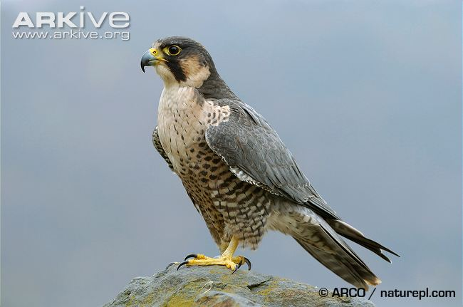
Make a Judgment
Thesis statement:
Human interaction with falcons has caused them to become an endangered species.

Slide 27
Making reports interesting
Talk to the reader
It’s OK to use “I”, especially if you are ten
Use the active voice
Use narrative vignettes or “little stories”
Be specific:
(Use real names of persons and places)
For older students, consider the “I-Search” paper, a first-person narrative of the inquiry process.

Slide 28
Inquiry Writing for ELLs and Everyone!
Wonder
Get the facts
Write
Revise
Edit
SUCCESS!

