Slide 1
The Reading-Writing Connection: Inquiry Learning and ELL Literacy Development Andrea Cayson, Ph.D.
Part One

Slide 2
Best Practices in ELL Instruction
Instruction should include…
activating prior knowledge
building background knowledge
comprehensible input
increased verbal interaction during classroom activities
contextualized language
strategies and grouping techniques that reduce anxiety
activities that promote active involvement of students
Notes:
Comprehensible input
materials presented during instruction should be presented in a manner that leads students to an understanding of the content
Visual, manipulative, scaffolded, etc.
Contextualized language
Provide a context for the use of the language through the use of pictures, scenarios, props, gestures
Meaningful and purposeful use of the language
Reduce anxiety
ELL students should be allowed to move into verbal production of their new language at a comfortable rate. Production of a language begins with receiving messages (processing and understanding) and building a strong listening vocabulary before moving on to language production.
This does not mean that ELLs not be expected to participate in classroom activities, but that classroom activities be structured in such a way that ELLs feel comfortable participating and free to practice their newly acquired language skills
Active involvement
Meaning exposure to language is not enough.
Students need many opportunities to engage in language interaction (solve problems or produce projects)
Authentic reasons to communicate
Supports refinement of their language production
Provides students with opportunities to realize their verbal communication is not always understood by others
This realization can help students move from the receptive, semantic processing (listening to understand) to expressive, syntactic processing (formation of words and sentences to communicate
If students are left to simply listen and observe without the opportunity or necessity to communicate they remain in the preproductive stage for an extended period of time.
The structure of communicative classroom activities prevents this from happening.

Slide 3
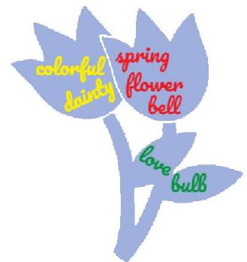
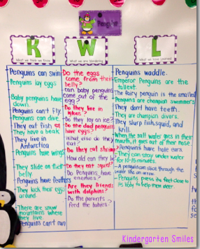
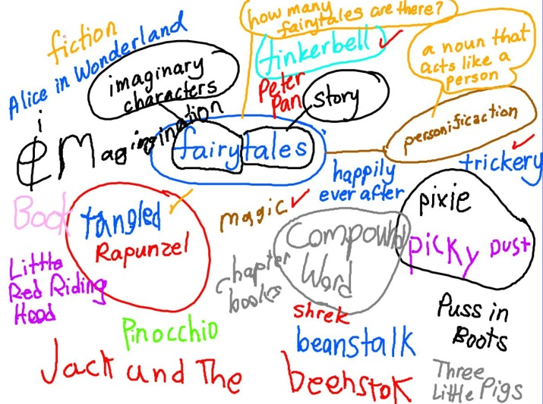
Activating prior knowledge
Semantic Mapping
K-W-L Chart
Word Splash
Corners
Carousel Brainstorming
Notes:
Activation of prior knowledge helps to engage the learner, connect to what the student already knows, allows teachers to find out what learners know about topic and clear up misconceptions.
Helps to adjust instruction as needed

Slide 4
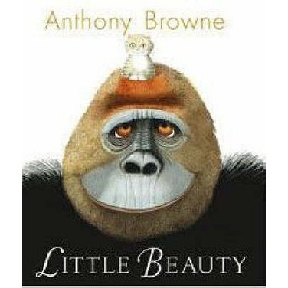
Building Background Knowledge

Slide 5
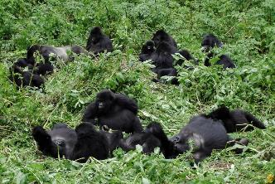
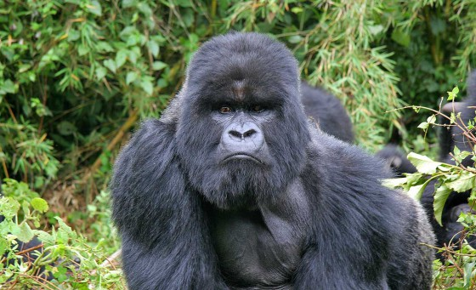
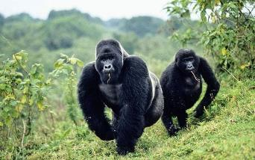
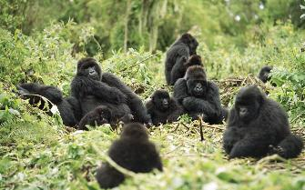
Gorillas live in the wild.

Slide 6
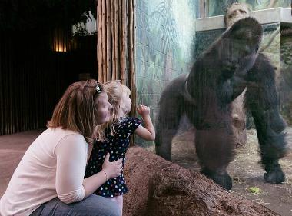
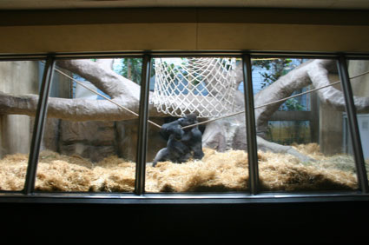
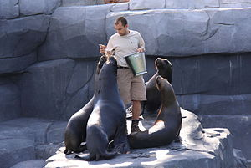
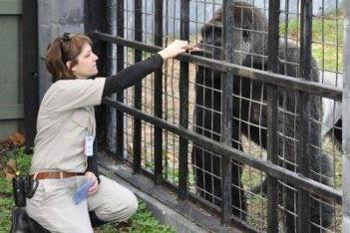
Gorillas live in zoos.
Zookeepers

Slide 8
Double click to enable video
Notes:
Double click to enable video

Slide 9
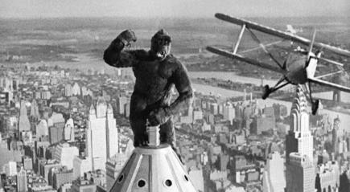
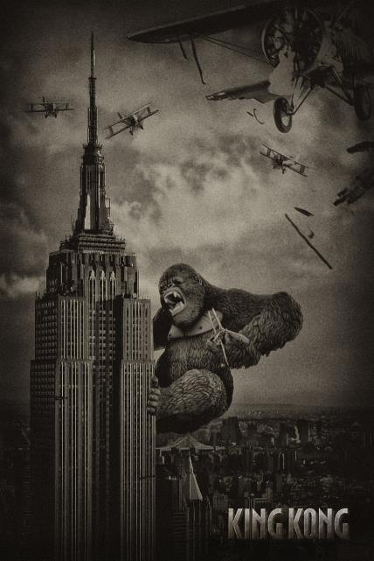
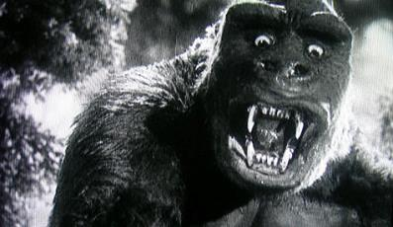

Slide 10
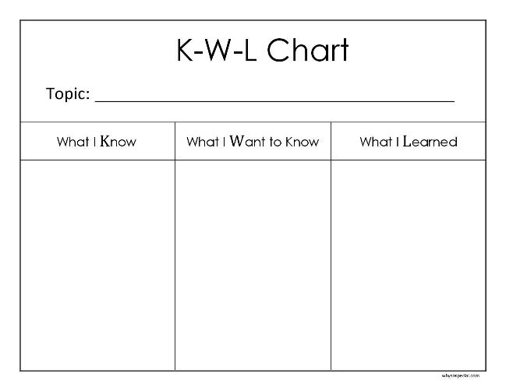
Building Background Knowledge

Slide 11
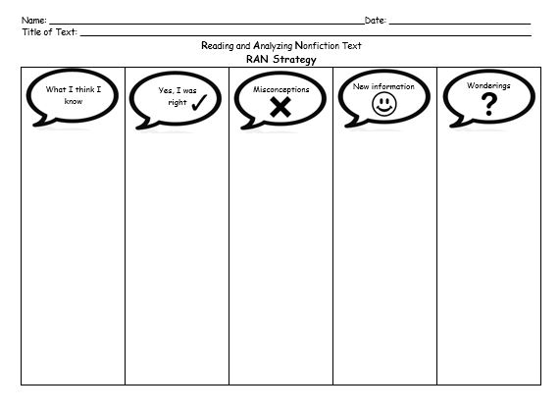
Building Background Knowledge

Slide 12
Tree frogs
are tiny
Tree frogs are green
Tree frogs have moist skin

Slide 13
They can be blue or orange. Some have red stripes or pink bellies
Tree frogs
are tiny
Tree frogs are green
Tree frogs have moist skin

Slide 14
They can be blue or orange. Some have red stripes or pink bellies
Tree frogs are green
Tree frogs can be as small as your thumb or as big as a kitten.
Tree frogs
are tiny
Tree frogs have moist skin

Slide 15
They can be blue or orange. Some have red stripes or pink bellies
Tree frogs have moist skin
Tree frogs are green
Tree frogs can be as small as your thumb or as big as a kitten.
Tree frogs
are tiny

Slide 16
They can be blue or orange. Some have red stripes or pink bellies
Do tree frogs live in the USA?
Are tree frogs poisonous?
Tree frogs have moist skin
Tree frogs are green
Tree frogs can be as small as your thumb or as big as a kitten.
Tree frogs
are tiny

