Slide 1
Designing Hybrid Courses for ESL Students for Intensive English Programs
Presenter: Judithann Walz
June 2, 2017

Slide 2
Welcome
Massachusetts International Academy (MAIA), is an innovative college preparatory school positioning high school graduates from overseas for success in United States’ colleges and universities.

Slide 3
Overview
Introduction
Objectives
Questions to Consider
Course Outline
Challenges
Best Practices
Conclusion

Slide 4
Quote of the Day
“The key to success is to appreciate how people learn, understand the thought process that goes into instructional design, what works well, and a range of different ways of achieving goals.” - Tim Buff

Slide 5
Objectives
You will understand the why and how hybrid courses are beneficial to both teachers and students.
Teachers
Redesigning the learning experience (i.e. flipped classroom)
Build better online educational and technological skills
Students
Increased learner autonomy
Team-based learning
Project-based learning
College prep

Slide 6
Once Upon a Time
It began with The Virtual High School (VHS)
Hybrid Idea
Blackboard

Slide 7
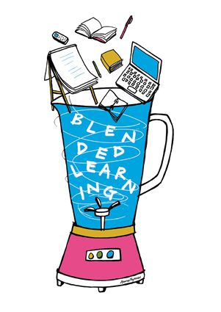
Questions to Consider
What are the learning outcomes for the course?
How will you integrate the face-to-face and online pieces?
What activities will benefit student learning?
How will you assess student learning?
What challenges do you anticipate?

Slide 8
Course Outline
Face-to-Face
MWF
Course check-in
Weekly calendars
Application/Integration
Discussions
Presentations
Activities
Games
*Homework and grading
Online Learning
T/TH
Attendance check-in
Flipped Classroom
Reading
Videos
Discussion board
Blogs
Wikis
Essays
Quizzes

Slide 9
Challenges
Student/Teacher learning curve
Learner motivation
Assessing essays
Safe Assign vs. Turnitin.com
*Blackboard + China = Time Difference

Slide 10
Best Practices
Provide in-class orientation
Clearly state all the information the student will need
Make course expectations explicit and available
Clearly present weekly schedules of in-class and online work
Provide online and in-class feedback
Ticket-out-the-door

Slide 11
Conclusion
How will you design a hybrid course?
Ask the questions
Choose the objectives
Develop the activities/assessments
Orientate the students
Anticipate challenges
Create back-up plans
Clearly state expectations

Slide 12
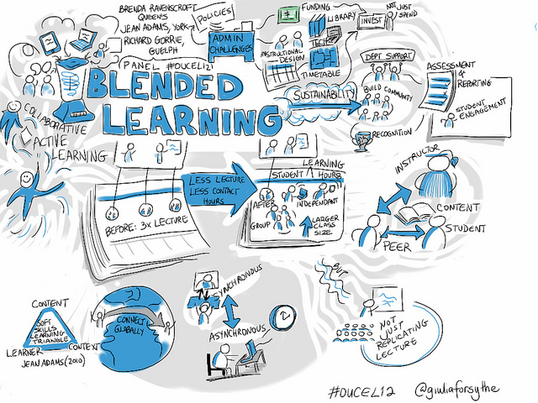
Thank You

Slide 13
Contact Information
Judith Walz
Email: judith.w@maia.edu

Slide 14
Works Cited
"Design Guidelines." Hybrid Microcircuit Technology Handbook (1998): 363-461. Brandeis University. Web. 5 Nov. 2016.
"Google Images." Google Images. N.p., n.d. Web. 11 Nov. 2016. <https://images.google.com/>.
Massachusetts International Academy." Massachusetts International Academy. N.p., n.d. Web. 11 Nov. 2016. http://www.maia.edu/massachusetts-international-academy/22773

