Slide 1
A New Media and Tech Tools Session for Non-Techies
Twitter Hashtag: #GEOtech
Monday, March 12, 2011
Grantmakers for Effective Organizations Conference

Slide 2
Brought to you by…
Moderator & Presenter:
Laura Efurd - V.P. of Strategy & Innovation, ZeroDivide
Twitter: @lefurd, @zerodivideorg
Presenters:
Jane Meseck – Director of Community Affairs, Microsoft
Twitter: @janemeseck, @msftcitizenship
Sidney Hargro – Executive Director, Community Foundation of South Jersey
Twitter: @sidneyrhargro, @sjerseygives

Slide 3
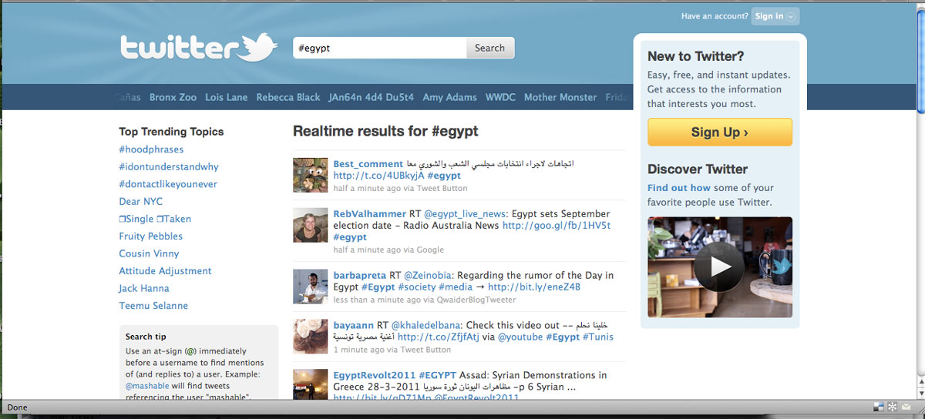
Intro: Increasing Impact via Tech
From Egypt to East LA: Powerful & participatory

Slide 4
Some Key Technology Trends
Mobile
The Cloud
Social Media
Online Video
Location
Crowdsourcing

Slide 5
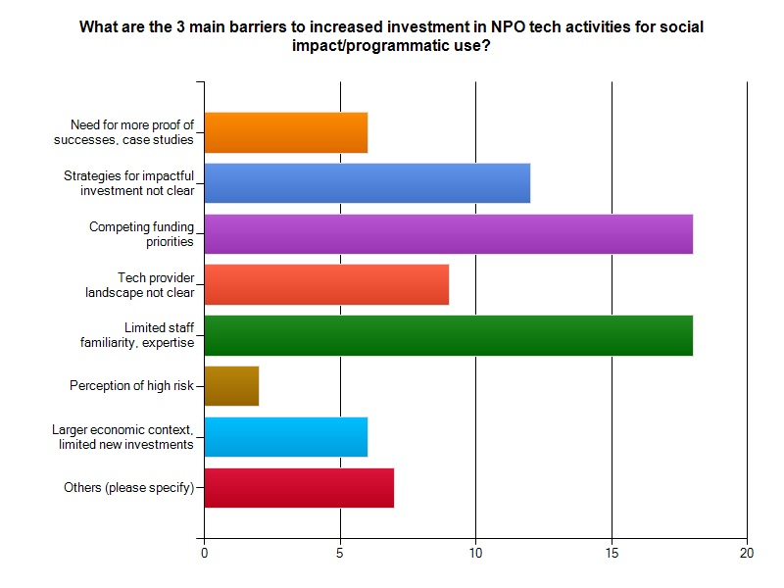
Funder Survey by ZeroDivide - 2011

Slide 6
Your Interests? Tech, Grantmaking & Impact
How savvy is your foundation about the use of new tech tools and social media?
Are you specifically supporting your grantees’ technology activities and/or capacity?
Over the next 2 years, do you expect your investment in grantees technology use to increase, decrease, or stay the same?
What’s your burning question for this session?

Slide 7
Jane Meseck – Microsoft, Community Affairs

Slide 8
The Nonprofit IT Pyramid
A Framework for IT Adoption and Innovation
Notes:
Microsoft Nonprofit Resources:
www.microsoft.com/nonprofit
IT Planning:
http://www.microsoft.com/about/corporatecitizenship/en-us/community-tools/nonprofits/whats-available/it-planning/

Slide 9
Sidney Hargro, Community Foundation of South Jersey

Slide 10
Online Matching Grants
Goal:
Help small nonprofits use online giving to increase revenue using a 2:1 match up to $3,000
Objectives:
Increase familiarity and use of online giving strategies
Identify new donors

Slide 11
Results – Online Matching Grants
Organization | Total # Gifts | Total # New Donors | Smallest Gift | Largest Gift | Total Gifts w/match
Your Food Shelf | 27 | 21 | $25 | $1,500 | $9,000
Interfaith of Burlington County | 26 | 9 | $10 | $5,000 | $15,232
People for People | 35 | 16 | $2 | $2,000 | $10,121

Slide 12
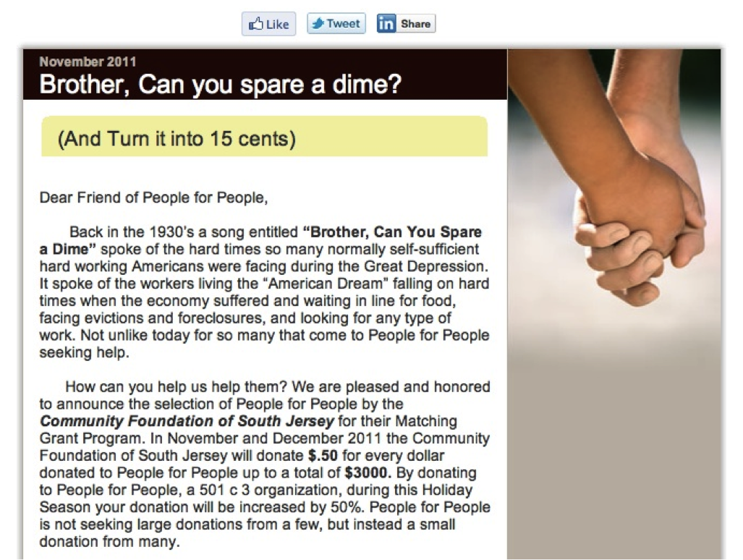
Sample eBlast

Slide 13
Resources – Sign in to receive a full list by email
Microsoft Nonprofit Resources: www.microsoft.com/nonprofit
ZeroDivide Resources: http://zerodivide.org/resources_1
IT Planning by Microsoft: http://bit.ly/MSFTresources
NTEN’s Resource Page: http://nten.org/learn/bytopic
Aspiration’s Resource Page: http://aspirationtech.org

Slide 14
Thank you and please be in touch!
Laura Efurd – laura@zerodivide.org
- Twitter: @zerodivideorg, @lefurd
Jane Meseck – janem@microsoft.com
- Twitter: @msftcitizenship, @janemeseck
Sidney Hargro – shargro@communityfoundationsj.org
- Twitter: @sjerseygives, @sidneyrhargro

