Slide 1
ESL & GENERAL EDUCATION: A SUCCESSFUL COLLABORATION MODEL
Wendy Anderson
Anna Gallo Knight
Kimberly Gaffney
Christine Lange
Notes:
2:30

Slide 2

Welcome!
Introductions
Presenters
This is our story, not the only story
Notes:
2:30 - 2:35
Wendy, Kim, Anna, Christine
Christine explains point 2

Slide 3

Objectives & Agenda
Participants will be able to:
Describe several key action steps to promote collaboration
Create an action plan for increasing collaboration in their district
Describe the progression of developing a collaborative and integrated model of ESL instruction
District profile
Current ESL/Science and Social Studies integration model & reasoning
Steps we took to implement collaborative and integrated instruction
  District level
  School Admin level
  Within the classroom
Action steps that were most important
Action plan for your district
Notes:
2:35 - 2:40
Kim

Slide 4

Our District - Hudson Public Schools
District demographics
Approximately 1,000 elementary students
Approximately 130 elementary EL students
District model of ESL instruction
Grades K-1 fully inclusive
  ESL services during the science/social studies block
  ESL services during RtI for level 1-2 students
Grades 2-4 only pull-out WIDA level 1-2 students
  ESL services during the science/social studies block
  Pull-out for level 1-2 students
With all this push-in, collaboration is key!
Notes:
2:40 - 2:45
Christine

Slide 5

Progress Towards Full-Inclusion
Determining need for full-inclusion (2013 - 2014)
  Students were inevitably being pulled during core academic subjects
ESL inclusion services occurred at different times throughout the day (2013 - 2015)
  Reader’s/Writer's workshop; math
  ESL teachers’ roles not clearly defined
Determined a need for more collaborative instruction
Notes:
2:45 - 2:50
Anna

Slide 6

How We Collaborate
Research key points
Administration’s support (Principal & District)
Weekly time to meet - share plans and build relationship
Shared responsibility and power
The ESL teacher viewing themselves as having equal power and expanding their view of the ESL teacher role
Co-Teaching in the ESL Classroom (Honigsfeld, Dove)
ESL and Classroom Teachers Team Up to Teach Common Core (Lesli A. Maxwell)
Notes:
2:50 - 2:55
Wendy

Slide 7

Why Science/Social Studies Integration?
Readers and writers workshop
  Already targets reading and writing development
  Little room for oral language development
Science/Social Studies
  Usually the focus is more on content & vocabulary - not necessarily how to use the content and vocabulary in an authentic way
  ESL instruction potential at the sentence and discourse level (i.e. student discussions; presentations)
  More opportunities for oral language development
  More authentic experiences with language
  More authentic language development through shared experiences (i.e. field trips; experiments)
Began piloting ESL/Science and ESL/Social Studies integrated instruction (2015 - 2016)
New model for 2016-2017: collaborate with classroom teacher to integrate ESL & Science/Social Studies in order to develop language
Notes:
2:55 - 3:00
Kim

Slide 8
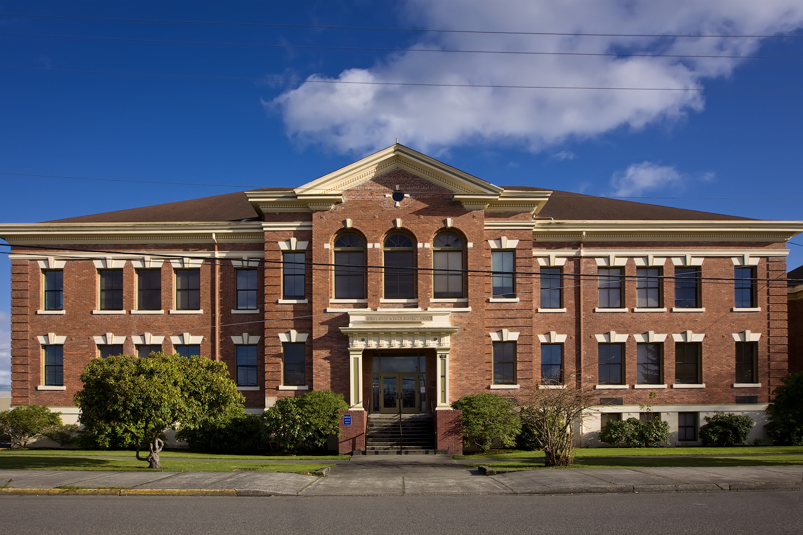
Steps of Implementation:
District Level (2016-2017)
Superintendent in support of inclusion model
ESL Coordinator communicated vision to school administrators
Provided 6 release days within the school year for PD & curriculum development
  Content coaches, content teachers, and ESL teachers participated
  DESE ESL MCU Project documents (role of ESL teacher, collaborative tools)
  Development of two pilot units--Grade 1 (Comparing Young and Adult Plants) and Grade 4 (Kinesthetic and Potential Energy)
  Implementation of both pilot units and subsequent revision
Flexibility to continue this work and further develop curriculum
Notes:
3:00 - 3:05
Anna

Slide 9

Steps of Implementation:
School Level
Principals in support of clustering ELs
Principals included ESL teachers in creating schedules
  Master schedule sample
Working toward finding time for collaboration
  Common prep times
  After/before school meetings
Notes:
3:05 - 3:10
Christine

Slide 10

Steps of Implementation: Classroom & Teacher
Outside the classroom
Schedules with collaboration time (20 minutes/week)
Communication of vision and how it will benefit all students (i.e. Speaking and Listening Standards)
  Explicit language instruction alongside content
Collaborative meeting tools
  Microfunction documents
During instruction
Flexible teacher roles
Shared “teaching time”
Promote language building through shared experiences with content materials
Language and content learning targets
Notes:
3:10 - 3:15
Wendy

Slide 11
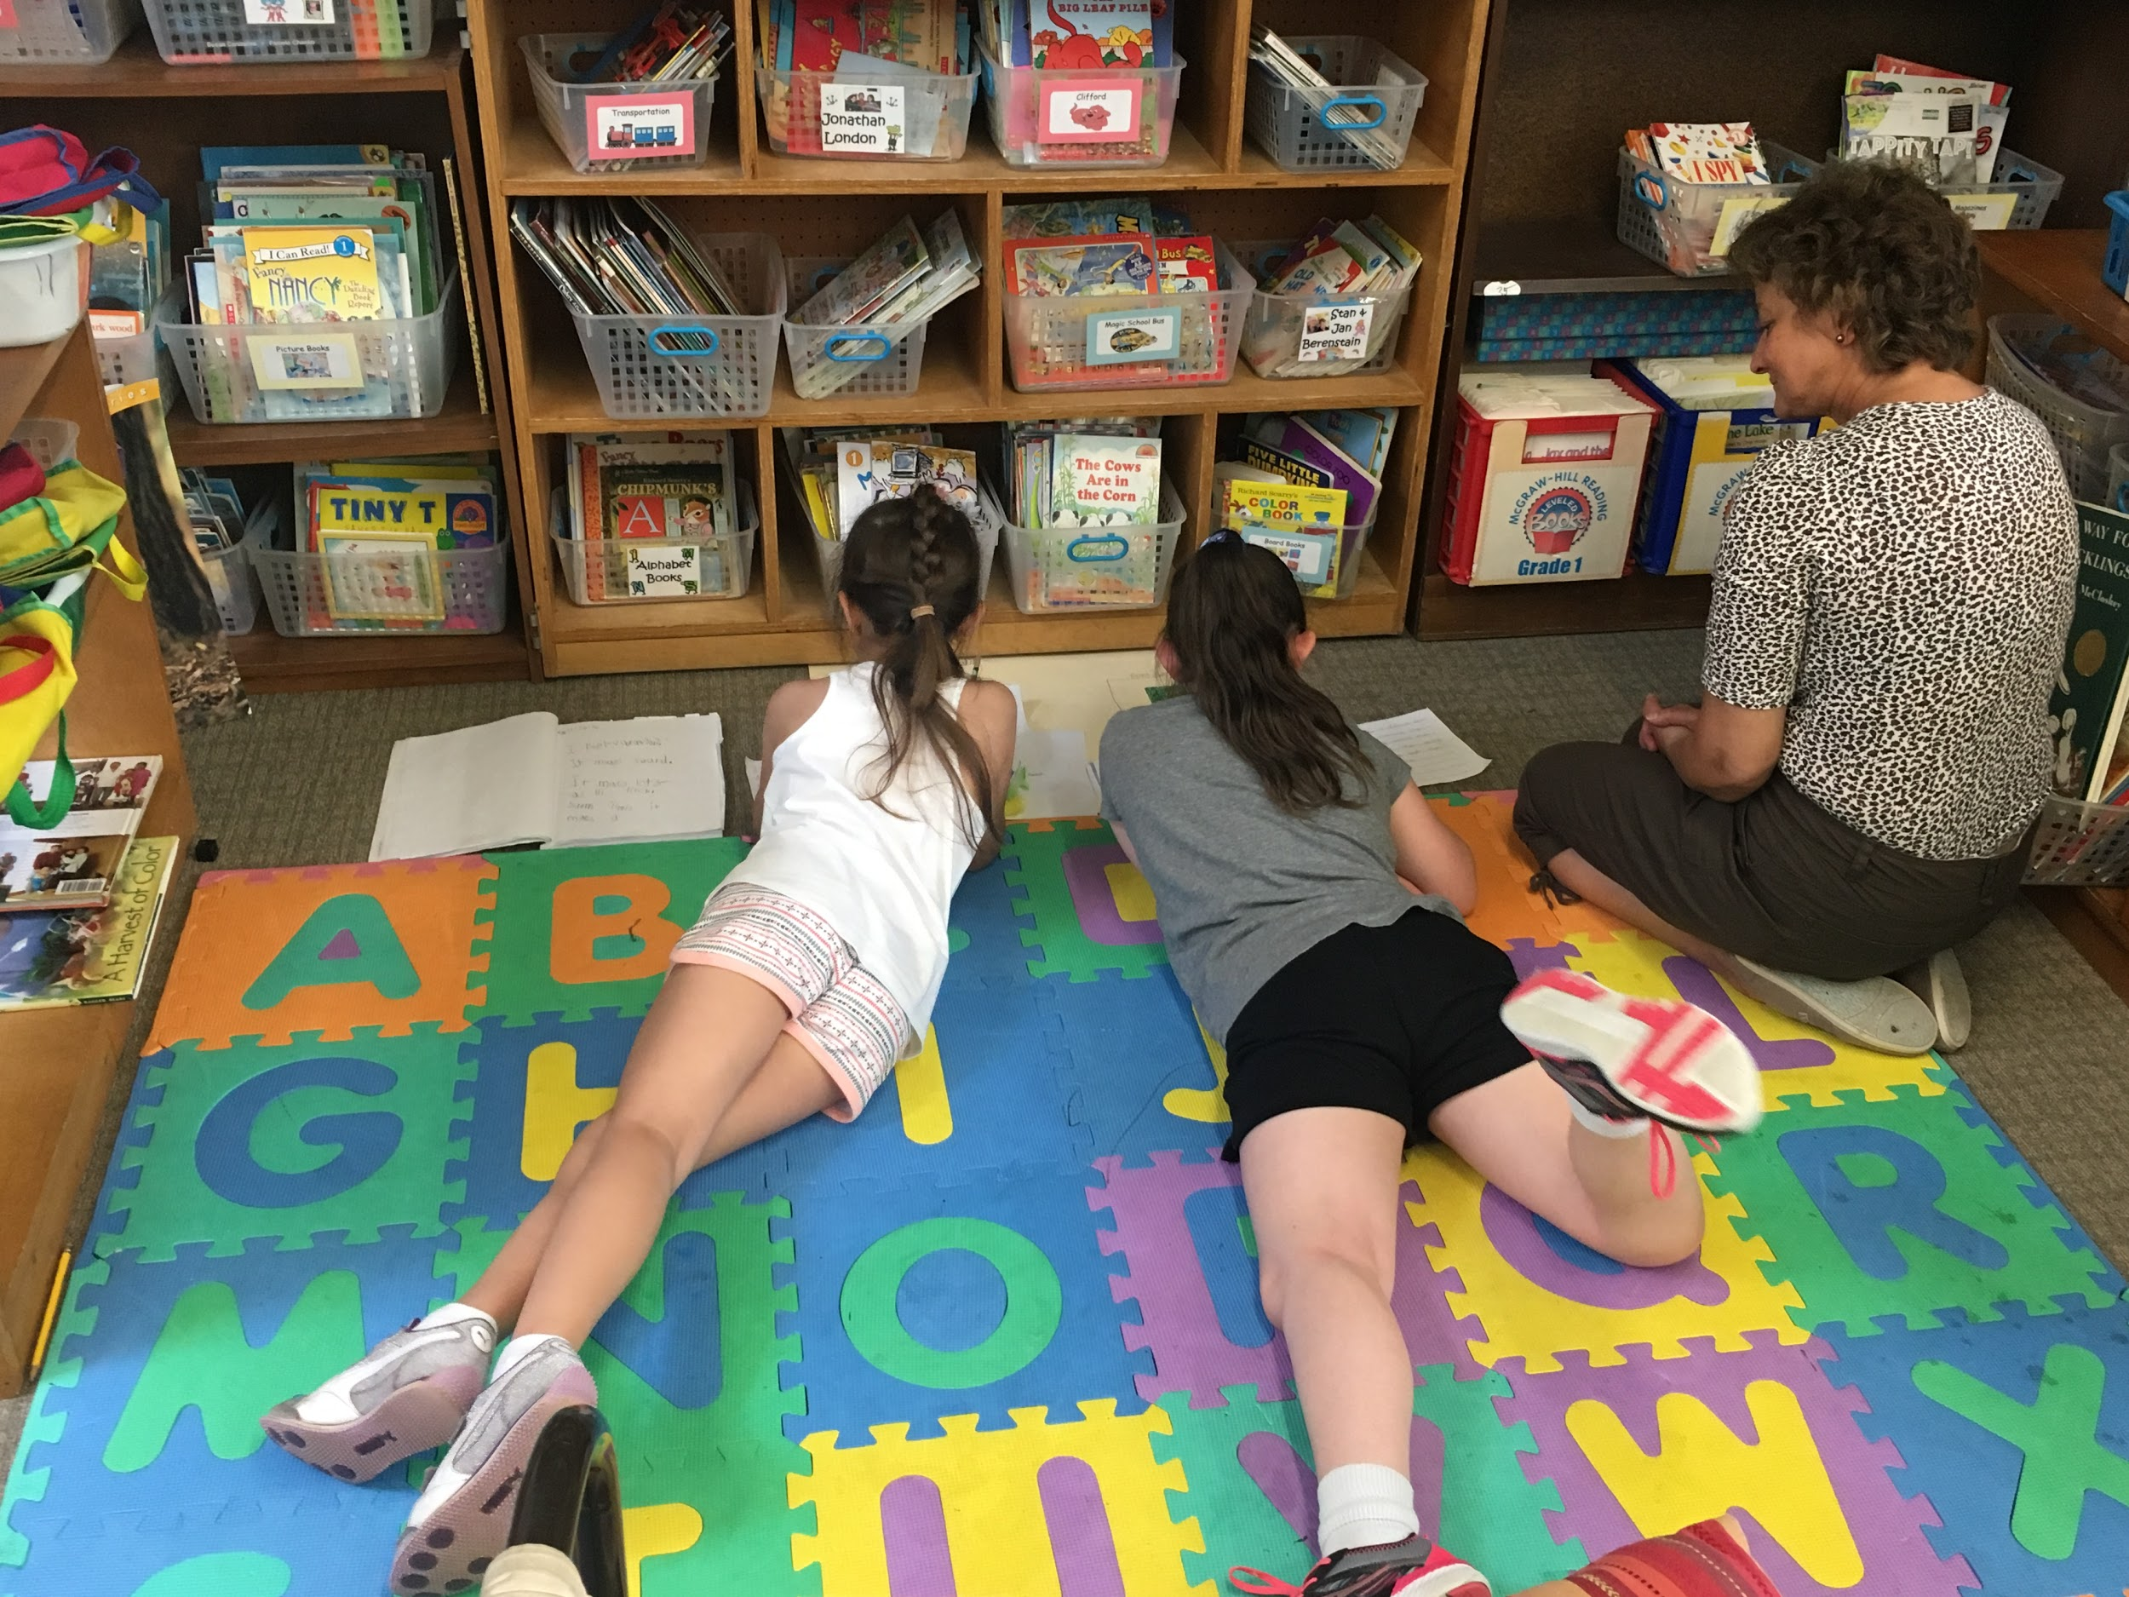
Notes:
Anna
*Refer to handout - Grade 1 Plant unit Lesson 5

Slide 12
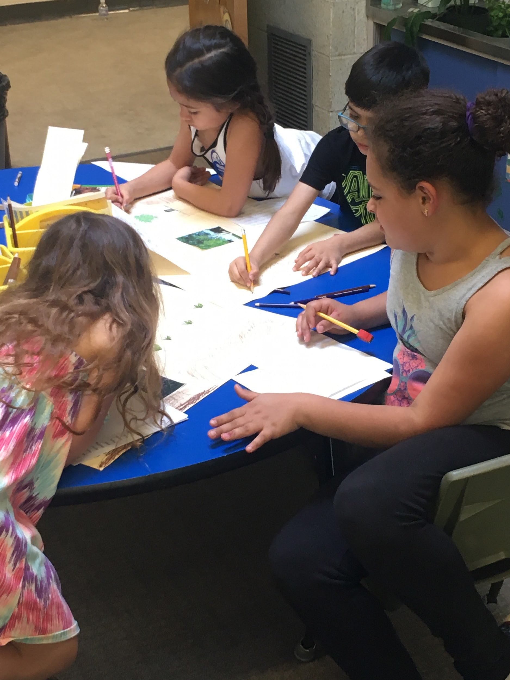
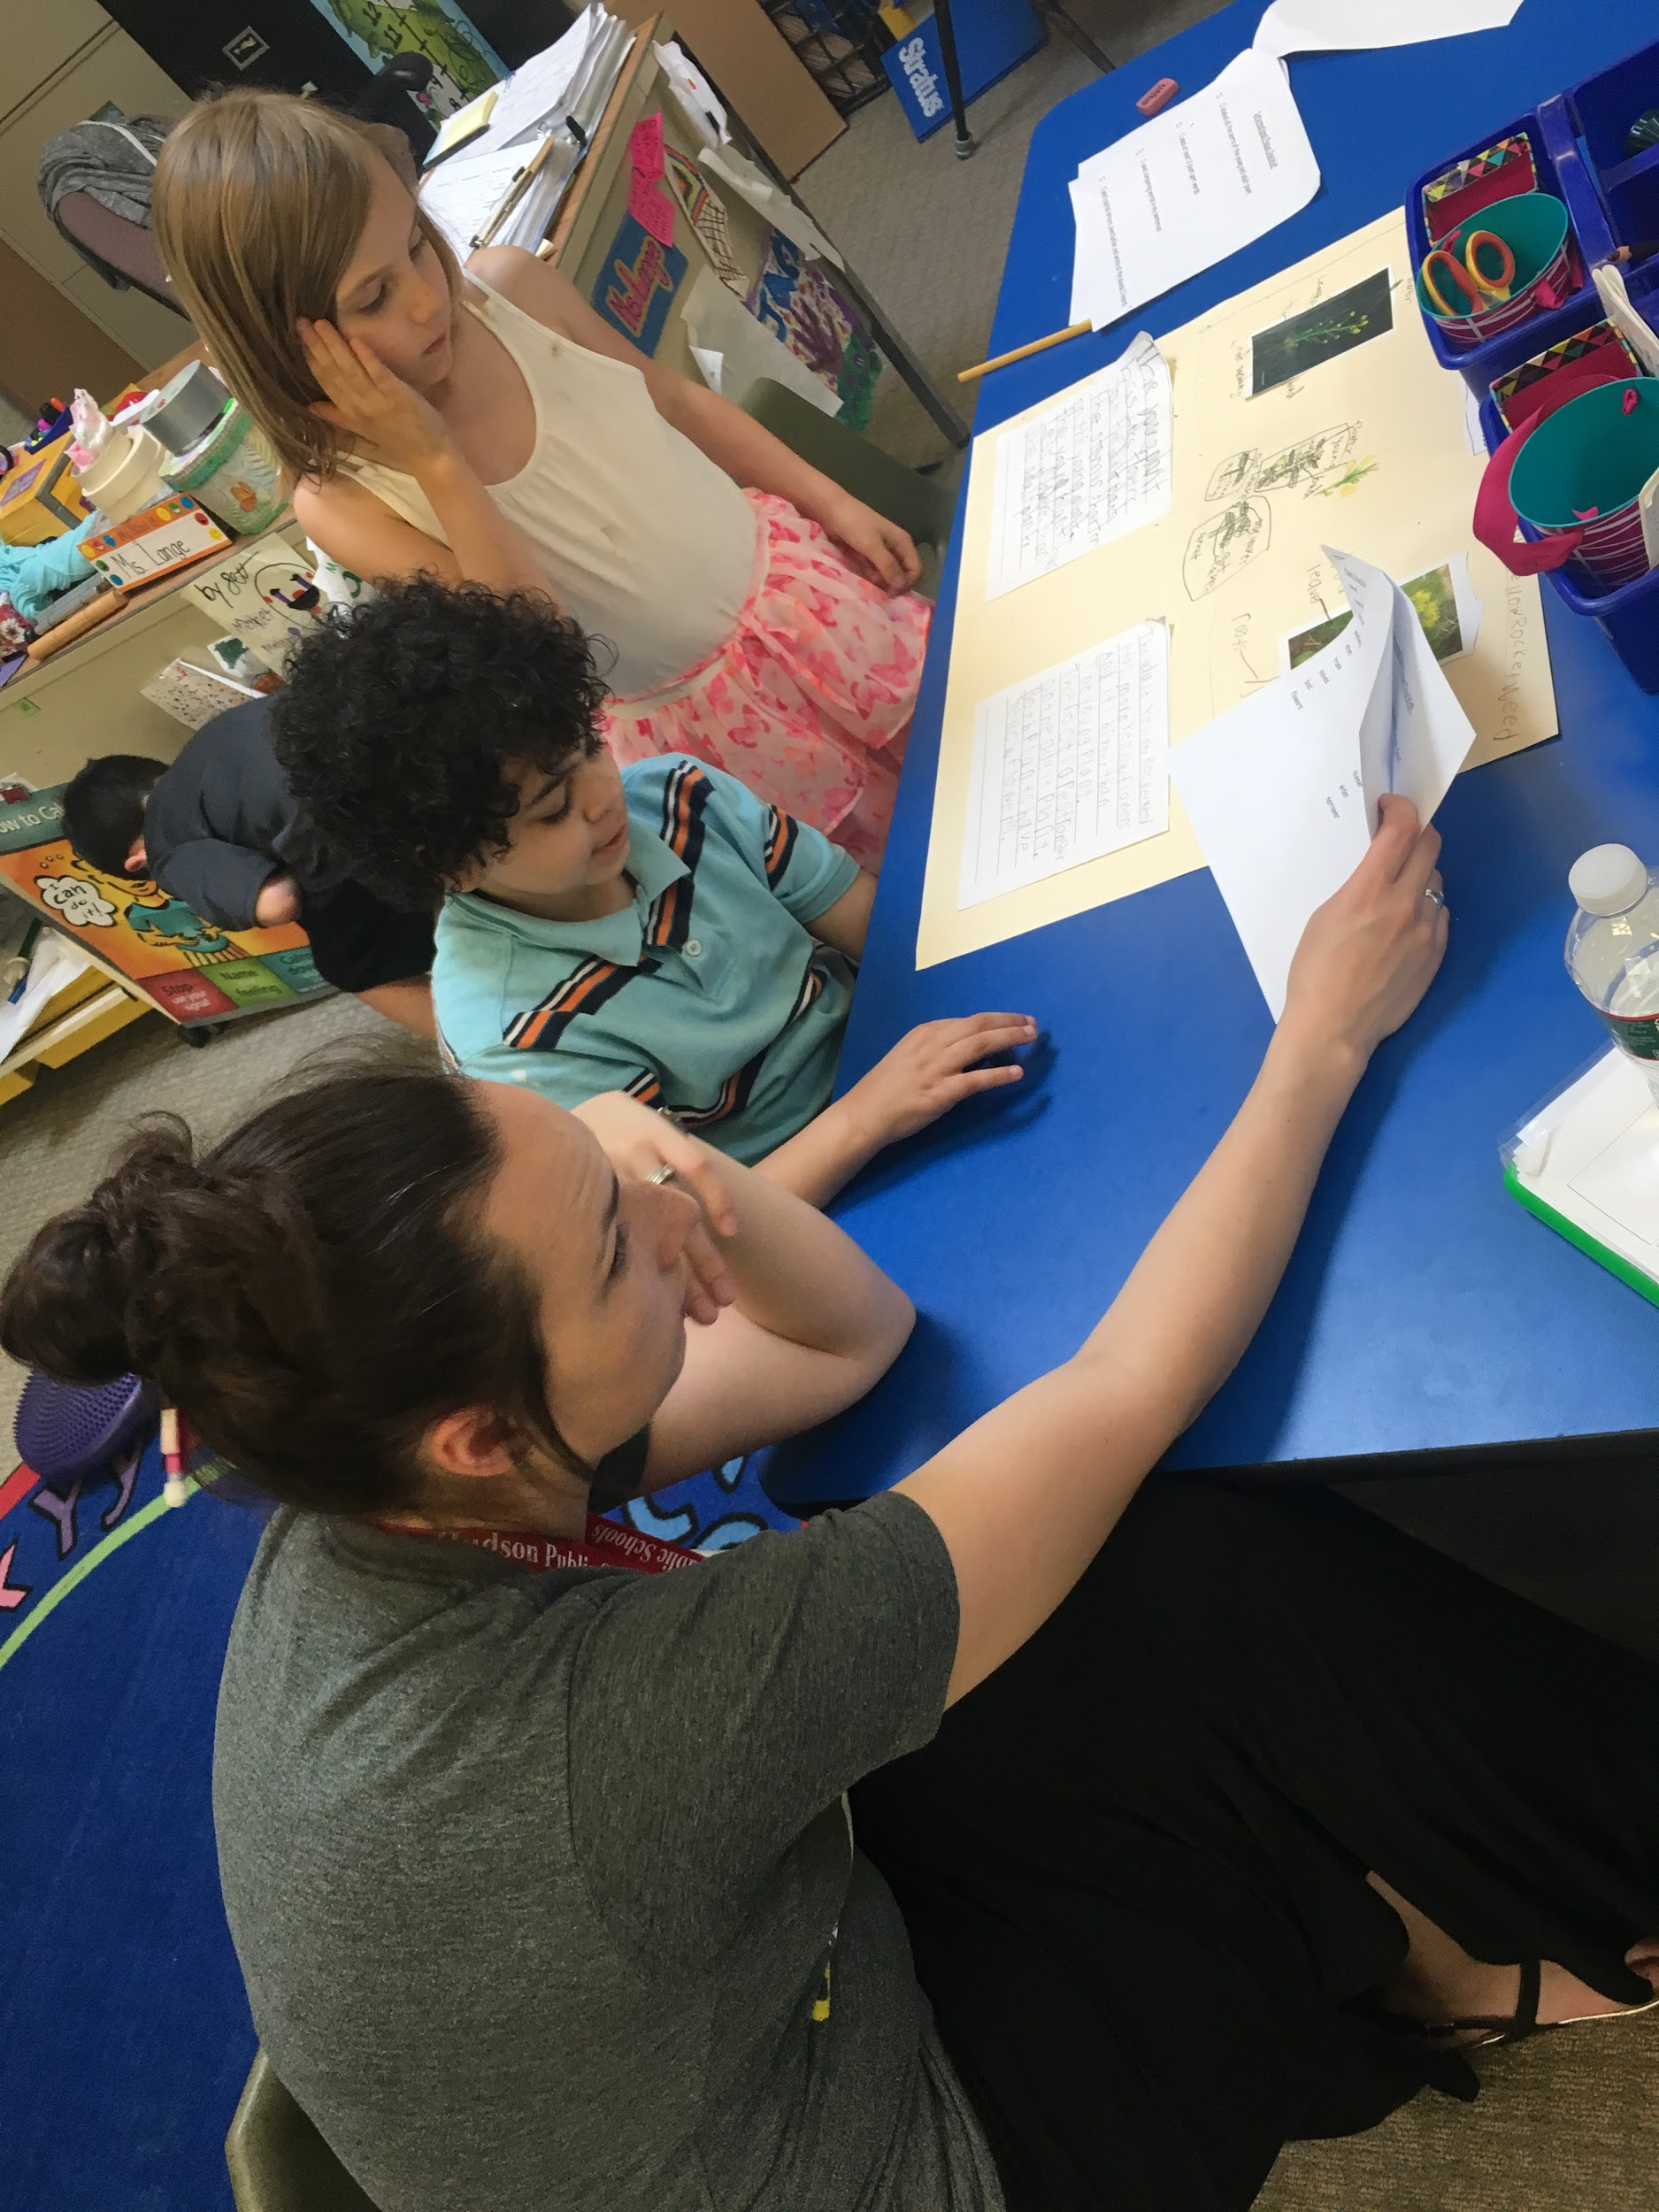
Notes:
Anna--refer to Grade 1 plants unit handout (Lesson 5)

Slide 13
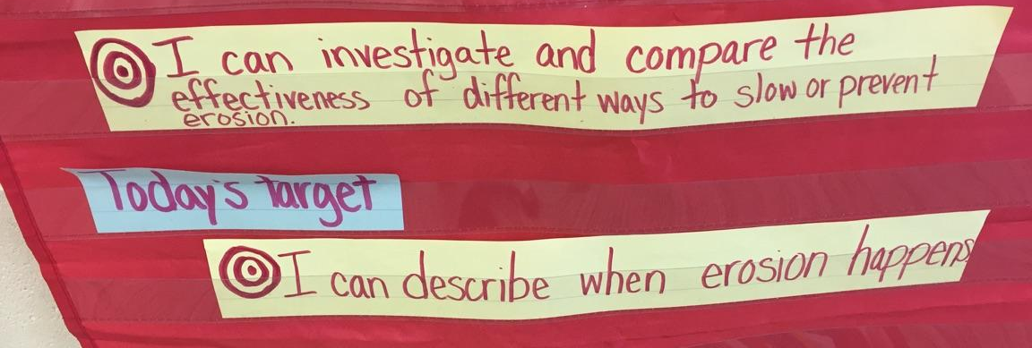
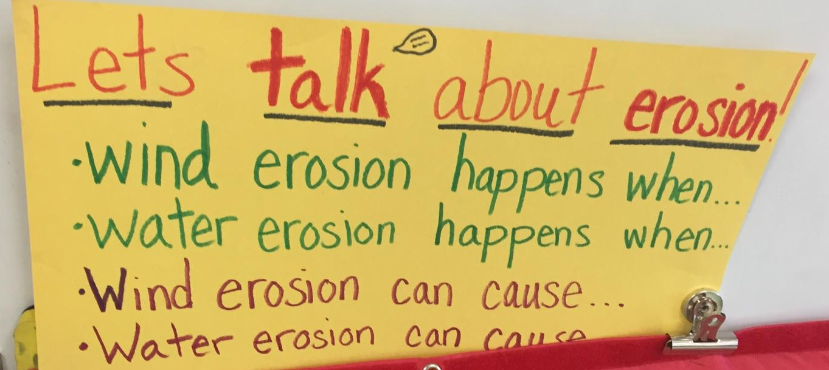
Notes:
Kim

Slide 14
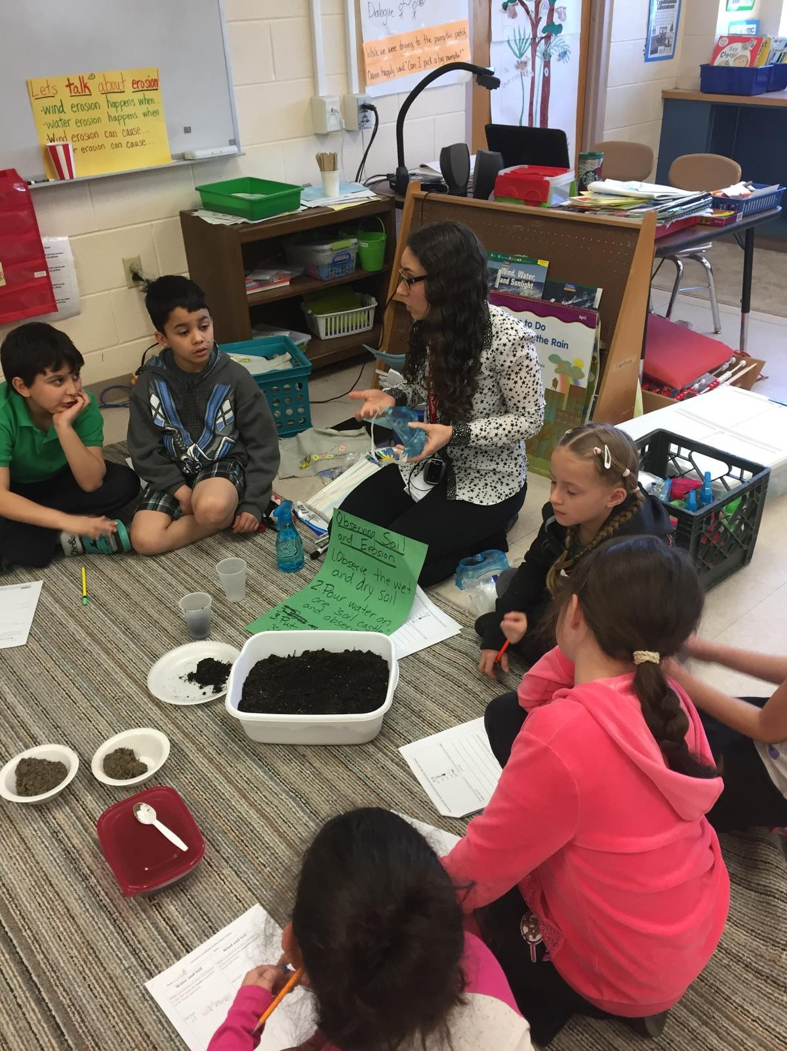
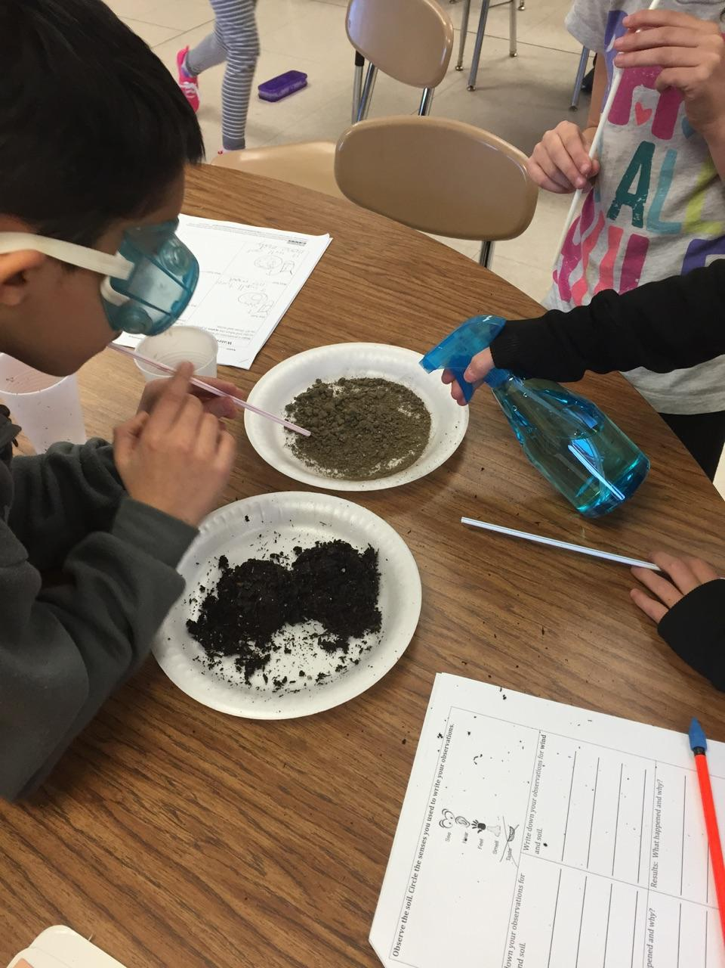
Notes:
Kim
*Potential video instead of photos

Slide 16
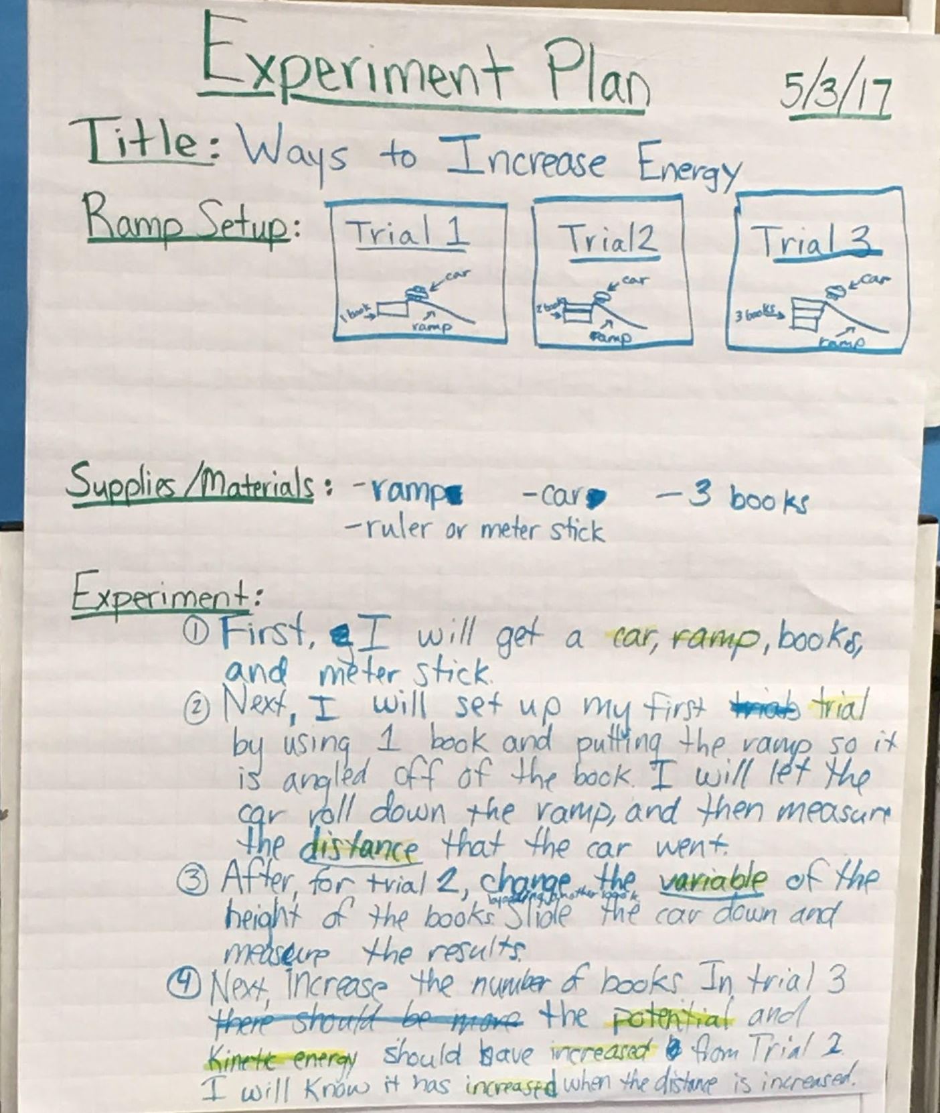
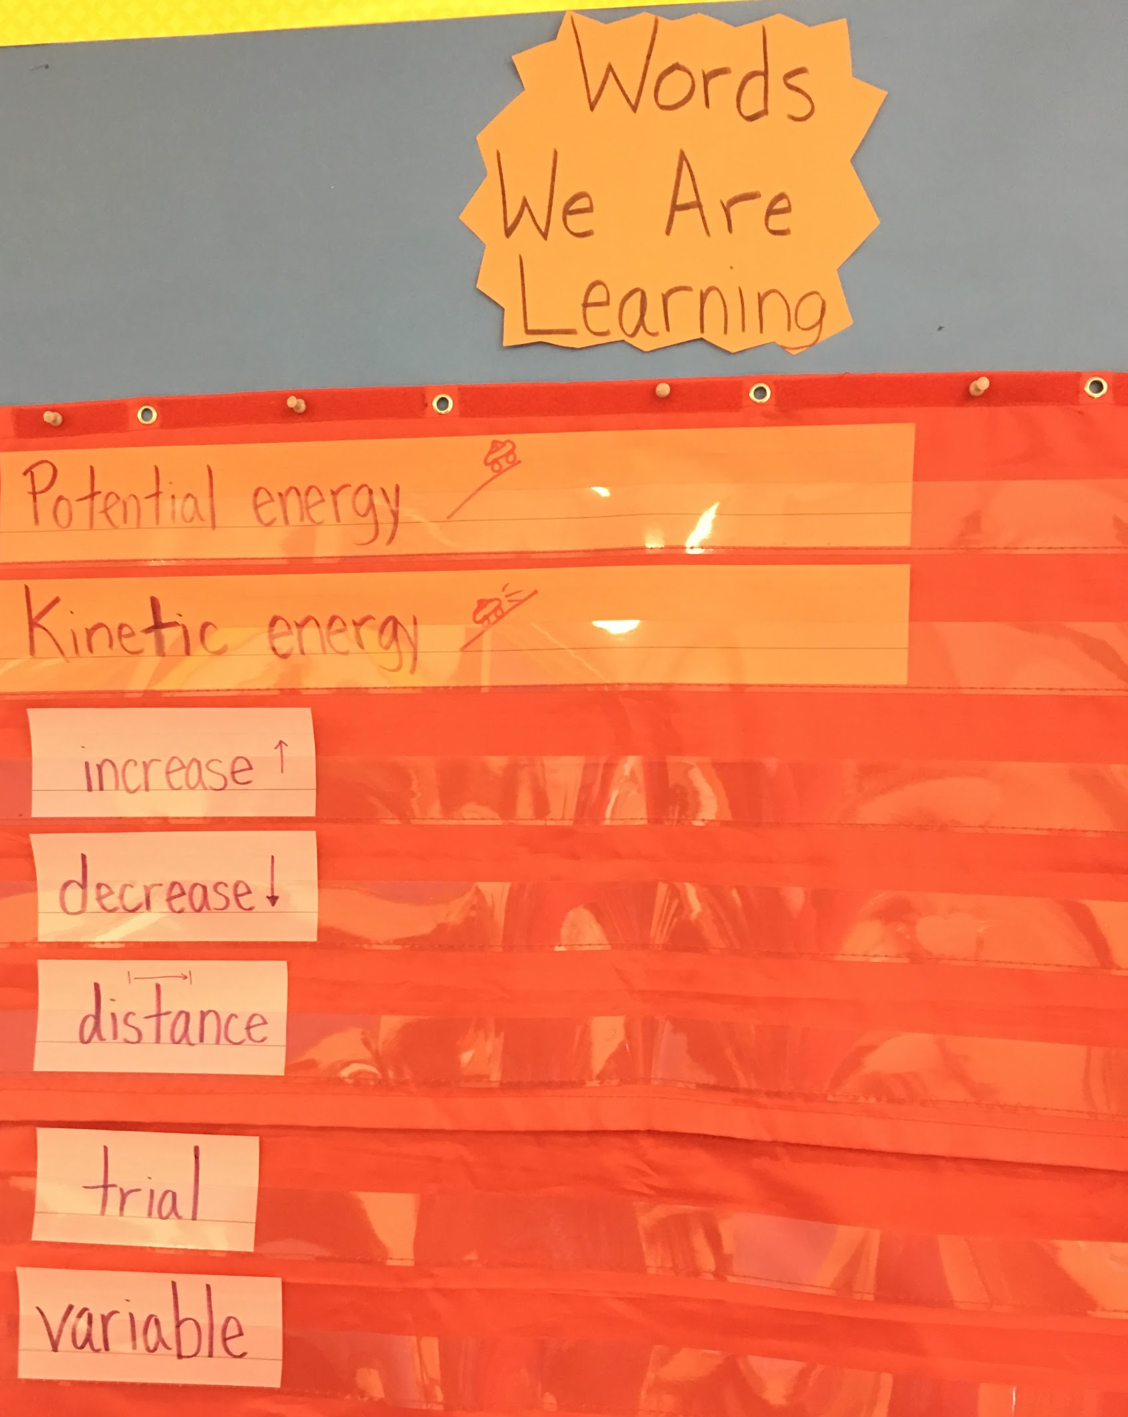
Notes:
Wendy
Grade 4 Energy/ESL unit
State standards:
--understanding how energy transfers
--science practice
Language Goals:
--”explain the engineering process in sequence to communicate experiment findings”
-- “discuss by agreeing/disagreeing in order to build on the ideas of others and articulate your own ideas”

Slide 17
Actionable Steps For Your District
Get district administration on board
Carve out time for professional development or curriculum development
Build relationships with teachers
  Trust
  Equal partners/team mentality
Get school administration on board
Ask for flexibility to try new practices
Be willing to let others be in charge/control
Take time to figure out the role of each teacher, and share the power
Spend time considering language and content, and trying to balance the two
Notes:
3:10 - 3:15
Anna

Slide 18

Questions?
Notes:
*whoever most comfortable

Slide 19
Try It
Using the action plan template, begin the steps of collaboration for your district/school.
Notes:
Wendy

Slide 20
Thank you!
Please contact us if you have any further questions!
Check out the presenter website for these materials!
Wendy Anderson - wmanderson@hudson.k12.ma.us
Kim Gaffney - kgaffney@hudson.k12.ma.us
Anna Gallo-Knight - amgalloknight@hudson.k12.ma.us
Christine Lange - celange@hudson.k12.ma.us

