Slide 1
Using Oral Language Development to Develop Academic Language
CIRCLE-ELD

Slide 2
Introductions!
Sandy Lord
MA Applied Linguistics, Boston University
Elementary ESL Teacher, Massachusetts Public Schools 2010-Present (Burlington 2015-Present)
Now you! Do we have any…
Elementary ESL Teachers?
Principals?
Middle School ESL Teachers?
ESL Department Heads?
High School ESL Teachers?
Other Teachers or Administrators?

Slide 3

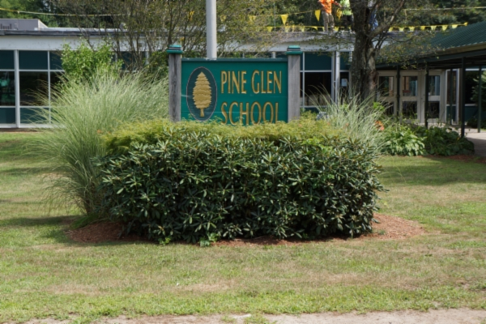
Let’s go to my classroom and meet some students…
Pine Glen Elementary, Burlington, MA

Slide 4
Kindergarten
Languages: Korean, Spanish, Luganda, Atesu, Malayalam, Tamil, Samia, Marathi, Urdu

Slide 5
First Grade
Languages: Portuguese, Hindi, Spanish, Cantonese, Urdu, Luganda, Gujurati

Slide 6
Second Grade
Languages: Korean, Urdu

Slide 7
Third Grade
Languages: Gujurati, Cantonese

Slide 8
4th and 5th Grade
Languages: Spanish, Portuguese, Amharic, Malayalam, Hindi, Luganda, Urdu

Slide 9
2 Goals for this Presentation
1. Examine the scope of the task at hand for English Learners (ELs)
2. Explore my LD curriculum CIRCLE-ELD and discover how it helps me meet the wide range of needs for ELs by seeing it in action

Slide 10
1. What is Language? Let’s look at…
The magnitude of complexity that is fluency in a language
What that magnitude means for people who do not acquire a target language from birth
What linguists recommend for the acquisition and development of a non-native target language

Slide 11
Language has 6+ overlapping, interconnected, and interdependent levels.
Mastery of each is prerequisite for fluency in a language
There is a LOT
phonetics
Let’s check these out real fast
pragmatics
phonology
semantics
morphology
syntax

Slide 12
Phonetics
Each language and dialect has a set of sounds that native speakers use
These sounds are produced by certain manipulations of the vocal tract, from the lungs to the lips
There are many more sounds in a language than you might think!
Spanish
Japanese
English
!Xoon
24
22
44
208

Slide 13
Phonology
Each language and dialect has a set of rules that inform speakers how to combine sounds.
When these sounds combine, each sound changes. Consider American English /t/. All sounds in English exhibit a similar range of possibilities!
teal
steal
sit
sitting
mountain
team
steam
bat
butter
Newton

Slide 14
Morphology
All languages combine phonemes into morphemes, which are minimal bits of encodable information
free morphemes
bound morphemes
lamp
choose
bupkis
un-
out-
-s
-[s]
-[z]
-[∂z]

Slide 15
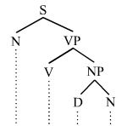
Syntax
How words are strung together to make meaningful phrases and sentences. Starting pretty simple, they get more complex QUICKLY.
To very complex!
Pretty simple…
Saanvi writes a story.

Slide 16
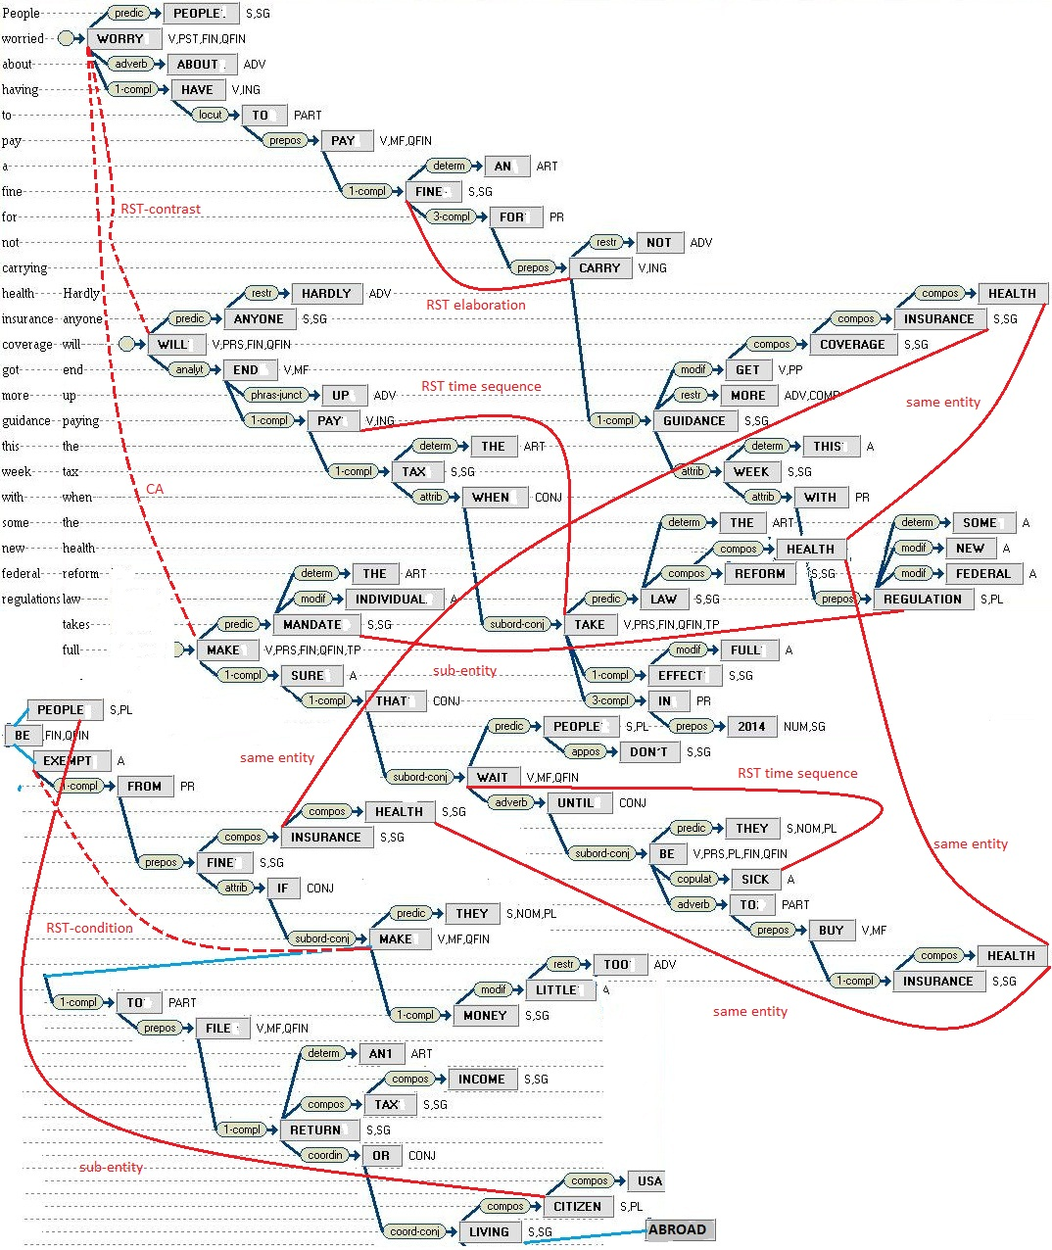
Syntax!
People worried about having to pay a fine for not carrying health insurance coverage got more guidance this week with some new federal regulations. Hardly anyone will end up paying the tax when the health reform law takes full….
https://commons.wikimedia.org/wiki/File:Parse_thicket_constructed_from_parse_trees_for_sentences.jpg#filelinks

Slide 17
Imagine how complex this 4th grader’s syntax is!
It has to be how do you say it a certain type of bear because where we live there's not like Antarctica or Alaska or like these type of caves so we have like brown bears or black bears. So in Antarctica I think in the North Pole there is a type of bear that's white but it's not really white it's just that the light reflects off the snow and into and onto the bear so it's the polar bear. I'm not so sure it lives in this cave or maybe it's just like sleeping or hibernating
20

Slide 18
Semantics
Language is not only a complex pattern but a complex pattern that provides reference and meaning to a set of conditions in the world
dog vs. a dog vs. the dog
“Oof, my dogs are barkin’ today.”
The detective dogged the criminal for a week.
“As sick as a dog” “Dog days” “raining cats and dogs”

Slide 19
Woah! That’s a lot.
Yet…
Native speaking children usually have developed complex, efficient usage of their first language by the age of 5. For example, my daughter Evelyn (now nearly 9) just after her 4th birthday:

Slide 20
This ability – strong, fluent usage – is used as the primary means of instruction in school…
From the first, nervous day of kindergarten to the sturdy steps across the stage 13 years later

Slide 21
Multiple Reasons for Lower Fluency Levels
Lower SES
Limited Access to Education
Primary language not English
Our students are those whose primary language is not English, but who often also come from lower income households with limited access to educational activities

Slide 22
How can we ensure equitable access to education for L1?
The field has 2 main observations
1. Oral language is foundational to access all curricula
2. Continued L1 development is critical to L2 development

Slide 23
Oral Language Development Recommendations

Slide 24
Opportunities for practice (output and interaction) are necessary to get feedback and automatize language.
(Swain, 1985; Long, 1996; Gass, 1997)
(WIDA, 2014)
Oral Language Development Research

Slide 25
ELs who have had ample opportunity for oral rehearsal and interaction with native speakers in multiple contexts are far more equipped to reach higher levels of written discourse than ELs who have had fewer opportunities to do so.
(Williams & Roberts, 2011)
Oral Language Development Research

Slide 26
Well developed oral proficiency in English is associated with well-developed reading comprehension skills and writing skills in English.
(August, 2008)
Oral Language Development Research

Slide 27
For ELLs especially, oral language is foundational to literacy development.
(August & Shanahan, 2006)
Oral Language Development Research

Slide 28
I wanted a curriculum that lets all my students have consistent opportunities to develop strong, academic oral language
6 grade levels
6 proficiency levels
15+ home languages and 30 students
students on IEPs and 504 plans
- and a million scheduling conflicts that mean having a full class consistently is unlikely

Slide 29

So I made CIRCLE-ELD for my elementary English Learners (ELs)
www.circle-eld.org

Slide 30
Give Students the Means to Have Meaningful, Sustained Oral Interaction
Lower affective filters
Provide ample practice time
Increase awareness that all contributions are important
Extend individual, meaningful speech events
Model enthusiastic speaking and listening
Provide students with something they want to talk about and that is academically relevant across all 5 standards

Slide 31
CIRCLE-ELD
A picture is worth a thousand words….
CIRCLE-ELD helps students reverse that and get a thousand words out of a picture!

Slide 32
Now you! Look at the following pictures and have a quick conversation with your table mates.
Any and all Questions, Comments and Observations are great!

Slide 33
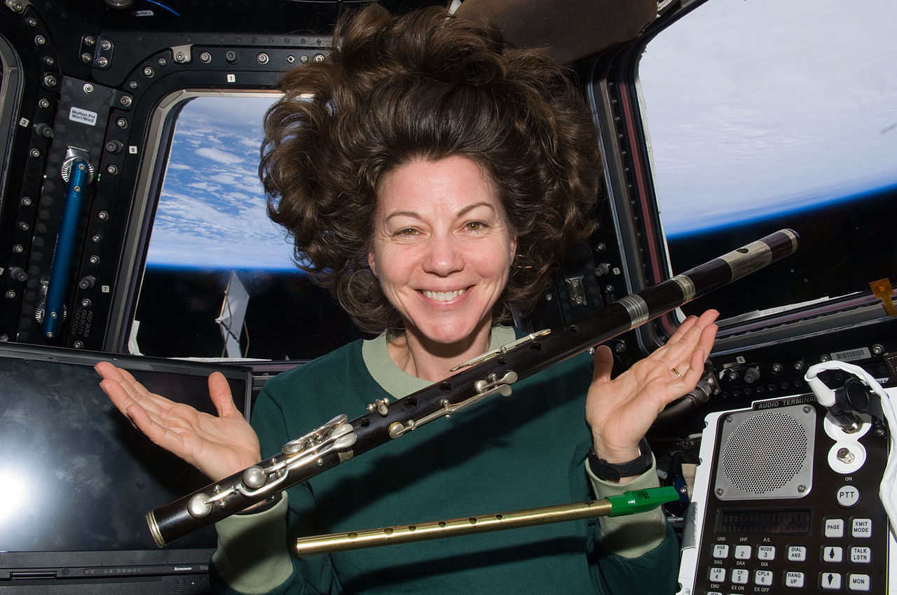
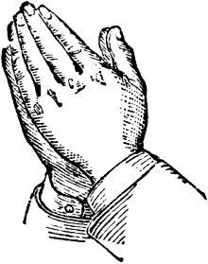
flute

Slide 34
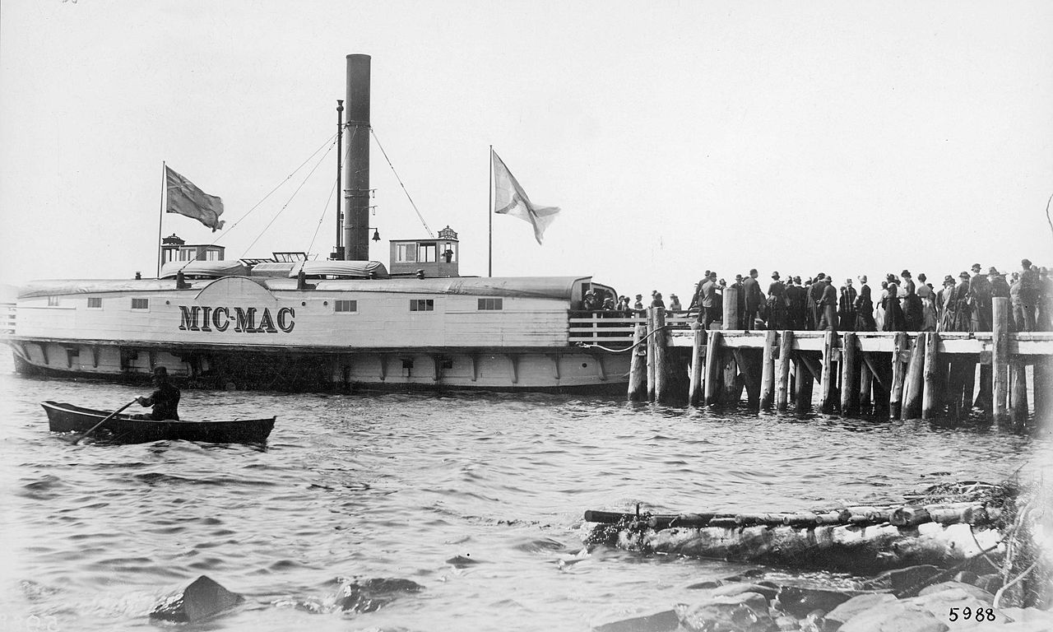
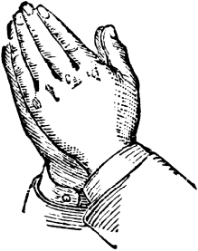

ferry
Notes:
34

Slide 35


crimson

Slide 36
CIRCLE-ELD:
21+ completed themes
Wide variety of academic topics
Body
Color
Electricity
Fall
Farm
House
Music
Number
Past and Present
Plants
Police and Fire
School
Space
Sports
Tools
Transportation
Water
Weather and Atmosphere
Winter
World Culture

Slide 37
We begin each class by coming together
CIRCLE-ELD’s Activity Wheel
Spinner of the Day spins the wheel and chooses an activity
Students come from as many as 4 different classes
The Activity Wheel provides a chance for students to exercise, stretch out, and be themselves for 6-8 minutes
And there’s more than a little language involved too

Slide 38
Each theme has…
20 vocabulary words of varying complexity.
40 amazing images, 2 per word, of diverse people and places
2 Academic Language sentences for each image
2 Language of…Questions tied to the 5 WIDA Standards for each image
10 Digital or Printed Interactive Worksheets accessible on any platform
Student Teacher day, a chance for the students to shine on their own and be leaders

Slide 39
Even more importantly…
Non-timed “Questions, Comments, and Observations”
Students say whatever they want, as long as they are not being intentionally inappropriate
                Really, anything they want. Ninjas and gorillas and puppies are frequently running all around.
All students are required to be listening and respectful

Slide 40
Let’s Check Out the Water Theme First

Slide 41
Go to
www.circle-eld.org
on whatever device you have

Slide 42
Click on
Open CIRCLE-ELD
at the top
and scroll down to
Water

Slide 43
I’ll join you there now…

Slide 44
But enough for us, let’s watch my students in action
The kids and I are looking at and discussing various HUGE pictures
Some of their comments are in response to my questions, many are their own unique observations
If you hear loud background noise, it is because my room was in the cafeteria!
A SMALL SAMPLE OF WHAT WE DO MOST OF THE DAY EVERY DAY

Slide 45
Kindergarten

Slide 46
Kindergarten

Slide 47
First Grade

Slide 48
Second Grade

Slide 49
Third Grade

Slide 50
4th and 5th Grade

Slide 51
These students are free, eager and confident
We see that the students are thriving in a language-rich academic environment
Students use the language of Science, Social Studies, Math and Language Arts, and Social and Instructional Language
How does that translate as success in the classroom?

Slide 52
Let’s hear from a 5th grade student who has appreciated the CIRCLE-ELD curriculum and classroom. Her confidence in using English has spread beyond the CIRCLE-ELD classroom, as the research suggests it should.

Slide 54
This young lady’s confidence in using English directly stems from her comfort with language associated with all standards.
She is able to extend her linguistic confidence to Math and beyond.
My job is to get her ready to succeed in all academic environments.

Slide 55
With 21 themes and 13 days per theme and 2 tiers per theme, CIRCLE-ELD will give you 546 unique language filled days with your ELs.

Slide 56
Work with parents and caregivers to keep language development going in the afternoon and evening too!

Slide 57
In development for each theme are the parent and caregiver presentations. Whether in English or L1, parental involvement is crucial.

Slide 58
Continued L1 Development Recommendations

Slide 59
…development of a students’ first language can facilitate development in the 2nd language
(Genessee, Geva, Dressler, and Kamil, 2007)
(Guccione, 2012)
Continued L1 Development

Slide 60
Among ELLs, both L1 vocabulary and L2 vocabulary contribute to English reading comprehension
(Carlisle, Beeman, Davis, & Spharim, 1999; Proctor, Carlo, August & Snow, 2005; Ford 2005)
Continued L1 Development

Slide 61
…phonological awareness skills developed in L1 transfer to L2 and facilitates L2 literacy development
(WIDA 2014)
Continued L1 Development

Slide 62
Cognitive and academic development in one’s first language has been found to contribute positively in second-language learning.
(Bialystock, 1991; Collier, 1989, 1992; Garcia, 1994; Genessee, 1987, 1994; Thomas & Collier, 1997)
Continued L1 Development

Slide 63
Quick Thank You!
Thank you to my new and old colleagues in Taunton and Burlington.
Thank you to MATSOL for allowing me to speak today.
A special Thank you to my mentor and friend Mary Wohler, for taking a calculated risk on a new idea :)

Slide 64
Thank you for coming!
Please use CIRCLE-ELD and let me know how it goes!
www.circle-eld.org

