Slide 1



The Key to Advancing Change is Building an Effective Network
Jane Donohue, The Deaconess Foundation
Allison Williams, Wyman Center
Clark McCain, The Coleman Foundation

Slide 2

Let the challenge begin

Slide 3
Session Overview
Examine 4 Success Factors from 2 Network Models
Discuss Lessons Learned at Different Points during a Network’s Lifecycle
Understand Role Funders Can Play in Networks

Slide 4
Four Success Factors
Intentional Process
Focus on Relationships
Building Momentum Through Action
Engaging All Levels

Slide 5

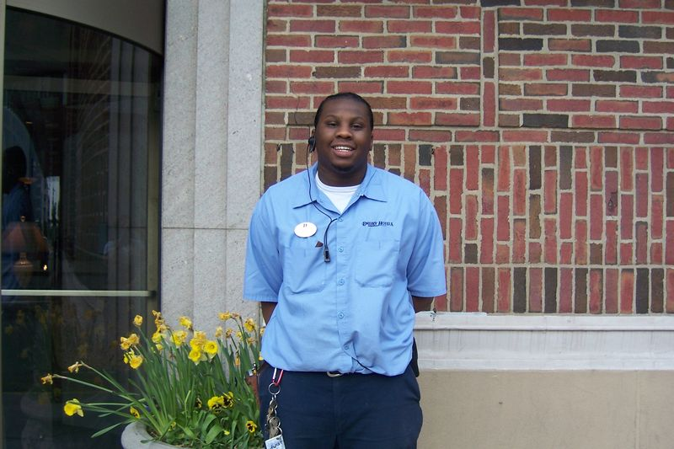
THE REAL STORY

Slide 6

Develop Vision
Big Goal:
50% of Adults in the St. Louis Region Have a Postsecondary Degree by 2020
Moving the Needle: St. Louis will need a 15% increase in postsecondary degree attainment between
2009 and 2020
Notes:
How to get to that
How people shared vision
Timeline rught level of stakeoldres at right time
Guided process
Stair step
Tool pr0cess – how to get to alignment
Essential compones
Intentionality
Factors of success--

Slide 7
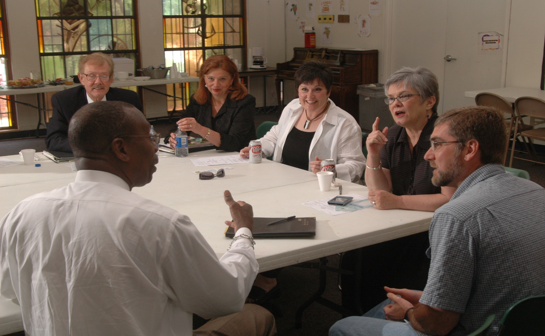

SADDLED BY OLD STORIES
We tried that already….
You’ll Never Get those two to work together
The Business Community Won’t Come to The Table…
The economy&#!
We don’t have the right leaders in place…

Slide 8

“…too hard to try here…”
SADDLED BY OLD STORIES
More than 100 high schools in the region; 51 school districts
Two states; rural & urban
Rotating superintendents
New field; lack of data
Storytelling over data
Funders’ needs trump some common sense

Slide 9
WRITING A NEW STORY
…new theories…
“…much of the knowledge and experience grantmakers need to solve the problems they want to solve resides in the communities they serve…” Do Nothing Without Me, GEO/IISC 2009
“…high impact organizations help the competition succeed, building networks of nonprofit allies and devoting remarkable time and energy to advancing the larger field.”
Forces for Good, 2008
“Greater progress could be made in alleviating many of our most serious and complex social problems if nonprofits, governments, businesses, and the public were brought together around a common agenda to create collective impact.” SSIR, 2010
Notes:
REFER PEOPLE TO THE NURTURE NONPROFIT CHART HANDOUT

Slide 10
THE JOURNEY
The coffee shop
Learning and exploring the issue
Setting a vision
Identifying common concerns
Building trust with patient, exploratory conversations
50% degree attainment by 2020
Gathering the data
Community Forum
Call for involvement
“Building Better Futures”
300+ community members
Opportunities to self-select areas of interest

Slide 11

THE JOURNEY
Creating the plan
Implementation
Engagement across levels; rooted in data and best practices
Sequencing, further engagement of critical partners
Beginning efforts
Small, meaningful action steps

Slide 12
Intentional Process
Rooted in Data & Best Practices
SUCCESS FACTORS
SUCCESS FACTORS
12 • 24 •
Metro Area | Degree Rank | Income Rank
Washington, DC | 1 | 2
San Jose | 2 | 1
Baltimore | 11 | 7
Kansas City | 16 | 22
Indianapolis | 18 | 24
St. Louis | 24 | 27
College As a Goal
Affordability
Persistence to Graduation
Academic Preparation
College-Going Climate
Navigating the Process
Research shows “what it takes”
Notes:
Also to discuss how strategies suggested in the community plan were vetted to ensure they followed what research showed was best practice. Tool to share = Strategy Matrix Sheet

Slide 13
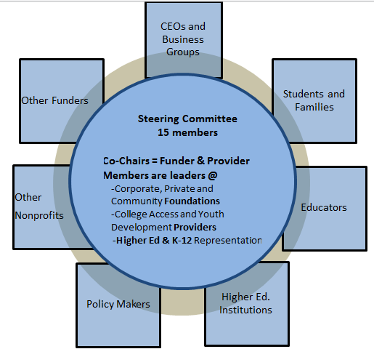
Intentional Process
Multiple Sectors/Balanced Power
SUCCESS FACTORS
FACTORS
St. Louis Graduates Steering Committee
Notes:
Emphasize funder / provider dynamic both as part of steering committee as well as all the community planning work groups
Here will refer people to the steering committee description we distribute

Slide 14

Focus On Relationships
SUCCESS FACTORS
Spending time together
Honoring group norms
Modeling the way
Keeping org. agendas in check
Appreciating complementary capacities
Wearing two hats
Notes:
Recognition that organizations and people are at different points in the continuum (i.e. give examples of various providers in our network – each with some similarities, but also differing competency sets); believing the idea that the group is “smarter” than the individual;
Wearing Two Hats
Appreciation of maximizing complementary capacitities

Slide 15
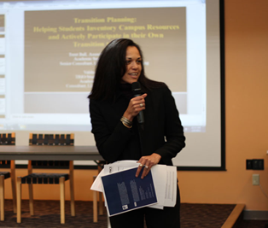
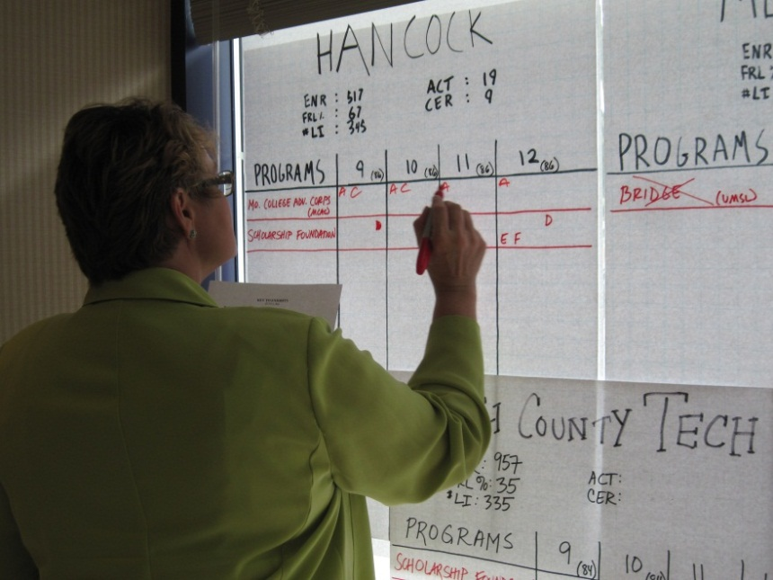
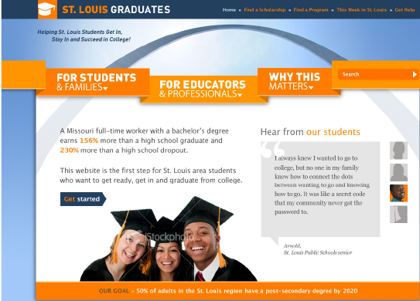
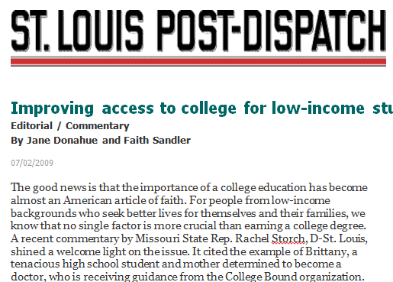
Building Momentum Through Action
SUCCESS FACTORS

Slide 16
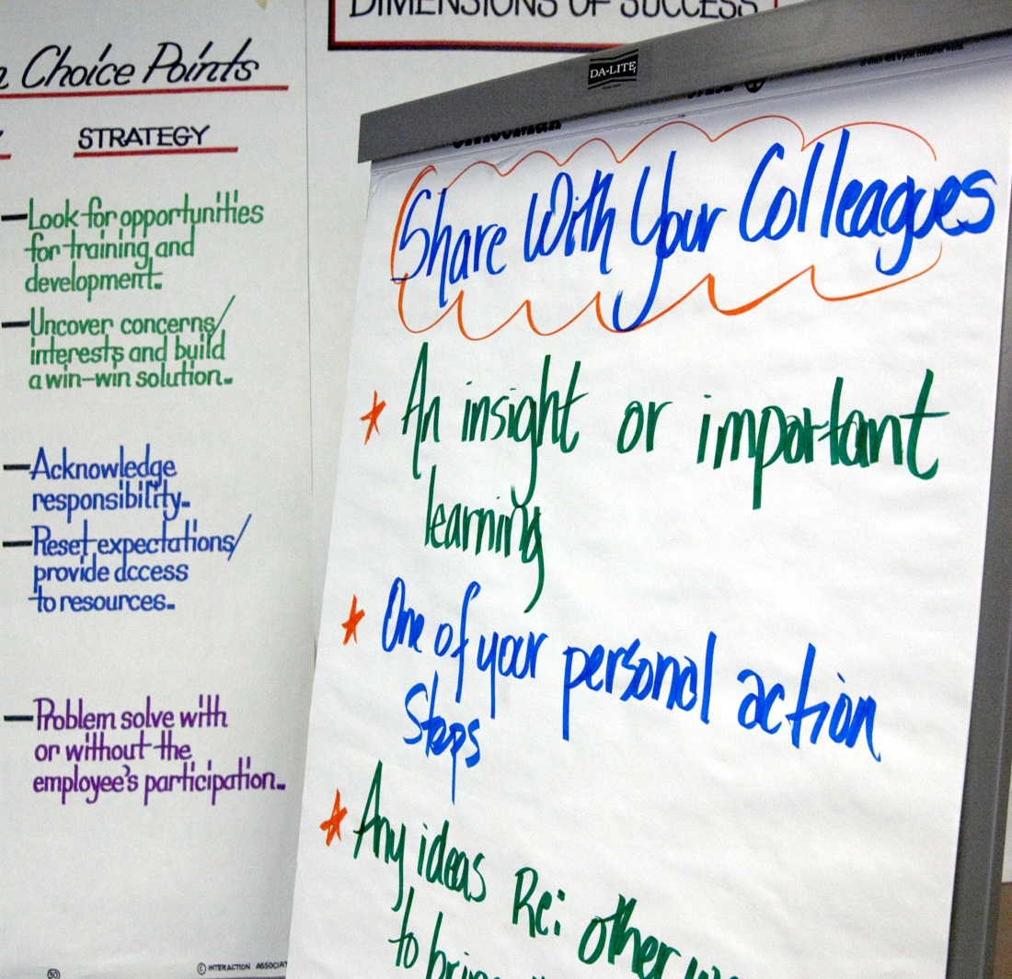
Engaging All Levels
SUCCESS FACTORS
Slide will
Peer exchanges for frontline staff
Directory of scholarships for students

Slide 17
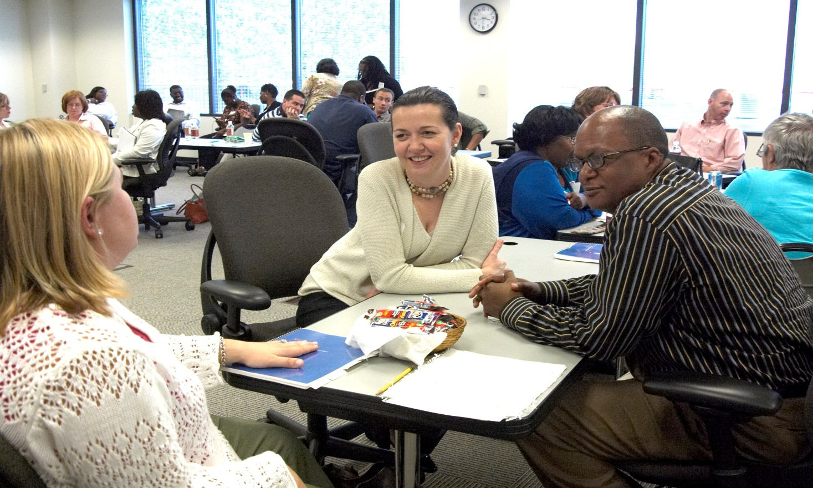
Engaging All Levels
SUCCESS FACTORS
CEOS + Students + Guidance Counselors + Deans + Superintendents + Policymakers + Youth Development Staff + Foundation Officers + Parents + Employers =
A REGIONAL PLAN
Notes:
REFER TO COMMUNITY PLAN WHICH WE HAVE PLENTY TO DISTRIBUTE

Slide 18










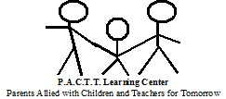


Intersect for Ability
THE JOURNEY
A collaborative network of twelve agencies located in the Chicago Metropolitan area that serve individuals with developmental disabilities.

Slide 19
THE JOURNEY
<Intersect for Ability video>

Slide 20

Demonstration projects, System Supports and Network Development
THE JOURNEY
Demonstration
Projects
Network
Development
System Support
Members Lead Collaborative Programs Targeting:
Staff Training and Retention
Lifestage Transitions
Community Employment
Required Engagement by Network Partners:
Network Council
Joint Priority Development
Guiding Principles
Levels of Collaboration
Annual Conference
Managing Partner Delivers Required Supports:
Organizational Assessment
Program Evaluation
Technical Assistance
Communications

Slide 21
Intentional Process
Managing Partner Role
SUCCESS FACTORS
SUCCESS FACTORS
Experience in disabilities and network development
Intentional network weaving
Neutral third-party for navigating areas of conflict
12 • 24 •
Notes:
Add the

Slide 22
Intentional Process
Defined Levels of Collaboration
SUCCESS FACTORS
FACTORS
Level of Collaboration
Full Partner
Secondary Partner
Shadow Partner
Observation
No Involvement
Notes:
Helped member organizations begin to conceive of what collaboration meant in practice
All partners sign grant agreement
MOUs among partners

Slide 23
Intentional Process
Defined Levels of Collaboration
SUCCESS FACTORS
Full partner - Leadership:
“Share equal responsibility for execution of proposed program…”
Secondary partner - Support:
“Not responsible for execution but allocates staff/resources to provide services/products to advance overall objectives…”
Shadow partner – Future replication:
“Will allocate staff to participate in training, consultation and development…”

Slide 24
Building Momentum Through Action
SUCCESS FACTORS
Joint priority development
  “We’ll fund it if you all agree it is important”
Baptism by fire of proposal writing
  “10 partners, 7 weeks”
5 initial projects spanning organizations and levels

Slide 25
Focus On Relationships
SUCCESS FACTORS
Monthly meetings of Network Council
Facilitated by Managing Partner
Hosted by members
Preceded by facility tours
Once baseline of trust established, relationships must develop organically through actual collaborative work

Slide 26

Engaging All Levels
SUCCESS FACTORS
Many job types from Executive Directors to program leads
  “Mix” adds perspective on planning as well as credibility for those who need to seek “permission”

Slide 27

Funders’ Role in Networks
LESSONS LEARNED
960 sandwiches
Creating Connections
Influencing Peers
Staying the Course
Redefining
Expectations

Slide 28
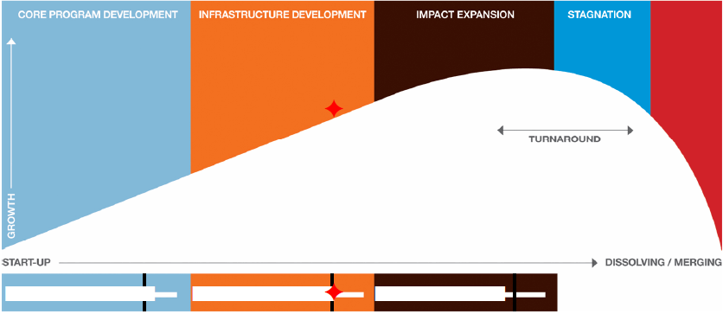
What Makes a Nonprofit Ready?
LESSONS LEARNED
Lifecycle Matters
Some Degree of Discretionary Time/$
Source: TCC Group

Slide 29
Future Challenges…
LESSONS LEARNED
Community Plan IS NOT a Strategic Plan. Implementation and accountability are collective responsibilities
Identifying the right “home” for a network is an evolving process
Success can spark desire for one organization to “own” the initiative
Funding Conundrum: Don’t Want to Siphen funds from direct services
Notes:
Here will have functions tool to pass out as a means of showing how STL Graduates is deciding whether or not to embed project across different agencies

Slide 30
Funders’ Role in Networks
LESSONS LEARNED
Loose Governance versus Tight
  Grantees need opportunity to learn how to self-organize for collaboration
  Foundations must find balance between guiding / framing and empowering grantees to design
“Trust develops through collaboration as intense as this.”

Slide 31
Four Success Factors
Intentional Process
Focus on Relationships
Building Momentum Through Action
Engaging All Levels

Slide 32
Closing Thought From a ‘Thought Leader…’
“Success happens when you get people together who represent different areas; you want people who have different thoughts; you want people who are passionate and willing to stand for their principles….Those are the best people for this endeavor….”
--L.Kass, Casting Director for Survivor and Dancing with the Stars….
Notes:
This is an attempt at some humor at the end…I heard this person being interviewed, and thought, wow, this person understands the dynamics of collective impact…only to learn at the end of the interview that she is the Casting Director for reality TV shows….

