Slide 1




Inside the Collaborative Classroom
Culturally Responsive Instruction:
Fostering Student Collaboration in Writing

Slide 2


The Center for the Collaborative Classroom
is a nonprofit organization dedicated to students’ growth as critical thinkers who learn from, care for, and respect one another.

Slide 3
How we teach matters as much as what we teach.
Fostering caring relationships and building inclusive and safe environments are foundational practices for both the student and adult learning communities.
Classroom learning experiences should be built around students constructing knowledge and engaging in action.
Honoring and building on students’ intrinsic motivation lead to engagement and achievement.
The social and academic curricula are interdependent and integrated.

Slide 4

Sometimes we...
Over-scaffold in oral and written language.
Take away the students’ opportunity to do the first thinking.
Miss opportunities to facilitate the “struggle” necessary for student learning.
Speak more than listen.
Lack a sense of wonder into our students’ thinking.

Slide 5
What does learning feel like when given a chance to:
think, wonder, and “struggle” with a text?
create meaning in a situation void of a right or wrong answer?
What does writing feel like when given a chance to:
talk about an idea before writing about it?
create a meaningful text before editing?

Slide 6
Experiencing the work as adult learners
Puts you in the role of your students
Helps you understand the work we ask students to do
Makes you aware of your feelings and the effects on the learning
Elevates your commitment to change
Jenni Iwanski, “The Instructor’s Balancing Act”
Excepted from June 2014, Journal of Staff Development

Slide 7


Lesson Experience
“Chanclas”

Slide 8
Personal Narrative Unit – Day 1
In this lesson, the students...
Writing Focus
• Hear and discuss a personal narrative
• Quick-write about early memories
• Write freely about things that interest them
Social Focus
Work with new partners

Slide 9
Getting Reading to Write
Learning from published authors.
“Chanclas”
from The House on Mango Street
by Sandra Cisneros
Quick Write
If you were to write a story about your own life, what memories could you write about?

Slide 10
Writing Time
Write about an early memory.
Remember…Double space your writing. Writers need quiet time to think so there should be no talking, whispering, or walking around.
Write about anything that interests you.

Slide 11
Sharing & Reflecting
Share with a partner what you wrote about today.
What did you find out about your partner today?
What early memories did you write about?
What other topics did you write about?

Slide 12
Guided Rereading of Drafts
Reread drafts and think about how you
might improve and revise writing.
Find one place in your writing you really like.
Put a sticky note next to that place and write “I like” on it.

Slide 13
Guided Rereading of Drafts
Reread drafts and think about how you
might improve and revise writing.
Find a place in your writing where you describe or could describe what something feels like. Put a sticky note next to it and write “feels” on it. Find two or three more places.
.
Find a place in your writing where you describe or could describe what something looks like. Put a sticky note next to it and write “looks” on it. Find two or three more places.

Slide 16
Writing Time
Revise first drafts.
Complete your draft.
Add sensory details to places you marked to help the reader imagine what was happening.

Slide 17
Sharing and Reflecting
P: What sensory details did you add to your draft? Read that part to your partner.
P: What do you imagine when you heard that passage?
What did you do to take responsibility today? How does that improve our writing community?

Slide 18
Self-assessment & Pair Conferring
Look at the following set of self-assessment questions. Ask yourself these questions as you reread your drafts.
Does my piece describe an interesting personal experience?
Is my meaning clear
in every sentence?
Are there sensory
details in it?
Does it tell what I learned or how I changed?

Slide 19
Self-assessment & Pair Conferring
What questions do you want to ask your partner today about your draft?
Meet with your partner to discuss your questions.
Revise your draft based on what you and your partner discussed.

Slide 20
Proofreading & Language Skills
Students reread drafts and circle words they’re not sure how to spell. Volunteers share circled words and check word banks for correct spellings.
Record Proofreading Notes about to, too, two in the Student Writing Handbook.
Q - What else is listed in your proofreading notes that you will check for in your draft today?
Proofread & Write Final Drafts.
Discuss proofreading for grammar, to, too, two. Students reread and circle anywhere they used one of these.

Slide 22
Debrief Lesson Experience
What did you notice about the instruction in this lesson?
How did this unit structure support you as a writer?
How might this lesson support your students as writers?

Slide 23
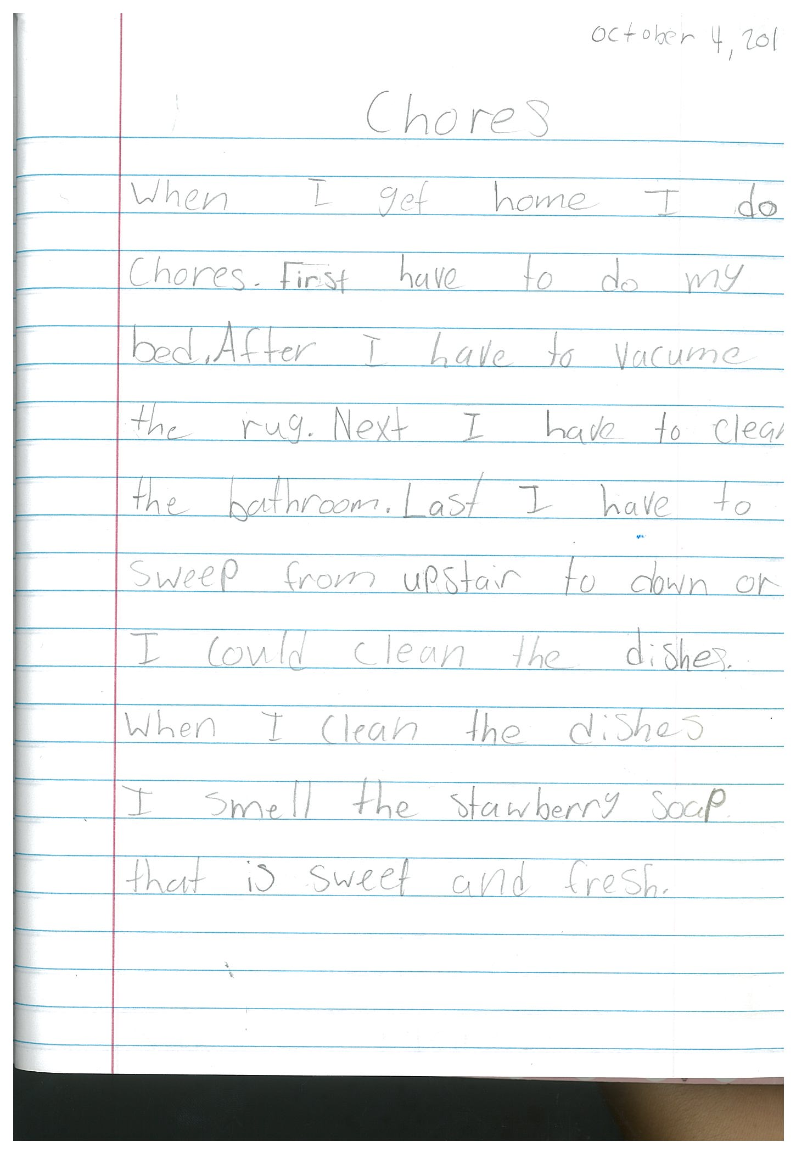

Slide 24
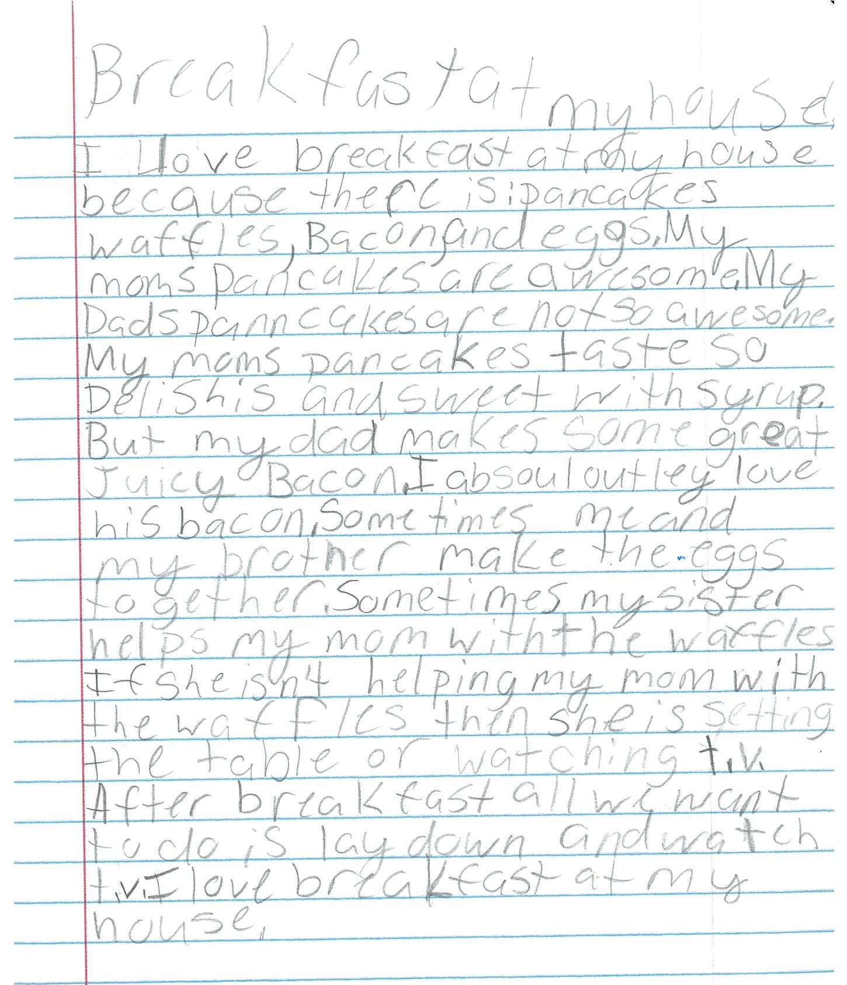

Slide 25
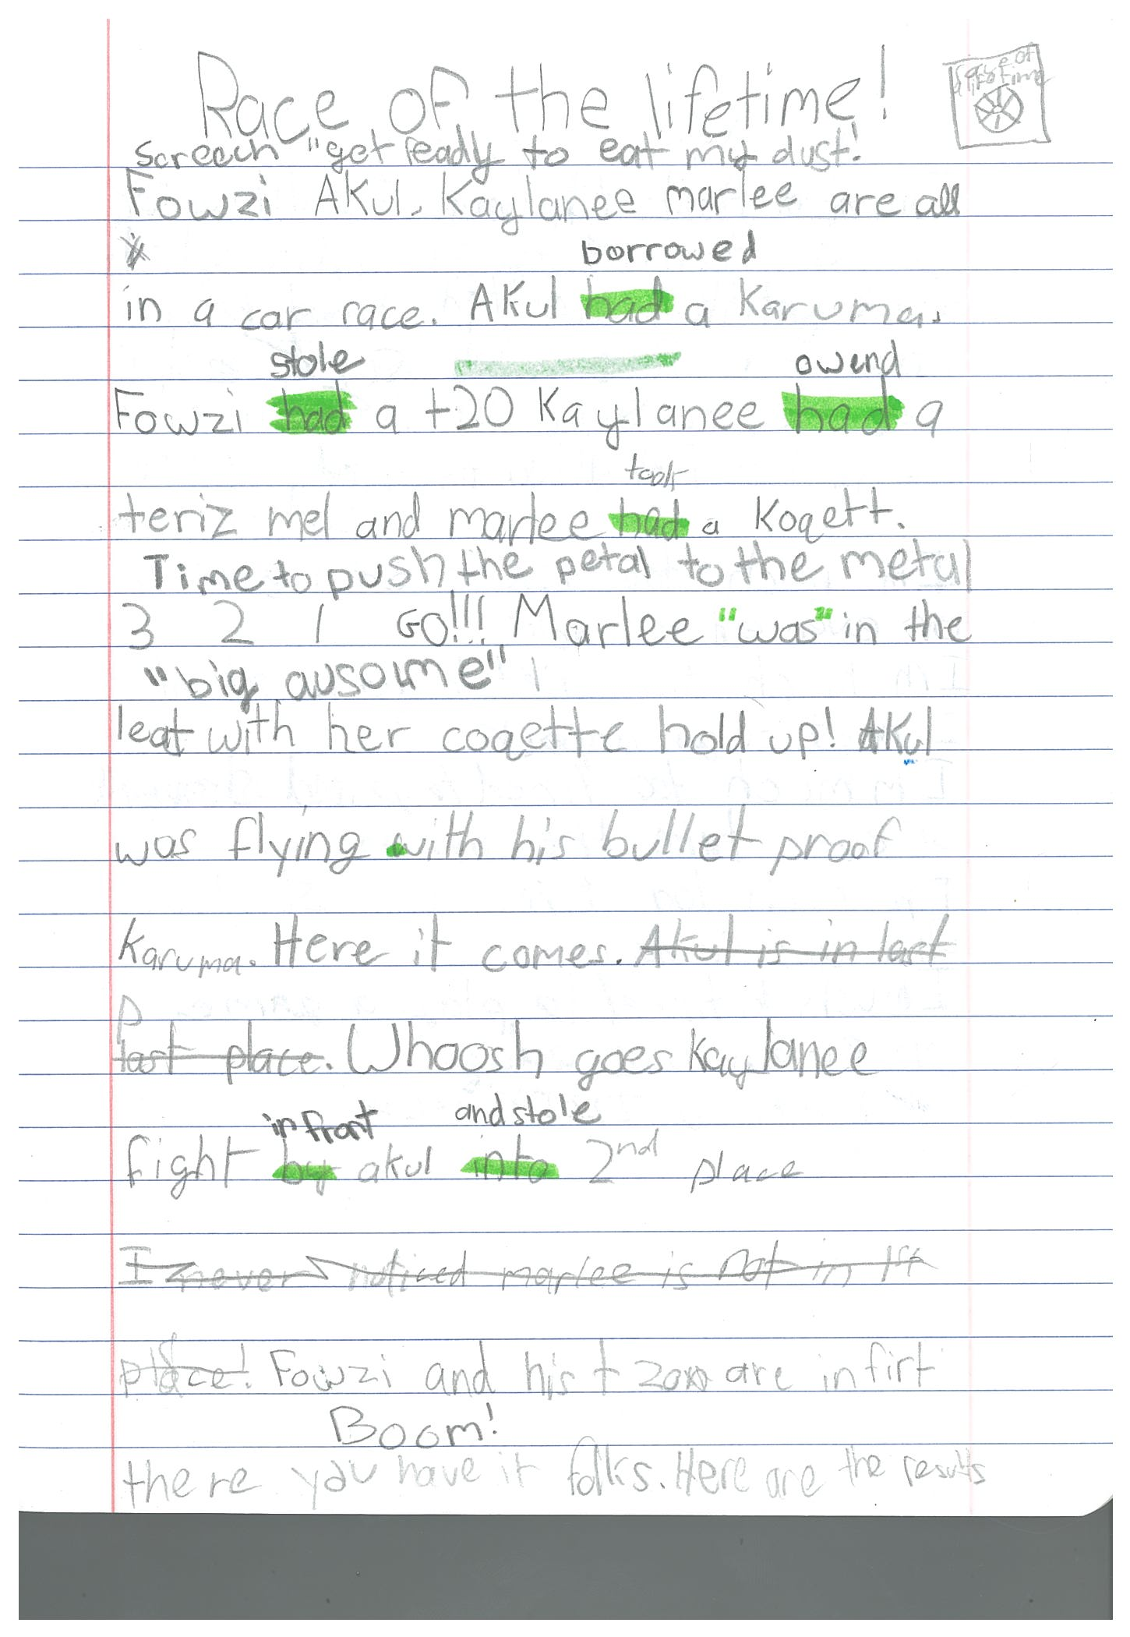

Slide 26
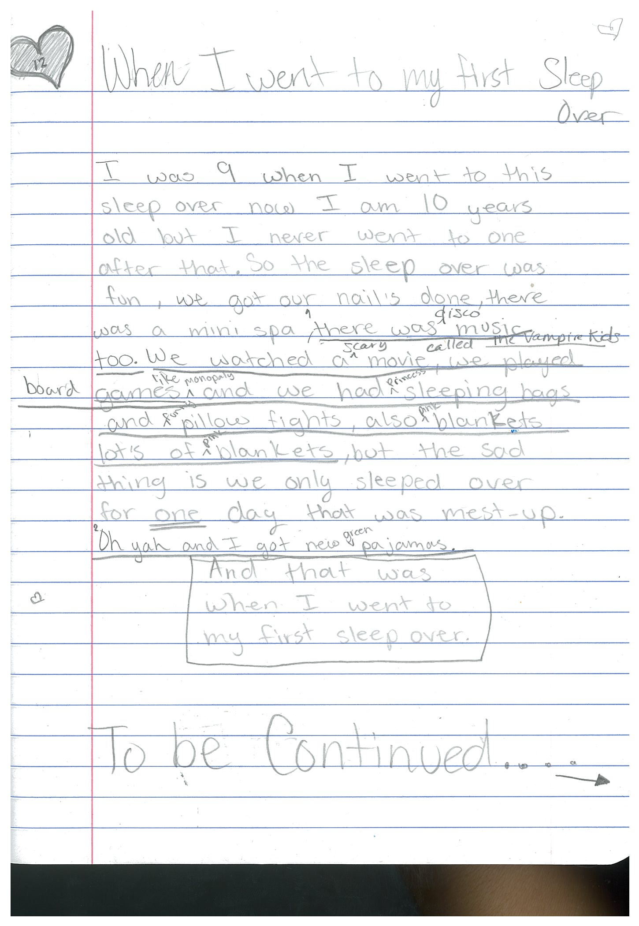

Slide 27
Instead of thinking that I am “The Teacher”
—the knowledge-giver who stands up front in total control—instead of that traditional pedagogy, we need a 21st-century vision of teaching, where there is less teacher talk and more student talk, where what I’m doing is thinking about how I am going to pull the most out of these kids; how I’m going to enable these students to be empowered; how I can make sure that I create a classroom that’s free from threat and stress, where they’ll be willing to take risks.
Sheryl Nussbaum-Beach, The Connected Educator

Slide 28
Facilitation Techniques
Using cooperative structures (e.g., Turn to your Partner)
Asking open-ended questions
Asking follow-up questions (How do you know? Why does that make sense?)
Using wait-time to call on a student to respond
Listening carefully and responding neutrally
Avoiding repeating or paraphrasing students so they learn to listen to one another, not just the teacher
Asking students to respond to one another (“What questions can we ask Phillip?” Asking students to Turn and Look)
Asking students to use discussion prompts to connect their ideas (I agree with ____ because…)
Notes:
We

Slide 29
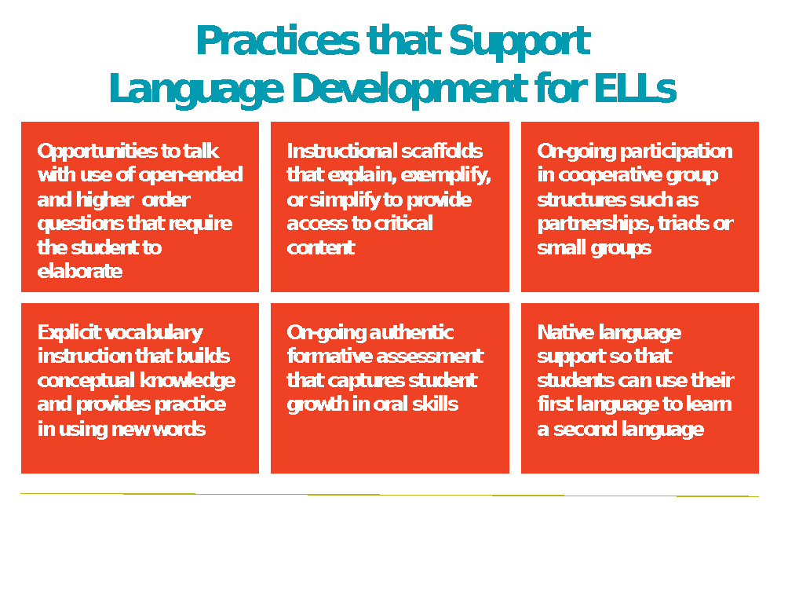
February 2016 Educational Leadership
“Let Them Talk!” By Wayne E. Wright

Slide 30
Key Aspects of Facilitation
Embrace situations where students do not know the “right” answer.
Listen to students and explore strategies for being a better listener.
Present ways to craft and deliver open-ended questions that encourage student thinking.
Explore the powerful effect our words have on student thinking and behavior.

Slide 31
What are the implications of using facilitation techniques to deepen student thinking?

Slide 32

Students learn language and culture through meaningful use and interaction.
Students’ development of academic language and academic content knowledge are interrelated processes.
-from The Cornerstone of WIDA Standards: Guiding Principles of Language Development

Slide 33
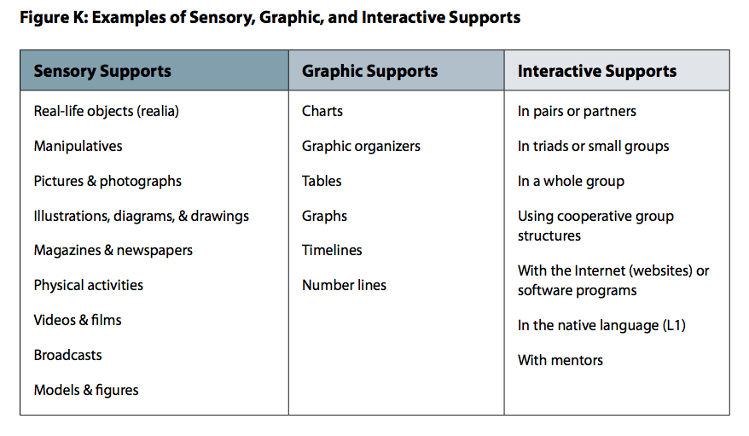
Essential Actions for Academic Language Success
Use instructional supports to help scaffold language learning.

Slide 34
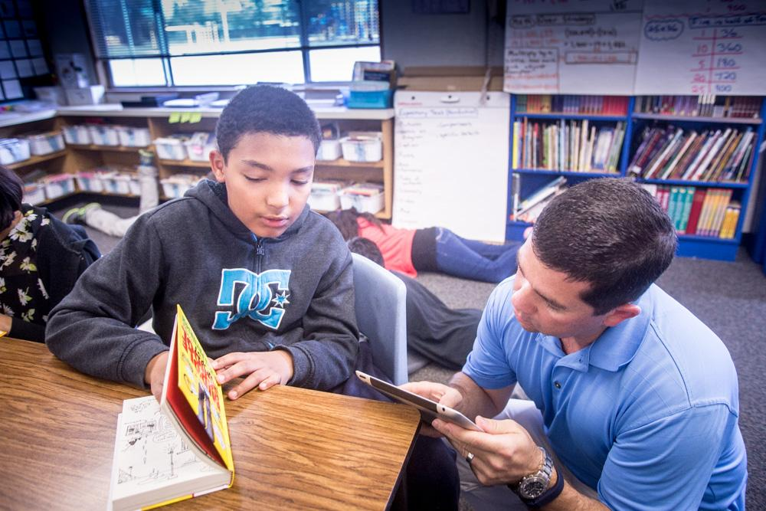
Steps to Fostering
Student Collaboration and Critical Thought
Listen attentively.
Resist over-scaffolding.
Protect students’ opportunity to do the first thinking.
Develop a sense of wonder and genuine interest in the ideas that students share.
Learn facilitation techniques that allow the “struggle” necessary for student learning.

Slide 35
Good teachers make instruction look easy. Sometimes it seems magical. To many teachers, powerful teaching can even be a bit mysterious. Powerful teaching is not easy and certainly does not come from magic. Powerful teaching is the result of intentional teacher planning and deep reflection.
Peter Brunn, The Lesson Planning Handbook

Slide 36
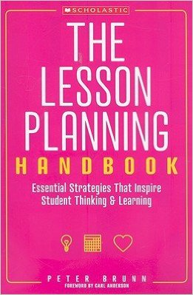

Read more about it...
February 2016
Educational Leadership
“Let Them Talk!”
By
Wayne E. Wright
By Peter Brunn

Slide 37

Welcome to Our Community!
We are here to support you!
collaborativeclassroom.org/pd
Take advantage of our free online resources to support our programs in your school or after-school site.
Visit
Check our website at collaborativeclassroom.org/forum
for upcoming events, Common Core tips, and inspiring blogs.
Share
Share your success stories! E-mail us at success@collaborativeclassroom.org.
Ask
Do you have a question? Ask us via our online community at collaborativeclassroom.org/forum.
Try
Try out for all our programs by starting a trial account at ccclearninghub.org.

