Slide 1
Toward Inclusive Understandings of Gender that Hold and Honor Everyone
Mauro Sifuentes & Laurin Mayeno

Slide 2
Our Vision and Hope
A just world where people from diverse backgrounds and experiences are free to be who they are, with no pressure to fit in, pass, or prove that they are a particular gender.

Slide 3
What we’ll cover
Our approach
Current understandings of gender
Holding and honoring everyone
Approaches and resources for supporting young people
Where to from here?

Slide 4
What this is/isn’t
Is
Isn’t
Exploration, raising questions
Sharing our thinking, to push the dialogue forward.
Planting some seeds
Some resources
All questions answered
A definitive model
A deep dive
A blueprint for action

Slide 5
Communication Guidelines
Be self-reflective.
Allow for discomfort.
Be loving and gentle with self and others.
Explore ideas, let go of attachment.
Allow for unanswered questions.

Slide 6
Quick Warm-up
One minute each:
Introduce yourself, including pronouns
What are you curious about in relation to this topic?
What questions do you have?

Slide 7
Where we are
Our approach
Current understandings of gender
Holding and honoring everyone
Approaches and resources for supporting young people
Where to from here?

Slide 8
Cultural Humility
The work starts with us - what we bring to interactions, rather than the “cultural other”
Gender is about all of us.
Being self-reflective about how we think & about talk about gender
“The master’s tools will never dismantle the master’s house.”
Audre Lorde

Slide 9
Context
Social, cultural, and historical context
Gender work as decolonization and liberation

Slide 10
Where we are
Our approach
Current understandings of gender
Holding and honoring everyone
Approaches and resources for supporting young people
Where to from here?

Slide 11
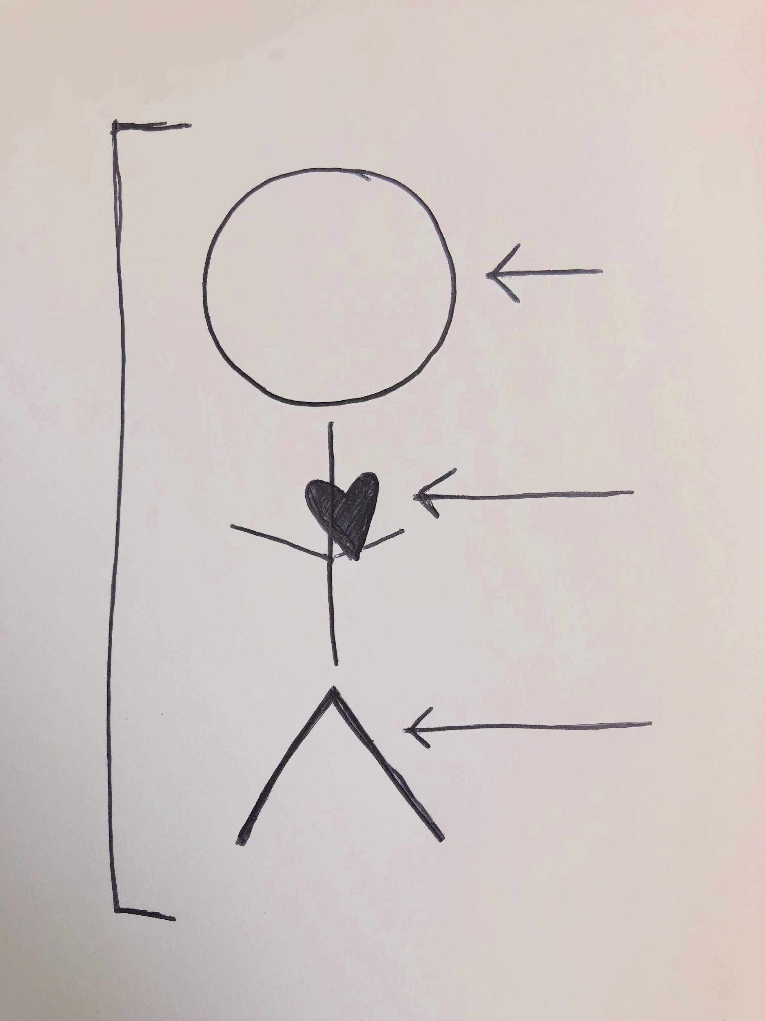
Anatomical
Splicing
Reductive
Dehumanizing
Non-holistic

Slide 12
Historical Origins
UCLA Clinics in 1960s-70s
Sex-gender split defined as pathological condition
Cures defined exclusively through psychological or medical interventions

Slide 13
Impacts of Current Models
Isolation
Pressure to define gender
Mind-body separation

Slide 14
Where we are
Our approach
Current understandings of gender
Holding and honoring everyone
Approaches and resources for supporting young people
Where to from here?

Slide 15
Inclusive Understandings of Gender
Tools to resist oppressive ideas including:
Binary understandings of gender
“Gender diversity as a white thing”
Gender exploration without having to land on a definitive self-identity
People as whole beings
Culture and community context
Mixes of masculine and feminine energy
Support for everyone to be their fullest and best self

Slide 16
Where we are
Our approach
Current understandings of gender
Holding and honoring everyone
Approaches and resources for supporting young people
Where to from here?

Slide 17
What is a binary?
“A division into two groups or classes that are considered diametrically opposite.”
merriam-webster.com

Slide 18
The Gender Binary Paths
“It’s a boy”
Be a boy.
Be masculine.
Partner with cis women.
“It’s a girl.”
Be a girl.
Be feminine.
Partner with cis men.
Mayeno Consulting, 2018

Slide 19
The Binary Impacts Everyone
Punishes anyone who doesn’t live by the rules
Pressures people to “prove” their masculinity or femininity
Creates a climate of fear and violence
Restricts what we can do and how we can grow
Damages self-esteem
Justifies discrimination

Slide 20
What if there were no gender binary?
“It’s a boy”
Be a boy.
Be masculine.
Partner with cis women.
“It’s a girl.”
Be a girl.
Be feminine.
Partner with cis men.
Mayeno Consulting, 2018

Slide 21
Gender-Inclusive Path
Love freely.
Be the way you are.
Be who you are.
“It’s a child!”
Mayeno Consulting, 2018

Slide 22
Does gender diversity come from Europeans?
OR
Is gender diversity a white thing?
OR
Does gender diversity come from liberal American culture?

Slide 23
Gender Identities
Hijra (South Asia), Bissu, calabai, calalai (Sulawesi, Indonesia), Bakla (Philippines), Mahu(Hawai’i), Whakawahine, Wakatane, Takatapui (New Zealand) Fa’afafine (Samoa), Nádleehí (Navajo), Winkté (Lakota), Niizh Manidoowag (Ojibwe), Hemaneh (Cheyenne), Mashoga (Swahili), Mino (Benin) Ashtime (Maale), Sekrata (Madagascar), Mamluk (Egypt)Muxe (Mexico), Quariwarmi (Inca, Peru), Chuckchi (Siberia), Femminielo (Italy)
Sources: Independent Lens, PBS, API Equality Nor Cal, National Queer Asian Pacific Islander Alliance, United Belize Advocacy Movement

Slide 24
Gender Binary Roots in the Americas
European
Patriarchy
Colonization
Racism

Slide 25
Binaries
True/False
Good/Evil
White/Black
Straight/Gay
Man/Woman
Mind/Body

Slide 26
Contrasting
Western Binary
Non-Western Dualism
Polar Opposites
Mutually exclusive, no overlap, clearly distinguished
One side of the binary usually more highly valued than the other
Close Proximity
Interconnected/intertwined, not completely distinguished
Complementary/Mutually Necessary/Equally Important to Create Overarching Balance

Slide 27
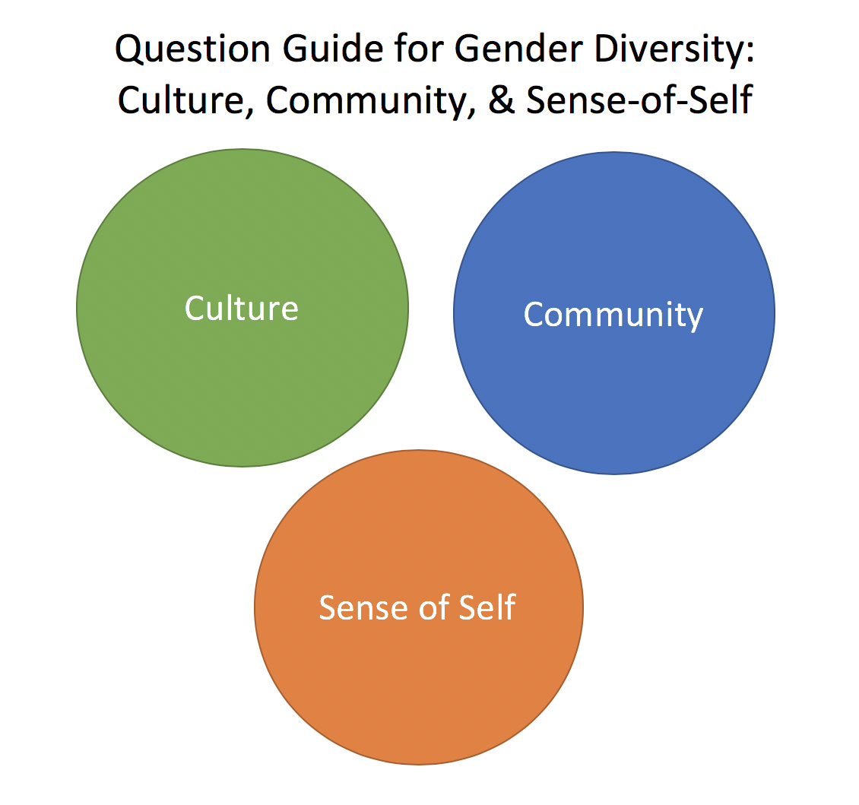
Mauro Sifuentes, 2018

Slide 28
Using the Question Guide
Take a moment to look over the Question Guide
Circle up with 2 other people
Pick one section (Culture, Community, or Sense-of-Self)
Explore which questions might be appropriate for your work, and how to adapt when working with youth

Slide 29
What we’ll cover
Our approach
Current understandings of gender
Holding and honoring everyone
Approaches and resources for supporting young people
Where to from here?

Slide 30
Where to from here?
In pairs:
Any take-aways for your work?
What would make this work most useful to you?

Slide 31
Thank you for your participation!
Mauro Sifuentes
sifuentes.mauro@gmail.com
Laurin Mayeno
laurin@mayenoconsulting.com
mayenoconsulting.com
oneofakindllikeme.com

