Slide 1
Legal Advocacy for Trans and Gender-Diverse Youth
Anya Morgan, Northwest Justice Project
Erin Lovell, Legal Counsel for Youth and Children

Slide 2
Engaging with Trans Youth
Be mindful of assumptions about the youth’s experiences.
Ask for pronouns – it’s polite!
Explain as you go.
Notes:
For providers: make sure forms are accessible and use right language.

Slide 3
Cultural Humility
“Cultural humility is a stance toward understanding culture. It requires a commitment to lifelong learning, continuous self-reflection on one’s own assumptions and practices, comfort with ‘not knowing’, and recognition of the power/privilege imbalance that exists between clients and [...] professionals.
A cultural humility approach is interactive: we approach another person with openness to learn; we ask questions rather than make assumptions; and we strive to understand rather than to inform.”
Culturally Connected, www.culturallyconnected.ca

Slide 4
Updating ID Documents:
Name and Gender Marker Changes

Slide 5
Legal Name Change
Name changes in Washington require getting a court order from the District Court in the youth’s county of residence, but the process varies by state and by county.
The requirement for dual parent consent can be a roadblock.
In Washington, you can proceed with single parent consent, but you need to give notice of the hearing to the other parent.
After the hearing, update the youth’s name with federal and state agencies that control IDs, as well as at school.
Notes:
Look up the District Court nearest to you.
Call or look online for your county’s minor name change pleadings.
Prepare documents for court (see next slide).
File documents with the District Court Clerk and set a hearing date.
Serve notice of the hearing to 2nd parent (if applicable).
Attend name change hearing.
Update name with agencies that control IDs, schools, etc.

Slide 6
What to Bring to Court
Again, varies by state. In Washington:
Motion for Fee Waiver (if applicable)
Petition for Change of Name
Parent’s ID showing residency in the county
Certified copy of child’s birth certificate
If contested by 2nd parent, also bring:
Parenting Plan
Letter from child’s doctor stating that a name change is in their best interest
Proof of Service (showing that other parent got notice of the hearing)

Slide 7
Best Interest of the Child
Many counties in WA have a local rule stating that the District Court may authorize a name change for a minor if changing name would be in the “best interest of the child.”
It’s a good idea to come prepared with evidence as to why the name change is in the youth’s best interest.

Slide 8
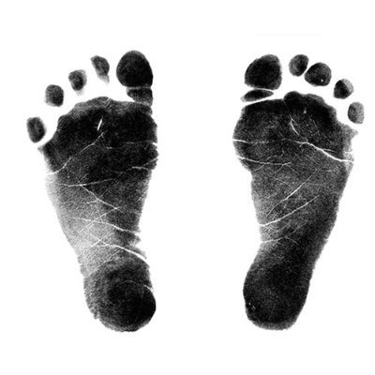
Updating Name and Gender on State Documents
Birth Certificate
Each state is different; contact the health department in the youth’s birth state.
Most state health departments will accept a name change order from a court of competent jurisdiction in another state.
Some states require a court order to change gender marker on the birth certificate as well—there is sometimes a way to do this out of state, but may require getting a lawyer.
On WA birth certificates, changing gender marker for a youth requires permission from a parent and doctor, but no court order.

Slide 9
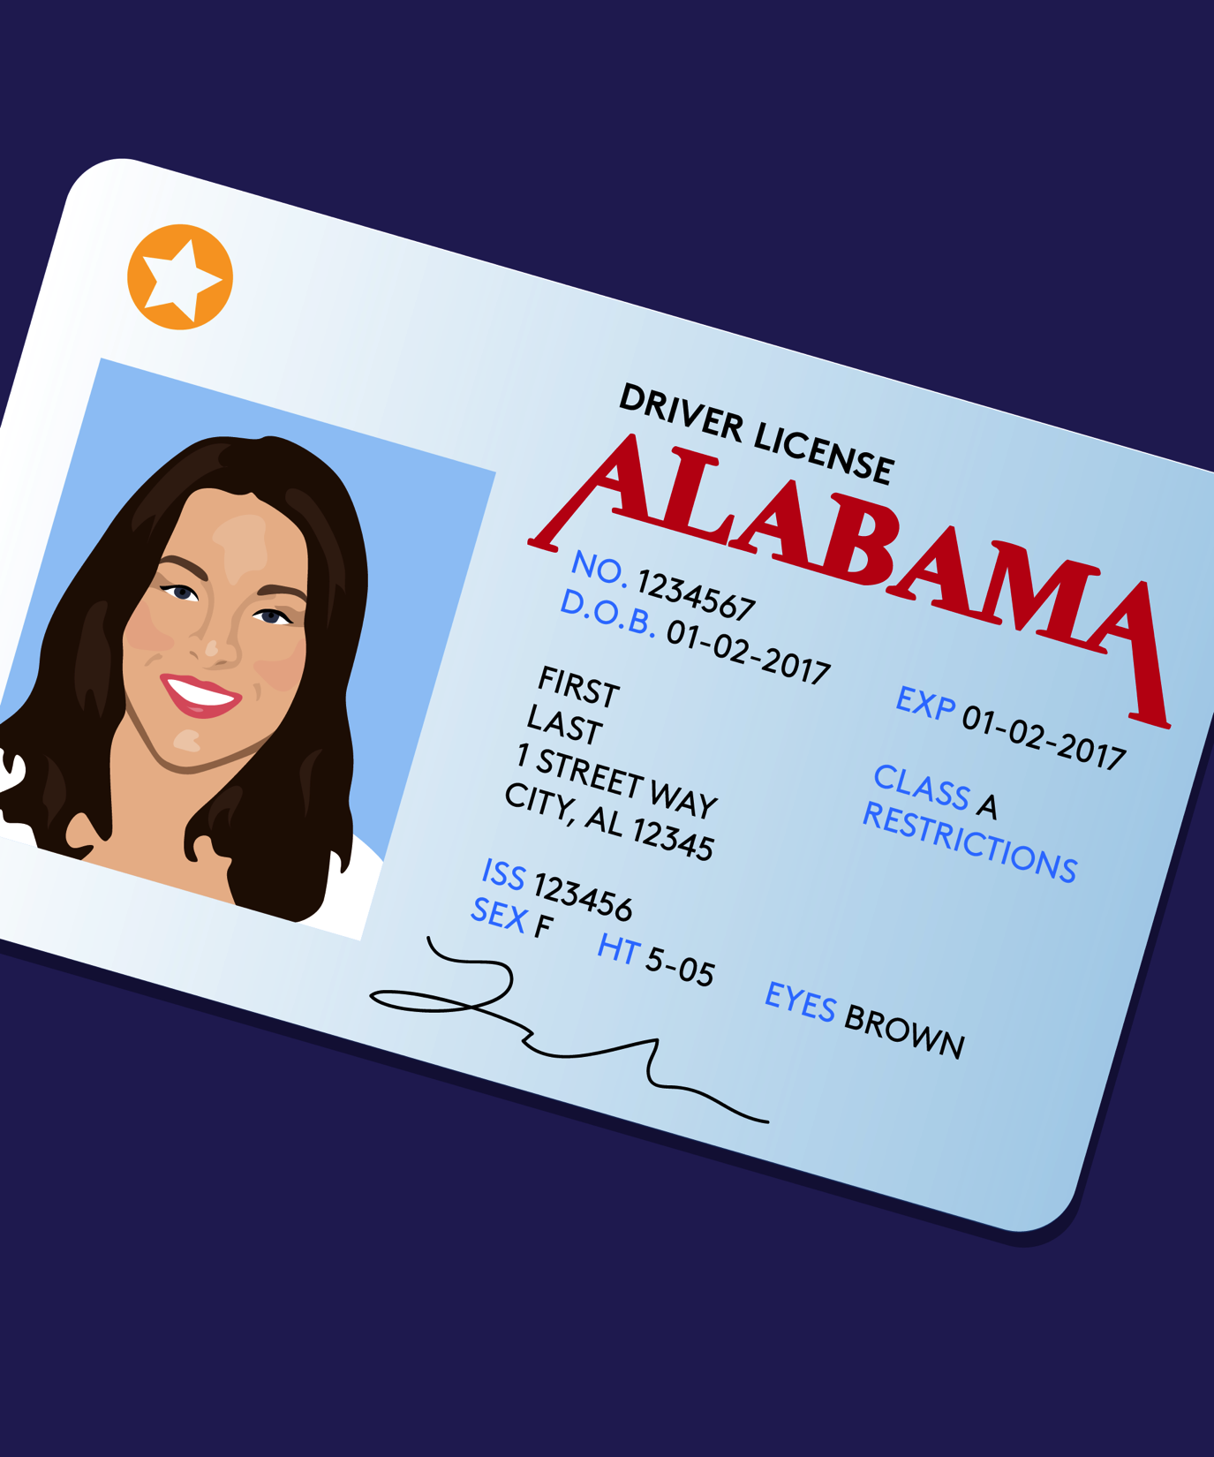
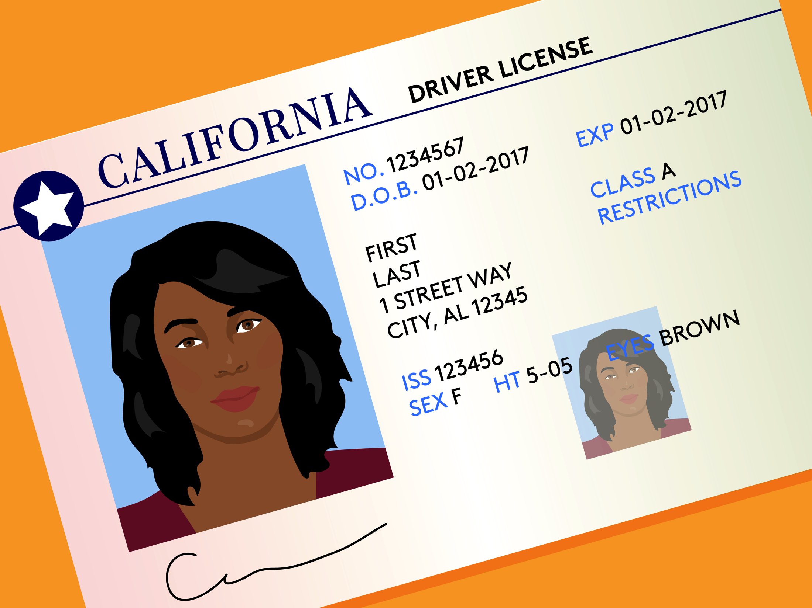
Updating Name and Gender on State Documents
Driver’s License/ID card
For name change: submit the name change order to DOL/DMV.
In WA, changing gender marker with DOL is an administrative process.
In other states, changing gender marker on
state ID could require a court order.

Slide 10
Updating Name and Gender on Federal Documents
Social Security
Needed for name change: Application, proof of US citizenship, proof of ID, and proof of a name change.
SSA will accept any of the following as proof of a name change:
Name change court order (original or certified copy);
Marriage, civil union, or domestic partnership certificate (original or certified copy);
Divorce decree (original or certified copy); or,
Certificate of citizenship or naturalization (original only).
Needed for gender change: a letter from an MD stating that the youth has “undergone appropriate clinical treatment for gender transition.” Follow NCTE guidelines.

Slide 11
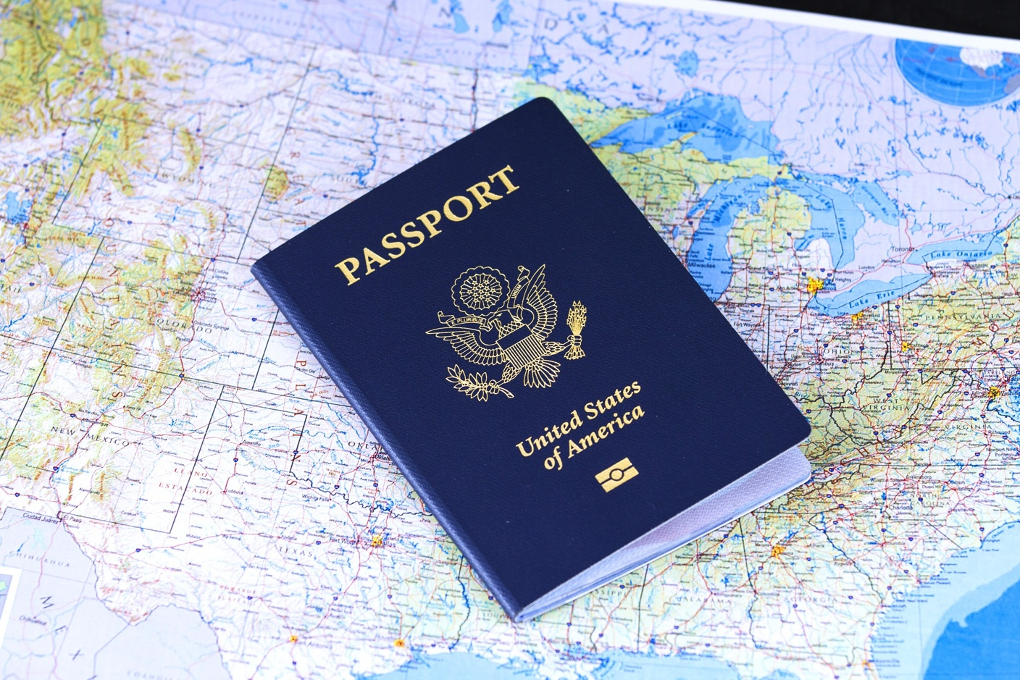
Updating Name and Gender on Federal Documents
Passport
This could change, but as of now, the policy is fairly straightforward.
Submit a letter from an MD or DO stating that the youth has undergone “appropriate clinical treatment for gender transition.”
Follow the NCTE guidelines exactly.
It’s a good idea to get passports taken care of ASAP, but the reporting around this issue has been inaccurate.
It is still very possible for trans people to get passports, and the policy has not changed.

Slide 12
The National Center for Trans Equality
www.transequality.org/documents

Slide 13
Name and gender marker changes on ID documents can usually be done at the same time, as long as you have all the appropriate paperwork for each.
Pro Tip!

Slide 14
Accessing Medical Care:
Understanding Consent Requirements and the Mature Minor Doctrine

Slide 15
Minor Consent to Health Care in WA
In WA, minors can consent to:
emergency medical services
STI testing (if over 14)
birth control services
abortion services
prenatal care services
inpatient and outpatient mental health treatment (if over 13), and
outpatient substance abuse treatment (if over 13).
Some minors will be able to consent to other care under the Mature Minor Doctrine (see next slide).

Slide 16
The Mature Minor Doctrine
The Mature Minor Doctrine was created as a result of a 1967 court case, Smith v. Seibly, in which a minor consented to his own sterilization.
The MMD allows health care providers to treat minors as adults based upon an assessment and documentation of the young person's maturity.
Whether a minor is mature enough to consent to care is a determination made by the provider; no court order is necessary.

Slide 17
The Mature Minor Doctrine
Providers are sometimes hesitant to apply the doctrine when the minor has involved parents, out of fear of liability.
However, battery suits against doctors treating minor patients under the doctrine are largely unheard of.
Notes:
“Indeed, no court has rejected the doctrine itself since 1941, and no doctor has been held liable for battery in the past thirty years when treating a patient over age fourteen without parental consent. Courts will protect physicians in their ‘non-negligent treatment of . . . mature minor(s) who consent . . . to a procedure after discussion with the physician’” Lawrence Schlam & Joseph P. Wood, M.D., Informed Consent to the Medical Treatment of Minors: Law and Practice, 10 Health Matrix 141, 163 (2000).

Slide 18
Single/Dual Parental Consent
Some providers require dual parental consent before they will administer HRT or other transition-related services.
However, dual parental consent is a risk management requirement, not a legal requirement.
Notes:
The Supreme Court of the United States ruled on a similar concept in an abortion case, Hodgson v. Minnesota, stating:
“The combined force of the separate interest of one parent and the minor's privacy interest outweighs the separate interest of the second parent.”
And noting that two parent requirements are “virtually an oddity among state and federal consent provisions,” which “further demonstrates [their] unreasonableness and the ease with which the State can adopt less burdensome means to protect the minor’s welfare.”

Slide 19
Single/Dual Parental Consent (cont’d)
Research your provider’s informed consent policy before your first appointment, as it may influence what information you disclose to your provider.
For example, Seattle Children’s Hospital’s policy is:
1. Either mother or father may consent when parents are married. It is not necessary to check with or obtain the consent of both parents.
2. If married parents are separated, either may consent unless there is a court order specifying that one parent is the sole ‘health care decision maker’.
However: 3. If staff knows that married parents disagree, the parents must reach a mutual agreement regarding treatment or nontreatment.

Slide 20
If one provider says no to single parent consent, you can try another provider.
Pro Tip!

Slide 21
Holistic Legal Advocacy for Systems Involved Youth

Slide 22
Child Welfare (birth to 21 years)
Juvenile Justice
Youth who are or are at risk of experiencing homelessness in King County, Washington (ages12 -24 years)
Immigrant Youth and Families

Slide 23
Foster Care
Overrepresented
19% out of home care
34% youth aging out
Shortage of placements
Group homes
Placement changes
Risk of Running
Laws or Policies to protect against discrimination
13 states plus DC
7 additional states

Slide 24
Foster Care: Holistic Legal Advocacy
Identification Docs
Access
Medical Care
Counseling Services (child/family)
Positive Connections
Stability
Placement
School
Permanency / Independence

Slide 25
“Recent research has shown that up to 20% of the youth confined in America’s juvenile detention facilities identify as LGBT, questioning or gender nonconforming, which is almost three times their estimated number in the general population."
-Annie E. Casey Foundation, Sept 2015

Slide 26
Juvenile Justice
Circumstances
Status offenses (Truancy, Run)
Domestic violence / abuse
Sex trafficking
While in secured detention, at high risk of harassment, emotional abuse, physical and sexual assault, and prolonged periods of isolation.
Exits

Slide 27
Juvenile Justice: Holistic Legal Advocacy
How did he/she/they arrive?
Access, Safety, and Exit Planning
Identification Docs
Medical Care
Counseling Services (child/family)
Positive Connections
Education
Safe Housing / Caregiver

Slide 28
Homeless Youth
200 youth referred to LCYC
Roughly 50% Minors
67% Youth of Color
21% LGBTQ
Community Partners
Service providers, shelters
Schools

Slide 29
Missed Opportunities: Service Entry
Access to Child Protective Services
Access to Shelter
Access to Court

Slide 30
MINORS
YOUNG ADULTS
Orders of protection
Warrants / record sealing
Landlord tenant
Identification docs
Financial
Medical / Consumer debt
Public benefits
Identity theft
Restitution/Court fees
Understanding safety options
Accessing
Emergency shelter
Long term housing
Systems (education, child welfare, medical)
Emancipation

Slide 31
Immigrant Youth
17% served through LCYC’s homeless youth program
Northwest Immigrant Rights Project
Special Immigrant Juvenile Status
Asylum
Additional access challenges
Outright International

Slide 32
So What? Now What?
Navigating Services & Systems
First Impression
Law & Policy

Slide 33
Additional Resources
Opening Doors for LGBTQ Youth in Foster Care: A Guide for Lawyers and Judges, American Bar Association 2008
LGBTQ Youth in the Foster Care System, Human Rights Campaign Issue Brief, May 2015
Lesbian, Gay, Bisexual and Transgender Youth in the Juvenile Justice System: A Guide to Juvenile Detention Reform #11, Annie E. Casey Foundation, September 2015
Judges’ Bench Guide on the LGBTQ Community and the Law, Prepared by the QLaw Foundation of Washington 2017
Protocol for Safe and Affirming Care: Improving the Lives of LGBTQ+ Youth in Washington State’s Child Welfare and Juvenile Justice Systems, Nicholas Oakley, Center for Children and Youth Justice, Jan 2017
www.transequality.org/documents

Slide 34
Anya Morgan After August, reachable at: Lavender Rights Project (206) 639-7955 www.lavenderrightsproject.org Erin Lovell Legal Counsel for Youth and Children, Executive Director erinlcyc@gmail.com (206) 494-0323 x700 www.lcycwa.com

