Slide 1
Dissociation in Transgender Clients/Patients/Students
by Laura Gardener
LauraGardener59@aol.com
(206) 720-0091
Seattle

Slide 2
In this presentation, my objectives are to:
1) Provide a general understanding of the principles of Trauma, Dissociation, and Dissociative Identity Disorder and how they apply to trans clients, patients, and students.
2) Differentiate between different kinds of trauma, namely ‘Traumatic In-pression ’ & ‘Traumatic Failure to Express’.
3) Consider specific examples of: A trans client who initially presents, or discovers in the process of therapy, that they are DID. A cis-gender DID client in whom an alter emerges that has a different gender than previously encountered alters.
4) Conduct a participation exercise in groups of 3 to better understand how the phenomenon of ‘Traumatic Failure to Express’ manifests in a person's life.
5) Conduct a second participation exercise to allow participants to confidentially discuss clients or patients for whom these phenomena are relevant.
6) Invite audience feedback and discussion in the larger circle.
My hope/goal is that medical and psychotherapeutic treaters, teachers, and legal workers will better be able to recognize and understand the presence of dissociation in their transgender clients.
(Special thanks to Lindsay MacGregor for helping me create these projected images. Technologically, I'm a luddite.)

Slide 3
"I felt a Cleaving in my Mind-
As if my Brain had Split-
I tried to match it- Seam by Seam-
But could not make them fit.
The thought behind, I strove to join
Unto the thought before-
but Sequence ravelled out of Sound-
Like Balls- upon a Floor."
- Emily Dickinson (1864)

Slide 4
CIS-GENDER: When a person feels accepting of the gender that was assigned to them at birth and continues to be assigned to them through their life.
TRANS-GENDER: When the gender assigned at birth feels inadequate to describe the person's felt-experience of their gender. This creates an experience of conflict for the person, until such time that greater consonance occurs between one's inner experience of gender and how one is recognized and affirmed by others.
Trans-Gender can refer to an increasingly vast continuum of phenomena including, but not exclusive to:
Dressing in clothing that others deem inappropriate for the gender that they assign to you.
Wanting to make changes to your body that others deem inappropriate for the gender that they assign to you.
TRANSITION: In terms of gender, this refers to when a trans person takes steps toward claiming their own personal gender.

Slide 5
BINARY: In terms of gender, this refers to the two poles of man/woman, male/female, and/or masculine/feminine.
Just as most cis-gender people describe themselves using these terms, some trans-gender people continue to describe themselves in these ways, even after achieving great consonance between their inner and outer gender. Examples would be the Trans-Man or Trans-Woman.
NON-BINARY: In terms of gender, this refers to people who do not identify as either of the polarities of masculine/feminine, male/female, and/or man/woman. Their pronouns could include they/them/theirs or a quickly increasing array of choices.
TRAUMA: The experience of not having sufficient space, whether physically or psychologically, to integrate and accommodate an experience that is suddenly thrust upon them.
DISSOCIATION: One of the ways that a person copes with Trauma. It may begin while the person is being traumatized or it may develop at a later time. Dissociation manifests in a myriad number of ways, some of it not even classically seen as 'traumatic'.

Slide 6
CLINICAL DISSOCIATION may include:
Reverie or day-dreaming; imaginary friends; living in an inner-reality not shared by others;
Distraction or wandering of the mind; 'tuning out',
'Altered states of consciousness' aided by the use of: food, alcohol, other drugs, self-inflicted or other-inflicted pain, thrill-seeking, over-work, & engagement in conflict.
Psychic numbing of the body, emotions, and/or mind;
Forgetting or amnesia that an event ever took place;
Development of 'parts of self'; 'alter personalities'; 'multiple personalities’; 'dissociated identities', and/or a 'system'.

Slide 7
DSM-5 Dissociative Disorders
The DSM-5 (2013) lists these Dissociative Disorders:
Dissociative identity disorder (DID) DSM5 code 300.14 (ICD-10 F44.81)
Dissociative amnesia including Dissociative Fugue DSM5 code 300.12 (ICD-10 F44.0)
Depersonalization/Derealization disorder DSM5 code 300.6 (ICD-10 F48.1)
Other Specified Dissociative Disorder DSM5 code 300.16 (ICD-10 F44.89)
Unspecified Dissociative Disorder DSM5 code 300.15 (ICD-10 F44.9)
DSM-5 Conversion Disorders which are Dissociative Disorders in the ICD-10
Dissociative Disorders of movement or sensation DSM5 300.11 (ICD-10 F44.4, F44.5, F44.6)

Slide 8
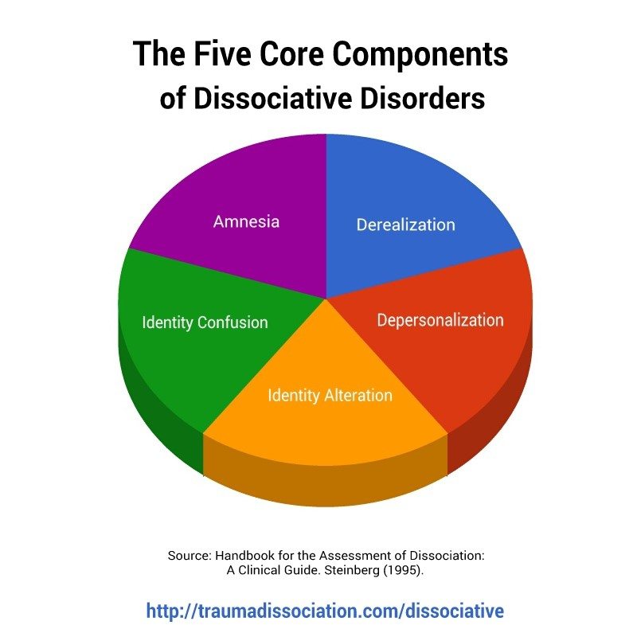
Amnesia: recurrent memory problems, often described as "losing time", these gaps in memory can vary from several minutes to years
Depersonalization: a sense of detachment or disconnection from one’s self, this can include feeling like a stranger to yourself, feeling detached from your emotions, feeling robotic or like you are on autopilot, or feeling like a part of your body does not belong to you.
Derealization: a sense of disconnection from familiar people or one’s surroundings, for example, close relatives or your own home may seem unreal or foreign
Identity confusion: an inner struggle about one’s sense of self/identity, which may involve uncertainty, puzzlement or conflict.
Identity alteration: a sense of acting like a different person some of the time
Reference: Dissociative Disorders. (Jul 27, 2018).
Traumadissociation.com. Retrieved Jul 27, 2018.

Slide 9
CRITERIA FOR DISSOCIATIVE IDENTITY DISORDER IN THE DSM-5; FORMERLY MULTIPLE PERSONALITY DISORDER
1. Two or more distinct identities or personality states are present, each with its own relatively enduring pattern of perceiving, relating to and thinking about the environment and self.
2. Amnesia must occur, defined as gaps in the recall of everyday events, important personal information and/or traumatic events.
3. The person must be distressed by the disorder or have trouble functioning in one or more major life areas because of the disorder.
4. The disturbance is not part of normal cultural or religious practices.
5. The symptoms are not due to the direct physiological effects of a substance (such as blackouts or chaotic behavior during alcohol intoxication) or a general medical condition (such as complex partial seizures).
Reference: https://www.healthyplace.com/abuse/dissociative-identity-disorder/dissociative-identity-disorder-did-dsm-5-criteria

Slide 10
TRAUMATIC FAILURE TO EXPRESS: Trauma that results when one is blocked from outwardly expressing one's internal experience.
TRAUMATIC IN-PRESSION: Trauma that originates outside of the person. It comes at them prematurely or too suddenly and, without physical or psychic space to receive and integrate the experience. 'Traumatic In-Pression' creates a severe wound that is often quite difficult to heal.
Ways that ‘Traumatic Failure to Express' can manifest:
Not being able to articulate, even to oneself, the extent of one's being trans due to guilt, embarrassment, and shame.
Not being able to articulate to others the extent of one's being trans due to guilt, embarrassment, and shame but also for fear of abandonment, punishment, exile, humiliation, and exposure.

Slide 11
Transgender people have trauma syndromes and dissociative syndromes whose etiologies are endemic and stem directly from being trans.
Trans people often suffer from more than one kind of disabling trauma, and subsequent dissociation, concurrently.

Slide 12
Ways that Dissociation manifests in the Trans client & patient
Distraction, wandering of the mind, and 'tuning out'. (In both children and adults this could be mistaken for ADD or occur concurrently.)
Reverie, day-dreaming; fantasies, sanctioned 'cross-dressing' (such as costume parties, Halloween, cos-play and other role-play situations), imaginary friends that might be the unlived gender, living in an inner-reality not shared by others.
Repetitive, night-time dreaming in which one experiences oneself as the as-yet-unlived gender. Like nightmares, these kinds of dreams, even when pleasant, can be understood as the psyche's attempts to work through the traumatic conflict within. Though themselves a kind of dissociative experience, they also help to heal dissociation by giving the trans person an alternative experience of themself.
Psychic numbing of the body, emotions, and/or mind including feelings of depersonalization in which one distances oneself from one's body and feels that one's body isn't one's own. Examples of this include when trans people refer to body parts as their 'junk', something that's not part of them that should be discarded or removed.
Using food (by either or both under-eating and over-eating), alcohol, other drugs, self-inflicted pain, thrill-seeking, over-work, and engagement in conflict to create altered states of consciousness.
Development of 'parts of self'; 'alter personalities'; 'multiple personalities'; 'dissociated identities’; and/or a 'system’. Yet, sometimes without a history of classic instances of abuse and trauma.

Slide 13
POST-TRAUMATIC STRESS DISORDER: a condition of persistent mental and emotional stress occurring as a result of injury or severe psychological shock, typically involving disturbance of sleep and constant vivid recall of the experience, with dulled responses to others and to the outside world.
MICRO-AGGRESSIONS: Brief and commonplace daily verbal, behavioral, or environmental indignities, whether intentional or unintentional, that communicate hostile, derogatory, or negative slights and insults toward marginalized people.

Slide 14
Scenarios in psychotherapy
A cis-gender-identified DID client in whom an alter emerges that has a different gender than previously encountered alters.
A client who comes to session and self-identifies as trans or Gender Non-Binary. They either initially present as having 'a system' of parts-of-self or else alters start to manifest as the work progresses. Some of the parts identify as 'binary trans', others as 'gender non-binary', others as 'cis-gender', others as having no gender whatsoever.

Slide 15
INTEGRATION: different parts of Self become aware of each other and share what they know about the person's life with each other and they act cooperatively with one another so that the person can function more successfully in the world and be less conflicted, within and without.

Slide 16
"I felt a Cleaving in my Mind-
As if my Brain had Split-
I tried to match it- Seam by Seam-
But could not make them fit.
The thought behind, I strove to join
Unto the thought before-
but Sequence ravelled out of Sound-
Like Balls- upon a Floor."
- Emily Dickinson (1864)

Slide 17
Session #1:
Think about some way in your life that you were unable to express something that caused considerable stress for you. How did that manifest?

Slide 18
Session #2:
Consider the clients, patients, students or other people with whom you work for whom ‘Traumatic Failure to Express’ is an issue.
Has this manifested in any symptoms of trauma including dissociation?

Slide 19
"...None of us has any personal problems. We have only our own personal form of the human problem, which is ultimately the problem of the separate self." (Ayurveda and The Mind, David Frawley, p.254)
"We must learn who we are, not merely what our name or job is, but the nature of our awareness freed from all external conditioning factors." (Ayurveda and The Mind, David Frawley, p.256)
"A blockage develops from equal and opposing forces meeting on a particular plane. We cannot merely eliminate one or the other force. They must be integrated." (Eastern Body, Western Mind, Anodea Judith, p.16)

