Slide 1
Philanthropy’s Albatross
Debunking Theories of Change
http://postcards.typepad.com/Philanthropy%20s%20Albatross.doc
albert@gnof.org

Slide 2
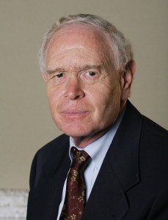
“The Power of Theories of Change” Spring 2010

Slide 3
What is a theory of change,
anyway?

Slide 4
“A theory of change describes a process of planned social change, from the assumptions that guide its design to the long-term goals it seeks to achieve.”

Slide 5
“Grant makers who use the term may be describing anything from a detailed map to a general storyline.”

Slide 6
A theory of change “defines all the building blocks required to bring about a given long-term goal.”

Slide 7
“A THEORY OF CHANGE is the empirical basis underlying any social intervention.”

Slide 8
“[T]he product of a series of critical-thinking exercises that provides a comprehensive picture of the early- and intermediate-term changes in a given community that are needed to reach a long-term goal articulated by the community.”

Slide 9
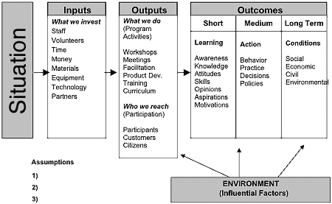
Theory of Change ≠ Logic Model …
… for most people

Slide 10
So what is a theory of change?

Slide 11
A program theory is a sequence of causes and effects, in which our interventions function as the instigating causes and certain hoped-for social benefits function as their ultimate effects.

Slide 12
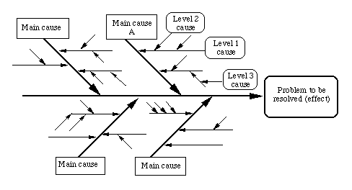
A → B → C … → OUTCOME

Slide 13
Giving a child a caring adult mentor →
An increase in that child’s sense of self-worth
If a child is given a caring adult mentor, then his/her sense of self-worth will increase.
My program will provide child A with a caring adult mentor.
_____________________________________
Therefore, child A’s sense of self-worth will likely increase.

Slide 14
We propose to create a park in Neighborhood X so residents can use and enjoy it … This will lead to better health outcomes for residents …

Slide 15
If we create a park within walking distance of neighborhood homes, then residents will use the park.
Our organization will create a park within walking distance of neighborhood homes.
_________________________________
Therefore, residents will use the park.

Slide 16
If we create a park within walking distance of neighborhood homes, and residents participate in the design of the park, and the city commits to its upkeep, then residents will use the park.
Our organization will create a park within walking distance of neighborhood homes, residents will participate in the design of the park, and the city will commit to its upkeep.
__________________________________________
Therefore, residents will use the park.

Slide 17
If we create a park within walking distance of neighborhood homes, and residents participate in the design of the park, and the city commits to its upkeep, and residents feel safe in the park, then residents will use the park.
Our organization will create a park within walking distance of neighborhood homes , residents will participate in the design of the park, the city will commit to its upkeep, and we’ll take steps to ensure that residents feel safe in the park.
__________________________________________
Therefore, residents will use the park.

Slide 18
If we create a park within walking distance of neighborhood homes, and residents participate in the design of the park, and the city commits to its upkeep, and residents feel safe in the park, and residents feel safe walking from their homes to the park , then residents will use the park.
Our organization will create a park within walking distance of neighborhood homes , etc.
__________________________________________
Therefore, residents will use the park.

Slide 19
Some Lessons
The most relevant parts of the theory of change were already implicit in the original grant proposal.
Articulating the beliefs, assumptions, and conditions necessary for the desired change to occur can get ridiculously complicated. In general, you cannot know ahead of time what the “relevant” beliefs, assumptions, and conditions will be.

Slide 20
If we create a park within walking distance of neighborhood homes, and residents participate in the design of the park, and the city commits to its upkeep, and residents feel safe in the park, and residents feel safe walking from their homes to the park , then residents will use the park.
Our organization will create a park within walking distance of neighborhood homes , etc.
__________________________________________
Therefore, residents will use the park.

Slide 21
Some Lessons, Cont.
Your theory of change is not helping you with your evaluation.
Your theory of change is not working for you: you are working for it.

Slide 22
In order to improve conditions at Public Housing Project X, we propose to include tenants on the managing board.

Slide 23
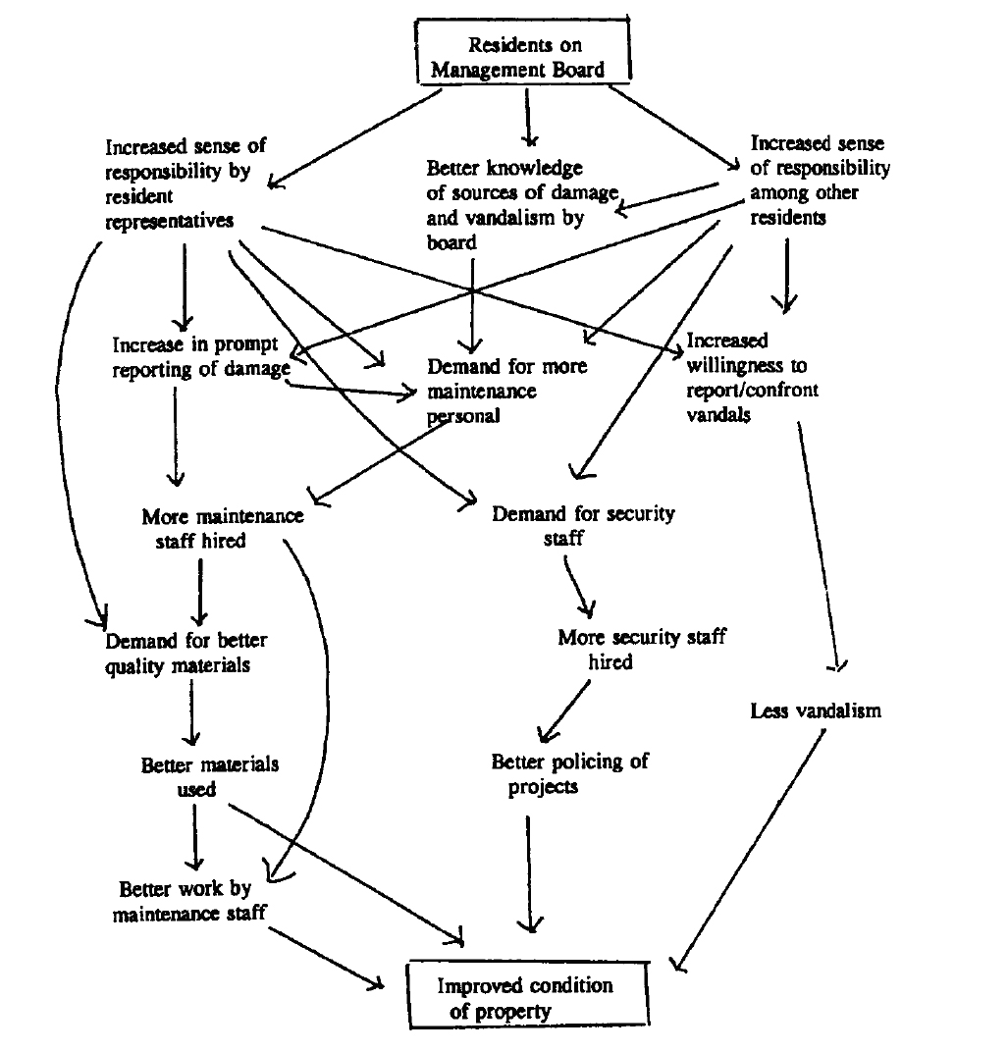

Slide 25
Keep in Mind
This TOC, as unwieldy as it is, doesn’t begin to articulate all the underlying beliefs and conditions that might be critical to the success of the project.
If, after a year, the condition of the property doesn’t improve, it’s not the TOC that will guide the evaluation.
We can imagine scenarios in which the property improves but for none of the reasons outlined in the TOC!

Slide 26
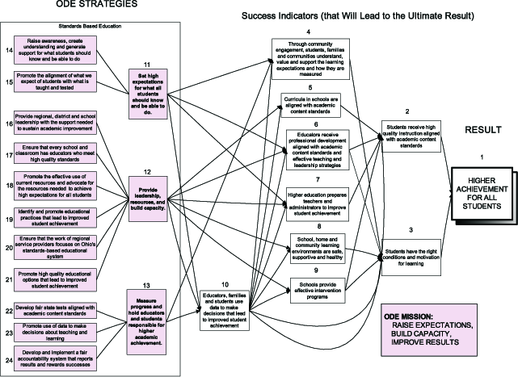

Slide 27
Plausibility Test

Slide 28
Try This At Home
Don’t request a separate theory of change. Read the proposal carefully and/or ask appropriate questions during the site visit, then simply apply the Plausibility Test.
Key question: What, beyond what’s said in the proposal, do you believe a theory of change will buy you?
If you must articulate a separate theory of change, keep it simple.

