Slide 1
Using Voyager Short Loans to Reserve and Circulate Study Rooms
Subtitle

Slide 2
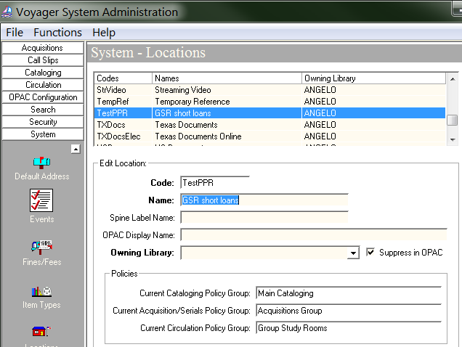
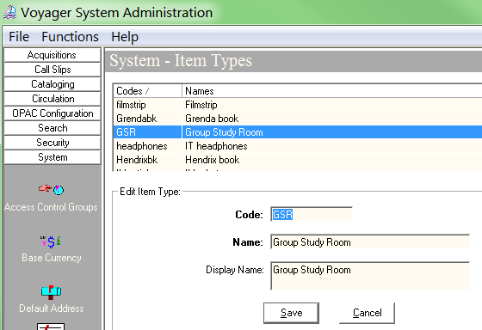
Short Loans - Staff Side
TIP: Set aside plenty of time
SYS ADMIN
System - Create location and item type(s)
TIP: When establishing Codes, if starting out small, think about future developments
Notes:
Once created, Codes cannot be changed/updated.

Slide 3
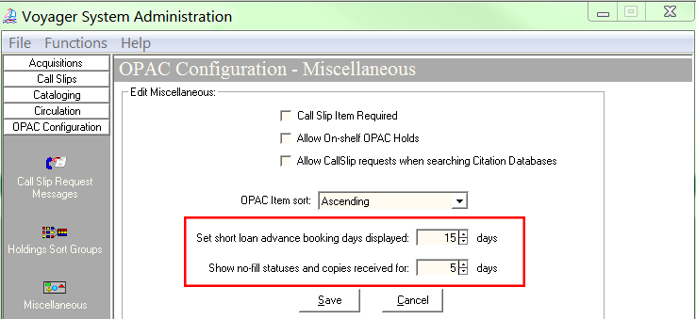
Short Loans - Staff Side cont’d
Circulation - Create Calendar (24 hours) and Circ Policy Group
OPAC Configuration > Miscellaneous
Notes:
Display of short loan advance booking days applies to Circ module, and is reflected on web schedule from library site.

Slide 4
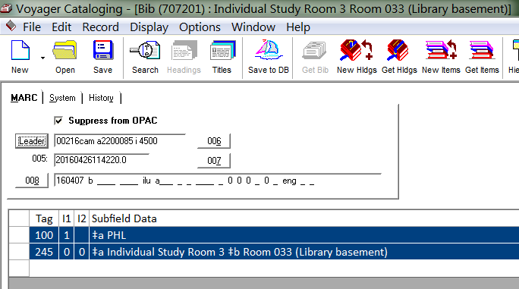
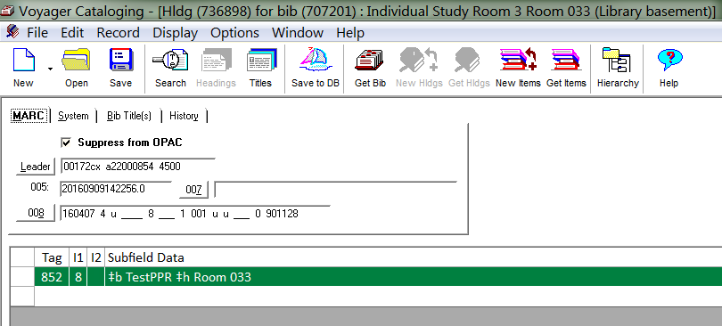
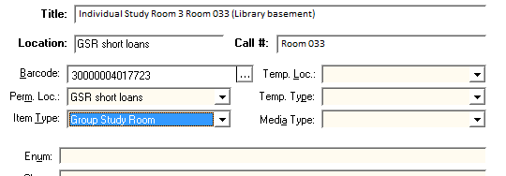
Short Loans - Staff Side cont’d
CAT - Minimal BIB, MFHD and ITEM records
Notes:
First room to come online - Presentation Practice Room -

Slide 5
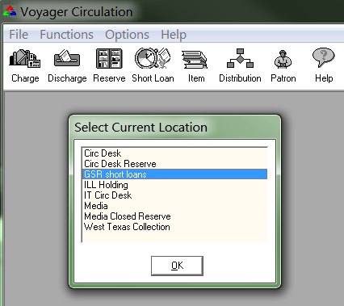
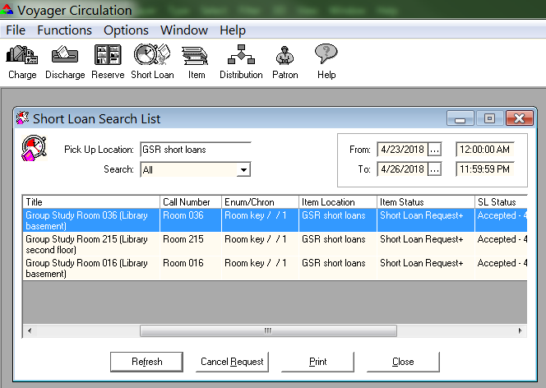
Short Loans - Staff Side cont’d
CIRC - Manage reservations / charge and discharge rooms

Slide 6
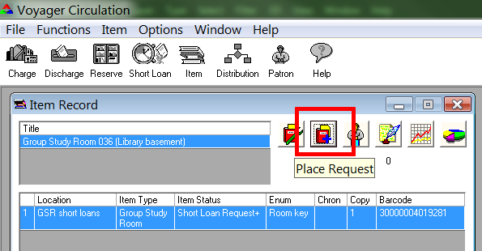
Short Loans - Staff Side cont’d

Slide 7
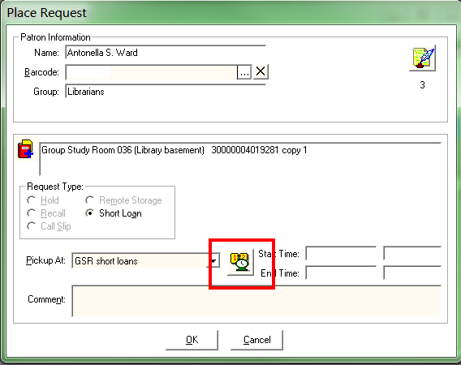
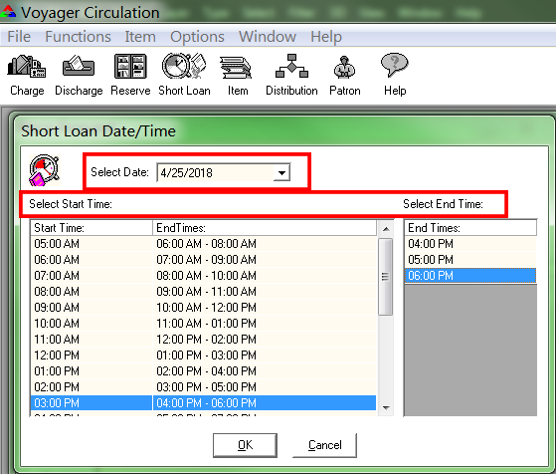
Short Loans - Staff Side cont’d

Slide 8
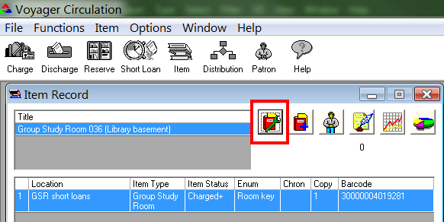
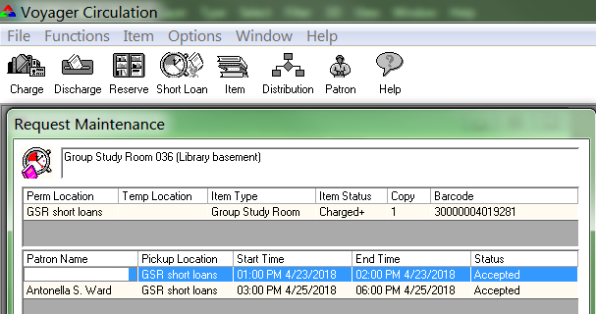
Short Loans - Staff Side cont’d
Notes:
The steps illustrated above show how a reservation request is input in the Circ module. At the time of check out, each work station at the Circulation desk is equipped with laminated sheets displaying the room number and associated barcode. The patron checking out the room receives a binder with a set of instructions and the key to unlock/lock the room.

Slide 9
Short Loans - Patron/Staff Side
TIP: Maintain an excellent working relationship with your Voyager Server Admin
ASU Library Study Rooms home page
Group Study Room schedule Individual Study Room schedule
Notes:
My Voyager server admin installed the files developed by Michael Doran, and troubleshoots issues on the server side related to those files.
The Study Room home page provide patrons with details about features and amenities found in each study room. The schedules give both staff and patrons the ability to see at a glance which rooms are available or reserved from the current day to 14 days in the future.

