Slide 1
The Role of Assessment Literacy in Empowering
Instructors to Engage in Meaningful
Pedagogical Alignment
Catherine Baumann, Director
Shinhye Lee, LPII Coordinator
University of Chicago Language Center
University of Chicago Language Center

Slide 2

Language Pedagogy Innovation Initiative (Autumn 2016)
Significant professional development for LCTL instructors across the Big Ten and Ivy+, leading to cross-institutional Collaborative Partnerships
Language Pedagogy Innovation Initiative (Autumn 2017)
Local funds for curricular innovation through reverse design and alignment across all languages
Insights from both projects evolve into this process:
  • ACTFL 4-day OPI workshop
  • Test Design and Development workshops
  • Instructors create end-of-sequence 4-skills assessments
  • Instructors engage in curricular realignment
Funds to support or compensate instructors at each phase.
The Role of Assessment Literacy in Empowering Instructors

Slide 3
Why these key steps?
ACTFL 4-day OPI workshop “pedagogical incubator”
• delivers assessment literacy
• common language of levels and outcomes
• “implications and applications” session in all workshops
• participants start thinking about their curricula during the workshop
• community of experts
• outcomes MUST be defined using ACTFL GL (or CEFR scales)
The Role of Assessment Literacy in Empowering Instructors

Slide 4
Why these key steps?
Test design and development workshops and creation of 4-skills assessments
• hands-on approach working with instructors
• ensure valid assessments
  • design and development of 4-skills assessments
Curricular realignment
• ONLY when assessments were in place
• informed by reverse design
• intimate knowledge and comprehension of assessment
agency
operationalization
The Role of Assessment Literacy in Empowering Instructors

Slide 5
The Role of Assessment Literacy in Empowering Instructors

Slide 6
Operationalization of identified outcomes
Reverse design, i.e. working back from outcome not new to most of us, HOWEVER
the step from outcome to test task – operationalization – is critical and is best accomplished
when informed through assessment literacy
  how to define the skill: what does intermediate listening look like?
  how one needs to be teaching and practicing the skill
  how learners will prepare for an assessment in that skill
The Role of Assessment Literacy in Empowering Instructors

Slide 7
Operationalization 1. Intermediate low listening comprehension, M/C
You hear a phone message about a change in plans. Choose the best answer. You will hear the message twice.
Where are the friends planning to go? a. a movie c. sailing b. a concert d. swimming | 2. Where will they meet before the event? a. a café c. the caller’s house b. the caller’s workplace d. the subway station
3. Why does the caller need to change plans? a. illness c. traffic b. work d. got lost | 4. How will the caller make up for the change of plans? a. buy dinner c. pay for tickets b. apologize d. pay next time
The Role of Assessment Literacy in Empowering Instructors

Slide 8
Operationalization 2. Intermediate low listening comprehension, table fill-in
You hear a phone message about a change in plans. Fill in the table, using English. You will hear the message twice.
Details about the event
Plans for before the event and changes
Plans for after the event and changes
The Role of Assessment Literacy in Empowering Instructors

Slide 9
Operationalization and assessment literacy
think deliberately about the characteristics of the outcome (IL listening)
what evidence is needed to demonstrate INTERMEDIATE (not Novice) listening
constructed response over selected response
gets at intermediate-level function “creating with language”
The Role of Assessment Literacy in Empowering Instructors

Slide 10
Operationalization Washback
will my learners be able to succeed at this task?
what am I doing in the classroom to prepare them?
how am I using materials? which materials will be most effective?
how am I using pre-F2F and F2F time?
what kinds of formative testing am I doing?
The Role of Assessment Literacy in Empowering Instructors

Slide 11
Operationalization, assessment literacy and instructor agency
instructor buy-in: I want to do this, my choice, as opposed to top-down mandates
agency goes beyond buy-in
  I identified the outcomes
  I designed the assessment
  I understand the design of the assessment and its operationalization
  I’m accountable for implementing instruction that makes my learners perform successfully on these (i.e. my) assessments
Readiness and buy-in for curricular realignment and redevelopment.
The Role of Assessment Literacy in Empowering Instructors

Slide 12
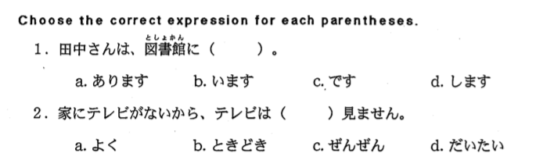
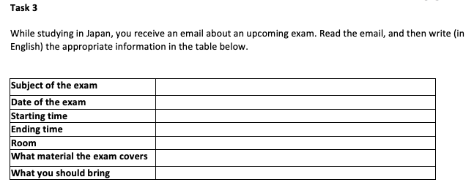
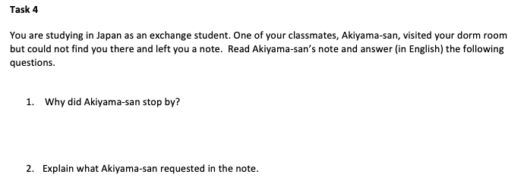
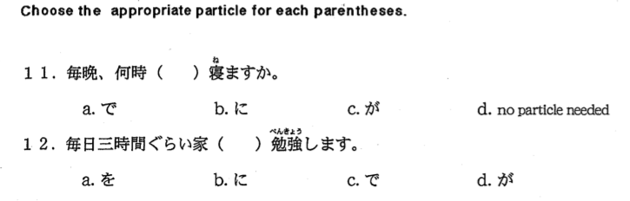
Japanese Competency: Reading
Previous
Current
Functional Language Use
Test Usefulness
2.32

Slide 13
Instructor Voices
On reverse design:
So I think ironically by having this work like really rigid assessment criteria in the end, that is actually an invitation for teachers to do their own thing throughout the year because if you are defining it by a book in a way you don't have time to be an inventor, you don't have time to be yourself. Rather if you define it through by goals then different teachers can use whatever themes they want to stress in the classrooms and introduce the language, so I feel like having a professionally determined, structure, research-based assessments at the end, have been strongly time-consuming but in the end when we have that in place, we are liberating teachers. And you don't have to watch over them.
Arabic instructor
The Role of Assessment Literacy in Empowering Instructors

Slide 14
Instructor Voices
On programmatic perspective:
I think before even among East Asian languages, the Chinese, Korean and Japanese has been really independent but we started talking each other much more. And in the big picture we didn't really have any connections with European languages, but now as a whole of language courses, we started to meeting the teachers we never could meet to exchange ideas. We met them through workshops. And even though the different languages, the goal is very same. So we started to exchange information about courses, differences, and we understand each other very well. So that is very good.
Japanese instructor
The Role of Assessment Literacy in Empowering Instructors

Slide 15
Instructor Voices
On articulation:
“This initiative definitely helped us to think, especially think of the program as a whole, and we feel very confident that now we’ve became a better articulating language program. I also obviously see the impact on our department as a whole in the ways really positive. Now we have the capacity and mindset to probably inform the faculties on what students can do and not do by the end of X years of language study.”
Polish
The Role of Assessment Literacy in Empowering Instructors

Slide 16
Instructor Voices
On the textbook in the curriculum:
“If you are defining it [curricular goals] by a textbook, in a way you, don't have time to be an inventor, you don't have time to be yourself as an effective teacher. Rather, if you define it through by the real-life language goals, then different teachers can use whatever themes they want to stress in the classrooms and introduce the language. So I feel like by participating in the LPII, we are now able to have a professionally determined, structured-, research-based assessments at the end, and when we have that in place, we are liberating our teachers. And as a program coordinator, with that curricular goal implemented in the program, you don't have to watch over whatever they do in their classrooms; as long as they are all in line with the target language goals.”
Chinese
The Role of Assessment Literacy in Empowering Instructors

Slide 17
Instructor Voices
On the methods:
“And also it helps us to rethink our teaching method. We usually start from our textbook, what's the objective and what do we need to cover, but after this program, I think it gives us more sense to initiate a teaching perspective not only guided by the textbook but also focusing more on the current students' ability and what we need to do to help them improve to the targeted level.”
Catalan
The Role of Assessment Literacy in Empowering Instructors

Slide 18
Thank you!
ccbauman@uchicago.edu
languages.uchicago.edu
The Role of Assessment Literacy in Empowering Instructors

