Slide 1

Casa de Salud Team:
Phoenix Leon
Health Apprentice Fellowship
Program Developer
Alejandra Casarrubias, RN
Clinical Manager
Erika Rios-Casillas
Health Apprentice Clinical Supervisor
Anjali Taneja, MD MPH
Executive Director
Integrative Medicine for the Underserved Conference, August 2019
Health Apprenticeship:
A Model for Transforming
the Healthcare Workforce and Developing Diverse Leaders

Slide 2
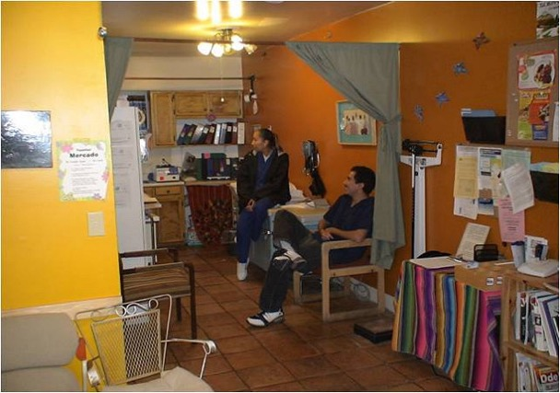
Topahkal Health Collective

Slide 3
Context: New Mexico
South Valley of Albuquerque
Huge disparities in access to primary care and behavioral health and in health outcomes (highest ER visit rates in the county)
Concentration of industry; poverty
Marginalized populations
>15 year decrease in life expectancy
Resiliency; tight knit grassroots community orgs, resources
New Mexico
1st or 2nd for per capita drug overdose death, alcohol related deaths
49th or 50th for kids’ health and poverty
50% of New Mexicans have Medicaid
Generational trauma, poverty. Also, generational wisdom
Unique factors: culture, trade routes, migration hx, isolation, racism

Slide 4
Context & vision: Casa de Salud
Decolonizing medicine, integrating healing modalities
Systems change advocacy and community organizing
Realignment of clinic/org with community
Accessible – no gatekeeping or barriers to care or time
Early direct primary care innovator for low-income community of color
Center and uplift marginalized populations, including immigrant families, low-income residents, active drug users, former heroin users, and queer and transgender community

Slide 5
Context & vision: Casa de Salud
Clinical Staff: Doctor of Oriental Medicine, Reiki master, Massage therapist, Social worker, Physicians, Nurse practitioners, Physician assistants, Nurse, Coaches, Community health workers, Health apprentices
Staff are employees on salary (not contractors)
Nonprofit pay equity model
Integrative case discussions, interactive staff meetings, clinician leadership
Flexible schedules, project and passion/leadership development time
Shared mission and vision
Women of color led organization, entirely female board of directors

Slide 6
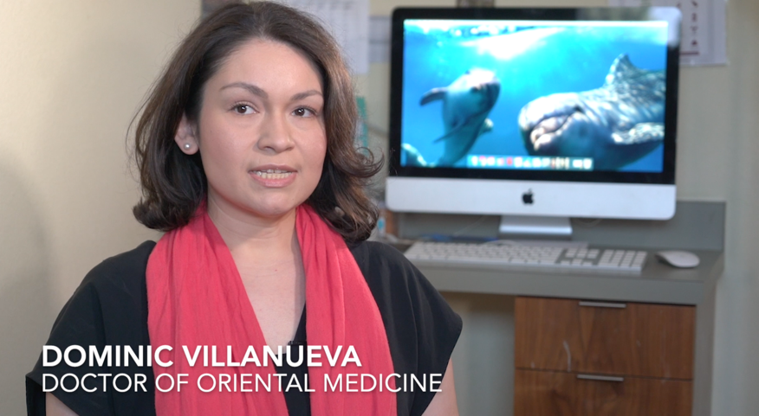

Slide 7
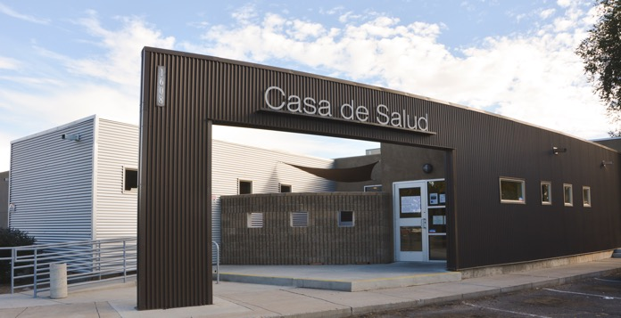

Slide 8
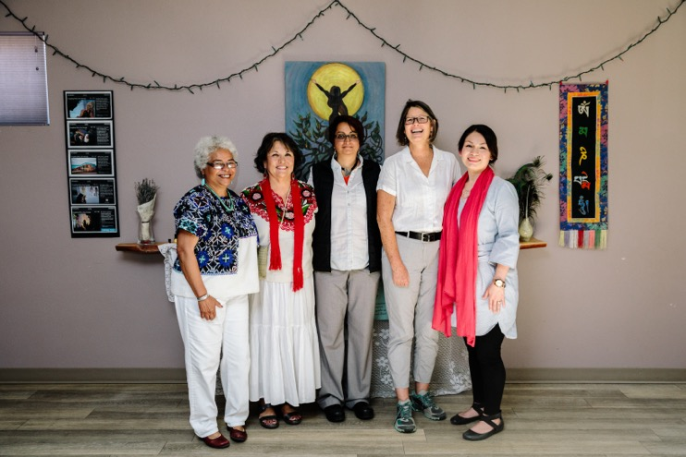
Copyright 2017 William Widmer. Used with permission from the Robert Wood Johnson Foundation.

Slide 9
Context & vision: Casa de Salud
Transparent pricing. $40 visit for consultation with any clinician, deeply discounted lab savings and procedure costs passed onto patients
Bills never sent to patients’ homes, accounts never sent to collections
90+% payment rate from poorest communities
Serve patients on medicaid (work to ensure medicaid is preserved)
Actively work to engage and assist patients who receive overwhelming medical debt from ER and hospital visits

Slide 10

VIDA: Vision for Dignity, Access, Accountability, and Access in Healthcare
Medical debt navigation and trainings
Over $2 million in medical bills saved
Regional health planning
Advocacy
Health navigation
Patient coalition

Slide 11
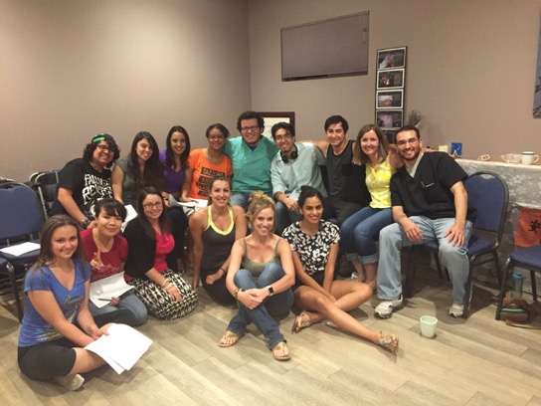
We have a privilege problem in medicine
Health apprentice program – one year commitment, 8 volunteer hours per week, run the clinic (MA skills, culturally relevant interactions, admin, creative projects)
Students from community, many 1st generation, youth of color. 200 alumni apprentices
Successful pipeline program for a state with brain drain + oldest primary care workforce in the U.S.
10% of 2015 UNM 1st year med school class were former apprentices

Slide 12
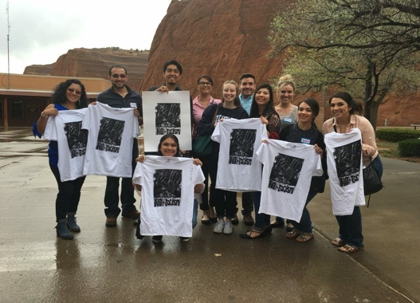
Our Team
Demanding equity
& accessibility in healthcare

Slide 13
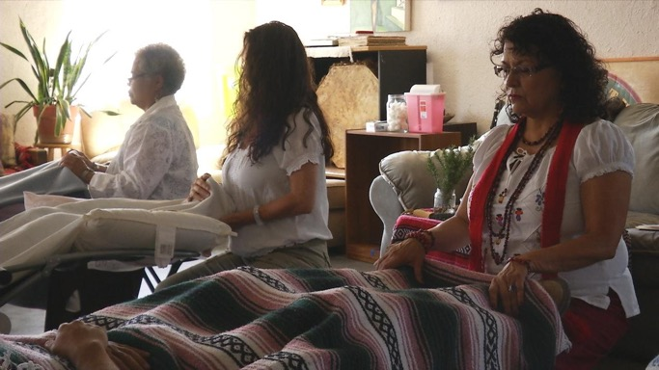
Nationally recognized recovery program for opioid addictions:
Raices Fuertes/ Strong Roots
Healing mind, body, & soul

Slide 14
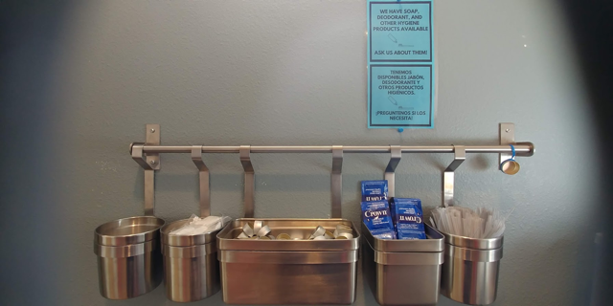
“Addiction rates are higher in poor people—not because they are less moral or have greater access to drugs, but because they are more likely to experience childhood trauma, chronic stress, high school dropout, mental illness and unemployment, all of which raise the odds of getting and staying hooked.”
– Maia Szalavitz

Slide 15
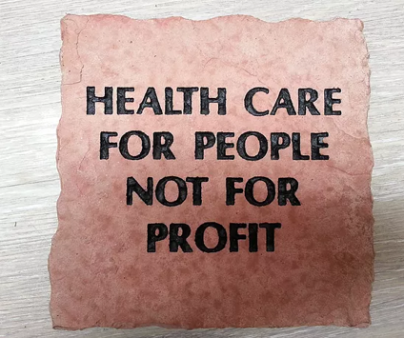
Our Values
Mind/ Body/ Soul Approach
  Recognizing that trauma is stored in the body
  Treating patients as a whole being to provide healthcare that heals
Dignity and mutual respect
Anti-racism
Cultural humility
Understanding oppressions and inequality in the community
Taking responsibility for transforming the current healthcare model
Embodying the concept of “harm reduction” in drug use and treatment

Slide 16
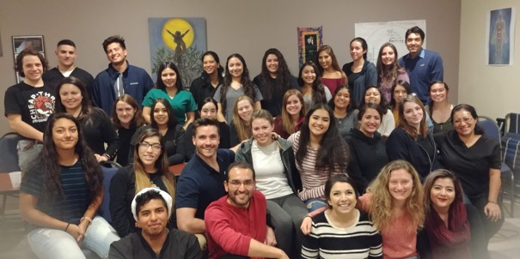
Fellowship Program
Community service ㄧLeadership experience
Direct patient care ㄧHumility
  Vital signs, charting patient information, phlebotomy training, medical interpretation, EKGs.
Safe learning environment with
supportive mentors
Meaningful & Respectable training:
patient advocacy, integrative medicine,
marginalized populations
Young adults, immigrants, ESL
students, 1st generation college students

Slide 17
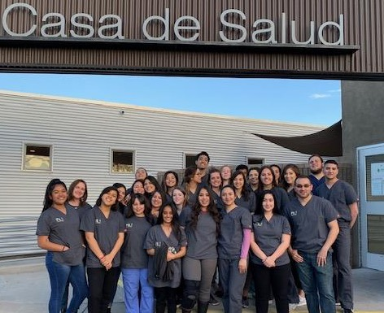
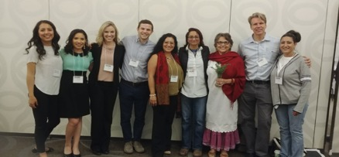

Slide 18
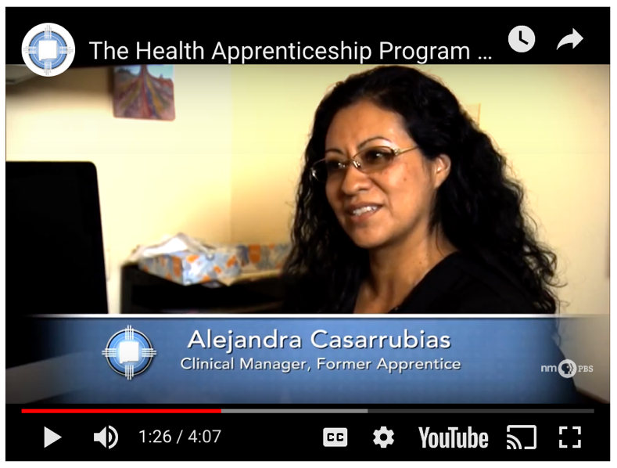

Slide 19
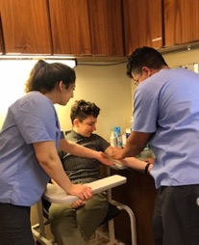
Application Requirements
  Commit to at least one year of volunteering
  Dedicate at least eight hours/week (15-20 hours/week if UNM or CNM work-study qualified student)
  Demonstrate proficiency in Spanish speaking, reading, and writing skills
  Ability to effectively multitask in a fast paced environment
  Driven to provide quality health care with compassion
  *At least 16 years old

Slide 20
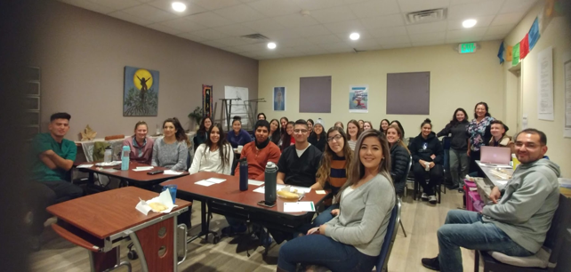
Socioeconomic Status and Educational Outcomes
  >80% of apprentices identify themselves as a minority
  >80% of apprentices are women
  Many apprentices come from immigrant families and/or families without great privilege

Slide 21
Does Diversity Matter for Health? Experimental Evidence from Oakland
Marcella Alsan, Owen Garrick, Grant Graziani
June 2018
1,300 black men from Oakland, CA. 14 black & non-black male doctors.
Those who utilized the clinic voucher were more likely to be unemployed, less likely to have graduated high school, less likely to have a primary care provider, and more likely to have visited the ER
Blacks comprise approximately 13% of the U.S. population but only 4% of physicians and less than 7% of recent medical school graduates
Upon interacting with their doctor, subjects assigned to black doctors increased screening services by 16 percentage points compares to non-black doctors

Slide 22
Does Diversity Matter for Health? Experimental Evidence from Oakland
Marcella Alsan, Owen Garrick, Grant Graziani
June 2018
Evidence pointed to better trust and communication between black subjects and black doctors than between black subjects and non-black doctors (based on subject feedback forms and doctor notes)
Subjects were 29% more likely to talk with black male doctors about their health problems outside of offered screenings
Black doctors were able to convince 26% of subjects to get the flu shot who initially declined the flu shot, even after an incentive was offered
It was calculated that increased screening could lead to a 19% reduction in the black-white male cardiovascular mortality and a 8% decline in the black-white male life expectancy gap

Slide 23
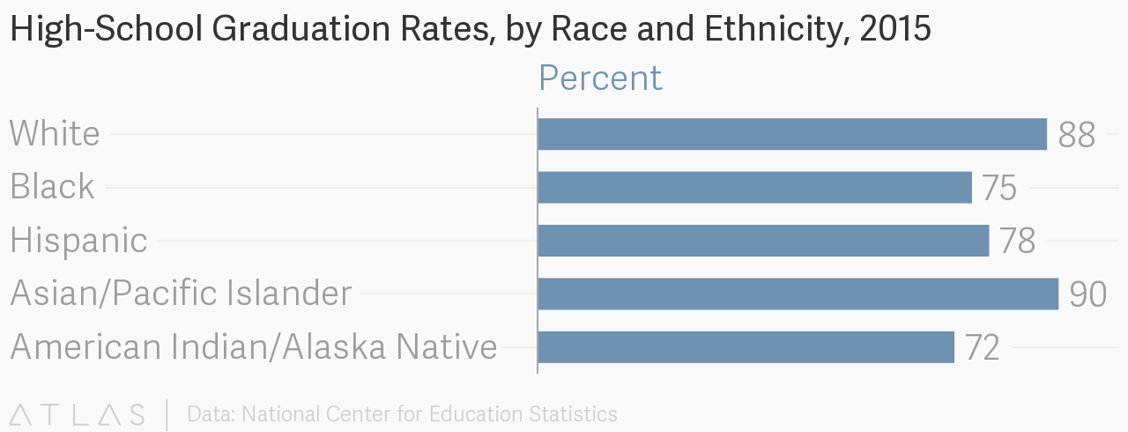

Slide 24
Adolescent Risk Behaviors and Young Adult Outcomes by Family Income Level
 | Youth from low-income families (n = 896) | Youth from middle-income families (n = 594) | Youth from high-income families (n = 365) | All youth (n = 2,041)
Highest Degree Completed by Age 23-24
None | 29% | 10%* | 5%* | 17%
High school diploma | 55% | 54% | 39%* | 51%
Associates degree | 5% | 8% | 5% | 6%
Four-year college degree or higher | 10% | 28%* | 50%* | 26%
Source: ASPE, 30 Mar. 2017,

Slide 25
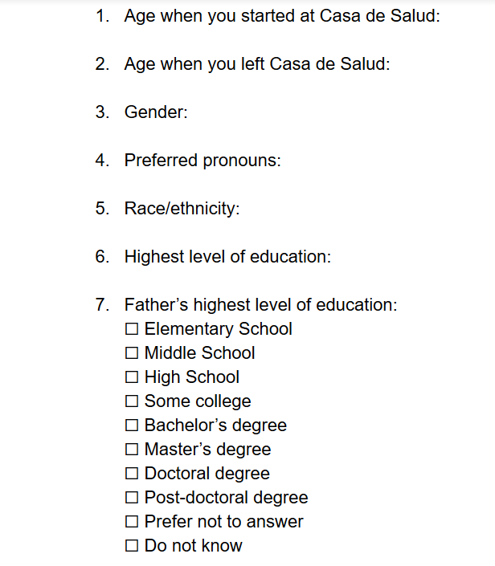
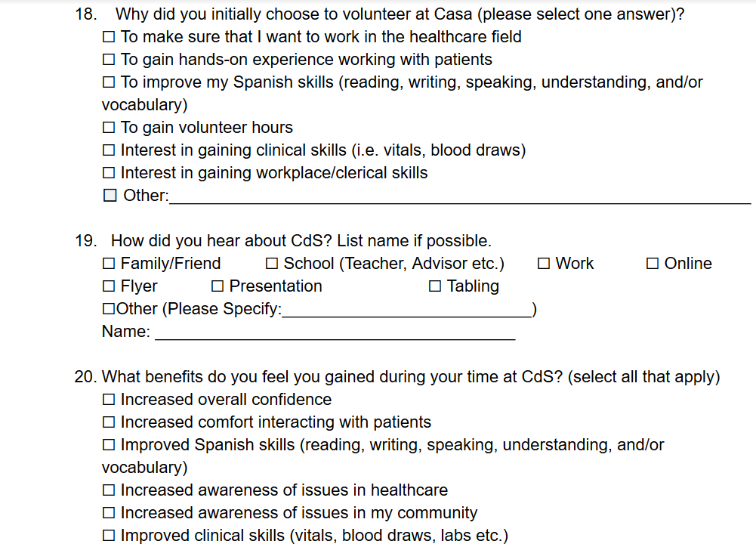

Slide 26
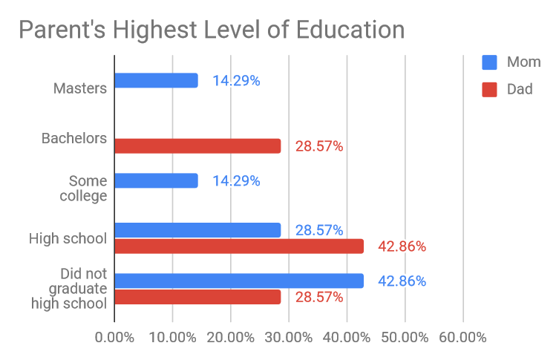

Slide 27
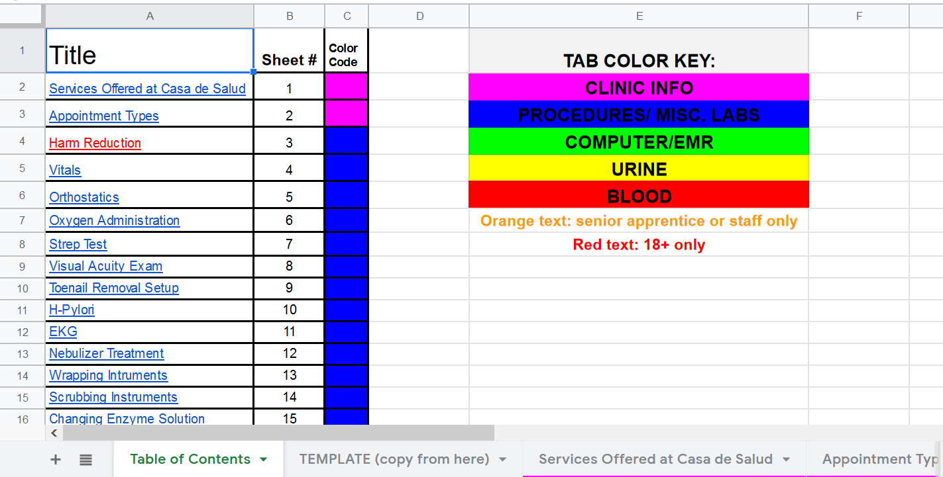
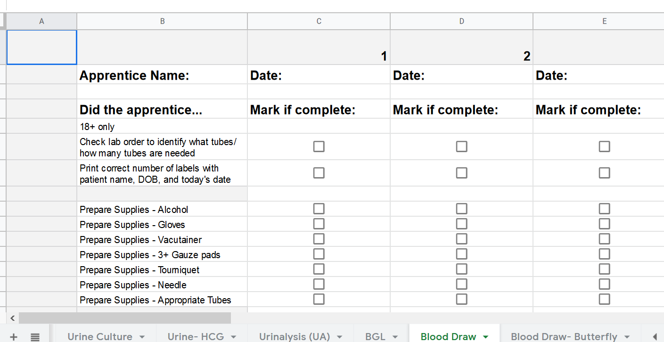
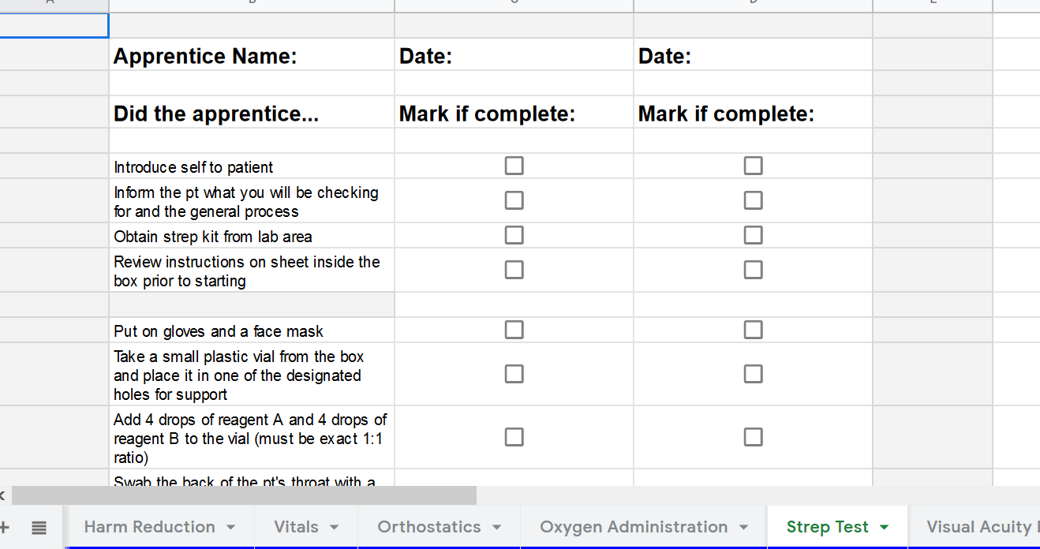

Slide 28
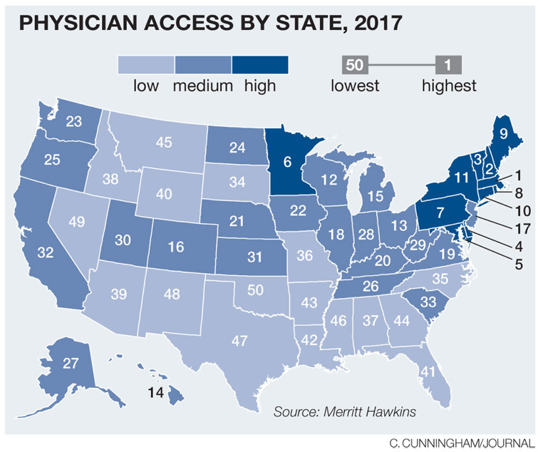

Slide 29
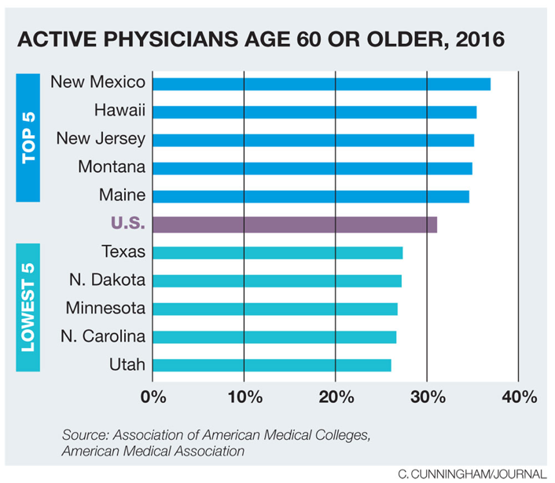

Slide 30
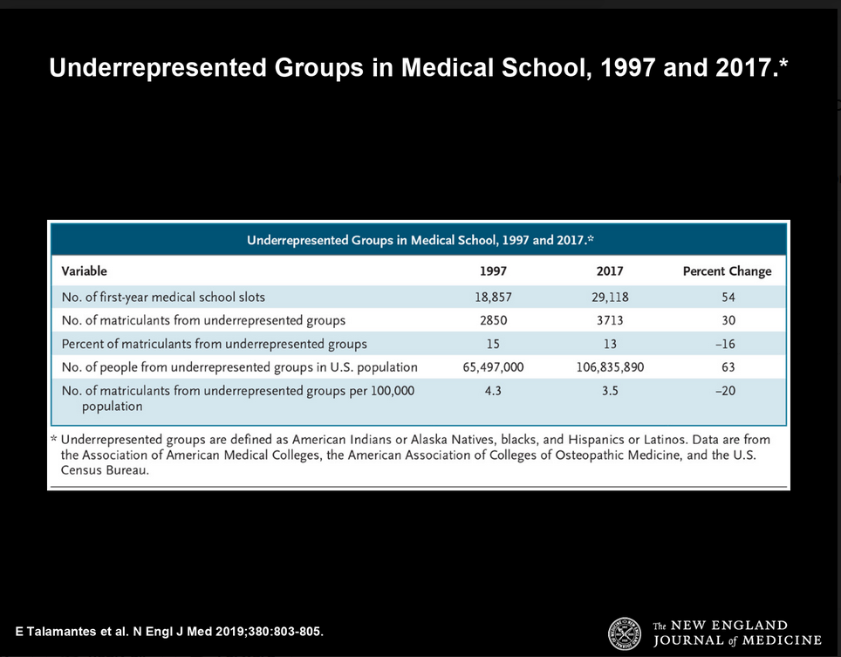

Slide 31
Benefits of Health Apprentice Fellowship Program for Albuquerque and New Mexico
Exposing future healthcare professionals to marginalized populations and accessibility issues in medicine
Increasing the number of healthcare professionals by providing the valuable experiences needed to enter graduate level programs
Most fellows that go onto medical school and other schooling stay in New Mexico to serve underserved populations
Increasing diversity of healthcare professionals
Helping with the clinician shortage in N.M.
Job creation: Apprentices able to move up to join staff team

Slide 32
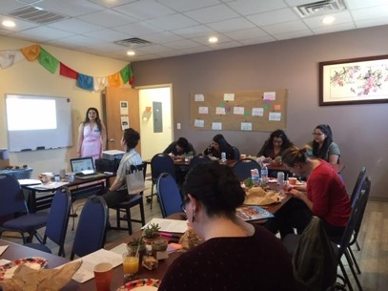
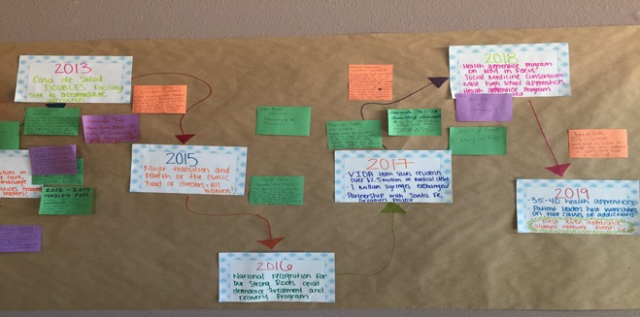
2019:
Launch of Alumni Network

Slide 33
Next Steps with the Fellowship Program:
Converting to formalized fellowship
Guaranteed trainings/ seminars/ conferences throughout the year
Workshops for resume/CV building, personal statement assistance
Formalized curriculum
Formal surveys to collect feedback
More hands-on training, case studies, imaging findings, EKG findings, etc.
Recognized diploma/ certificate at the completion of the program
Advance connections with other clinicians and organizations in the community for more mentorship and shadowing opportunities
Stipend or savings account throughout fellowship
Stipend/ scholarships to assist with cost of study materials, test-prep materials, cost of test (GRE, MCAT, PCAT, HESI, etc.)

Slide 34
Challenges We’ve Faced
Consistent trainings / conferences offered in predictable locations
Funding needs
Health apprentice turnover
Lack of consistent communication with alumni
Frequent updates and changing of policies in the clinic

Slide 35
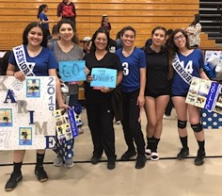
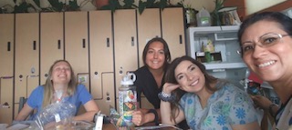
“There is no power for change greater than a community discovering what it cares about”
-Margaret J. Wheatley

Slide 36

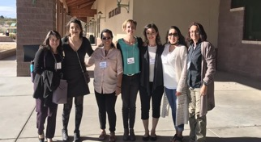
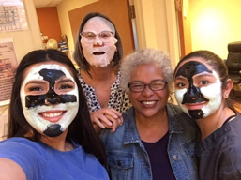
  “One of the greatest values of mentors is the ability to see ahead what others cannot see and to help them navigate a course to their destination.”
— John C. Maxwell

Slide 37
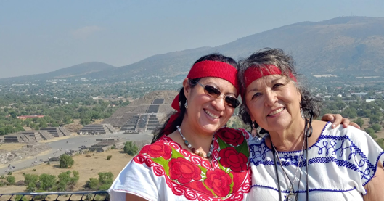

“A mentor is someone who allows you to see
the hope inside yourself.” – Oprah Winfrey
Mentorship
Teaching
Guidance
Involvement
Encouragement
Hope
Peer support
Trust

Slide 38
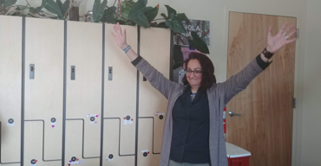
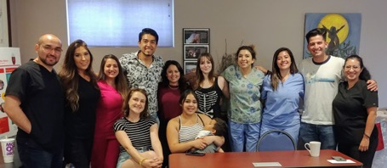
Meetings
Weekly Clinical Operations Meetings
Bi-weekly Staff Meetings
Monthly All Apprentices Meetings
Monthly Senior Apprentice Meetings

Slide 39

Clinic Management
Nursing
Management
Mentoring
Professionalism
Patient care
Quality of care
Trauma informed care
Best practices
Protocols
Notes:
Story, mentoring, clinical Manager, Meetings, social events, Apprentices, nursing

Slide 40
Health Apprentice Testimonials
It’s a color, a feeling
A love that bloomed, through the bad and good.
I still want to be within its breathe
Casa became a place where I grew. Where I added to the lives of others.
Where my abilities flourished
Looking at me, you couldn’t tell that I can draw your blood
or explain an A1c
I have that ability.
It’s a love that I hope can continue to develop between medicine and me.
It’s a color.
-Maranda Perez

Slide 41
Testimonials from Former Health Apprentices
“Volunteering at Casa de Salud was not only an extremely rewarding experience, but I firmly believe the applied skills I gained while there were pivotal in my acceptances to Master of Public Health Programs. The training and hands on approach afforded to apprentices in addition to working alongside seasoned clinicians is incredibly unique to Casa de Salud. I will always cherish my time volunteering alongside amazing apprentices at CdS! “
– Gina Gonzales, Columbia University MPH
“My time at Casa de Salud was so valuable and formative for my personal growth and future career as a physician. Through my volunteer hours at the clinic, I learned how to communicate effectively with patients while taking vital signs and health histories, as well as other skills like blood draws. I also learned the importance of humility - a critical trait for any future healthcare provider. I learned that I truly want to serve others in my future practice, especially patients that have been marginalized or underserved by the healthcare system.”
– Maranda Perez

Slide 42
Stories

Slide 43
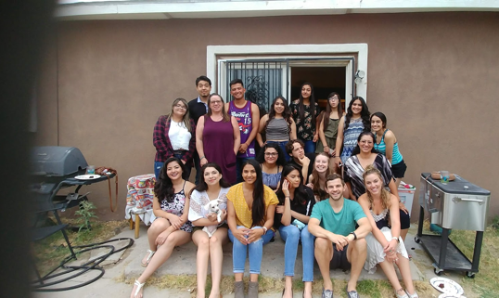


Slide 44
We would love to hear from you, learn from you, build with you!
Emails:
  anjali@casadesaludnm.org
  erika@casadesaludnm.org
  alejandra@casadesaludnm.org
  phoenix@casadesaludnm.org
Website: casadesaludnm.org
Facebook, twitter, Instagram: @casadesaludnm
Address: 1608 Isleta Blvd. SW. Albuquerque, NM 87105
Phone: 505-907-8311

Slide 45
Sources
Alsan, Marcella, et al. “Does Diversity Matter for Health? Experimental Evidence from Oakland.” 2018, doi:10.3386/w24787.
Heild, Colleen. “NM Faces Hurdles Recruiting Doctors.” Albuquerque Journal, 2019, www.abqjournal.com/1284623/nm-faces-hurdles-recruiting-doctors.html.
Heild, Colleen. “Initiatives Could Bolster NM's Physician Ranks.” Albuquerque Journal, 25 Feb. 2019, www.abqjournal.com/1284863/feeling-the-pain-initiatives-could-bolster-nms-physician-ranks.html.
Heild, Colleen. “Feeling the Pain: Waits Frustrate Patients Seeking Prompt Medical Care.” Albuquerque Journal, 16 Feb. 2019, www.abqjournal.com/1281756/feeling-the-pain-2.html.
Jjones. “High-School Graduation Rates, by Race and Ethnicity, 2015.” Atlas, Quartz, 28 June 2017, www.theatlas.com/charts/SJJazKb4W.
“Vulnerable Youth and the Transition to Adulthood: Youth from Low-Income Families.” ASPE, 30 Mar. 2017, aspe.hhs.gov/basic-report/vulnerable-youth-and-transition-adulthood-youth-low-income-families.

