Slide 1
Pushing the limit: Changing the face of school counseling in your building
Toni Dickerson, Ed.S.
2019 GSCA SCOTY Semi-Finalist
Lovinggood Middle School
Cobb County School District
Dawn M. Robinson, Ph.D., LPC, NCC
Assistant Professor of Human Services
University of South Carolina Beaufort
GSCA Conference 2019

Slide 2
“For a counselor, there’s no higher calling than improving the lives of their students academically, socially, and psychologically.” -Wake Forest University

Slide 3
Background

Slide 4
What barriers keep you from having a comprehensive school counseling program?
PollEv.com/tonidickerso913 or text tonidickerso913 to 22333

Slide 5
The Basics
1. Building a Foundation (Beliefs, Mission, Vision)
2. Helping Others to Understand the Role of School Counselors
3. Leadership Team
4. Data Collection and Analysis
5. Setting Program Goals
6. Gaining Buy-In
7. Changing the Face
8. Effective Programming
9. Sharing Your Results
10. Advertising Your Program
11. Advocate for Students and Your School Counseling Program

Slide 6
Building foundation
Identify your personal beliefs
Student benefits
Reflects beliefs for all students
Create/ revise a vision statement for your program that focuses on what your program will look like (future oriented)
Create/revise school counseling department mission
Alignment with the school and district mission

Slide 7
Building foundation
Examples:
Beliefs
As Professional School Counselors:
We believe that all students are able to learn and meet high standards when provided with an environment that is safe, nurturing, and conducive to their learning style.
We believe that student developmental needs are best met through the collaborative effort of all stakeholders in designing and implementing a comprehensive school counseling program.
We believe that school counselors must be leaders within their school communities, advocates for all students, and collaborators with key stakeholders in order to effectively meet the needs of all students.
We believe that certified professional school counselors are responsible for the planning, management, delivery, and evaluation of the comprehensive school counseling program.
We believe that school data must be evaluated to develop a comprehensive school counseling program that promotes student achievement.
We believe that as professional school counselors, we must utilize the ASCA ethical standards as a guide in order to make decisions that are centered around the best interests of all students.

Slide 8
Building foundation
Examples:
Our Mission
The mission of the school counseling program at XXX Elementary School is to provide all students with a comprehensive counseling program that removes barriers and promotes student growth in the areas of academics, college/career readiness, and personal/social development to ensure all students become socially competent future global leaders. In collaboration with key stakeholders, the school counselors will assist all students so that they are inspired to be lifelong learners and motivated to achieve excellence.
Examples:
Vision Statement
The students at XXX Elementary School recognize their unique learning styles, have the knowledge and power to realize their full potential, are lifelong learners, and are motivated to achieve excellence as contributors to a global society.

Slide 9
Helping others to understand the role of school counselors
Visibility
Annual Agreements
Annual and Weekly Calendar
Building Relationships
Involvement in School and community committees and organizations
School Leadership Team
Education
Faculty/staff meetings
Advisory Council
Classroom Core Curriculum at the start of the Year
Parent workshops and meetings
Community Events

Slide 10
Leadership Team
Helping others to understand our role
Advocating for all students
Providing input on academic, personal/social, and career development
Addressing issues of equity and access
Addressing achievement gaps
Helping others gain an understanding of systems and how they impact student achievement
Hearing multidisciplinary perspectives in identifying programming needs for school counseling department

Slide 11
Data Collection and Analysis What does the data show?
CCRPI
Peer Mediation
Closing the Gap programming
Feedback from programs/events
Needs Assessment
Are you TRULY making an impact?
Pre and Post Tests
Reality Check
This Photo by Unknown Author is licensed under CC BY-SA-NC

Slide 12
Needs Assessment
1028 respondents:
Students –1019
Parents – 3
Teachers – 3
Administrators – 2
Other –1
Grade Level Respondents:
9TH GRADE – 253
10TH GRADE – 232
11TH GRADE – 247
12TH GRADE – 289
N/A – 7

Slide 13
Needs assessment

Slide 14
Needs assessment

Slide 15
Needs assessment

Slide 16
Needs assessment

Slide 17
Needs assessment

Slide 18
Needs Assessment Elementary school teachers

Slide 19
NEEDS ASSESSMENT ELEMENTARY SChOOl Teachers

Slide 20
Needs assessment elementary school teachers

Slide 21
Data Collection and Analysis
Attendance Data
Achievement/Academic Data
Discipline Data
Share with a partner:
Name some ways you currently use data at your school?
This Photo by Unknown Author is licensed under CC BY-NC

Slide 22
Pre and Post Test
I believe that it is okay to call someone a name if they called me a name first.
A, True B. False
2. I believe that it is okay to hit someone if they hit me first.
A, True B. False
3. One of the steps of the debug system is:
A. Talk friendly
B. Hit
C. Call names
D. Yell
4. The second step of the debug system is:
A. Ignore
B. Walk away
C. Hit
D. Get adult help
5. Someone in your class is bugging you. What is the first thing that you will do?
A. Ignore them
B. Tell the teacher
C. Hit them
D. Bug them back
6. Someone on your bus is bugging you. You have used the first four steps of the debug system. What will you do last?
A. Get adult help
B. Ignore them
C. Bug them back
D. Hit them

Slide 23
Classroom core curriculum conflict resolution-second grade

Slide 24
Setting program goals
Data driven
School strategic plan/connected to school’s data
Address achievement, attendance, discipline
SMART-specific, measurable, attainable, results-oriented, time bound
Ex:
1) 90% (527) of Cohort 2015 will be promoted and on track for graduation at the end of the 2017-2018 school year, as compared to 85% (496) at the end of the 16-17 school year.
2) By May 1, 2017, the number of 9th grade students in In School Suspension (ISS) will decrease by 10% from 71/865 (8% of 9th grade students) during the 2015-2016 school year, to 63.2 (7.2% of 9th grade students) during the 2016-2017 school year.

Slide 25
Gaining Buy- In
Administrators
Staff
Students
Parents

Slide 26
Administrator Buy-in
Relationship Building
Sit-down meeting
Honest and open dialogue
What do they see from you?
Advisory Council
This Photo by Unknown Author is licensed under CC BY-NC

Slide 27
Staff Buy-In
Faculty Meeting presentations
Staff appreciation
Jeans days
College & Career Day
Counselor Advisory
Classroom lessons
Scheduling through subject areas
Department Liaisons
Wellness Weeks and Activities

Slide 28
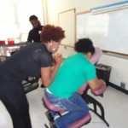
Wellness week
Staff De-stress Week
A week devoted to your wellness
February 29th-March 4th
Monday, February 29th
EXERCISE.
Afternoon walk—Come join us for an afternoon walk. We will meet in the front lobby at 3:00pm.
Tuesday, March 1st
YOUR PHYSICAL HEALTH. THE DIVINE SPINE. 9am-12pm
Complete Spine Solutions, will be available to provide free 5 minute massages and posture screenings in room 3. Please stop by if you would like a massage or screening. Services are first come, first serve. A sign-up sheet will be in the teacher’s lounge.
COPING. STRESS MANAGEMENT.
There will be a free stress management workshop in room 401 at 3:00pm.
Wednesday, March 2nd
YOGA.
Yoga class. Bring your yoga mats. We will meet in room 401 at 6:40 a.m. for morning yoga class (15-20 minutes).
Thursday, March 3rd
POSITIVE HUMOR.
De-stress through humor. Listen to the Avondale Comedy Crew on the morning announcements. Play your favorite practical joke on a close co-worker (for faculty/staff only, please be appropriate).
Friday, March 4th
PLAY. FOOD, FRIENDS, AND FUN. (School cookout, well sort of)
One of the best ways to deal with stress is to play and have fun. Come to the teacher’s lounge during your scheduled lunchtime for lots of food, fun and games. Gas South will be sponsoring the lunch. Lunch will be catered by Jim ‘N Nick’s Bar-B-Q.
HAVE A PEACEFUL, SAFE AND RESTFUL WEEKEND!!!
AVONDALE SCHOOL COUNSELING DEPARTMENT

Slide 29
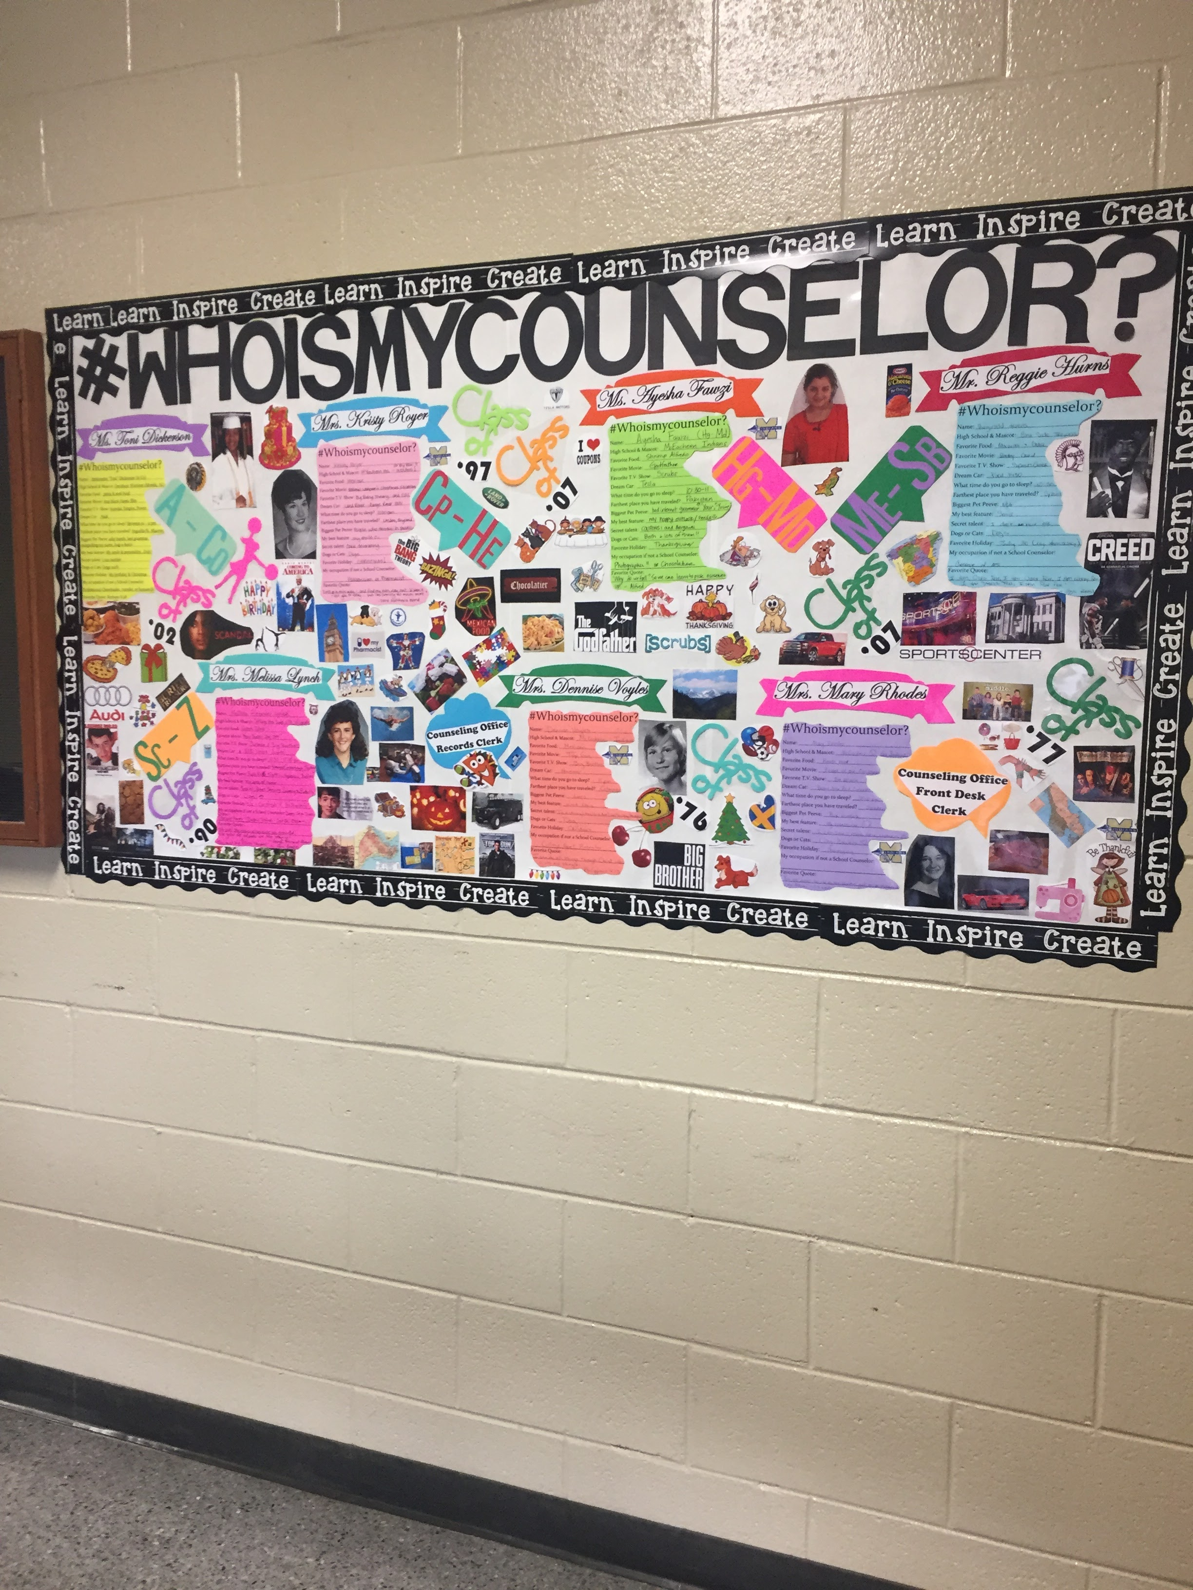
Student Buy-in
Who are the Counselors?
Faces in presentations
What does coming to the Counseling office mean?
Advisory Council
Student/Mentor Feedback (HS)
Snacks and food (small group, etc.)
Age appropriate lessons, groups, and setting
Use Students for Curriculum
Interactive/engaging lessons
Field trips
College Visits and Tours
Student of the Month

Slide 30
Parent Buy-in
PTA Meetings
MOMS of McEachern
Academic Boosters
Parent Breakfasts
All Pro Dads
Muffins with Moms
Coffee Talks
Coffee, Tea, and Sympathy
Volunteering in the office
Parent Workshops
Helping students to be successful
Helping children cope with anxiety/stress
Communicating with your child
Spending quality time with your child

Slide 31
How do you change the face?
Growth mindset
Attend conferences
Build the Right Team
Share the Data
Be “ok” with hearing NO
Change your programming

Slide 32
Effective programming
Classroom core curriculum
Use data to determine needs and assess effectiveness
Perception Data: Attitudes, skills, knowledge
Interactive and Engaging
Based on students’ interests
Current trends
Games/Technology with Lessons
Age appropriate

Slide 33
Effective programming
Small Group Counseling
Collect and analyze data
Perception Data: Student, staff, and parent surveys
Outcome Data:
Discipline data
Achievement data
Attendance data
Identify gaps
Collect baseline data
Collect data at close of group
Work with administrators and staff to determine scheduling needs

Slide 34
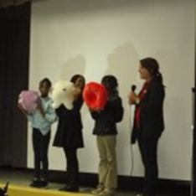
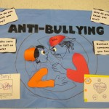
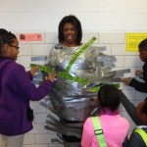
Programs and services
Parent Breakfast & Presentations – Arena style format or more intimate and interactive presentations
Mental Health Awareness Days
Counselor in the Café
Lunch and Learns
Birthday Acknowledgments
College/Themed Days
Cocoa/Coffee with the Counselors
College 101Games
Community Service

Slide 35
Programs and services cont’d
Collaboration with community agencies/organizations
Funding and support or programs and services
Junior Achievement
Big Brothers Big Sisters
Area Fraternities and Sororities
Peer helpers
Field Trips
College Visits and Tours
School Transitions

Slide 36
Sharing your results
Faculty/Staff meetings
PTA/PTSA meetings
Board Meetings
Community Events
Websites

Slide 37
Advocate For Students and your school counseling program
Use data
Discuss your results
Share experiences

Slide 38
Advertising Your program
Counseling blog and/or twitter
School website
School phone call-outs
School email blasts

Slide 39
Resources
Wake Forest University

Slide 40
Take-a-ways
Now that you have received this information, what are your next steps in creating an effective comprehensive school counseling program?
PollEv.com/tonidickerso913 or text tonidickerso913 to 22333

