Slide 1
SEI Kindergarten
Survival Guide
Jennifer Ellis
Allison Greco
Malden Public Schools
MATSOL
May 3, 2013

Slide 2
Agenda
Time: | Content:
5 min | Introduction
20 min | Overview of SEI Kindergarten Classroom Management Strategies: Routines, Procedures and Autonomy
15 min | Application of WIDA – Language of Social Instruction
5 min | Wrap up, next steps, ideas for immediate implementation
Notes:
Molly and Jen

Slide 3
SEI Kindergarten Survival Guide Objectives
Analyze components SEI Kindergarten classroom management routines and procedures.
Identify common classroom management techniques.
Analyze WIDA Standard (the use of Social Instructional Language, SIL) and academic discourse using student/teacher video clip samples in a Kindergarten classroom.
Create objectives according to WIDA standards using hands on application of strands and differentiation of procedures.
Create an action plan to implement SEI classroom management strategies.
Notes:
Review Objectives

Slide 4
“Every…educator ought to spend time in a kindergarten or first-grade class each year, just to look at and feel the excitement there. Children get excited about everything in the world. All the world is their stage, and there is nothing they cannot do, even though they cannot read, write, or spell. Yet they are ready to do anything you want them to do…
Notes:
We wanted to start off today with an excerpt from Harry Wong’s book. We think this speaks to the core of being a Kindergarten teacher….

Slide 5
…Then look at their teachers. They know that their charges cannot read, write, spell, or even speak correctly. Some of these students do not even know how to eat, use the bathroom, or hang up their jacket without help. Yet these teachers do not complain that they have a bunch of slow learners. Instead, their classrooms and their demeanor sparkle with an invitational attitude toward learning.” (Wong & Wong pg. 65)
Notes:
This excerpt is directly referring to us Kindergarten teachers. I know that one of the reasons why I stay teaching in this grade level is their feeling of invincibility, and we K teachers are ready to take that invincibility and use it to our teaching advantage. In this presentation we will be exploring how to foster this invincibility through effective teaching and good classroom management.
Im going to now hand the floor over to Allison.

Slide 6
What do the first few days of school look like in your classroom?
Group Participation

Slide 7
The First Days of School
Sweat the Small Stuff…

Slide 8
Preparation is Key
Before
Before the students arrive already have in place how you want everything in your classroom to run.
First Day
Model every procedure
Give feedback to help students understand what is expected.
School Year
Students will know what is expected of them and how to complete routines around the classroom.
Decrease students ideas that other behaviors may be acceptable
Plan all procedures through out the day starting with walking to the classroom and ending with leaving the building.
Whole group modeling along with individual assistance.
Notes:
Rules, routines, procedures. EVERYTHING must be planned before. You can not let the students show up and you think on the spot. You need to have direction before they arrive. Show how you want everything done, use ques, models, feedback, WHOLE GROUP – individual assistance if needed. When students know what to do they are less likely to test the waters. Helps accomplish goals quick and easily.

Slide 9
The Teacher will set the tone for the whole year…
Teacher
Students behavior
Class expectations
Class/students
organization
Notes:
It all falls back to what you taught the students. Behavior expectations, work expectations, do/ done folders, lunch, starting or ending the day.

Slide 10
Take Nothing For Granted
Locker routine
Lunch count
Seating arrangement
Lining up / Walking in line
Transitions
Circle time behavior
Visuals- Do not assume they can comprehend your oral instructions.

Slide 11
“ By the end of the first or second week, the entire class will have taken signals from you as to how they should behave for the rest of the school year.”
(Wong & Wong pg. 53)

Slide 12
Video clip
Notes:
Greco….table to line

Slide 13
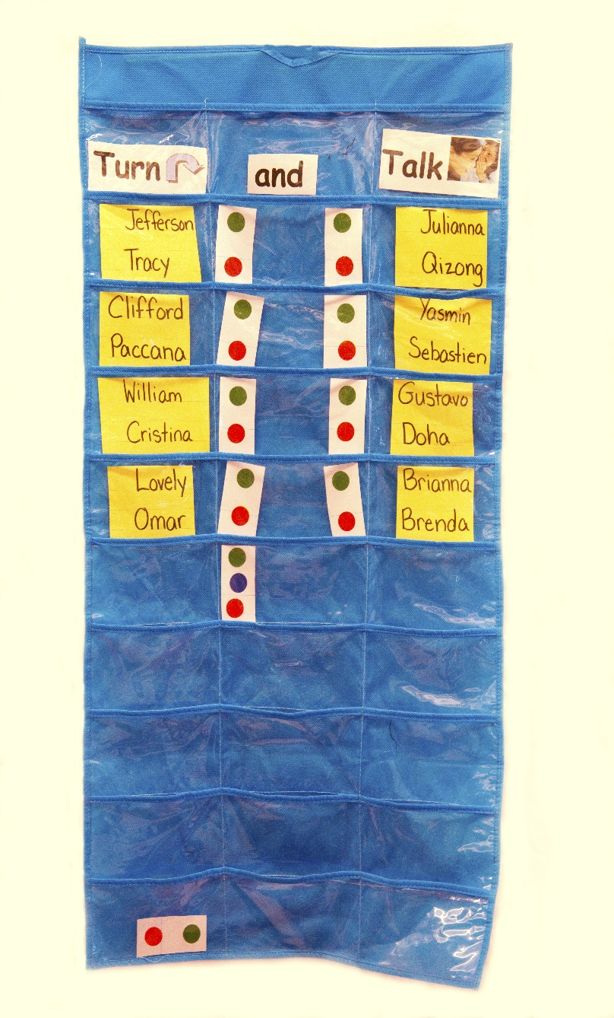
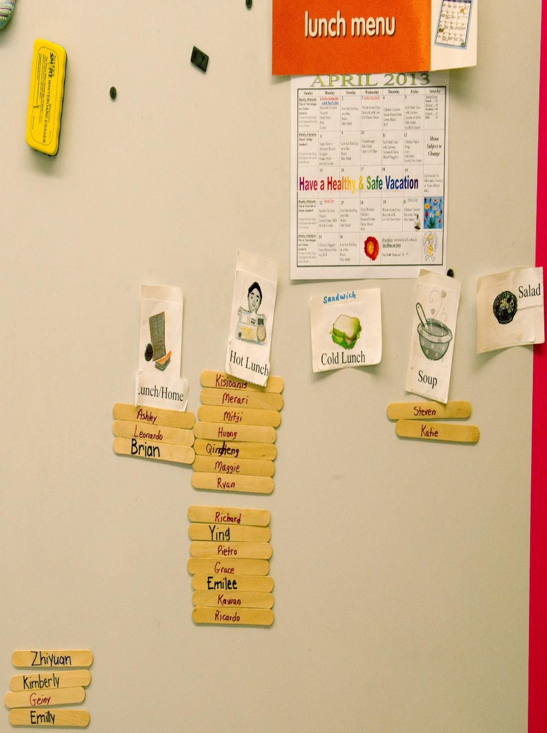

Slide 14
Video Clip
Notes:
Ellis…rotate 2

Slide 15
“ Student Achievement at the end of the year is directly related to the degree to which the teacher establishes good control of the classroom procedures in the very first week of the school year.” (Wong & Wong pg. 4)

Slide 16
Procedures, Rules, Routines
Procedures
A method for students to complete activities around the classroom.
Rules
Focus on students behavior
Incorporates penalties and rewards
Routines
Independent
Activities students complete automatically in the classroom.
Discipline is not incorporated
Notes:
Procedures and Rules become routines. Students follow teachers lead for procedures and rules – Routines are done independently.

Slide 17
Procedures vs. Rules
Procedures
Arrival/ Dismissal
Bathroom
Rules
Classroom Rules
Behavior Expectations
Routines
Effective Transitions
Engaged Student Learning
Notes:
Procedures and Rules become routines. Teacher demonstrates procedures and rules which become routines independent.

Slide 18
Consistency
Procedures
Rules
Routines
Effective Learning Environment
Notes:
Consistency is the KEY that holds everything together.

Slide 19
“ The number one problem in the classroom is not discipline; it is the lack of procedures and routines.” (Wong & Wong, pg. 167)

