Slide 2


The Choreography of Collaboration:
A case for sustainable academic partnerships

Slide 3
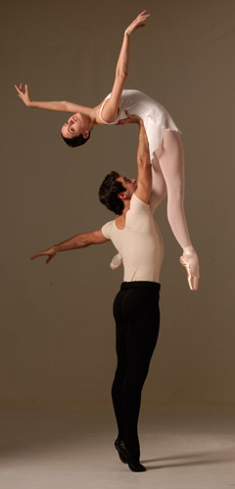


Presenters:
Kristi Woodworth
Assistant Director of Partnerships & Alliances
k.woodworth@neu.edu
Dave Czesniuk
Assistant Dean of Partnerships & Alliances
Executive Director for Community Engagement
d.czesniuk@neu.edu

Slide 4
Agenda
College Overview
Boston Ballet & CPS Partnership
Partnership Basics
Assessing Partnerships
Cross-functional Collaboration
Creating Visibility

Slide 5
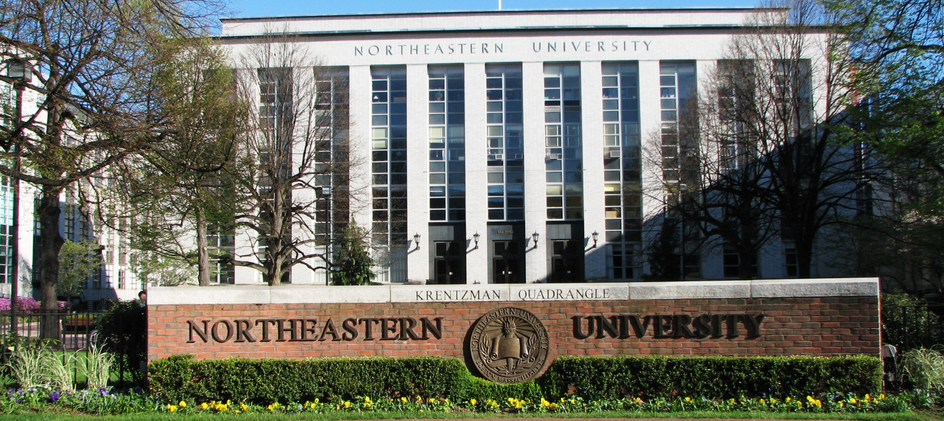
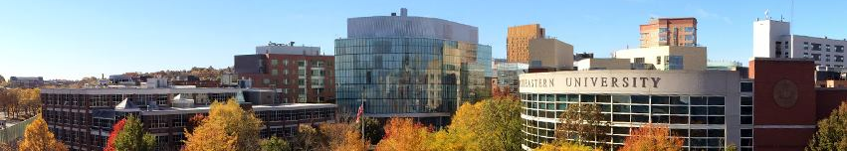
Northeastern University
9 Colleges
College of Professional Studies
10,700 Students
40,000+ Alumni Base
85 Countries
70+ Programs
Flexible (on-ground & online)
Faculty (industry leaders & scholars)
2 Regional campuses (Seattle & Charlotte)

Slide 6
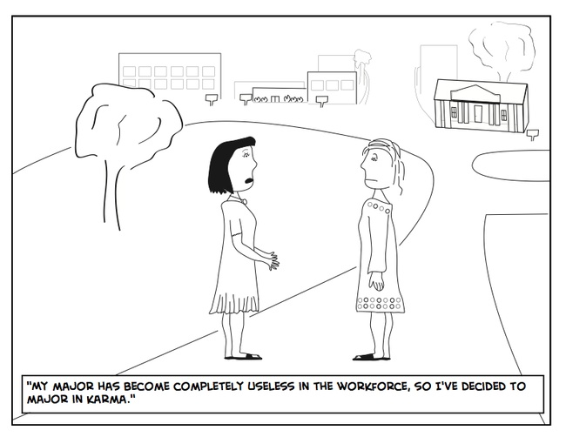

Slide 7
Mission
Committed to providing career-focused educational programs that are designed to accommodate the complex lives of motivated learners. Offered in a variety of innovative formats, our courses are taught by accomplished scholars and practitioners who have real-world experience. The result is an educational experience founded on proven scholarship, strengthened with practical application, and sustained by academic excellence.
Access
Excellence
Innovation
Student-focused
Global
Notes:
CORE VALUES:
Access High-quality, world-class education, which allows them to achieve their career goals and aspirations. History of providing educational opportunities to adult learners, diverse urban groups, and international students, which are highly aligned with industry-specific requirements and skills.
Excellence Career-focused educational programs provide the highest level of academic excellence to prepare our students with real-world experience. Commitment to quality pervades all aspects of program design and assessment.
Innovation Driven by understanding that higher educational delivery must be managed in a fiscally sustainable model, enabling the enterprise to secure resources and infrastructure to achieve and strengthen its mission. Our innovative course design and flexible delivery models are defined by the evolving needs of the global student community and ensure that our programs meet the needs of adult learners and working professionals regardless of geographic location or industry.
Student-focused We serve as catalysts to transform the academic experience to meet the needs of students. Deliver an academic experience that is highly relevant and enriching to our students’ lives .
Global
Curriculum developed to align with needs of the global economy’s leading industries. The diversity of our students reflects the global economy in which they will practice.

Slide 8
Vision
Career advancement for working adults
Global education with a focus on strategic partnerships
Leading educational delivery with exceptional accessibility
Innovative models serving urban students in pursuit of
college degrees

Slide 9
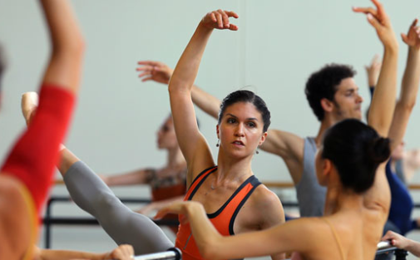
Boston Ballet
“The future of dance depends on the talent of our artists.”

Slide 10
Boston Ballet and CPS Partnership
Unique, innovative program
Adaptable learning models
Experiential learning
High-level services
Cohort Camaraderie

Slide 11
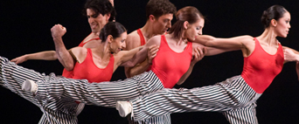

Boston Ballet Education Program
Bachelors, masters, or certificate program with scholarship
World-class education
Degree in 5 - 6.75 years
Choice of any CPS program
Career Counseling

Slide 12
Top Bachelor’s Degrees:
English
Graphic Design
Political Science
Psychology
Information Technology
Leadership
Management
Organizational Communication
Liberal Arts and Business
Top Master’s Degrees:
Corporate & Organizational Communication
Global Studies and International Affairs
Human Services in Leadership
Leadership
Nonprofit Management
Project Management

Slide 13
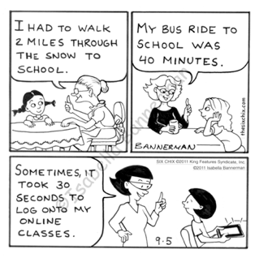

Slide 14
Adaptable Learning Models
6.75 Year Undergraduate Curriculum Map
 | SU |  |  |  | FL |  |  |  | WI |  |  |  | SP
 | A Session |  | B Session |  | A Session |  | B Session |  | A Session |  | B Session |  | A Session |  | B Session
 | CL 1 - | 8 WK |  |  | CL 4 - 12 WK |  |  |  | CL 5 - 12 WK |  |  |  | CL 7 - 12 WK
 | CL 2 - | 8 WK |  |  |  |  |  |  | CL 6 - | 12 WK |  |  | CL 8 - | 12 WK
 | CL 3 - 8 WK
 | A Session |  | B Session |  | A Session |  | B Session |  | A Session |  | B Session |  | A Session |  | B Session
 | JULY |  |  |  | SEPT |  |  |  | JAN |  |  |  | APR
Optimal Course Load per Term
 |  |  | 9 qhs |  |  |  | 3 qhs |  |  |  | 6 qhs |  |  |  | 6 qhs
Heavy Performance/Rehearsal
Season
cycle of activity for dancers
# of Credits Earned: 24 quarter hours per year
Degree in 6 Years + 3 Terms (27 Terms)
Hybrid/Blended Classes = 2 hours live class + 4 hours prep/homework per week
Online Classes = 6-7 hours prep/homework per week

Slide 15
Adaptable Learning Models
5.3 Year Undergraduate Curriculum Map
 | SU |  |  |  | FL |  |  |  | WI |  |  |  | SP
 | A Session |  | B Session |  | A Session |  | B Session |  | A Session |  | B Session |  | A Session |  | B Session
 | CL 1 - | 8 WK |  |  | CL 4 - 12 WK |  |  |  | CL 6 - 12 WK |  |  |  | CL 8 - 12 WK
 | CL 2 - | 8 WK |  |  | CL 5 - | 6 WK |  |  | CL 7 - | 12 WK |  |  | CL 9 - | 12 WK
 | CL 3 - 8 WK |  |  |  |  |  |  |  |  |  |  |  |  |  | CL 10 – 6 WK
 | A Session |  | B Session |  | A Session |  | B Session |  | A Session |  | B Session |  | A Session |  | B Session
 | JULY |  |  |  | SEPT |  |  |  | JAN |  |  |  | APR
Optimal Course Load per Term
 |  |  | 9 qhs |  | 3 qhs |  | 3 qhs |  |  |  | 6 qhs |  |  |  | 9 qhs
Heavy Performance/Rehearsal
Season
cycle of activity for dancers
# of Credits Earned: 30 quarter hours per year
Degree in 5 Years + 1.5 Terms (21.5 Terms)
Hybrid/Blended Classes = 2 hours live class + 4 hours prep/homework per week
Online Classes = 6-7 hours prep/homework per week

Slide 16


Slide 17
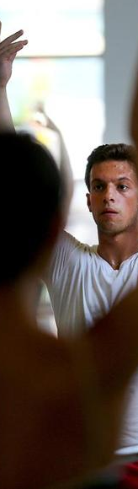
High-Level Administrative Services
Ballet Ballet Partnership Liaison
Office Hours
Liaise w/ Company Manager
Emails and 1-on-1 meetings
High-Touch Admissions & Student Services Outreach
Tailored information and orientation sessions
On-the-spot admission
Admissions point person
Annual Receptions
Recognize, welcome, and encourage
Boston Ballet Resource Center (webpage)

Slide 18
Experiential Learning Opportunities
Career Services Workshops
Cooperative
Education
Partnership Ambassadors

Slide 19


Slide 20
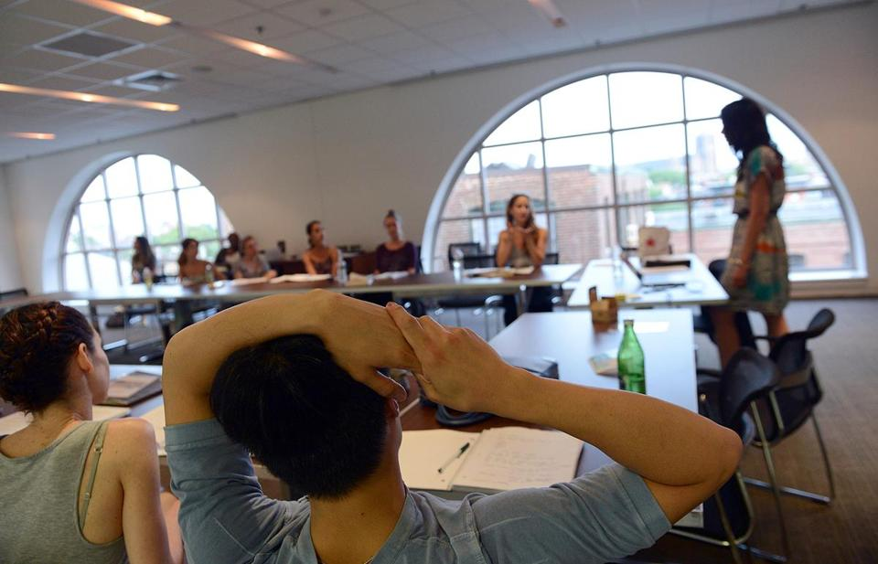
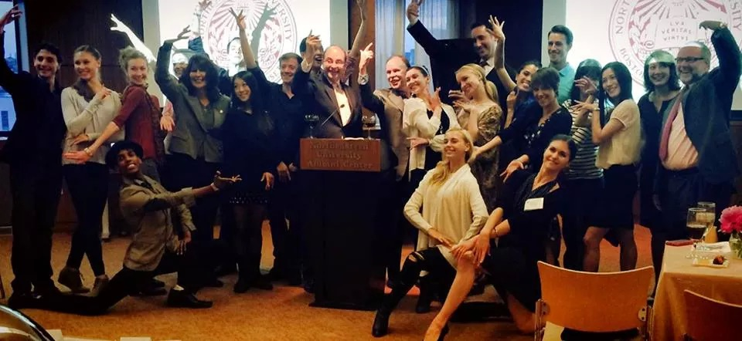
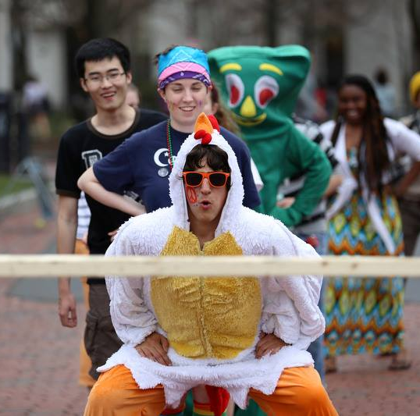
Cohort Camaraderie
Cohort classes
Social gatherings
Campus connections

Slide 21
Arabesque

Slide 22
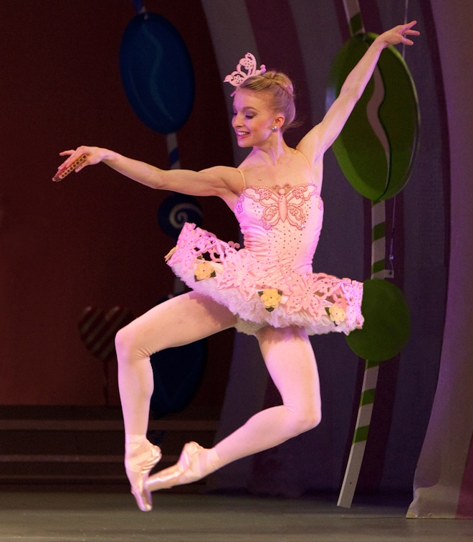

Shelby Elsbree
Bachelor of Science in Leadership

Slide 23
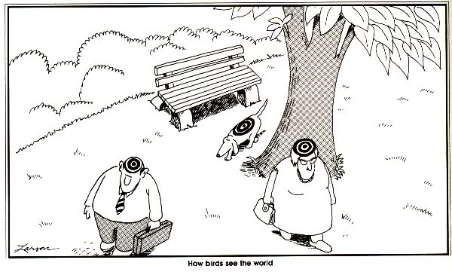
Bird’s Eye View
Partnerships
Partnerships
Partnerships

Slide 24
The Larger Picture
Employee recruitment | Investment in employees | Meet industry needs w/ innovative practices | Improve region or community | Create internal culture of support |
Response to grant funding
Why
Innovative curriculum | Flexible delivery | Collaborative relationship | Mutual trust | Frequent communication |Marketing from both partners
Need
Pitfalls
Underdeveloped strategy and communication |
Role transitions

Slide 25
CPS Partnerships
Emphasize
local, regional, & international programming and resources
Build strategies
enrollment
program design
advancement
social impact
Comprehensive approaches
identify, engage, build resources
sustainable student-focused relationships with corporations, community organizations, and government agencies

Slide 26
Assessing Partnerships
How does the opportunity align with the CPS mission, core values, and annual business objectives?
Enrollment
Advancement
Social Impact
Program Development

Slide 28

Cross-Functional Collaboration!
With our powers combined…

Slide 29
Cross-Functional Collaboration
Project Manager
Enrollment/Admissions
Activation Team
Academic Units
Marketing
  Guided by partnership statement of purpose
  Determine scholarships/discounts, expenses, tuition revenue

Slide 30
Academic Connection
  Detail life-cycle of the partnership & associated students
  Develop curriculum map
  Unique aspects of completion

Slide 31
Admissions Plan
  Strategies can flex based on College objectives
  Onsite and online information sessions
  On-the-spot conditional admissions events

Slide 32
Marketing Plan
  Designed to highlight value to employees, members, stakeholders
  Landing pages
  Reciprocity
Assessment
  Per metric defined at outset
  Attrition, anecdotal feedback, etc.

Slide 33


Slide 34

Visibility
Event Co-Sponsorship
Partner Appreciation Breakfast
Receptions
Northeastern Night @ the Ballet
Cohort Campus Outings
Service Days

Slide 35

Questions?

