Slide 1
Re-evaluating evaluation: Strategies, tools, and success at the University of North Texas
Karen R. Harker, MLS, MPH
Collection Assessment Librarian
University of North Texas Libraries
Carol Seiler
Account Services manager
EBSCO information services

Slide 2
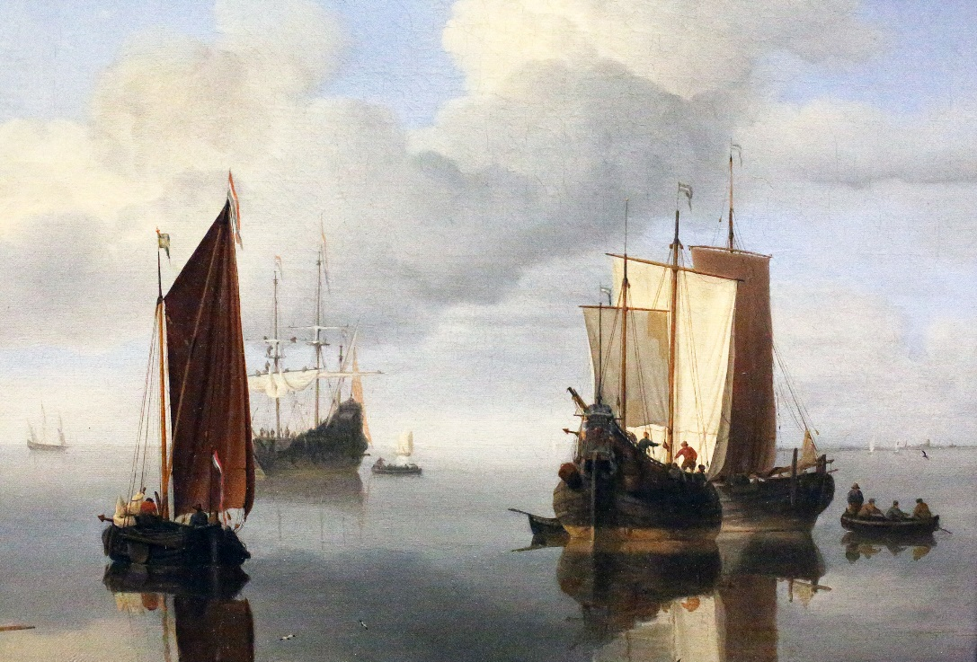
Prior to 2012…
No usage data collected
Renewals of journal subscriptions were automatic
Inflation rate of x% was built into each collection budget
Some multi-year packages were secured to reduce inflation rate

Slide 3
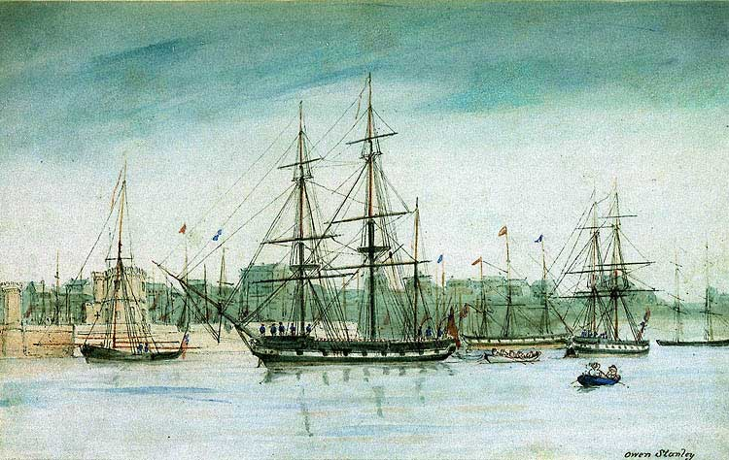
Waxing Tide
University of North Texas Libraries
Library Materials Funds Allocated
FY2002 - FY2011

Slide 4
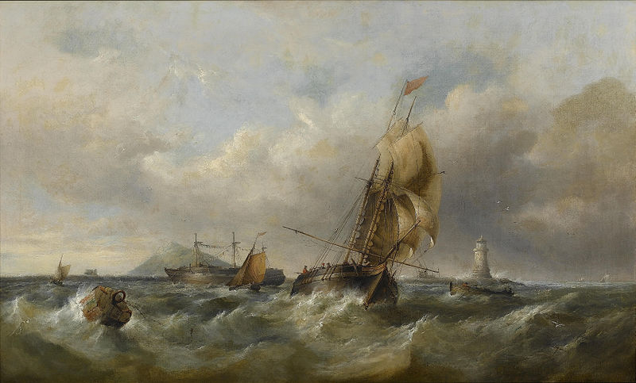
2012 Tropical Storm
Cut $1M from FY2012 budget
  Firm Orders
  Ejournal conversion
  Reductions in standing orders
Usage data collected
  Limited time period (Jan-Nov 2011)
  Limited number of titles
  Manually downloaded
  Put to limited use
  No attempt to make routine

Slide 5
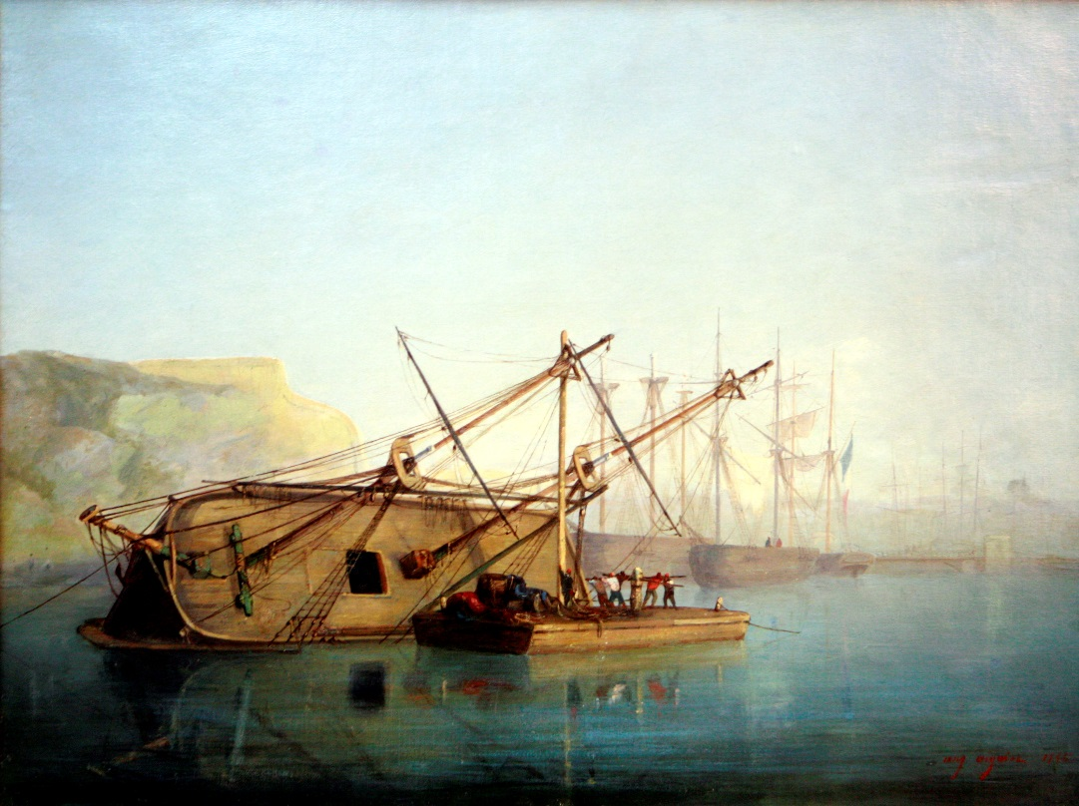
Assessing the Damage & Preparing for the Next Storm
2013 – Implemented EBSCO’s Usage Consolidation
Migrating 90% of subscriptions to EBSCO
  Will enable easy CPU calculations
Provided flexibility on implementation
  EBSCO uploaded selected platforms only
  Manually uploaded or implemented SUSHI for rest

Slide 6
Progress of Stats Collection
By June, 2013
Set | # | % of previous set | % of total
Total platforms collected | 121 | N/A | 100%
Current subscriptions | 93 | 77% | 77%
Usage statistics available | 90 | 97% | 74%
COUNTER-compliant usage reports available | 75 | 83% | 62%
Configured in Usage Consolidation | 66 | 88% | 55%
Data successfully & regularly uploaded | 57 | 86% | 47%
Data is manually uploaded into UC | 36 | 60% | 30%
Data is uploaded automatically using SUSHI | 18 | 32% | 15%

Slide 7
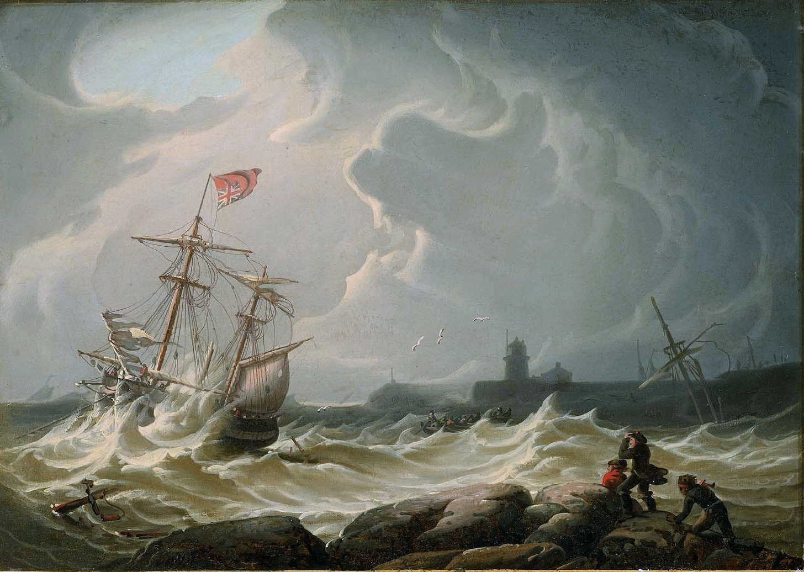
Preparing for the Storm

Slide 8

Gathering Clouds
Another $1.25M cut from collections budget for FY2014
  Mostly from renewables
Base decisions largely on evidence of value
  Usage
  Cost (notably, cost-per-use)
  Citations
  Impact factor

Slide 9
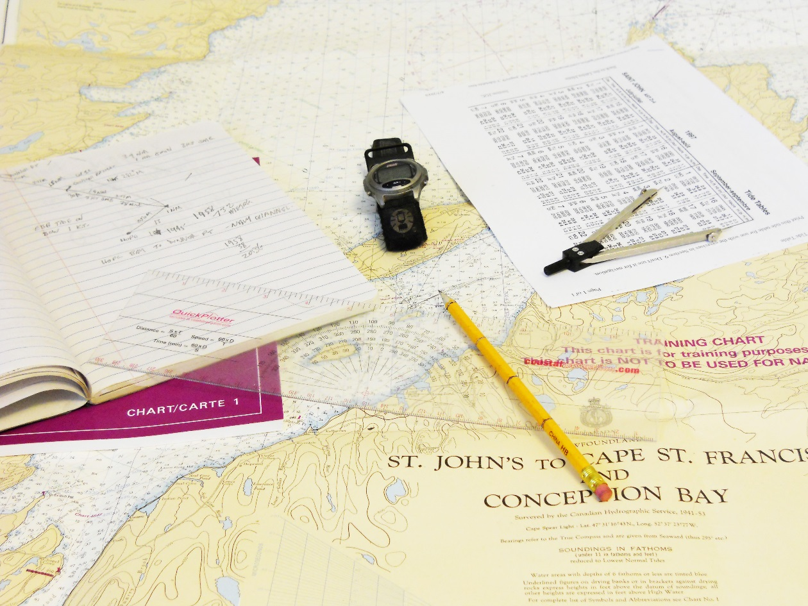
Logistics of Process
Tools used
  Usage Consolidation
  Vendor’s site (for non-COUNTER usage data)
  Sierra
  Ejournal Management System (Summon 360)
  Excel

Slide 10
Diagram with sources of data mapped out

Slide 11
Data Used in Decision Making
Cost
  5 Year Average Change in Price
  1 Year Change
Usage
  Highest & best usage measure
  3-year-average
Cost-per-Use
  Most recent price
  3-yr average use
Qualitative Measures
  Opinions of librarians
  Impact factors
For packages:
  Distribution of usage (Pareto Factor or 80/20)
  List Price CPU
  Overlap with other sources

Slide 12
Cost per Use
Usage Data
Cost Data
Sources
  UC was the source of some data
  Vendor reports for platforms not implemented in UC
Up to 3 years of usage
Downloaded data from UC by platform
Merged with cost data
Downloaded from Sierra
Last 5 years
Required a lot of work to get into standard format
Calculated rates of change

Slide 13
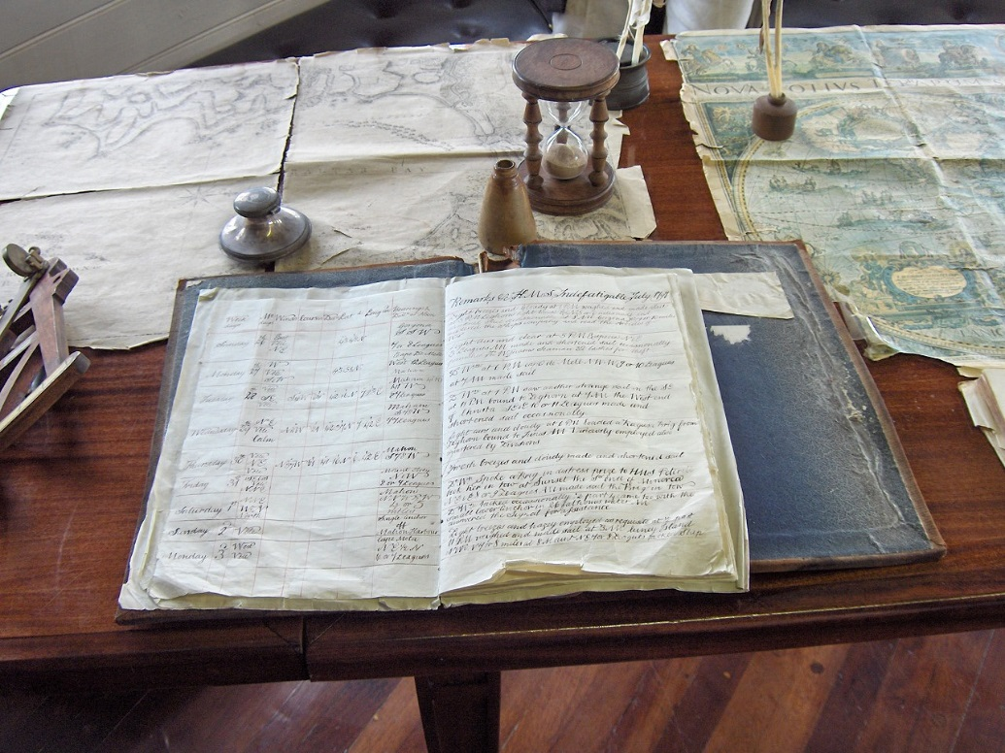
Steps for Each Package
Run Overlap Analysis from Ejournal management system (Summon 360)
  Package against entire collection
Export data to Excel
Download titles and payment data from Sierra ERM into Excel
Check usage data in UC
  If not complete, upload missing years/months
Download usage for past 3 years (if available)
Put all tables into single Excel workbook file
Merge data
  Use VLOOKUP() function.
  Match on ISSN or bibliographic record number, depending on the data source.

Slide 14
How Usage Consolidation Worked
How UC worked well for us
If we had only known…
Central repository of some usage data
Standard output of usage data
Reports
  Historical Price Analysis
E-Package Analytics
Analysis Report
  Usage & CPU by Publisher
    Costs data not available for many publishers/titles
  Summary reports
    Pie charts & graphs
    Export summaries

Slide 15
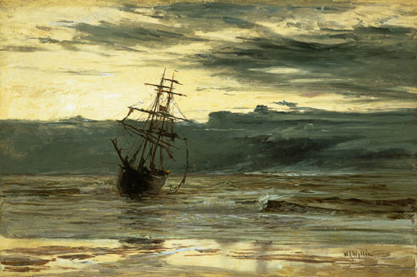
Dawn of a new day

Slide 16
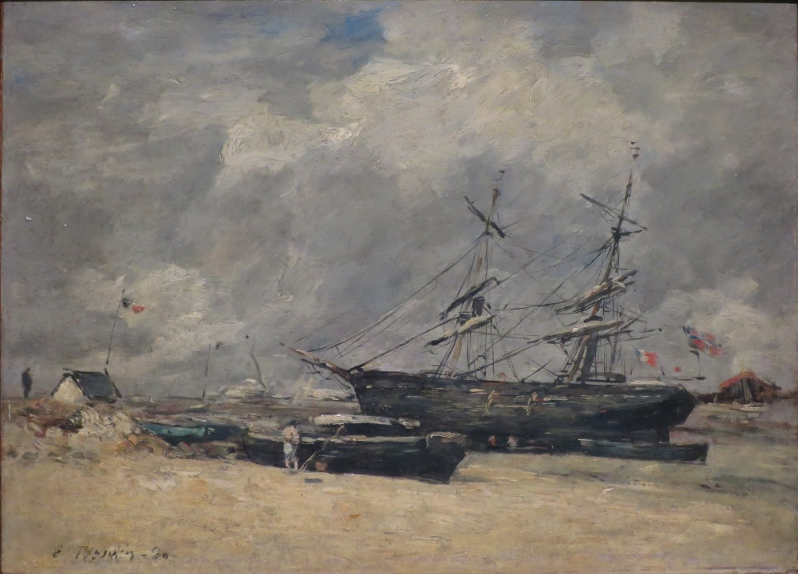
Waning Tide
University of North Texas Libraries
Library Materials Funds Allocated
FY2002 - FY2015

Slide 17

Access-Based Collection Development Plan (ABCD)
Focus on access, not ownership
  Cost-benefit analysis of access
Subject-based collections considered separately
  Focus on meeting needs, not balance of entire collection
Requires more monitoring

Slide 18
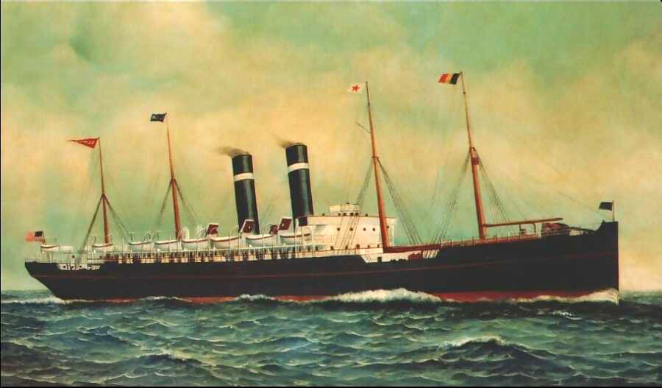
Smooth Sailing Through Stormy
Seas

Slide 19
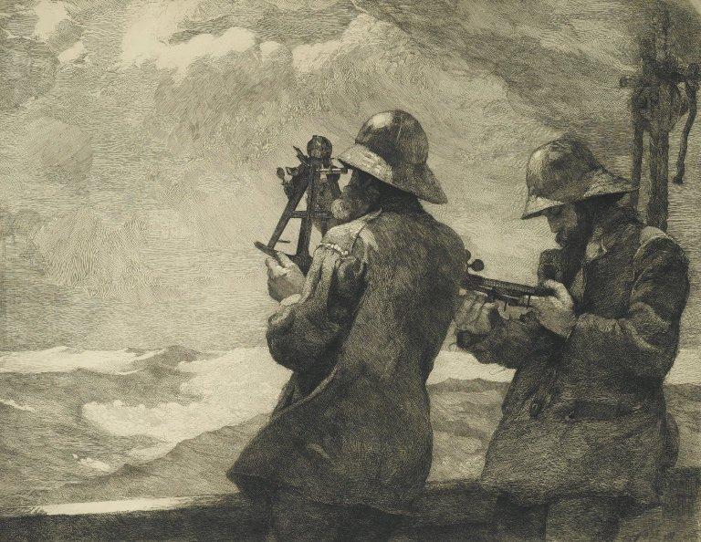
Improving Our Methods
Collect usage statistics from all resources
  100% of current platforms with stats available.
  88% of COUNTER-Compliant resources uploaded into Usage Consolidation
Preliminary analysis using…
  Analysis Reports
  Analytics in EBSCONet (e.g. E-Package Orders)
Download from Analysis Reports
  Provides prices, uses, & CPU
  Can generate rates in change in prices
  Merge data from previous years and calculate change in price
Merge with other data
  Overlap Analysis Reports
  JCR Impact Factor reports

Slide 20
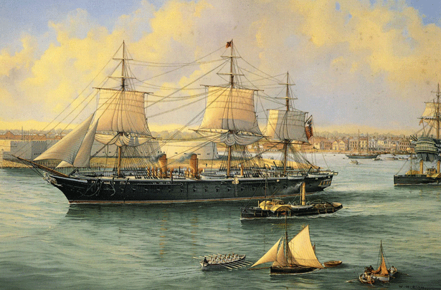
Future Changes & Additions to Usage Consolidation
Improved Integration
  EBSCO’s new Holdings and Link Manager (HLM) interface
  Marry COUNTER statistics with the next generation holdings management.
Workflow and performance enhancements
  Optimized loading of statistics
  Improved matching of resources
  Faster reporting
Cost-per-use reporting
  Automatic import of costs data for journals, e-packages and eBooks ordered through EBSCO
  Upload or direct entry of cost from other sources
  Produce holdings reports with cost, usage and cost per use

Slide 21

Ways to Contact Us
Karen R. Harker, MLS, MPH
  Collection Assessment Librarian
  University of North Texas Libraries
  Karen.harker@unt.edu
  LibrariesAreForUse.wordpress.com
  940-565-2688
  Carol Seiler, MLS
  Account Services Manager
  EBSCO Information Services
  Cseiler@ebsco.com
  205-790-1666
  800-356-0245, ext. 9002

