Slide 1
The SEI Smart Card
An observational guide for SEI classrooms
MATSOL Conference
May 8, 2015
Zhaneta Liti & David Valade
Urban ELL Coordinators

Slide 2
RETELL 2015 on…Extending the Learning
RETELL
SEI Endorsement ( Sheltered English Instruction)
Licensure : SEI teacher endorsement
( 15 ELL PDPs)
Strengthen instructional coaching capacity through coach coursework
SEI Extension Coursework : Mini Courses that teachers and administrators can take to earn the 15 ELL PDPs *
Smart Card: Walk-through tool
ESL/SEI Curriculum
WIDA ACCESS for ELLS Assessment
WIDA English Language Development Standards

Slide 3
Training Agenda
Laws and regulations
SEI definition as defined under RETELL
Video observation
Review indicators (front of the card)
Explanation and Examples (back of the card)

Slide 4
ELLs and the Law
“… there is no equality of treatment merely by providing students with the same facilities, textbooks, teachers, and curriculum”
  Lau v. Nichols (414 U.S. 563 (1974))

Slide 5
ELLs and the Law
Castañeda v. Pickard (1978)
Three-prong approach to Title VI compliance
Programs must be:
based on a sound educational theory,
implemented effectively with sufficient resources and personnel, and
evaluated to determine whether they are effective in helping students overcome language barriers

Slide 6
Admin Course Discussion
How did the SEI Administrators course inform your work with teachers of English Language learners (ELLs)?
What are some of the challenges?

Slide 7
SEI & ESL
Sheltered English Instruction in content areas
(SEI endorsement)
ESL
SEI: Sheltered English Immersion
A two-component program model

Slide 8
Definition of an SEI Classroom
A Sheltered English Immersion (SEI) classroom has one or more ELL students that may be at different language proficiency levels and cultural backgrounds taught by a content area teacher who also holds an SEI Endorsement.

Slide 9
SEI Smart Card
A new tool to facilitate SEI walkthroughs
Aligned to:
Educator Observation Tool (from SEI Administrators course)
Standards–based Characteristics of Teaching and Learning of Sheltered English in Content Areas (Educator evaluation)
Standards-Based Characteristics of Teaching and Learning Sheltered English in Content Areas: Continuum of Practice
Notes:
ESE has approved 10 Mini courses so far submitted by different vendors ( CAST, Center for Collaborative Education , Collaborative for Educational Services, Westfield State University, and MATSOL) . DESE provides districts, schools, collaborative and individual educators information about well-designed avenues to extend SEI learning NS We are still receiving more proposals. The RFR will be open until June 2016 for vendors to submit mini course proposals to be reviewed and approved by the content experts at OELAAA. Below is a list of courses already approved:
EEC101: Introduction to Universal Design for Learning (UDL) and Variability in the Learning Context Goals
EEC102: Using the Universal Design for Learning (UDL) Framework to Analyze Existing Lessons for English Language Learners(ELLs)
EEC103: Application of Universal Design for Learning (UDL) to Instructional Practice for English Language Learners (ELLs)
EEC104: Data-Driven Instruction for English Language Learners (ELLs)
EEC105: Teaching Academic Language to Improve Content Area Instruction for English Language Learners (ELLs) in the Elementary Grades
EEC106: Teaching Academic Language to Improve Content Area Instruction for ELLs (For Middle/High School Math and Science Teachers)
EEC107: Teaching Academic Language to Improve Content Area Instruction for ELLs (for Middle/High School Humanities and Literacy/ELA Teachers)
EEC108: Understanding academic language to improve content area instruction for ELLs (differentiated by content area)
EEC109: Teaching Academic Conversations in Classrooms with English Language Learners.
EEC110: Academic English for ELLs in the Talk, Texts and Tasks of Middle and High School Mathematics and Science Classrooms

Slide 10
Ideas from the field
Teacher Self-Assessment
Coaching
Individual teacher growth
Data from tool can be used to:
  focus professional development;
  allocate resources, such as materials and coaches
  Identify strengths and weaknesses of current SEI practice; and
  plan for ELE improvement

Slide 11
Benefits of the SEI Tool
It is easy and quick to use
It is not part of teacher evaluation
It is aligned to other existing tools
Easily adaptable to districts’ needs .

Slide 12
Video Observation - Questions
How does the teacher make the lesson accessible to the ELL student(s)?
What are some of the practices (strategies/techniques) used in the video that are appropriate for an ELL learner?
How does the classroom environment support and promote the process of language acquisition?
What’s missing from this lesson?
Notes:
SIOP Video
Interaction: Elementary Math 2:25-4:20
Strategies: Middle School ELA 2:00-4:00
Practice/Application: Middle School 4:47-10:05
Review/Assessment: Middle School Science
New Teacher Center
8th Grade English Language Arts

Slide 13
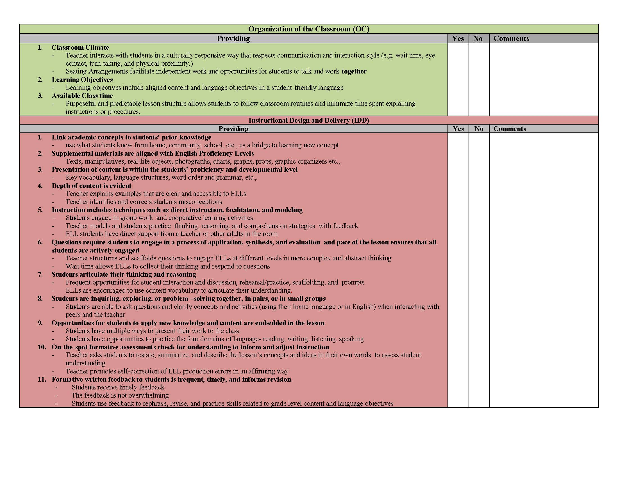

Slide 14
Explanations and Examples of Selected Indicators from Side 1
Organization of the Classroom
Classroom Climate Seating arrangements facilitate independent work as well as opportunities for students to talk and work together or with the teacher in small group instructional conversations; students collaborate or assist one another. Some examples of seating arrangements include: Students seated with a partner or in a small group for work that facilitates: interaction between participants, or shared ownership, authorship, use, or responsibility for a product Students work with a partner and/or help each other to use sentence frames to write simple, compound, and complex sentences Level 1 students work with a teacher who models and practices how to produce sentence frames while other students in the classroom work in cooperative groups Learning Objectives (Source: Digital Sandbox) Learning objectives are presented to students at the beginning of the lesson, and revisited as part of lesson closure. Learning objectives include aligned content and language objectives in a student-friendly language. Language objectives are the how of the lesson and articulate what students will be doing within the lesson in terms of reading, writing, listening, speaking, and thinking. Language Objective Examples from Kate Kinsella: Students will be able to evaluate two ways to solve a two-step algebra word problem Using reasoning language (because, in order to, as a result) During a conversation about a problem and on a quiz Students will articulate main idea and details using target vocabulary (main idea, detail) Students will describe a character’s emotions using precise adjectives. Students will revise a persuasive paragraph using correct present and conditional verbs. Students will report a group consensus using citation verbs (determined, concluded)
Instructional Design and Delivery
3. Presentation of content is within the students’ proficiency and developmental level Key Vocabulary refers to words from the lesson material that the teacher anticipates will significantly impact comprehension, and therefore intentionally pre-selects as tier words. The teacher pre-teaches these key vocabulary words to the students using research based strategies, and students have ample opportunities to apply the new vocabulary words during the lesson. (Source: SEI Endorsement Strategies from RETELL) Teaching includes techniques such as modeling, direct instruction, and facilitation. Students learn thinking, reasoning, and comprehension strategies through teacher modeling. The teacher also serves as a model of Standard English, which includes helping ELLs identify and self-correct production errors in an affirming way. Students gain access to the lesson through direct instruction and support from a teacher or other adults in the classroom. Elements of direct instruction include: carefully sequenced steps that include demonstration, modeling, guided practice, independent application, and feedback. rubrics, exemplars, and guided practice that reflect explicit teaching of language skills necessary for content area mastery and language and literacy development pre-teaching vocabulary through strategies such as the 7-Steps process to teach Tier 1 and 2 words debriefing students after reading to help them develop metalinguistic and metacognitive skills Teachers facilitate instruction through interactions with students engaged in group work, cooperative learning activities, or instructional conversations aligned to grade-level standards and learning objectives. Each approach has distinct characteristics: Grouping: (Paired) Students work with a partner based on task or interest (Small Group) Homogeneous for skill development - based on readiness Cooperative Learning: (Source: Johnson et al., 2006) Cooperative learning groups involves 3-5 students working together to produce a quality piece of work. Focuses on group performance: “If you win, I win!” Group members help, assist, encourage, and support each other’s efforts to be accountable to one another Teacher observes and intervenes when necessary Instructional Conversations: (Source: What Works Clearinghouse, Institutes for Education Sciences) Students work together in a small group facilitated by the teacher as a member of the group working on the task Teacher does more than float or intervene and provides small group instruction while other student groups work cooperatively

Slide 15
Classroom Visits
Identify a few indicators from the card
Look for evidence of these indicators when we do the walkthrough
How is the instruction accessible to ELLs?
What evidence did you observe?
What were the students doing?
How are all students, including the ELLs, engaged in grade-level curriculum?

Slide 16
Discussion & Feedback

