Slide 1
GEO Learning Conference
The State of Network Evaluation:
The Barr Fellowship
June 10, 2015
Notes:
Thank you, Madeleine, for including me in this session It is a pleasure to be with all of you.

Slide 2
Sabbaticals & Coaching
Barr Fellowship
Network
Organizations
Notes:
Let’s start with a quick overview of the Barr Fellowship, which the Barr Foundation has operated since 2005. It is a recognition for gifted nonprofit and school leaders in Boston and an investment in their relationships with each other.
The Fellowship operates on three levels: individual, organizational, and network.
Individual- At the individual level, we provide 3-month sabbaticals & executive coaching.
Sabbaticals can reconnect leaders with the reasons they chose their work.
They can change the structure of leadership in an organization, allowing others to step up to assume new responsibilities.
And when the organization is less dependent on the leader, s/he has the opportunity to rethink his/her role, which often prompts work at a higher level.
Organization- An important goal is to do no harm to organizations during the leader’s absence, so we provide $40,000 in flexible operating support during the first year of the 3-year Fellowship. Funds are often used as bonuses for those who take on more responsibility, contracts for short-term consultants, etc.
Network- Finally, there is a real intentionality around investing in the network of Fellows-- both within each class and then across the entire network.
This last component is our answer to the question: “What if our great leaders became a great network?”

Slide 3

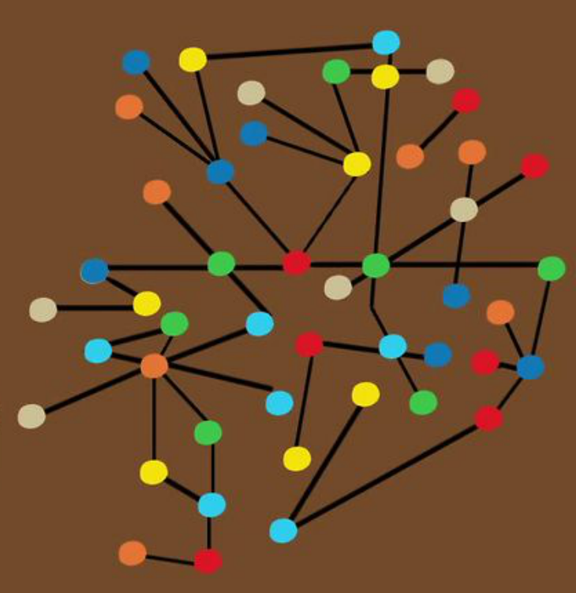
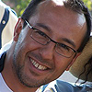
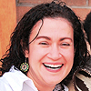
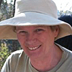
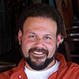
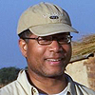
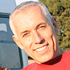
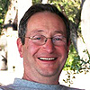
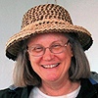
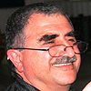

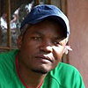

Congratulations!
Year 1-3
Year 3+
Notes:
It works like this…
[CLICK 1] A great Boston leader gets a call out of the blue: Congratulations, would you like to be a Barr Fellow?
[CLICK 2] If he or she says yes, they join a cohort with 11 other great leaders. The goal is to support their Authentic Relationships, which takes time, effort, and intentionality. So each cohort starts with a 2-week learning journey to the Global South. Classes have gone to South Africa, Zimbabwe, Brazil, Haiti and the next is going to Bolivia. Then, over the course of 3 years we provide semi-annual retreats that keep the class connected.
[CLICK 3] After the first year, we provide experiences that connect the classes to each other-- through retreats, trainings, and sometimes travel. We use this “creative disruption” to set the table, or provide the container, but not an agenda. There are no projects or work for them to do. Over time, connections develop, and collaborations emerge. These collaborations are all fueled by social capital.

Slide 4
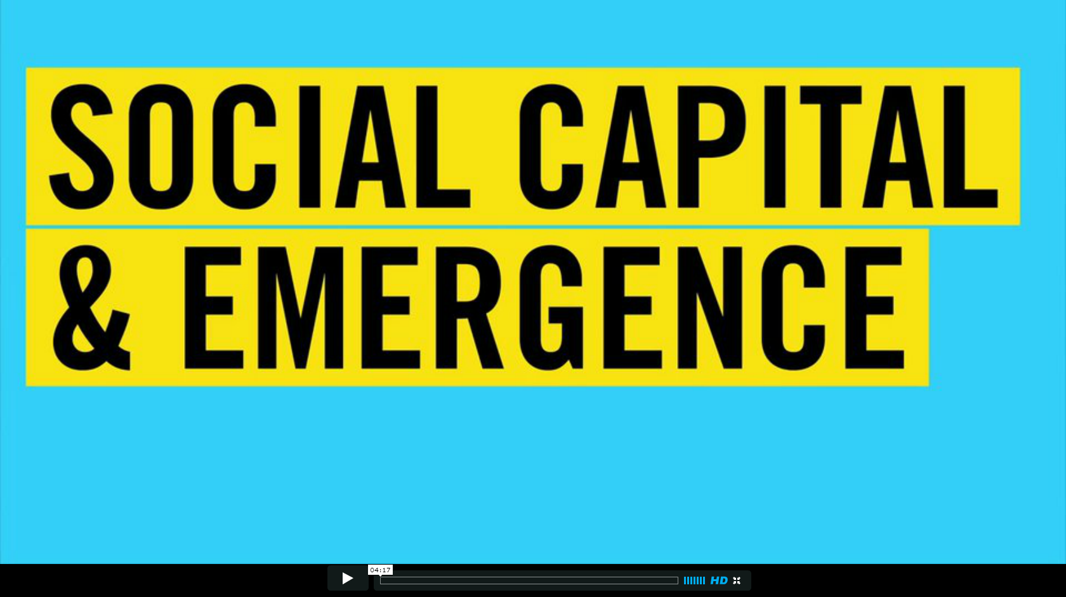
Notes:
I could tell you more about this, but it’s better to hear from the Fellows…
Watch Video
That all sounds great-- So, what do we measure?

Slide 5
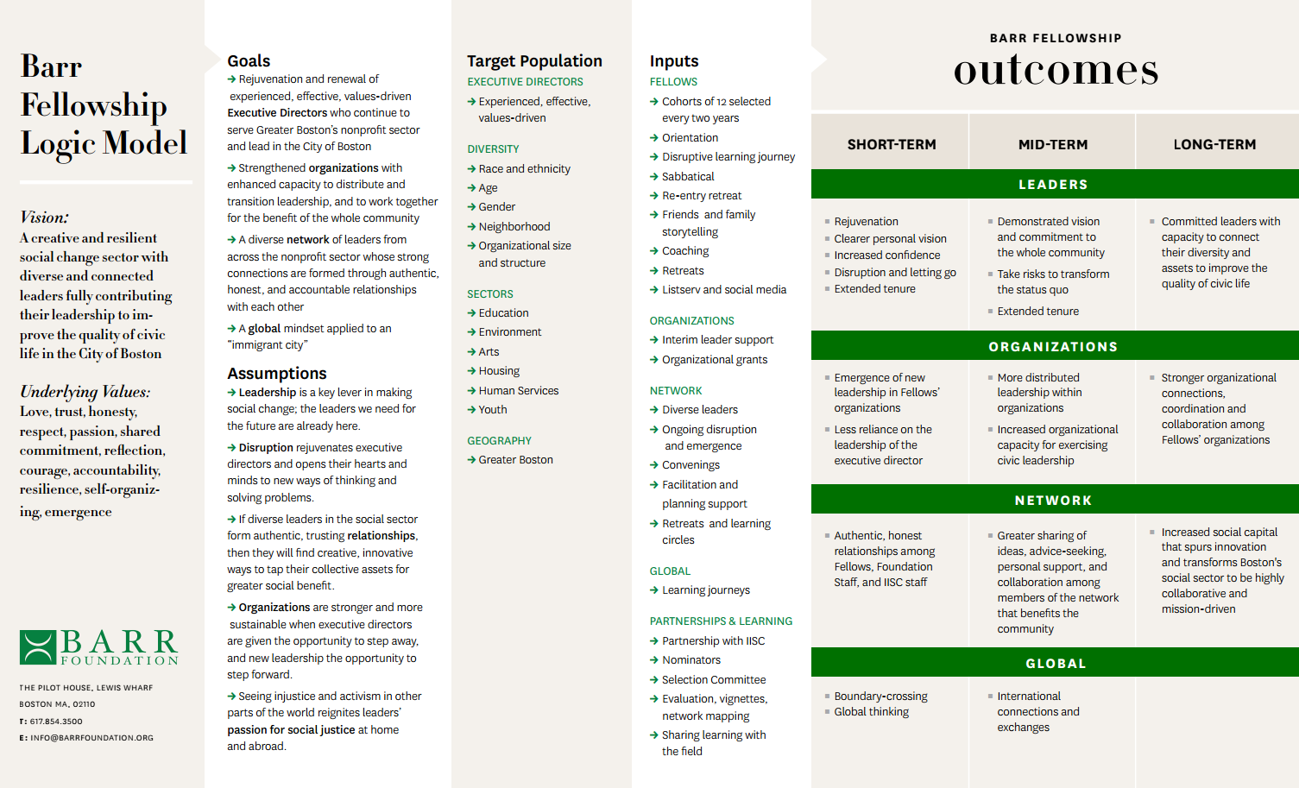
Notes:
Like most programs, we have a logic model that maps out our Theory of Change.
In the short-term, we look at whether Fellows are rejuvenated and continue their work.
Mid-term, we want to understand if Fellows are sharing ideas, seeking advice, and supporting one another– professionally and personally.
Long-term, we are watching to see if increased social capital spurs innovation and transforms Boston’s social sector so that it is more collaborative.
Our main tool is an Annual Survey that asks about all of these things.

Slide 6
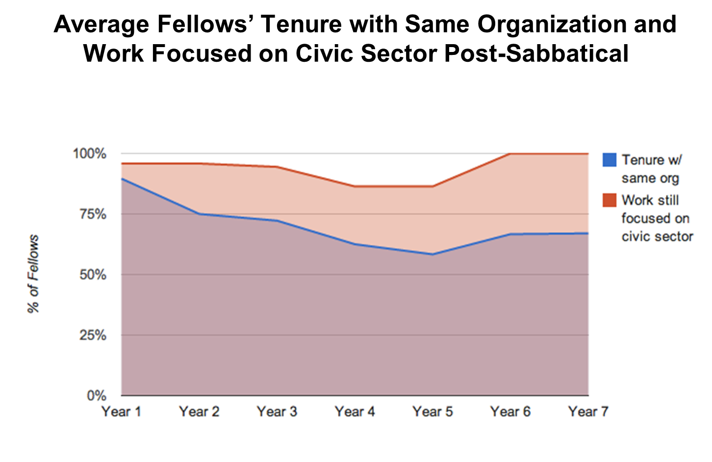
Notes:
At the most basic level, we get information about tenure
which Fellows have stayed in their roles (that’s everything in blue)
or, if they’ve left that role, whether they have stayed in the sector (that’s everything in orange)
We also look at network health.

Slide 7
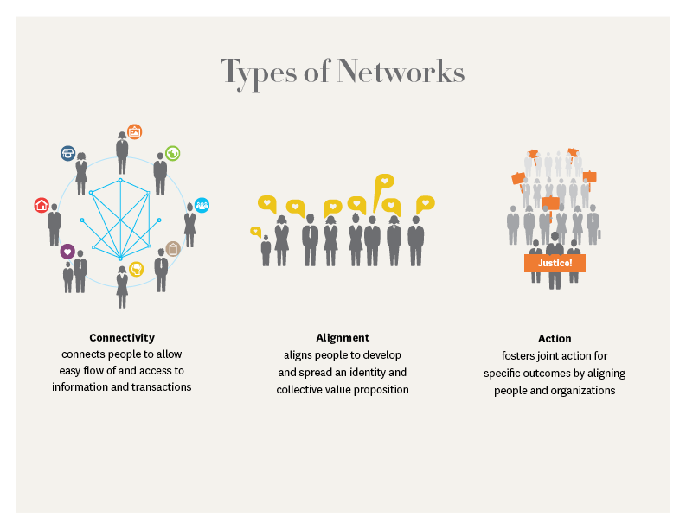
Source: Plastrik and Taylor, “Net Gains”
Notes:
As Madeleine has described, the Barr Fellowship is a Connectivity Network.
Our fellows work in different issue areas -- arts, education, environment, human services and more --and we want that diversity.
We are not Aligning them, or encouraging Action to solve a particular problem.
Instead, we focus on the relationships, and wait for the social capital to organically produce tangible results. In the beginning we hoped, but we’ve mapped the network since its inception and have seen results, like those mentioned in the video.

Slide 8
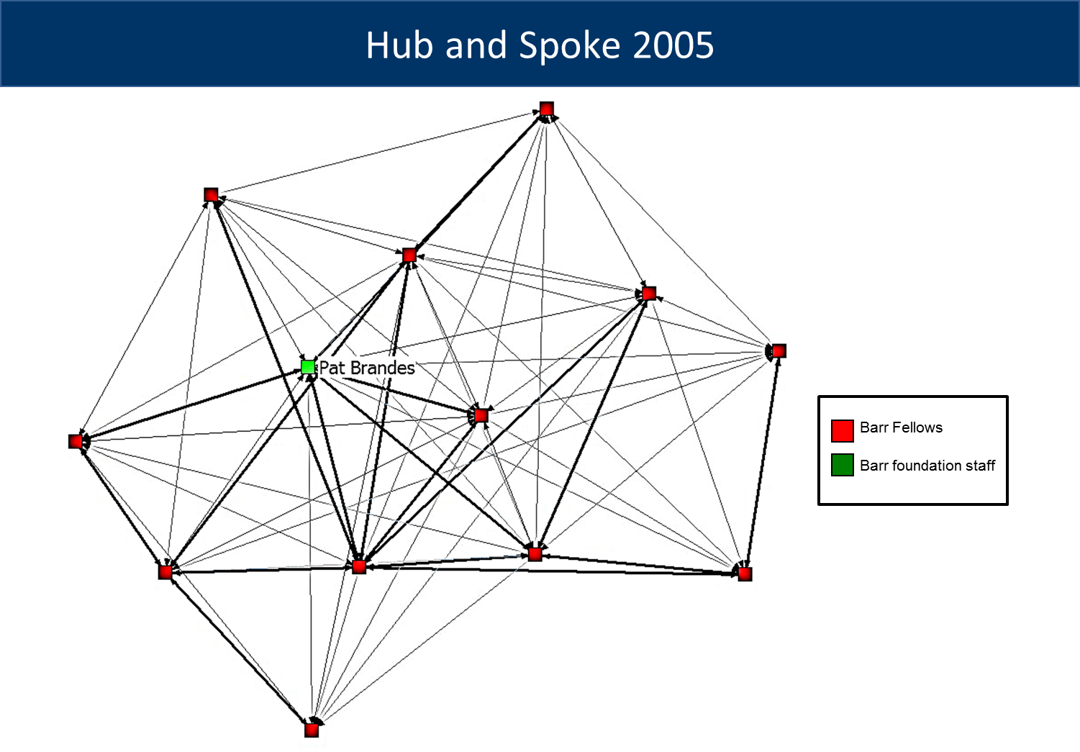
Notes:
Here’s a network map from 2005, when we started.
You see that green square in the center? That was Pat Brandes, our executive director at the time. The funder. Typical of a lot of collective efforts – a funder puts dollars on the table, or a political leader spends some political capital to convene people around a common challenge.
But what happens when the funding goes away or the political winds shift?
Most of those efforts flounder.
We knew we didn’t want to stay in the center.
Again, we wanted to set the table, but not the agenda.

Slide 9
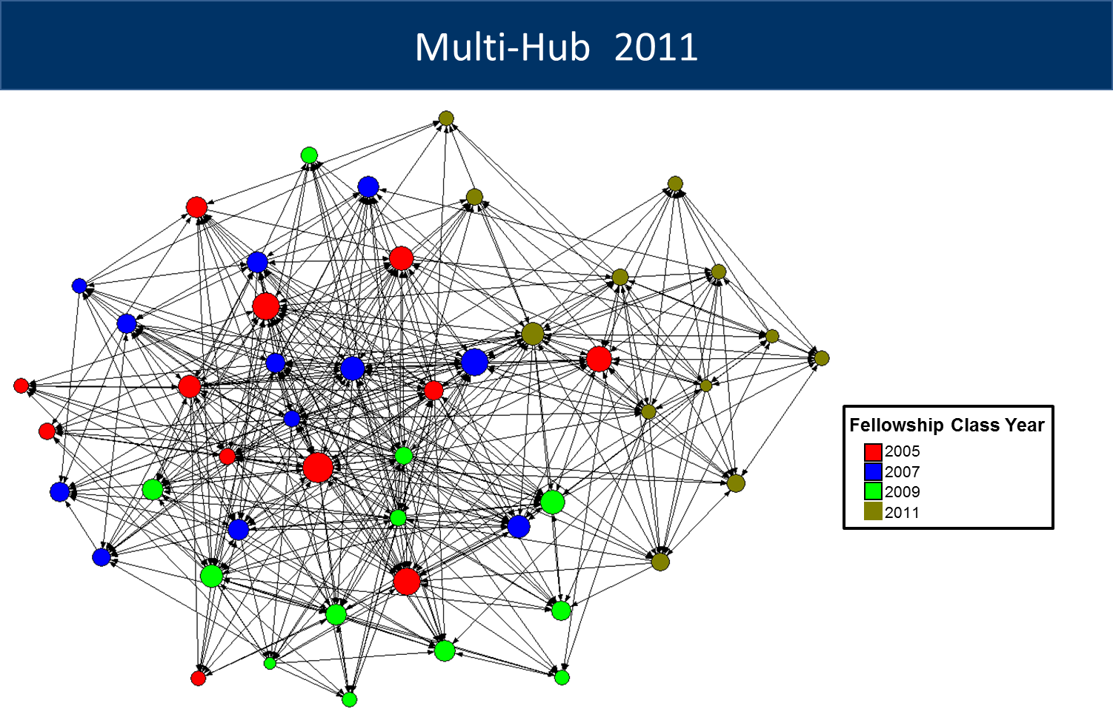
Notes:
After regular place setting, here’s how the network looked like in 2011. Barr isn’t even in this map.
You can see the web of connections Fellows have with each other, across all classes.
In addition to looking at the overall connections, we also ask questions to understand how our Fellows are working together. These are the questions to see if “Emergent Collaboration” is happening.
We map what the Fellows tell us…

Slide 10
Notes:
As you see from this map of the education field, they’ve been busy-- and they are working across classes and sectors. I’ll highlight examples of real results:
1- There are 2 new schools-- In the video, Meg and Vanessa discussed the Margarita Muniz Academy, named for one of our Fellows. John and Jesse, also in the video, launched the Dudley Street Neighborhood Charter School soon after filming.
2- The video also talked about the Boston Promise Initiative and what it took to get the whole city behind one application led by a Fellow. To elaborate, John Barros described what happened to make this possible…
“If it weren’t for the Fellowship,” he said, “I don’t know how we would have negotiated a single Boston application. There were some difficult conversations that we could get through because of the relationships, the trust, and the social capital we built.”
I won’t go through all of the details, but we now have an aligned set of partners working together, supported by $70 million of public and private funding.
As we hear about collaborative work like this, we engage in interviews to learn about it and follow it. Over time, these interviews have produced enough information to evolve into a case study…

Slide 11
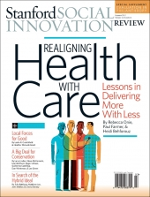
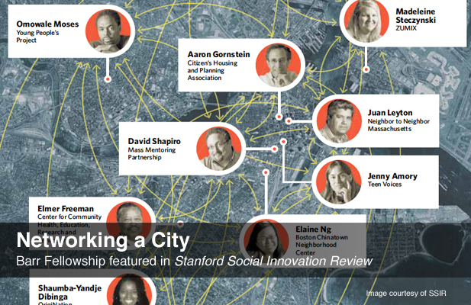
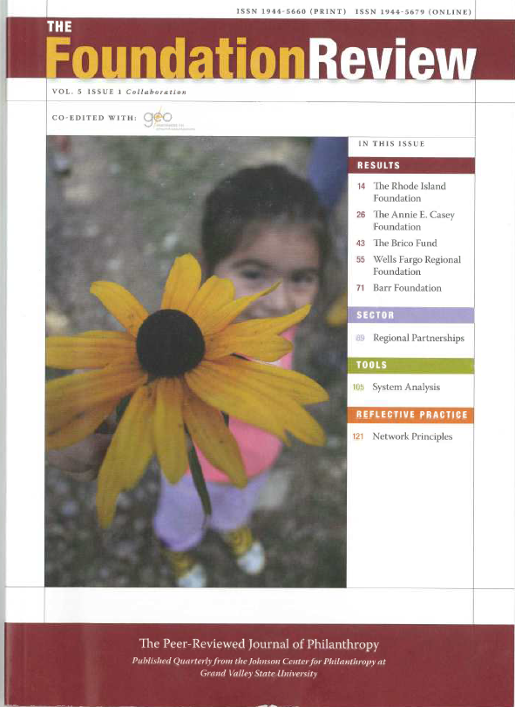
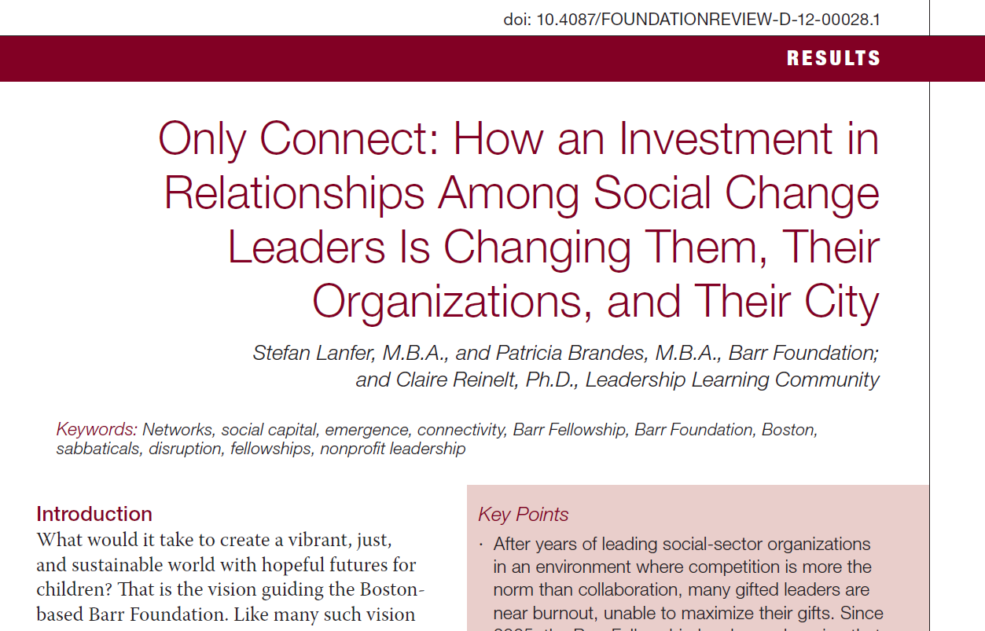
Notes:
Much of this work was shared in the Stanford Social innovation Review article, “Networking a City.”
And in the later piece in the Foundation Review’s, “Only Connect.”
To summarize, our main tools for evaluation have been:
1- An Annual Survey
2- Social Network Analysis or Mapping, that is the companion to the survey
3- follow-up Interviews and, over time, Case Studies

Slide 12
Fellowship Evaluation Learning Questions
Early Years (2005-2007) | Later Years (2008-2012)
Fellows Are fellows staying longer with their organizations and in the sector? Are fellows renewed and more satisfied with their role? Organizations Do interim directors have the supports they need to succeed in the leaders’ absence? Do organizations distribute leadership and develop emerging leaders? Do staff and board members become less reliant on the executive director? Do organizations develop leadership transition plans? Network Is the fellowship cohort becoming more connected? | Fellows Do Fellows demonstrate vision and commitment to the whole community? Do they take new risks, cross boundaries, and innovate? Organizations Are organizations increasing capacity to work together to create more community benefit? Network Are fellows across cohorts forming authentic and honest relationships with each other? Is there more cross-cohort sharing of ideas, advice-seeking, personal support, and collaboration leading to innovative and breakthrough projects? Are fellows bridging across sectors and neighborhoods? Global Are fellows developing a global mindset and applying that perspective to Boston -- an immigrant city?
Notes:
What’s important to note is that our learning questions have changed as the network has evolved.
We still ask about tenure and distributive leadership, but we don’t do as much follow-up because the results have been consistent across all of our classes.
That allows us to focus on other questions--
Are Fellows engaging in the community in new ways, taking risks?
Are the organizations, not just the Fellows, working more collaboratively?

Slide 13
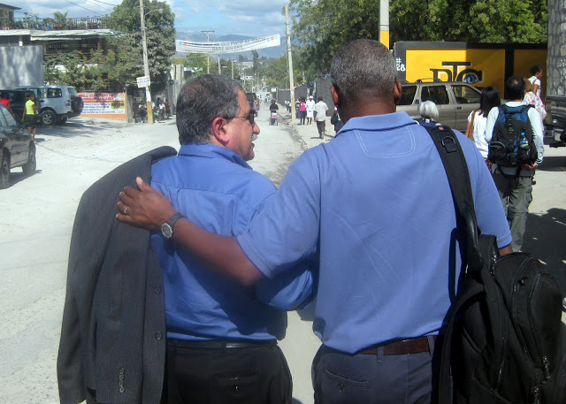
“If you want to go fast, go alone. If you want to go far, go together” – African Proverb
Notes:
Before I open the floor for questions, I just want to share an African proverb that the Fellowship has made real for us.
[CLICK 1]
If you want to go fast, go alone.
If you want to go far, go together.
Thank you. Who has questions?

