Slide 1
Investing in Capacity to Work with Communities
Janice Barbee, Nexus Community Partners
Frank Mirabal, City of Albuquerque
Jeff Raderstrong, Living Cities
November 17, 2015

Slide 2
Session Objectives
Participants understand the necessary components to designing successful community engagement strategies.
Participants analyze their assumptions about effective community engagement.
Participants bring home ideas and resources for improving their community engagement strategies and/or their grantee’s community engagement strategies
Notes:
Jeff or Lisa can go over the agenda.

Slide 3
Agenda
Introductory questions
Overview of Living Cities’ research on community engagement
Building the Field of Community Engagement in the Twin Cities
Community Engagement and Collective Impact in Albuquerque
Exercise
Closing questions

Slide 4


Slide 5


Slide 6


Slide 7
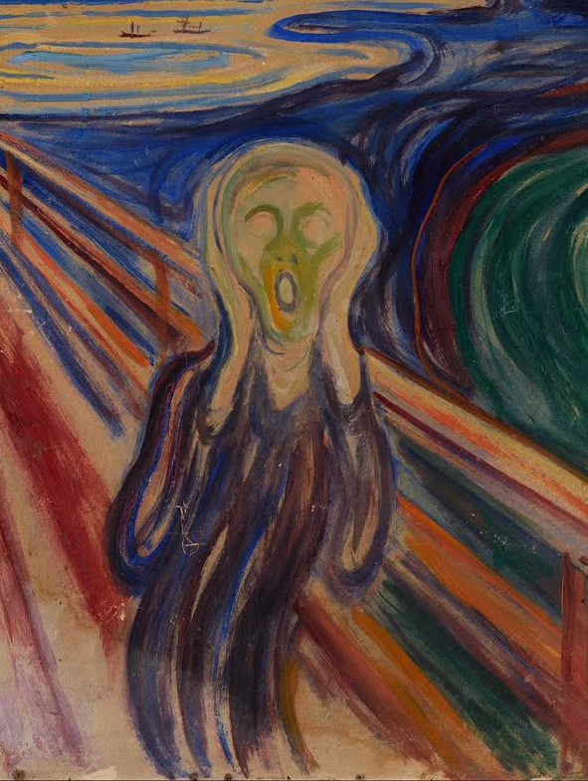

Slide 8

Top Down, Out Of Touch
Notes:
Collective impact has been criticized as too top down and not in touch with local communities. We began by interviewing our members to figure out how they approached community engagement through collective impact, and then came up with a rough synthesis paper of the different options. We then spoke with other practitioners in the field, such as our wonderful moderator today, to refine our thinking on community engagement and collective impact, and make sure our scan resonated with the field. What we are presenting today is a summary of our research that we hope you can take back to your work and strengthen your engagement with community members.
Once we had this synthesis complete, we create an e-course using the different resources that we offered, free of charge, to collective impact practitioners to see if what we had found resonated with them. Based on our initial data analysis, the participants found the course offerings useful and helpful for their work with community members. If you are interested in taking the e-course, it is still available online, free of charge, on our website, LivingCities.org.
Now I will pass it off to Jeff and he will walk you through some of our findings….

Slide 9
Three Approaches
Determine the “Why?”
Amplify Voices
Build Feedback Loops
Notes:
Jeff
Our research on collective impact and community engagement highlighted the need for practitioners to consider three main components of working with community members: NEXT
First, there is an overarching need to determine “why” you are working with community members.
Determining this “why” is not enough though. We found that even CI initiatives with clear understanding of why they are working with community members still struggle to engage with them effectively.
Need to focus on strengthening the capacity of a collective impact initiative in two dimensions
NEXT
First dimension is amplyfying the voice of communtiy members
NEXT
Second is building feedback loops with community members
I will walk through each of these components in turn

Slide 10
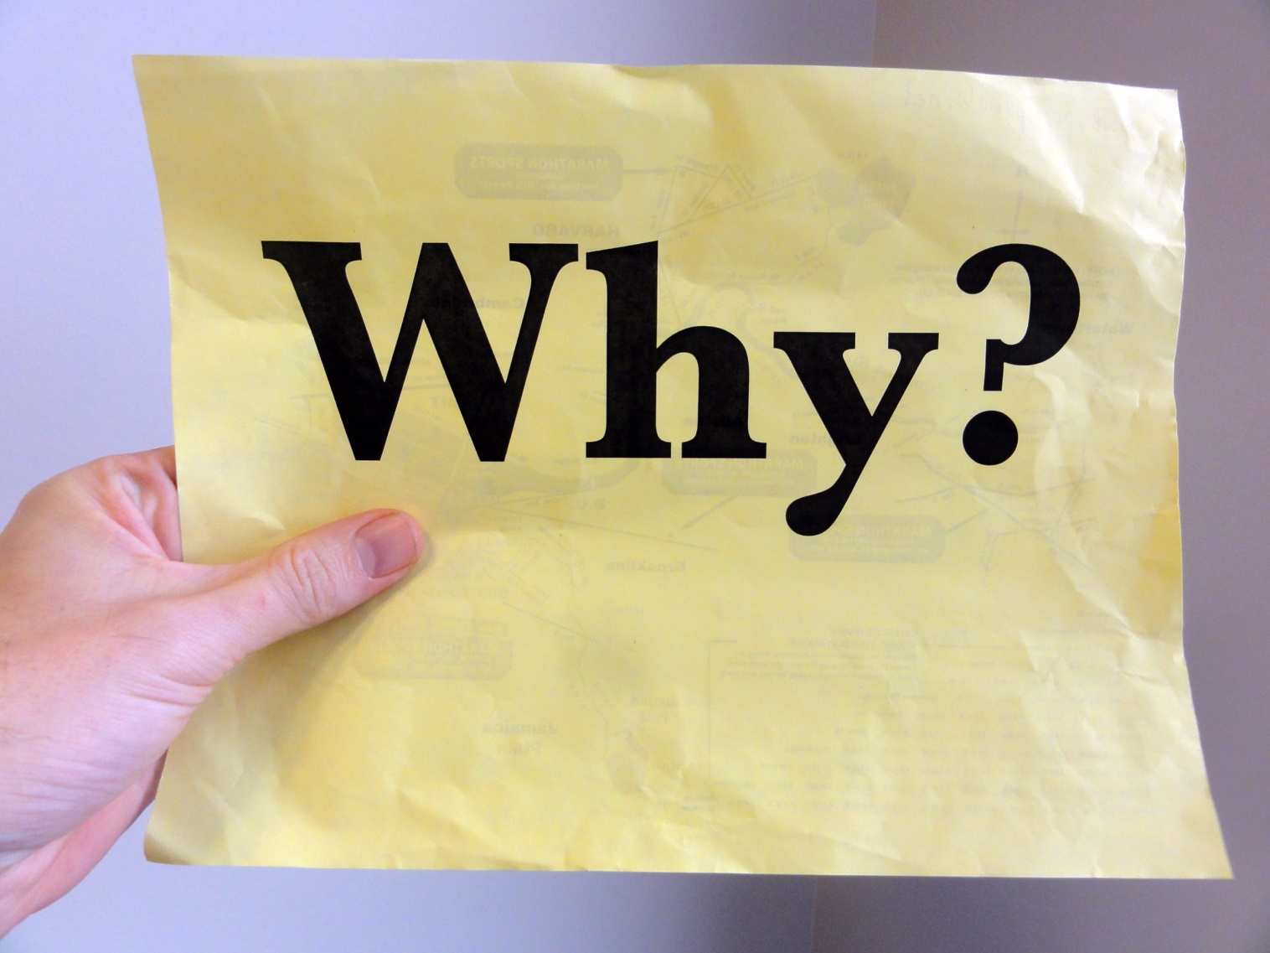
Notes:
Community engagement means different things to different people—grassroots organizing, town hall meetings, board leadership, etc.
Sometimes people think you can “do community engagement” and just check the box and get on with it. Not true.
Instead, you need to be very clear about WHY you want to work with community members, and WHO you want to work with.
After all, “community” is never a monolith, and you need to be very clear about your goals for engaging specific community groups and for what reason.
For example--one collective impact initiative we support in Albuquerque has actively involved community members in identifying how the city can encourage entrepreneurship, particularly among low-income people. Yet they do not have a community representative as a part of the formal governance structure, which is comprised of public sector, education and business leaders. Community input shaped the direction of this initiative, but the implementation strategy was designed by leaders with an understanding of the relationships and dynamics of Albuquerque’s city government and local economy.

Slide 11
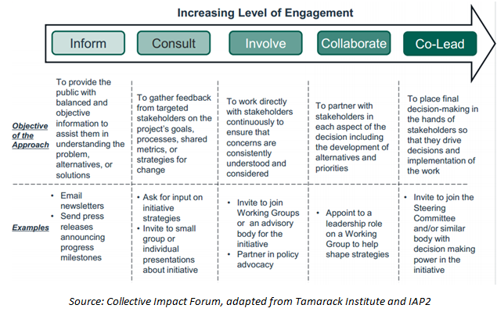
Source: Collective Impact Forum, adapted from IAP2 and Tamarack Institute
Notes:
This is one tool that our e-course participants have found very useful as a way to set engagement goals and align those goals with your engagement strategies.
It was originally developed by the International Association for Public Participation, and has been adapted countless times. This particular version was adapted by Tamarack and the CIF.
It basically helps you segment out the community groups you want to work with and your goals for working with them. Each goal is placed at a different “level” of engagement, with higher levels of engagement moving from left to right.
If you are interested in learning more about this tool, we have an exercise based on it in our e-course at LivingCities.org, that was actually adapted from an exercise Lisa, our moderator, created.
While the right level of engagement needs to be determined by the local context of the collective impact initiative, through our research we determined that each collective impact initiative needs to have ambitions to engage community members in some part of their collective impact initiative at at least “involve” or higher. If they can’t do that, then they aren’t putting community at the center and are at risk of being too “top down”, like Ty talked about earlier.

Slide 12

Amplify the Voice of Community Members
Notes:
So if you have your goals for engagement, and your strategies, you are set, right? Easy, right?
Not so much. Unfortunately, there are still many barriers to effectively working with community members, and these barriers fall into the two dimensions I talked about before.
The first barrier deals with the need to “amplify the voice” of community members.
For many reasons that we don’t have time to go into today, community members that collective impact initiatives seek to help are disenfrancished and cannot often authentically contribute to decision making.

Slide 13
Amplify the Voice of Community Members
Context experts
vs.
Content experts
Notes:
This disenfrancishement can create a fundamental disconnect between grassroots community members at grasstops collective impact leaders, blocking any real authentic community engagement.
One helpful frame for thinking about this disconnect is the difference btween “context” experts and “content” experts.
Context experts are those residents with the lived experiences to contribute to collective impact.
Content experts have technical expertise useful for solving specific problems, such as planners, affordable housing experts or school superintendents.
Need both content and context experts to make sure you collective impact initiative is effectively meeting the needs of your community.

Slide 14
Amplify the Voice of Community Members
    Leadership trainings
    Create shared aspirations
    Network building
    Grassroots/community organizing
Notes:
So how do you better amplyfy the voice of context experts to connect with content experts?
Many different tools to do so. We’ve found these tools to be useful in our work:
Leadership trainings that build a more direct pipeline for boards and commisions (nexus and urban habitat) NEXT
Create shared aspirations (harwood approach) NEXT
Network building (more about building indv relationships) NEXT
Grassroots/community organizing
More info on these approaches is on our website, but a quick example:
Living Cities supported a “Community Engagement Team” (CET) in the Minneapolis/St. Paul region during the development of several transit lines that connected different parts of the city. The CET funded and organized community-based organizations to advocate on behalf of low-income community members affected by transit planning. This work led to several policy changes and more equitable transit oriented development.

Slide 15

Create Feedback Loops
Notes:
Even if you have strong community representation in your collective impact initiative, and your context and content experts are connected, you could still stuggle to respond to community input. Many collective impact initiatives struggle from “tokenism” in their community engagement, and even though community members speak up, their input isn’t incorporated into the initiative.
One way to avoid tokenism in your collective impact work is to invest in community-centered “feedback loops”
Ty has written about feedback loops before, and she says they are fundamentally about collecting the information that is needed to know whether or not you are on track.
Feedback loops need to be iterative and support continuous communication. They should help you work with the people you seek to help, so that together you can learn faster and develop lasting solutions.
Feedback loops with community members will look different in different collective impact initiatives, but they all involve some form of continuious data collection from community members, and response to those community members. NEXT

Slide 16
Create Feedback Loops
    The Center for Effective Philanthropy
    The Fund for Shared Insight
    Markets for Good
    Feedback Labs
    Keystone
Notes:
We are still learning about how exactly to integrate feedback so that it can help communities become more engaged with collective impact initiatives
Several organizations have put out tools and materials to help you think about creating feedback loops in your collective impact initiative, such as: NEXT
The Center for Effective Philanthropy
The Fund for Shared Insight
Markets for Good
Feedback Labs
Keystone
Again, more information on these tools is avalaible on our website.

Slide 17
Notes:
Of course, many of the tools and appraoches you will find in these two dimensions are overlapping and not mutually exclusive. Some collective impact initiatives will need to focus on amplyfying voices over creating feedback loops. It just depends on the local context of your collective impact initiative, and the goals of what you are trying to accomplish.
However, what’s certain is that first and foremost that you need to determine why you want to work with community members, and then who those community members are—then you can move on to the how. We’ve found that the “how” generally splits into these two deminsions of amplyfying voices and creating feedback loops, and the tools we presented today have been shown to be useful ways to build capacity in these areas.
But we encourage you to check out the resources on our website and explore them further. Let us know what you think of them, and how they have been helpful. And if you know of other tools, let us know so we can share them!

Slide 18
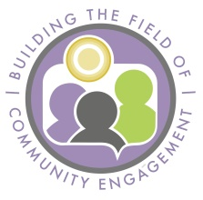

Slide 19

Building the Field:
Background
What is community engagement?
How is it different than “organizing”,
“civic participation,” “outreach”, etc.?
What kind of capacity is needed to support it?
Notes:
As an intermediary, when we would try to raise dollars to support CE, these were the questions we were always asked by our funders. We brought together deeply experienced practitoners to help us answer those questions. BTF was formed out of that.

Slide 20
Building the Field of CE:
Definition, Vision and Mission
Definition: A process that includes multiple techniques to promote the participation of residents in community life, especially those who are excluded and isolated. Building the Field of Community Engagement
Vision: Community engagement is valued, understood, practiced, and well-resourced.
Mission: Magnify and elevate the power of community engagement to change the way problems are solved and resources are invested.

Slide 21
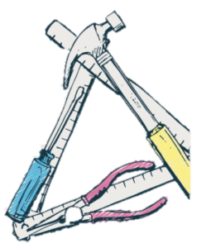
How to “Build a Field”?
Engaged Learning Series
New Tools and Resources
Stories of Impact
“Mentoring”
Notes:
Engaged Learning Series: A series of community conversations designed around a particular community engagement topic. Hosted 6; more than 300 people; topics such as evaluation, outreach vs. engagement;
Tools: highlight two of them the Impact Graphic and the Assessment Tool, developed in response to the community
Stories of Impact: Each organization documented a story of community engagement’s impact on their work/their community. NACDI – community engagement resulting in increased levels of voter turnout in the Native American community; CWC – engagement’s impact on improving parent engagement and student test scores for african american families in St. Paul; Nexus’ case study is how we “mentored” a housing organization along their path to integrate engagement into their work (AVAILABLE AT CONFERENCE?)

Slide 22
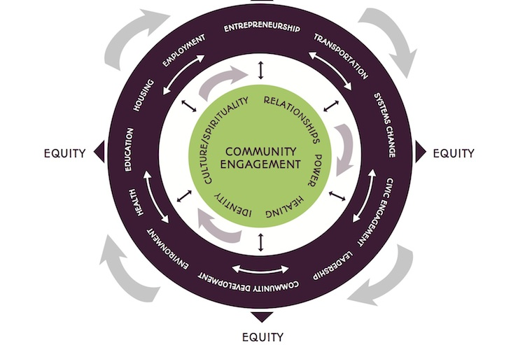
Impact Graphic
Notes:
Impact graphic – very high level – could do a full workshop on this alone; it’s designed to make visible the less visible impacts or community engagement – inner circle – areas that need to be paid attention to in any of our work, particularly work that is with underrepresented communities.

Slide 23
Outreach or Engagement:
An Assessment Tool
What kind of relationships do you have with community members?
Why are you engaging people?
How are you getting people involved? When?
How do ideas get generated?
How do your organizational policies and structures support engagement?

Slide 24
Challenging Assumptions
“Give a man a fish and you feed him for a day. Teach him how to fish and you feed him for a lifetime. “
~ Lao Tzu
Find out first:
  If people want to learn to fish
  If teaching people to fish would solve the problem
  If there are leaders within the community who could do the teaching
  If people already know how to fish and the problem
  is something you are not seeing
Notes:
Community engagement challenges the notion that “we” have the solutions; WE’VE DONE THE STUDIES AND THE DATA SHOW …
Challenges the notion of “experts” and expertise - asks us to see the expertise in the community; EXPERTS/WE RE HERE TO HELP
Challenges our need for efficiency and expediency; TIME, RELATIONSHIPS, TRANSFORMATION NOT TRANSACTIONAL
Challenges our notions of power – sharing power, willing to shift our work in response

Slide 25
Building the Field of Community Engagement: More Information
www.nexuscp.org
www.buildthefield.org

Slide 26

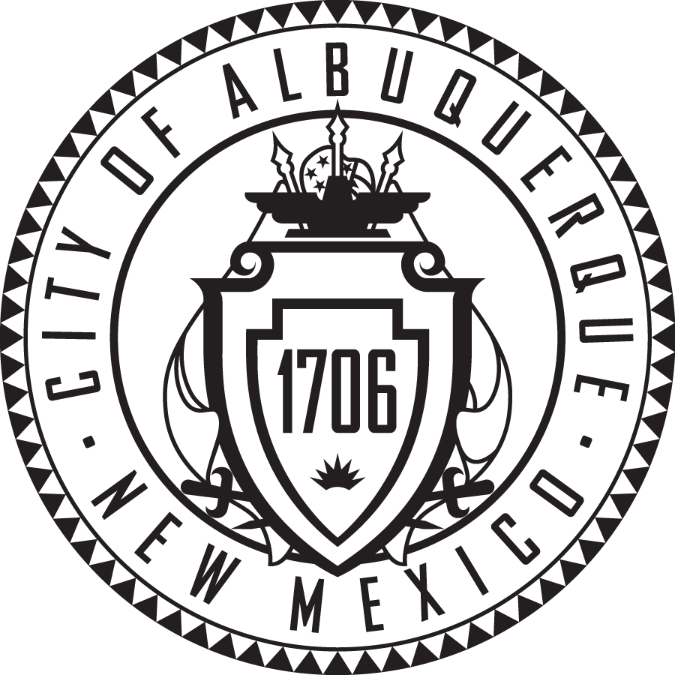
Frank Mirabal, Ph.D
Director of Collective Impact

Slide 27
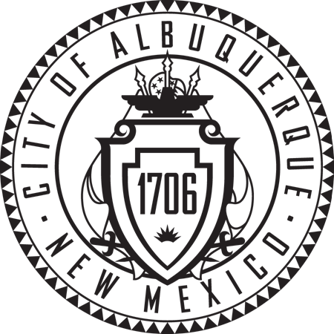
Our Approach: Collective Impact
Shared agenda
Shared measurement/metrics
Cross-sector partnerships
Backbone organizations

Slide 28
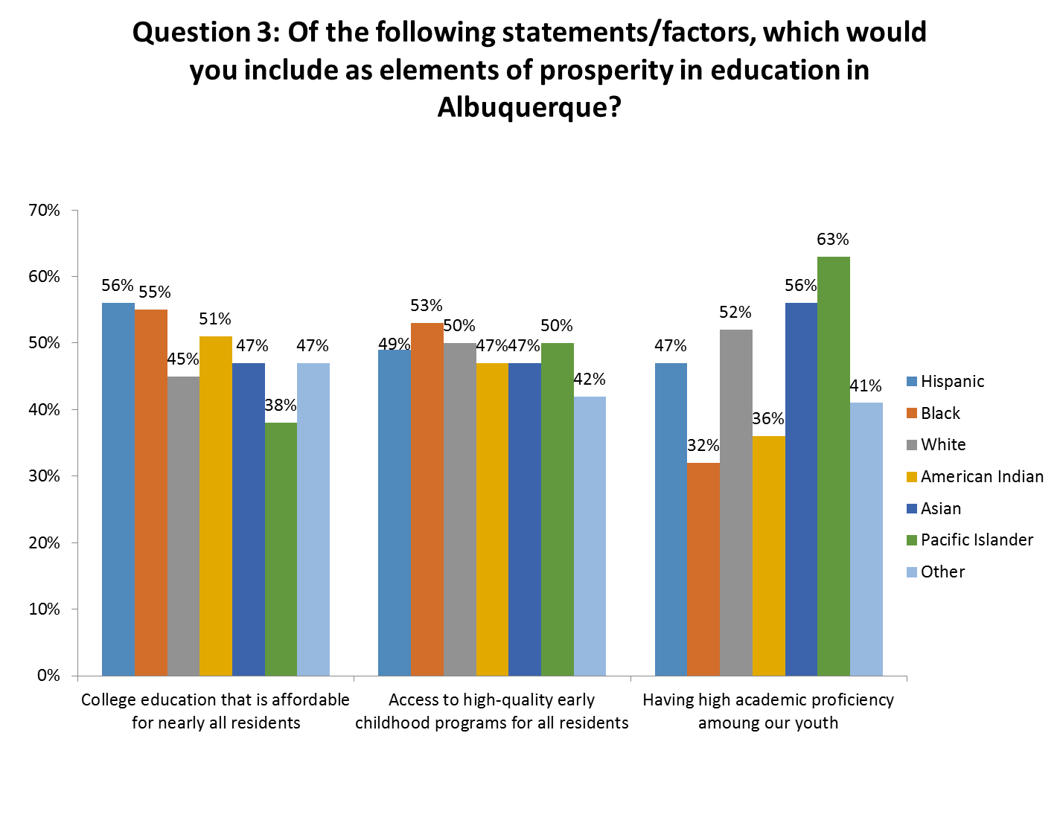
Plan for Prosperity (P4P)
Surveyed over 1,800 ABQ residents
Over 50 community dialogues at community centers, libraries, and small businesses
Engaged researchers, educators, and content experts to define strategies

Slide 29
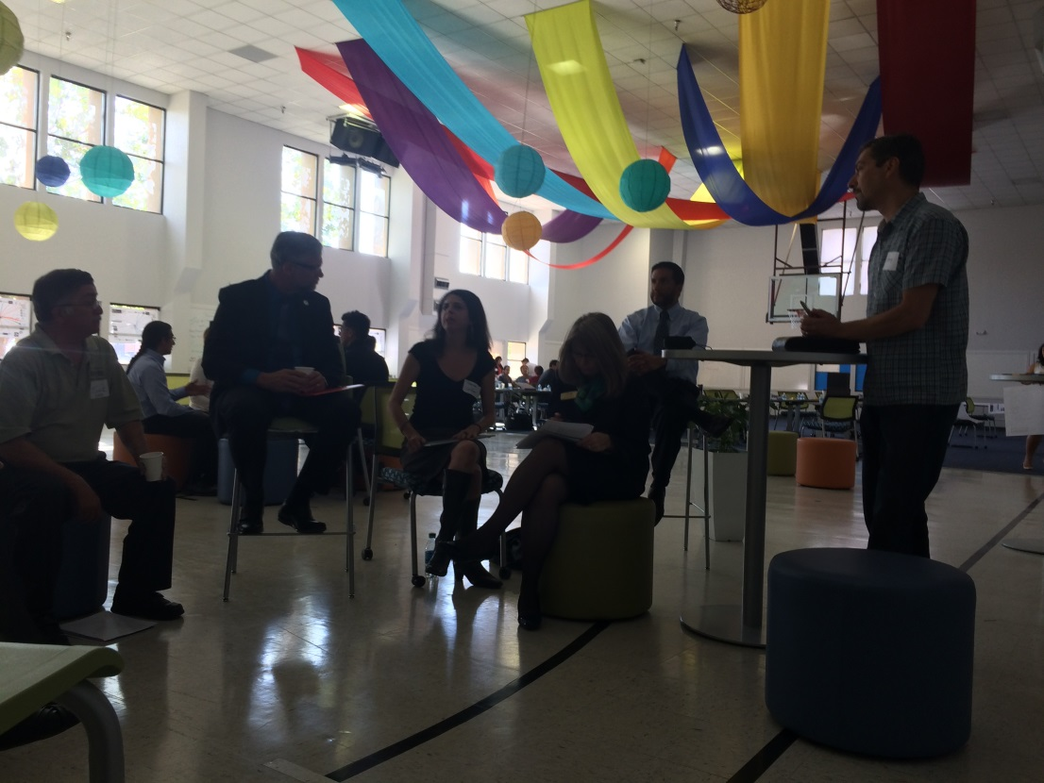
Molino Project: Engaging Through Human Centered Design
Brainstorm solutions to civic challenges
Use Design Thinking methodology to build prototypes
Hands-on problem solving
Over 40 people from 30 organizations participated

Slide 30
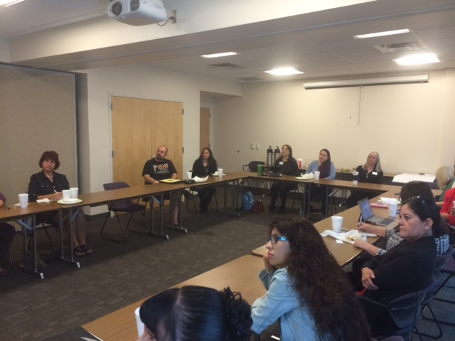
Small Business Deep Dives: Creating Feedback Loops with Community
15 small, focus group s with small businesses
Identify challenges impacting businesses
Ideation and co-creation of programs and policies

Slide 31
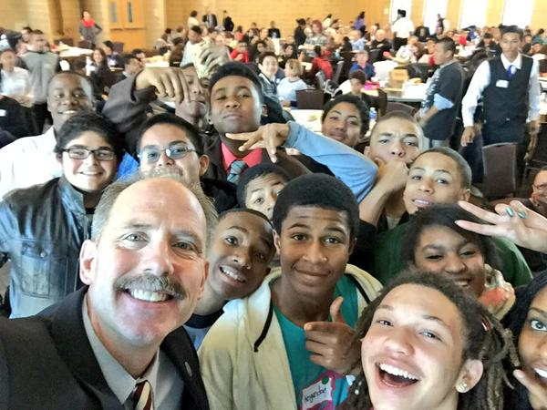
My Brother’s Keeper Action Forum: Head, Heart, Hands
MBK Action Forum engaged over 300 youth, community leaders, policy makers, and community members
The Head: Data informed
The Heart: Personal Experiences, storytelling
The Hands: Take Action!

Slide 32
Q&A

Slide 33
Exercise: Step 1

Slide 34
Source: Collective Impact Forum, adapted from IAP2 and Tamarack Institute
Notes:
This is one tool that our e-course participants have found very useful as a way to set engagement goals and align those goals with your engagement strategies.
It was originally developed by the International Association for Public Participation, and has been adapted countless times. This particular version was adapted by Tamarack and the CIF.
It basically helps you segment out the community groups you want to work with and your goals for working with them. Each goal is placed at a different “level” of engagement, with higher levels of engagement moving from left to right.
If you are interested in learning more about this tool, we have an exercise based on it in our e-course at LivingCities.org, that was actually adapted from an exercise Lisa, our moderator, created.
While the right level of engagement needs to be determined by the local context of the collective impact initiative, through our research we determined that each collective impact initiative needs to have ambitions to engage community members in some part of their collective impact initiative at at least “involve” or higher. If they can’t do that, then they aren’t putting community at the center and are at risk of being too “top down”, like Ty talked about earlier.

Slide 35
Exercise: Step 2

Slide 36
Closing Questions

Slide 37
Learn with us!
Theresa Gardella, Nexus Community Partners, TGardella@nexuscp.org
Frank Mirabal, City of Albuquerque, fmirabal@cabq.gov
Jeff Raderstrong, Living Cities, Jraderstrong@livingcities.org

