Slide 1

THE HUMAN SERVICES STRATEGIC RESTRUCTURING
PILOT PROJECT FROM FOUR PERSPECTIVES:
Funder, Nonprofit Executive, Nonprofit Board, and Consultant

Slide 2

To build and share knowledge about how funders could improve support for collaboration
in the nonprofit and philanthropic sectors.

Slide 3

Recognized the Power of:
Collective action and impact
Pooling resources and expertise
Modeling collaborative behavior
Engaging nonprofit leaders in the pilot design

Slide 4

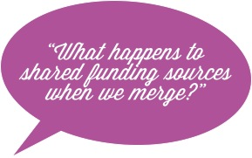




Slide 5

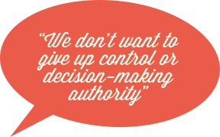
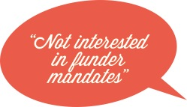

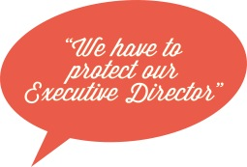
When funders speak, we want to listen, but…

Slide 6

Viewed this as a unique challenge to:
Work with funders and nonprofits
Learn from “interesting approaches” of colleagues
Function as one “Consulting Team”
Model collaborative behavior
Learn along with clients

Slide 7

An environment awaiting an experiment due to…
Endowment losses of up to 26%
Government funding cuts
Financial strain on individual donors
Increased demand for basic human needs

Slide 8

Tension of the status quo
Opportunity to have a greater impact than alone
The idea that 1+1=3

Slide 9

Board’s first charge is to protect the mission
Concern about the possibility of funding cuts and loss of organizational influence if their organization merges

Slide 10

Smart Strategy designed to:
Increase capacity and effectiveness
Strengthen impact
Reduce costly duplication

Slide 11
Video

Slide 12
QUESTION FOR THE AUDIENCE:
How can you/have you helped nonprofits look beyond their own agency and see the bigger picture for providing services in your community?
BE SURE TO PICK A HAT TO CONVEY YOUR PERSPECTIVE:
Funder
Nonprofit Board
Nonprofit Executive
Consultant

Slide 13


Slide 14


Slide 15


Slide 16


